Slide 1
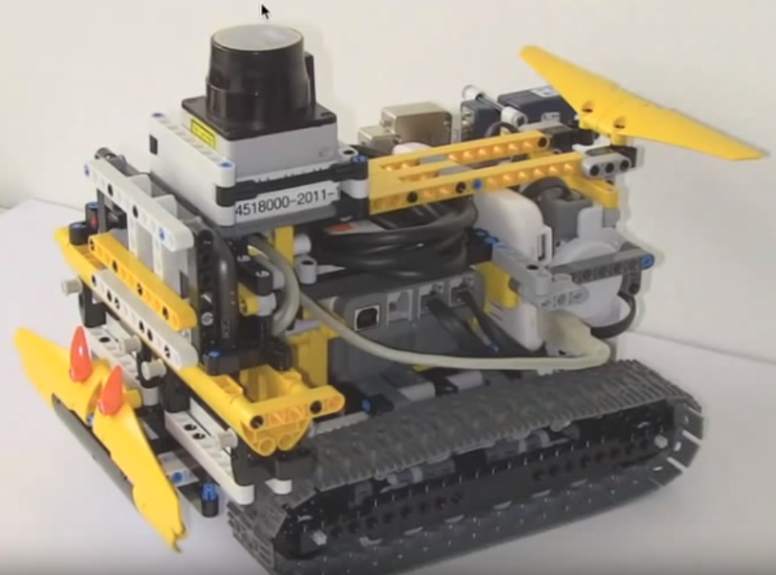
LiDAR
Bluetooth
Controller
Motor
Caterpillar System

Slide 2
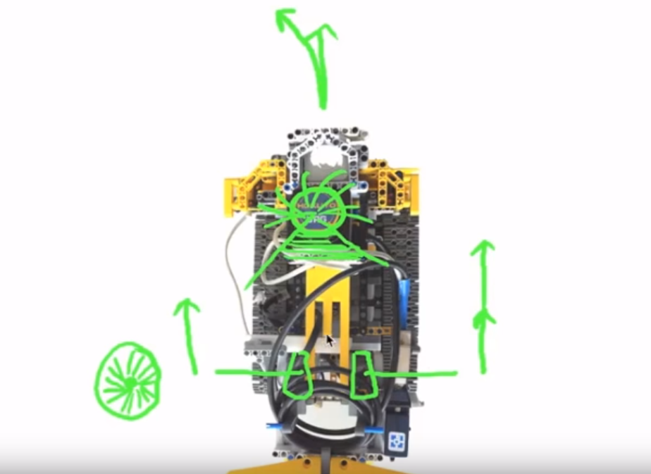
Direction
LiDAR
Right Motor
Left Motor
Motor Encoder

