Slide 1
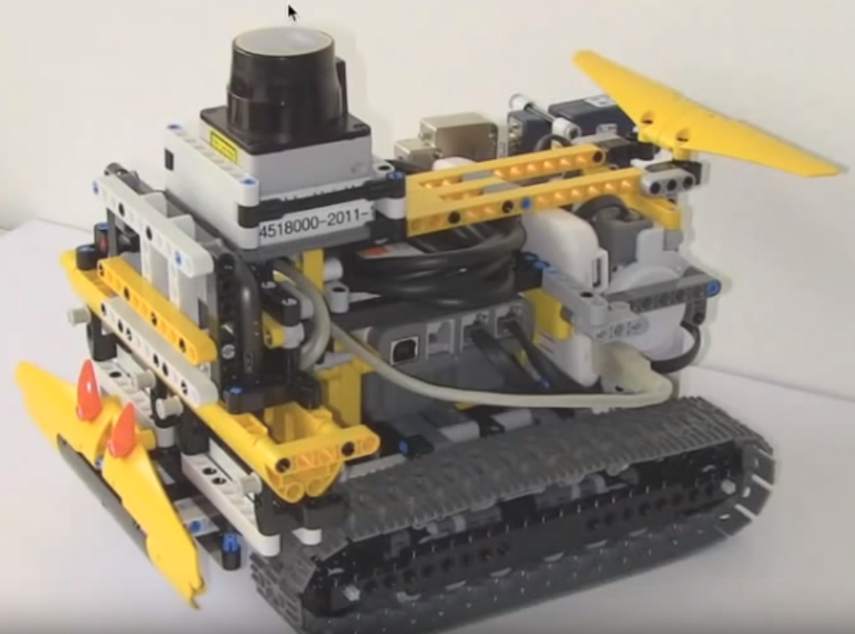
LiDAR
Bluetooth
Controller
Motor
Caterpillar System

Slide 2
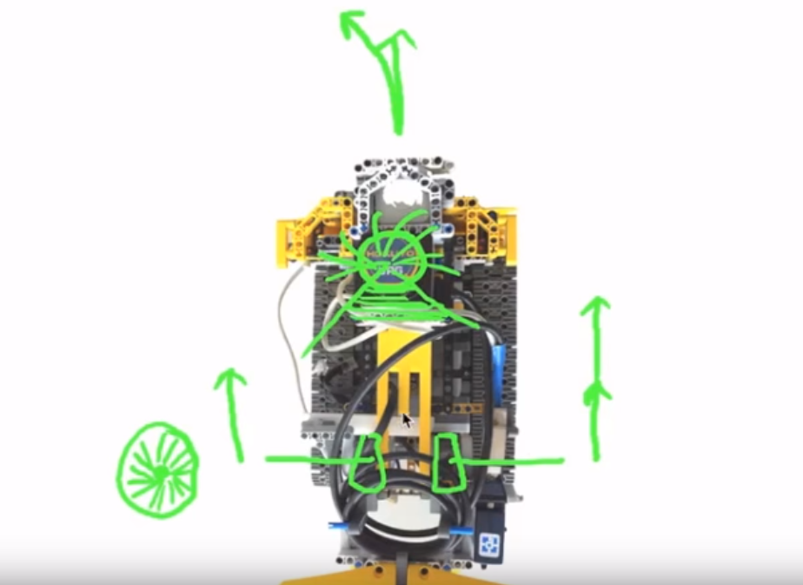
Direction
LiDAR
Right Motor
Left Motor
Motor Encoder

Slide 3
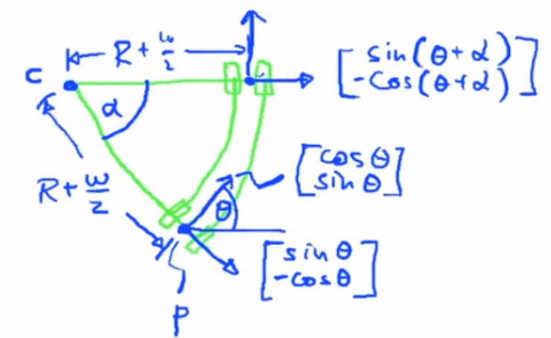
P‘
C
P

Slide 4
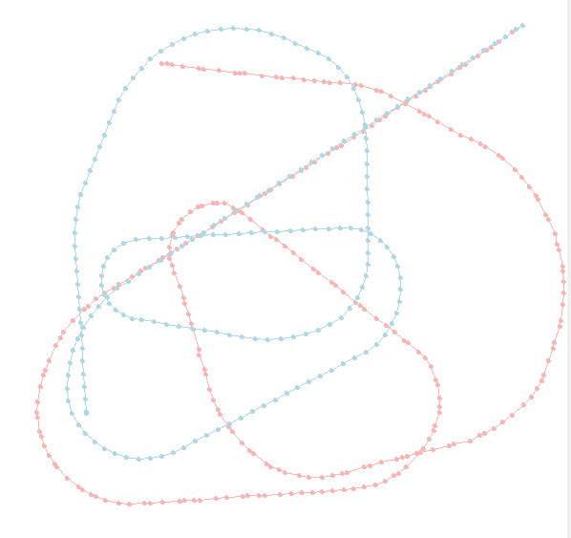
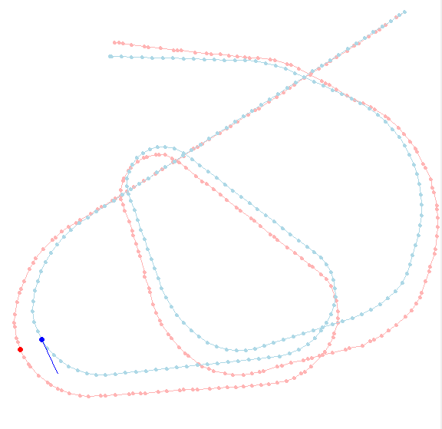

Slide 9
