Slide 1
Analysis of accidents severity

Slide 2
INTRODUCTION
The analysis is geared towards determining the major factors that could have lead to an accident and also the severity of the accident in Seattle.
For this, we will focus on specific columns which include severity code, addrtype, severitydesc, collision type, junction type, weather, speeding and light condition

Slide 3
Tools Used
The following libraries are used:
Pandas and numpy for data cleaning
Seaborn and matplotlib for data visiualization
Sklearn for our machine modelling

Slide 4
Methodology
Explore the provided dataset (accident severity)
Extract the required columns that could lead to accident using pandas library
Begin the exploratory data analysis of the dataset.
Perform data cleaning and preparation
Visualise the data and observe the correlation between the columns and the severity of accident.
Perform data transformation and one hot encoding of columns necessary to perform subsequent machine learning
Deploy machine learning and determine the level of accuracy

Slide 5
Exploratory Data Analysis(EDA)
The dataset originally consist of 194673 Rows and 38 Columns. However, the number of columns was reduced to 11 bringing out the most important details that is related to accidents.

Slide 6
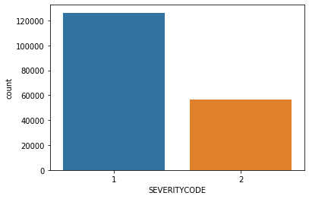
From the plot above, there are about 130,000 cases of level 1 accidents and about 60,000 of level 2 accidents

Slide 7
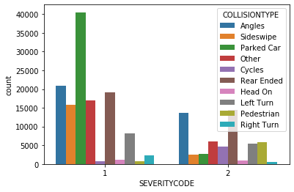
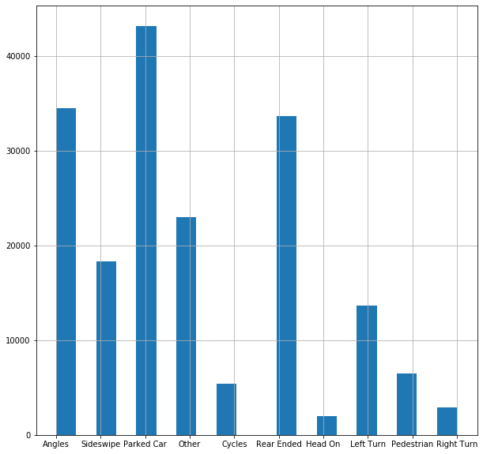
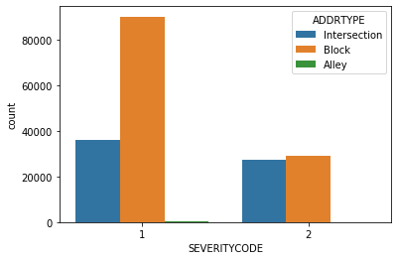
Relationship between severity of accidents and the Collision type

Slide 8
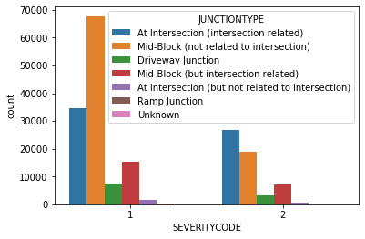
Relationship between severity of accidents and the Junction type

Slide 9
Relationship between severity of accidents and the Junction type

Slide 10
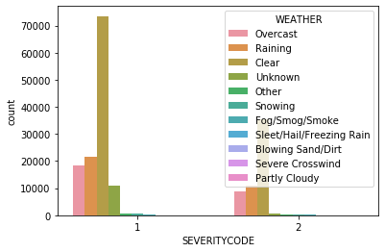
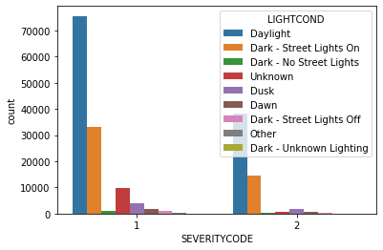
Relationship between severity of accidents and the Weather alongside light condition

Slide 11
Conclusion
Upon exploration of the data, it shows that most accidents that are severe(level 2) occurred at the intersection
There is no much correlation between the accidents and the light condition of the area
It can be concluded that most of the accidents are caused due to negligence of the drivers on the signs.

