Slide 1
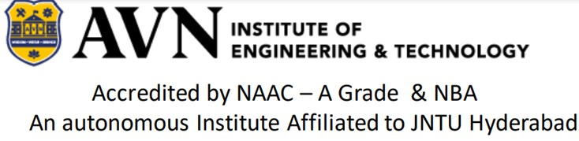
MINI PROJECT ON UNAUTHENTIC INFORMATION DISCOVERER BACHELOR OF TECHNOLOGY IN COMPUTER SCIENCE AND ENGINEERING Under the esteemed guidance of: Dr. S. Ramesh Babu Associate Professor by Batch: C7 SHAIK KHAJA MOIN - 205U1A05C3 GUDUGUNTLA YASHWANTH - 215U5A0515 MOHAMMED ABDUL HAFEEZ BAIG – 215U5A0524 VADIYALA SRAVANI - 205U1A05D7

Slide 2
ABSTRACT
A lot of things we read online, especially in the news, may seem true, but often they are not. False or unverified information is disseminated as accurate information on the web, which can go viral and influence public opinion and decisions. People intentionally disseminate these counterfeit articles using online social media sites. The ultimate goal of fake news sites is to influence popular beliefs on specific topics. The main purpose of fake news websites is to affect public opinion on certain issues. The proliferation of fake news on social media and the internet is misleading people to an extent that must be stopped. Current systems are not efficient when it comes to giving an accurate statistical assessment of a certain news item. Also, restrictions on entry and category of news make it less varied. We have found a reliable model that classifies a dataset as it can tell the difference between "real" and "fake" information using machine learning techniques. Now that you have your training and testing data, you can build your classifiers. To get a good idea if the words and tokens in the articles had a significant impact on whether the news was fake or real.

Slide 3
INTRODUCTION
Unauthentic news refers to fake news published under the pretext of being real news, commonly referred to as “fake news”.Fake news is now considered one of the biggest threats to democracy,journalism and freedom of expression.The scipe of the fake news was that India called on Pakistan to make motivated false propaganda on social media.During the period, Facebook suspended 103 pages,78 groups, 453 Facebook accounts and 107 Instagram accounts for engaging in unauthentic coordinator behaviour.Our economics are not immune to the spread of counterfeits news because fake news is related to stock market fluctuations and large transactions.The main reason is that fake news can be created and published online faster and more cheaply compared to traditional news.Media such as newspaper and television.

Slide 4

SYSTEM CONFIGURATION
HARDWARE REQUIREMENTS:
Processor-1GHz or more
Hard Drive-32GB or more
Memory(RAM)-1GB or more
SOFTWARE REQUIREMENTS:
OS- any Windows version
Programming Platforms:Notebook,Visual studio code
Front-End programming languages:HTML,CSS,JS
Back-End programming languages: Python,MySQL

Slide 5
SCOPE OF THE PROJECT
The project works with all types of information regardless of their type.
The project produces the user with precision.
The website is only accessible via internet.
The output will be generated in less than a minute.
The project only gives the result when the information transmitted is in English.

Slide 6
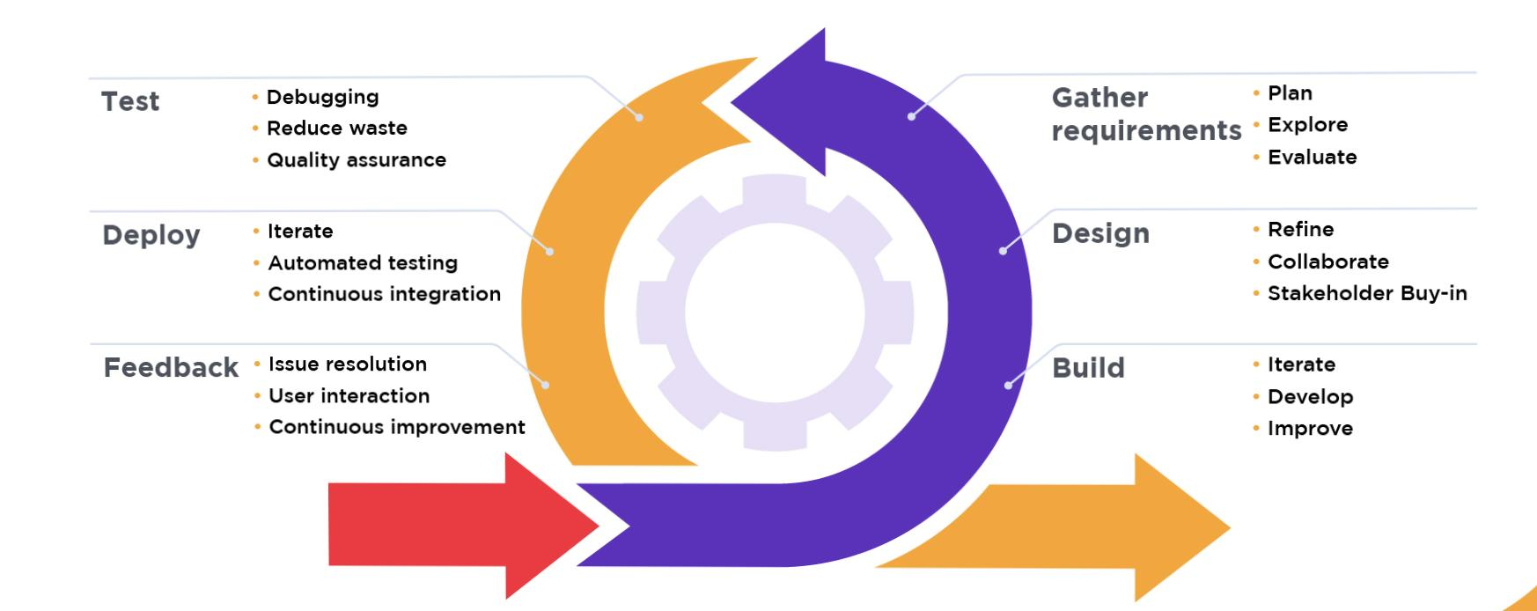
AGILE MODEL

Slide 7
ANY QUERIES?

