Slide 1
ACC: Neuroscience-Inspired Hallucination Detection
Weekly Research Update — June 7, 2026
Hafez Al-Khatib

Slide 2
Problem: LLMs Hallucinate Without Self-Correction
• Large language models generate fluent but ungrounded statements.
• Existing methods detect hallucination after output is complete (post-hoc).
• Our goal: intervene during generation, inspired by conflict monitoring in the anterior cingulate cortex (ACC).
• Core hypothesis: prediction errors between hierarchical layers signal when the model is departing from reliable patterns.

Slide 3
Approach: Predictive Coding + Conflict Monitoring
• Predictive coding: each layer predicts the next layer's representation.
• Large prediction error = potential conflict.
• Leaky integrator accumulates evidence over tokens.
• Decision engine maps conflict + entropy to actions: flag, regenerate, warn.
Generation → Hidden States ↓ Prediction-Error Features ↓ MLP Detector ↓ Conflict Score + Entropy ↓ Decision Engine ↓ Intervention

Slide 4
What We Built This Week
• Baseline detectors: DoLa, SAPLMA, Entropy.
• ACC intervention engine: draft → detect → regenerate with uncertainty priming.
• Model-specific detector training on Qwen2.5-1.5B (600 token-level examples).
• Unified evaluation script with fair comparison controls.
• Colab GPU notebook for larger-scale experiments.

Slide 5
Evaluation: Fair Comparison Controls
• Same 10 prompts across all methods.
• Same random seeds for reproducibility.
• Same softmax sampling strategy (no unfair top-p differences).
• Same judge function: substring-based correctness + uncertainty markers.
• SAPLMA trained on held-out prompts to avoid data leakage.

Slide 6
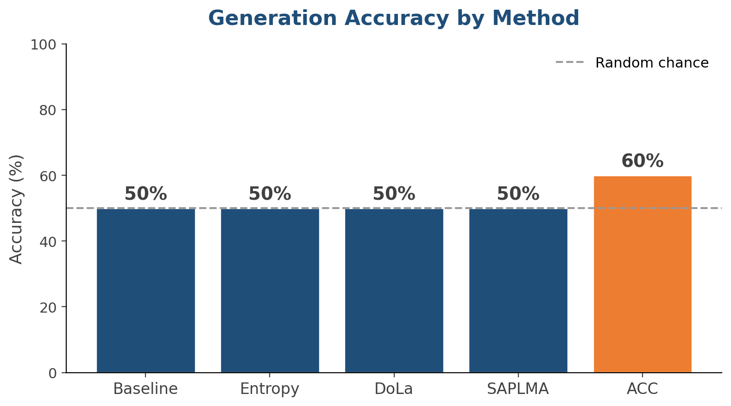
Results: Generation Accuracy
ACC improves over baseline, but absolute numbers remain modest.

Slide 7
Results: Detection Quality vs. Selectivity
DoLa has highest F1 but flags 100% of tokens. ACC balances F1 and selectivity.

Slide 8
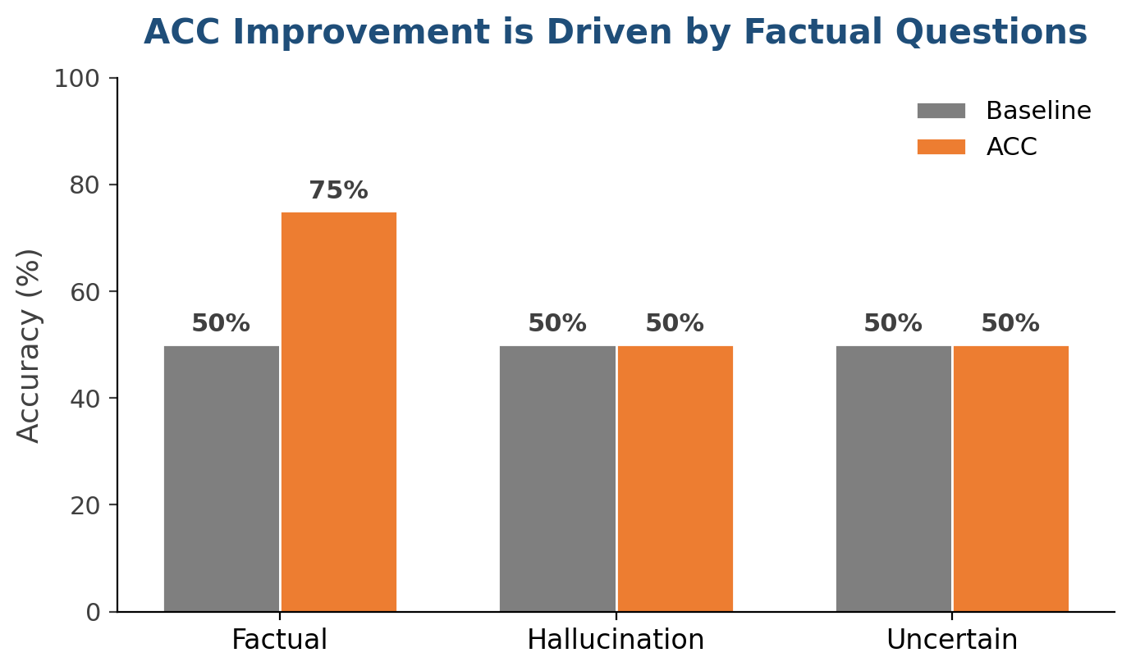
Results: ACC Improvement by Question Type
ACC gains come from factual questions. Hallucination and uncertainty detection remain at chance on this model.

Slide 9
Key Insight: Scale Is the Bottleneck
The detector works (83% validation accuracy), and the intervention pipeline works, but Qwen2.5-1.5B lacks the capacity to consistently act on the signal.
• Factual questions improve because the model knows the answer.
• Hallucination prompts produce inconsistent behavior regardless of detector.
• Next step: evaluate on Qwen2.5-7B via Colab GPU.

Slide 10
Critical Bugs Found & Fixed
• Inverted synthetic logits: detector always predicted 'supported'. Fixed mapping.
• Post-hoc mismatch: detection re-ran generation with different random sample. Now caches hidden states during main pass.
• Gradient leak: explainability backward() accumulated gradients on model weights. Now uses torch.autograd.grad.
• Plus: unfair sampling, SAPLMA data leakage, missing hook cleanup.

Slide 11
Code Audit: Quality Now Validated
• Audited 7 core files across architecture, integration, baselines, evaluation.
• Identified 20 ranked issues in results/code_audit_report.md.
• All critical/high issues resolved.
• 94 existing tests + 5 new regression tests pass.

Slide 12
Next Step: Colab GPU Evaluation
• Notebook ready: notebooks/ACC_Evaluation_Colab.ipynb
• Mounts Drive, downloads model, runs evaluation, saves results.
• First target: 30+ samples on Qwen2.5-1.5B for statistical confidence.
• Second target: Qwen2.5-7B on T4 to test whether scale unlocks hallucination detection.

Slide 13
Next Week's Plan
1 | Run Colab evaluation on Qwen2.5-1.5B (30+ samples) | Statistically meaningful metrics
2 | Run Colab evaluation on Qwen2.5-7B | Test scale hypothesis
3 | Implement logit-shifting intervention | Stronger intervention than phrase prepending
4 | Add LLM-as-judge evaluation | More reliable labels
5 | Generate publication-quality plots | Paper-ready figures

Slide 14
Discussion Questions
• Prioritize larger models or stronger interventions first?
• Primary benchmark: HaluEval, TruthfulQA, PubMedQA, or custom set?
• Budget for paid GPU hours if Colab free tier is insufficient?

