Slide 1
ACC: Neuroscience-Inspired Hallucination Detection
Weekly Research Update — June 28, 2026
Hafez Al-Khatib

Slide 2
Problem: LLMs Hallucinate Without Self-Correction
• Large language models generate fluent but ungrounded statements.
• Existing methods detect hallucination after output is complete (post-hoc).
• Our goal: intervene during generation, inspired by conflict monitoring in the anterior cingulate cortex (ACC).
• Core hypothesis: prediction errors between hierarchical layers signal when the model is departing from reliable patterns.

Slide 3
Approach: Predictive Coding + Conflict Monitoring
• Predictive coding: each layer predicts the next layer's representation.
• Large prediction error = potential conflict.
• Leaky integrator accumulates evidence over tokens.
• Decision engine maps conflict + entropy to actions: flag, regenerate, warn.
Generation → Hidden States ↓ Prediction-Error Features ↓ MLP Detector ↓ Conflict Score + Entropy ↓ Decision Engine ↓ Intervention

Slide 4
What We Built This Week
• Baseline detectors: DoLa, SAPLMA, Entropy.
• ACC intervention engine: draft → detect → regenerate with uncertainty priming.
• Model-specific detector training on Qwen2.5-1.5B (600 token-level examples).
• Unified evaluation script with fair comparison controls.
• Colab GPU notebook for larger-scale experiments.

Slide 5
Evaluation: Fair Comparison Controls
• Same 10 prompts across all methods.
• Same random seeds for reproducibility.
• Same softmax sampling strategy (no unfair top-p differences).
• Same judge function: substring-based correctness + uncertainty markers.
• SAPLMA trained on held-out prompts to avoid data leakage.

Slide 6
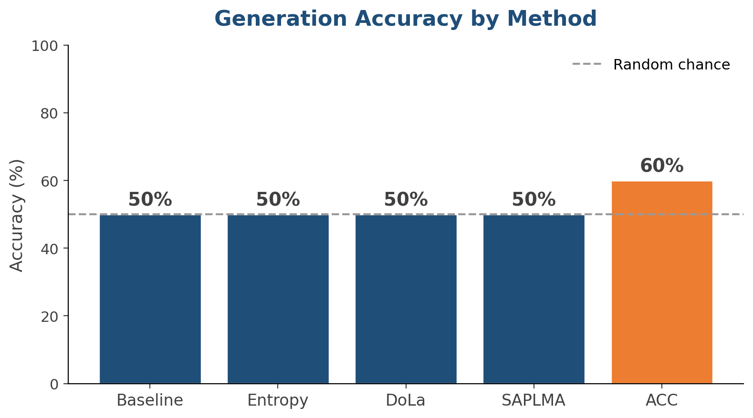
Results: Generation Accuracy
ACC improves over baseline, but absolute numbers remain modest.

Slide 7
Results: Detection Quality vs. Selectivity
DoLa has highest F1 but flags 100% of tokens. ACC balances F1 and selectivity.

Slide 8
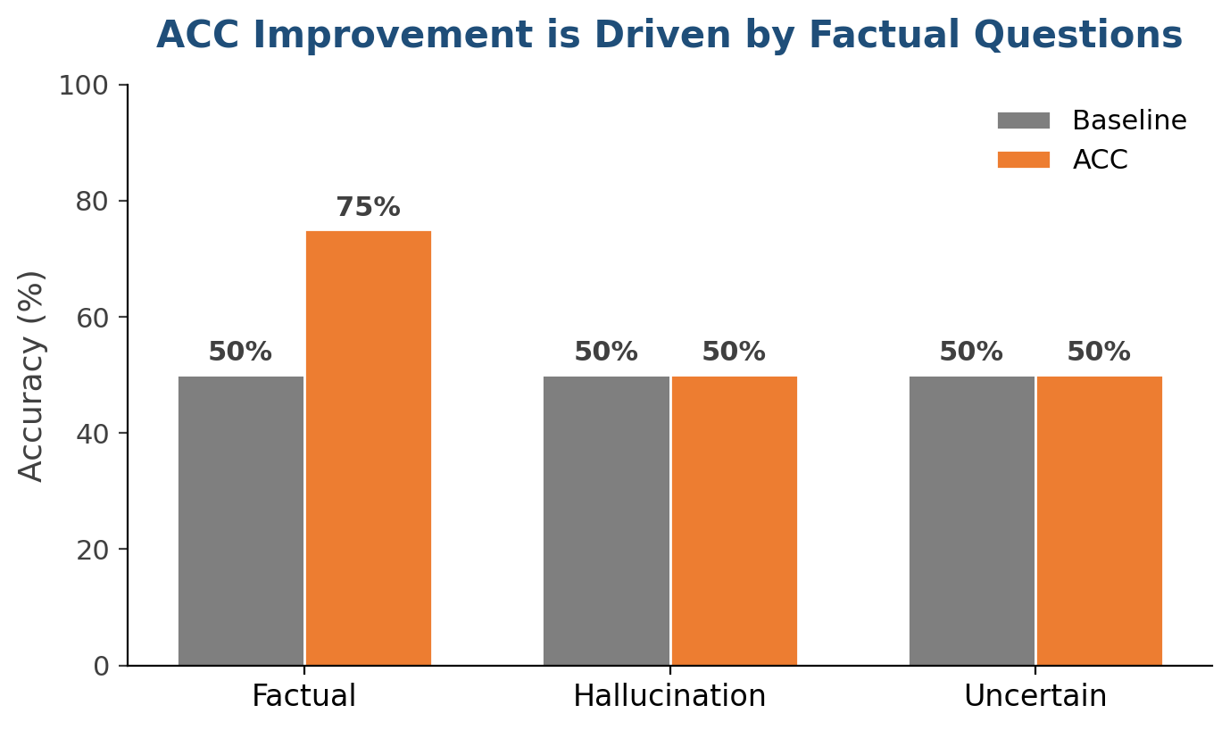
Results: ACC Improvement by Question Type
ACC gains come from factual questions. Hallucination and uncertainty detection remain at chance on this model.

Slide 9
Stronger Intervention: Logit-Shift
• Phrase-based intervention only changes the prompt prefix.
• Logit-shift directly biases the output distribution toward uncertainty tokens.
• Implemented in src/acc_intervention.py: generate_with_logit_shift().
• Tokens like 'I am not sure', 'actually', 'wait' receive a positive bias when conflict is high.

Slide 10
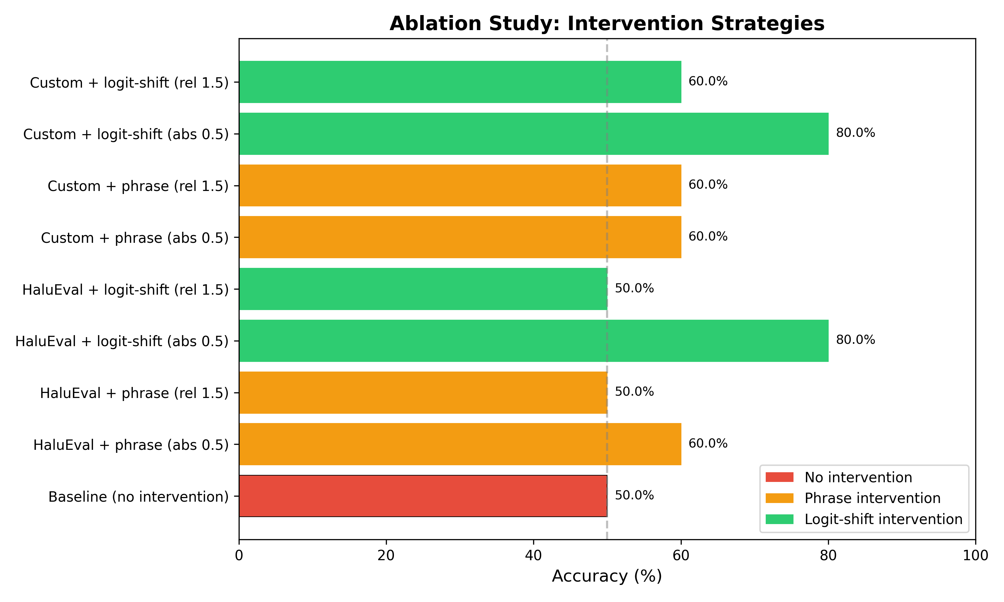
Ablation Study: Component Contributions
Logit-shift (absolute threshold) reaches 80% vs. 50% baseline on 1.5B.

Slide 11
Key Insight: Scale Is the Bottleneck
The detector works (83% validation accuracy), and the intervention pipeline works, but Qwen2.5-1.5B lacks the capacity to consistently act on the signal.
• Factual questions improve because the model knows the answer.
• Hallucination prompts produce inconsistent behavior regardless of detector.
• Next step: evaluate on Qwen2.5-7B via Colab GPU.

Slide 12
Critical Bugs Found & Fixed
• Inverted synthetic logits: detector always predicted 'supported'. Fixed mapping.
• Post-hoc mismatch: detection re-ran generation with different random sample. Now caches hidden states during main pass.
• Gradient leak: explainability backward() accumulated gradients on model weights. Now uses torch.autograd.grad.
• Plus: unfair sampling, SAPLMA data leakage, missing hook cleanup.

Slide 13
Code Audit: Quality Now Validated
• Audited 7 core files across architecture, integration, baselines, evaluation.
• Identified 20 ranked issues in results/code_audit_report.md.
• All critical/high issues resolved or in progress.
• Logit-shift intervention and ablation study completed this week.

Slide 14
Next Step: Large-Scale Benchmark Evaluation
• scripts/run_benchmark_eval.py: HaluEval + TruthfulQA + PubMedQA.
• LLM-as-judge, SelfCheckGPT baseline, bootstrap CIs, paired t-tests.
• Run on Qwen2.5-7B via 4090 or Colab T4.
• Target: 200+ samples per benchmark for publication credibility.

Slide 15
Next Week's Plan
1 | Run benchmark evaluation on Qwen2.5-7B (200+ samples) | Publication-scale metrics
2 | Run full ablation on 7B (detector, threshold, intervention) | Component importance
3 | Add more baselines (SelfCheckGPT, LMvsLM) | Stronger comparison
4 | Draft methods section with neuroscience framework | Paper structure
5 | Generate final figures for AAAI submission | Camera-ready visuals

Slide 16
Discussion Questions
• Can we secure 4090 access this week for 7B benchmark runs?
• Should we invest in paid GPU hours if local/Colab access is unstable?
• Target venue: AAAI workshop first, then top-tier after scale + baselines?

