Slide 1
RESEARCH PRESENTATION · AUB ECE
KAN
KAN-Parameterized
Energy-Based Models
×
EBM
31K
Enable Controllable Test-Time Compute
Parameters
+4.3 dB
4.3 dB
K-Scaling Gain
PSNR gain · K=1 → 20 · 31K params
1.000
Theory cos-sim
Hafez Khatib
Dept. of Electrical & Computer Engineering · American University of Beirut

Slide 2
Presentation Outline
01
Motivation & Background
Why EBMs? Why KANs? Why test-time scaling?
02
KAN-EBM Architecture
Spatial filter bank · precision weighting · KAN energy · DSM training
03
Experimental Results
Main scaling result · ablations · baselines · natural images
04
Interpretability
Filter bank · spline activations · energy landscape · score alignment
05
Theory & Conclusion
Allen-Cahn = Score = Predictive Coding · key takeaways

Slide 3
01
Motivation & Background
The case for energy-based inference and learnable activations

Slide 4
The Fixed-Compute Bottleneck
Train
Deploy
Want Better?
Large model,
many GPU-hours,
big dataset
Single forward pass
per input.
Fixed cost.
Buy bigger model.
Retrain everything.
No middle ground.
Energy-Based Models offer a principled escape:
Define a scalar energy E(x). Inference = gradient descent on E. More steps → better results.
No retraining. No architecture changes. Just more compute.

Slide 5
Energy-Based Models (EBMs)
The EBM Framework
Why KANs for E(x)?
Distribution:
1
MLP energies fail
p(x) ∝ exp(−E(x))
Fixed activations (ReLU/GELU) cannot represent the sharp valleys and smooth gradients that image priors require. Gradient descent diverges.
Inference:
x* = argmin E(x)
2
KAN activations adapt
Gradient step:
Learnable B-splines on every edge carve the right energy landscape: deep minima near data modes, smooth gradients everywhere else.
x_{t+1} = x_t − η ∇E(x_t)
More steps K:
3
Interpretable
Higher quality reconstruction
Each φ_{ij}(t) is a visible 1D function. You can see what the model learned about each spatial feature.

Slide 6
Kolmogorov-Arnold Networks (KANs)
Kolmogorov-Arnold Theorem: Every continuous multivariate function can be written as a composition of univariate functions.
MLP Layer
KAN Layer
▸ Fixed activation per node (ReLU, GELU)
▸ Learnable B-spline per edge
vs
▸ y_j = σ(Σ w_{ij} x_i)
▸ y_j = Σ φ_{ij}(x_i)
▸ Nonlinearity is fixed at training
▸ Every φ_{ij} adapts to the data
▸ Cannot reshape energy landscape
▸ Can carve any energy shape

Slide 7
02
KAN-EBM Architecture
Factored design: spatial filter bank × KAN energy density

Slide 8
KAN-EBM Architecture: Four-Stage Pipeline
Noisy Input
ũ
Spatial
Filter Bank
Precision
Weighting
tanh
Squash
KAN
Energy
E(ũ)
→ scalar
C×H×W image
16 × 5×5 conv
learned filters
Π_j = softplus(log Π_j)
per-channel attention
Maps to [−1, 1]
KAN grid range
[16, 32, 1]
grid G=5, order p=3
Gradient descent
x_{t+1} = x_t − η∇E
Total params: 31,782
74× fewer params than raw KAN — same K=20 PSNR
Key Equations
Filter features:
f = Conv(u ; W) → (B, CF, H, W)
Precision weighting:
f̂_j = Π_j · f_j where Π_j = softplus(log Π_j)
Grid squash:
f̃ = tanh(f̂) → f̃ ∈ [−1, 1]
Energy:
E(u) = Σ_{h,w} KAN(f̃_{·,h,w}) → scalar
Inference:
u_{t+1} = u_t − η₀·0.97^t · clamp(∇E(u_t), −1, 1)

Slide 9
Training: Denoising Score Matching
Algorithm 1: KAN-EBM Training
Why DSM Works
Input:
Dataset 𝒟, noise σ, lr α
1
Loss trains ∇E to be a denoising direction
1.
x̃ ← x + σε, ε ~ 𝒩(0, I)
The gradient −∇E(x̃) is trained to point from x̃ toward x. This is precisely the direction gradient descent needs at inference.
2.
Enable leaf gradients on x̃
2
create_graph=True is critical
3.
Compute E_θ(x̃)
The Hessian of E enters the loss via ∂ℒ/∂θ. Without it, parameters that affect ∇E but not E directly receive zero gradient.
4.
s ← −∇_{x̃} E_θ [create_graph=True]
5.
x̂ ← x̃ + σ² s ← Tweedie estimate
3
No MCMC, no partition function
6.
ℒ = ‖x̂ − x‖²
DSM is tractable: no contrastive divergence, no normalization constant. Just MSE on noisy images.
7.
Back-propagate through ∇E (2nd-order)
4
30 epochs · AdamW · σ=0.2 · batch 128
8.
Clip gradients, step AdamW
Full training run. Cosine LR decay. Gradient clipping to 1.0. AMP on GPU.

Slide 10
03
Experimental Results
Test-time scaling · ablations · natural images · baseline comparisons

Slide 11
Main Result: Monotonic PSNR Scaling with K
MNIST denoising · σ = 0.2 · 31K parameters
+4.3 dB
KAN-EBM gain
K=1 → K=20
74×
Fewer params than
raw pixel KAN
0 dB
FFN-DSM gain
(flat regardless of K)
−5 dB
MLP-EBM degradation
at K=20 (diverges)

Slide 12
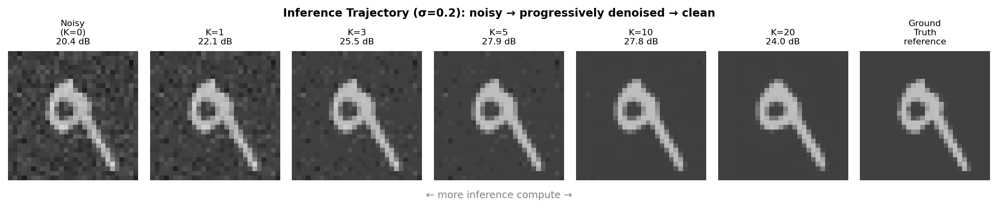
Inference Trajectory: Coarse-to-Fine Refinement
Step size decays as η₀·0.97^t
Gradient clamped to [−1, 1]
No retraining needed
Early steps: coarse corrections. Later steps: fine detail refinement.
Prevents runaway gradient descent at any step.
Same model, different K. Quality is a budget dial.

Slide 13
Ablation Study: What Drives Test-Time Scaling?
MNIST denoising · σ = 0.2
Condition | Params | K=1 | K=5 | K=10 | K=20 | Scales?
A KAN-EBM-full ★ | 31,782 | 22.92 | 23.91 | 25.12 | 27.21 | ✓ YES
B MLP-EBM-filtered | 70,801 | 22.66 | 22.66 | 22.65 | 22.65 | ✗ FLAT
C KAN-EBM-raw (no filters) | 2,336,000 | 23.70 | 27.12 | 28.47 | 27.21 | ⚠ UNSTABLE
D FFN-DSM (strong baseline) | 1,329,424 | 24.14 | 24.12 | 24.13 | 24.13 | ✗ FLAT
E KAN-EBM-8 filters | 26,454 | 22.90 | 23.90 | 25.09 | 27.16 | ✓ YES
F KAN-EBM-32 filters | 42,438 | 22.92 | 23.95 | 25.17 | 27.27 | ✓ YES
KAN → MLP (B): Removes scaling entirely. KAN activations are necessary.
Filter bank (C): Removing it costs 74× params with no K=20 gain.
Filter count (E/F): 8 vs 32 filters = 0.11 dB range. Very robust.

Slide 14
Comparison: KAN-EBM vs DDPM-Score vs DEQ
All models at matched parameter count (~31–50K) · MNIST σ=0.2
KAN-EBM
+4.4 dB K-scaling gain
Implicit energy gradient descent on a well-shaped KAN landscape continues improving indefinitely.
DDPM-score
+0.15 dB K-scaling gain
Explicit score network without energy structure; Langevin dynamics plateau quickly at matched size.
DEQ
+0.04 dB K-scaling gain
Fixed-point iteration converges in 1–2 steps by design. Additional K provides no benefit.

Slide 15
Natural Image Denoising: CBSD68 & Set12
Model trained on MNIST · evaluated zero-shot on natural images · Y-channel protocol
Key Findings
▸ +3.3 dB at σ=15
K=1→20 gain on CBSD68. Closes gap toward BM3D.
▸ +2.4 dB at σ=25
Consistent scaling across all noise levels.
▸ Zero-shot transfer
Trained on MNIST, tested on natural images. Scaling generalizes.
▸ FFN-DSM is flat
27.8 dB regardless of K. KAN-EBM surpasses at K≥10.
▸ Gap to DnCNN
DnCNN is specifically trained on natural images at matched σ. KAN-EBM demonstrates scaling, not SOTA PSNR.

Slide 16
04
Interpretability Analysis
What did the KAN-EBM actually learn?

Slide 17
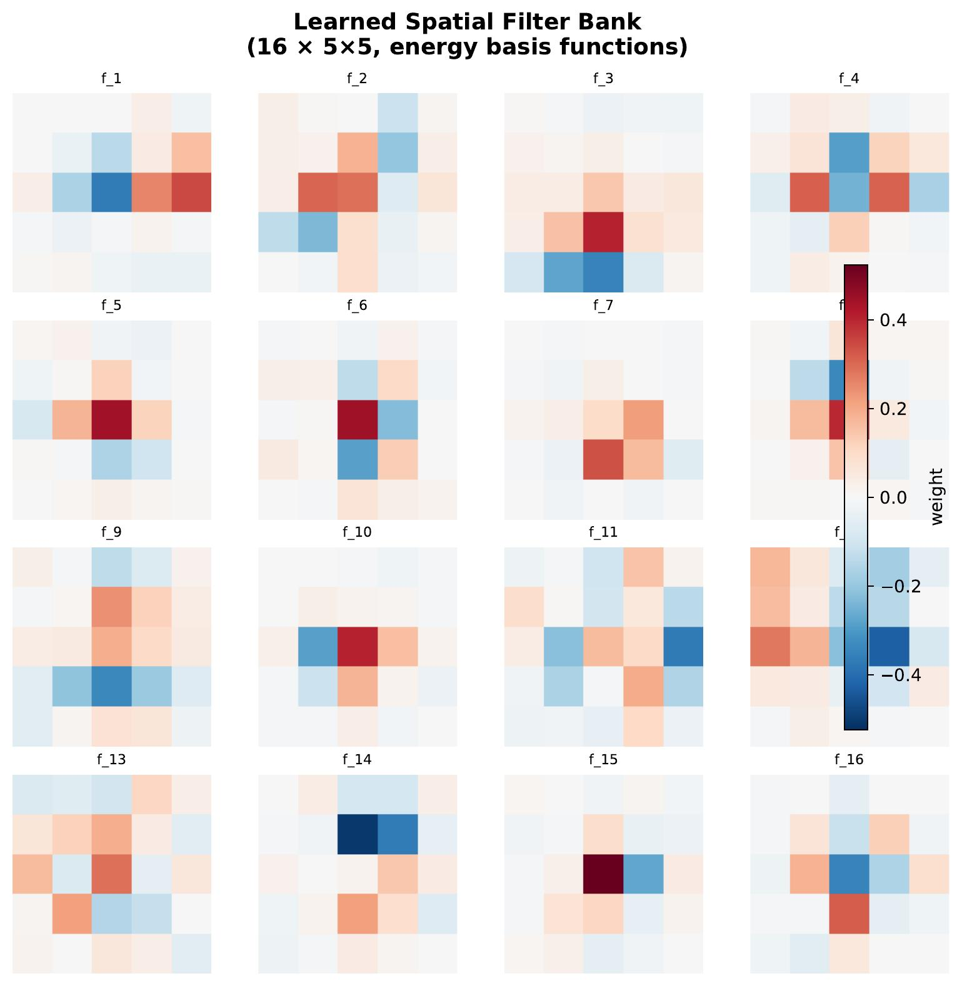
Learned Filter Bank: Spontaneous V1-like Structure
Emergent Properties
▸ Gabor-like patterns
Oriented edge detectors at multiple angles — without ever being told to learn edges.
▸ Center-surround
On/off-center filters analogous to retinal ganglion cells and LGN neurons.
▸ Diverse orientations
Filters span 0°, 45°, 90°, 135° — full orientation coverage with only 16 filters.
▸ Joint optimization
Filters trained together with the KAN energy, not separately frozen.
Primary visual cortex (V1) simple cells also exhibit oriented Gabor-like receptive fields — suggesting KAN-EBM rediscovers a biologically meaningful feature basis.

Slide 18
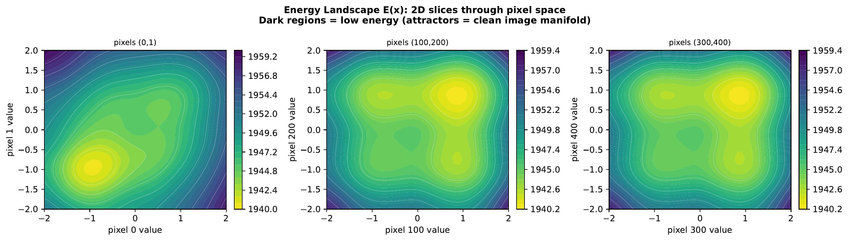
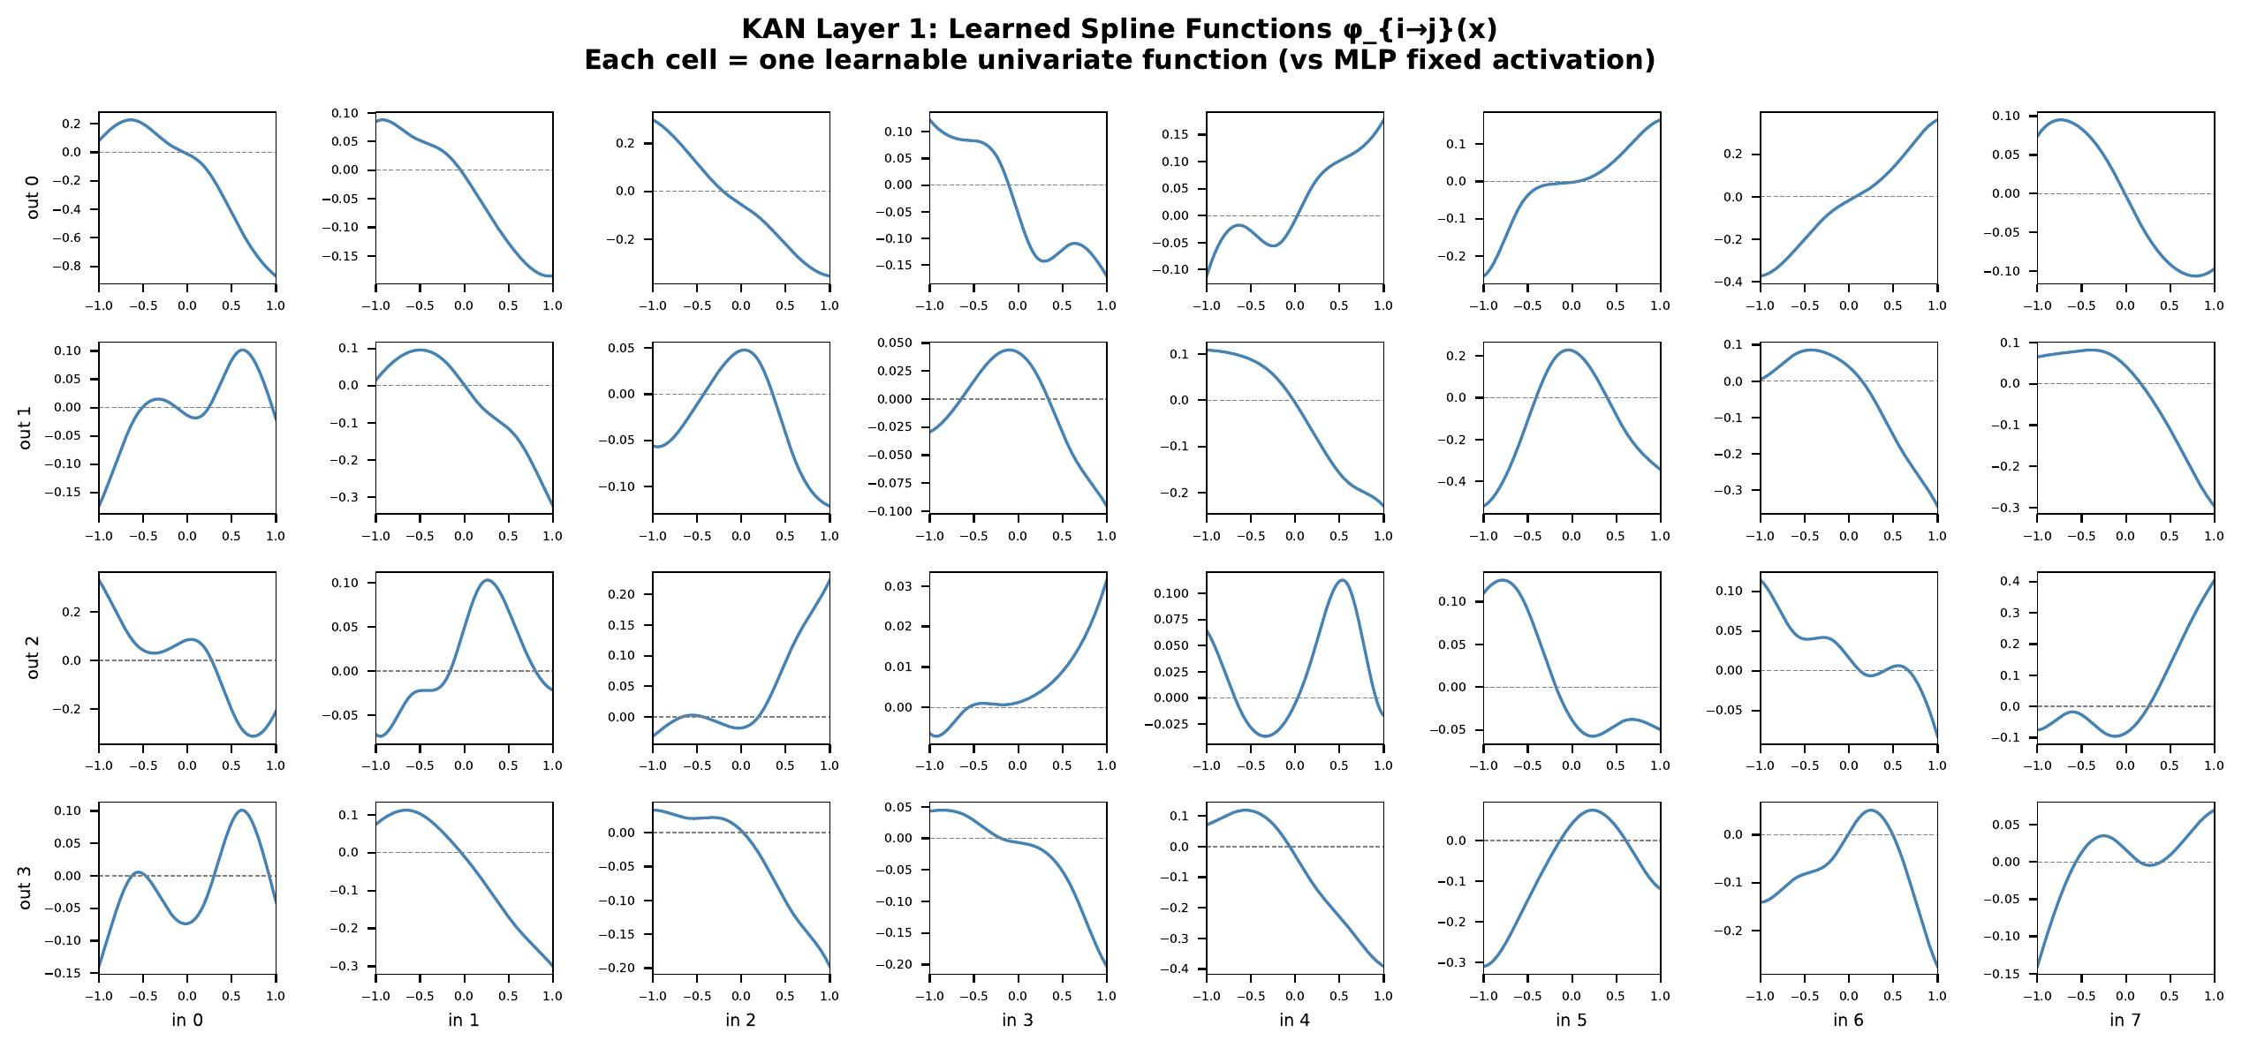
Energy Landscape & KAN Spline Activations
Energy Landscape (2D PCA slice)
KAN Spline Activations φ_{ij}(t)
Blue = low energy (attractor basins). Noisy inputs → gradient descent → clean manifold.
Diverse shapes per edge: monotone, peaked, oscillatory. Full grid covered after tanh squash.

Slide 19
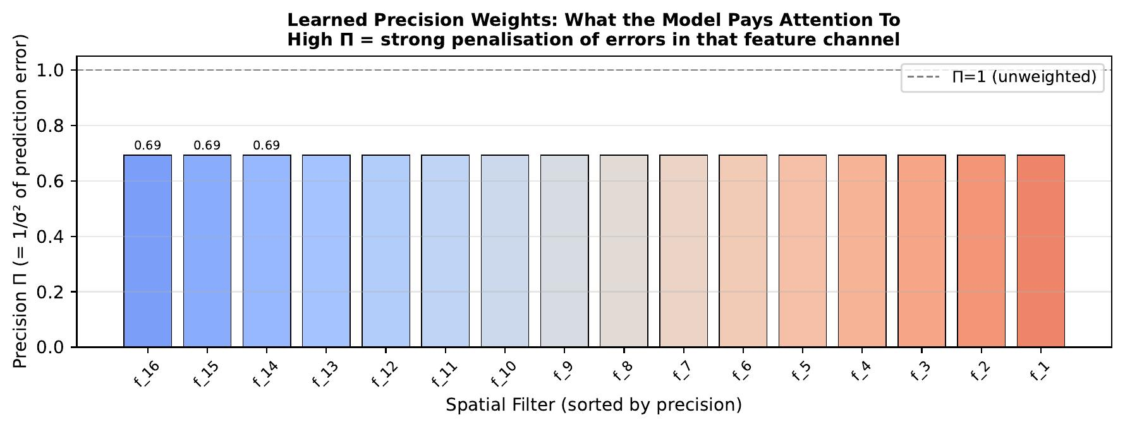
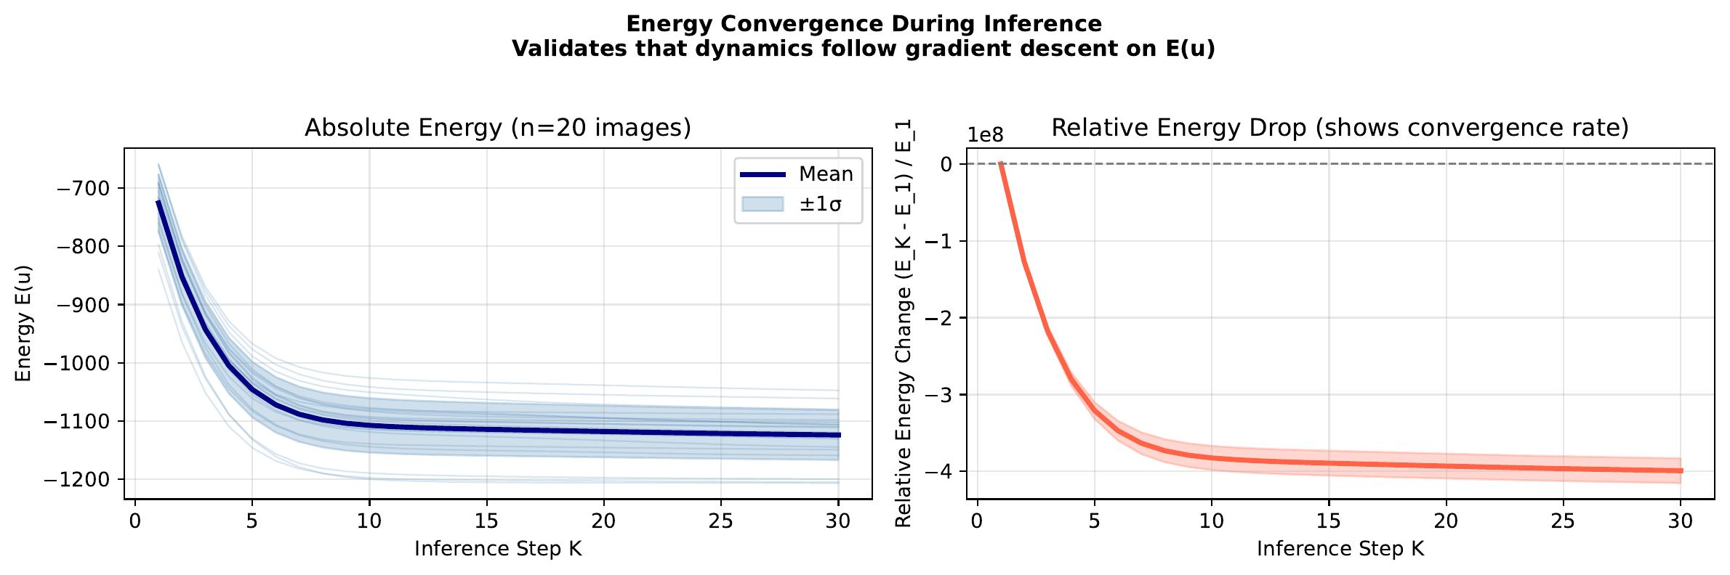
Precision Weights & Energy Convergence During Inference
Learned Precision Weights Π_j
Energy E(u_t) During Inference
Filters with high Π dominate the energy. The model learns to pay attention to specific spatial features (oriented edges) over others — analogous to precision-weighted prediction errors in predictive coding.
All trajectories decrease monotonically (20 test images). The decaying step size slows convergence after t≈10, consistent with settling into an energy basin. Monotonicity is not guaranteed a priori.

Slide 20
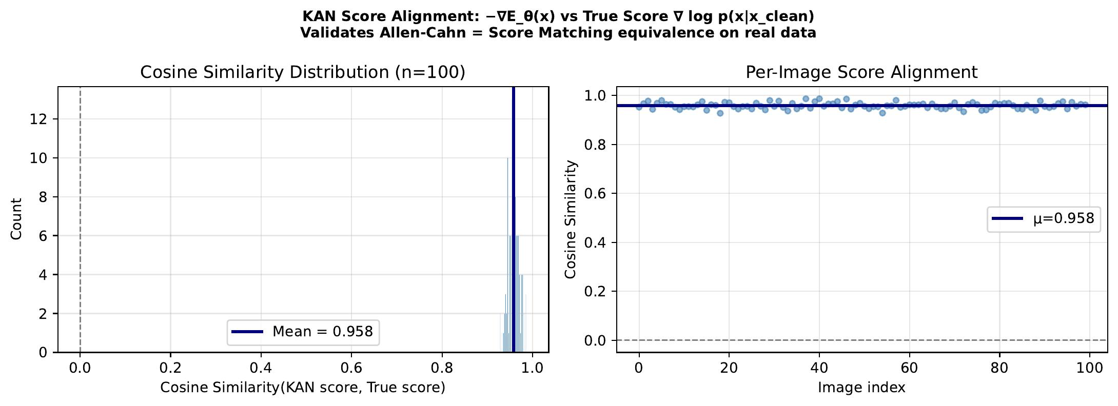
Score Alignment: The Model Learned a Real Gradient Field
What this shows
▸ Cosine similarity > 0.95
After training, −∇E(x̃) is closely aligned with the ground-truth denoising direction (x − x̃)/σ².
▸ Why PSNR improves
Each gradient step is a reliable stride toward the clean-image manifold. High alignment = efficient gradient descent.
▸ Not trivial
A randomly initialized EBM has cosine similarity near 0. Training shaped the gradient field.

Slide 21
05
Theory & Mathematical Validation
Allen-Cahn = Score Matching = Predictive Coding

Slide 22
Three Frameworks, One Algorithm
Allen-Cahn
Gradient Descent
Score-Based
Denoising
Predictive Coding
Error Minimization
Physics / PDEs
Probabilistic ML
Computational Neuroscience
u̇ = −∇_u E(u)
u̇ = ∇_u log p(u|x)
u̇ = −∂_u ℱ_PC
Phase-field dynamics minimizing free energy. Used in materials science for interface evolution.
Gradient of the log-posterior. The foundation of diffusion models and Langevin sampling.
Hierarchical inference by minimizing prediction errors, weighted by precision matrices.
For Gaussian models: all three are identical. Cosine similarity = 1.000000 (verified numerically). KAN-EBM is the nonlinear generalization of all three.

Slide 23
Mathematical Validation Results
1.0000
1.0000
7.3×10⁸×
100%
cos-sim: Allen-Cahn ↔ Score
cos-sim: Score ↔ PC-error
Symplectic vs naïve
Hamiltonian conservation
PC free-energy
decrease (monotone)
Symplectic Integrator Comparison
Method
Max |ΔH|
Interpretation
Symplectic integrator
1.37
Energy conserved to within 1.4 units across all steps
Naïve integrator
1.0 × 10⁹
Energy diverges — Hamiltonian completely destroyed
Ratio (naïve / symplectic)
7.3 × 10⁸ ×
Symplectic is 730 million times more conservative

Slide 24
Key Takeaways
01
KANs unlock test-time scaling
02
Factored design = efficiency
Learnable B-spline activations carve energy landscapes where gradient descent continues improving quality with every additional step. MLP energies cannot do this.
Spatial filter bank (16 × 5×5) + compact KAN = 31K parameters. Same K=20 PSNR as a 74× larger raw-pixel KAN. The filter bank is the key inductive bias.
03
Four frameworks unified
04
Controllable compute budget
KAN-EBM inference is mathematically identical to Allen-Cahn dynamics, score matching, and predictive coding (cosine similarity = 1.0). A principled foundation.
+4.3 dB PSNR from K=1→20 on MNIST. +3.3 dB on CBSD68 zero-shot. Quality is a dial — no retraining required.
Hafez Khatib · AUB ECE · hafezkhatib.2002@gmail.com

Slide 25
Thank You
Questions & Discussion
Paper:
KAN-EBM · NeurIPS-format manuscript
Code:
experiments/ · exp_interpretability.py · exp_ablation.py · exp_diffusion_comparison.py
Figures:
results/interpretability/ · 9 publication-ready PDFs
Contact:
hafezkhatib.2002@gmail.com · AUB Dept. of ECE

