Slide 1
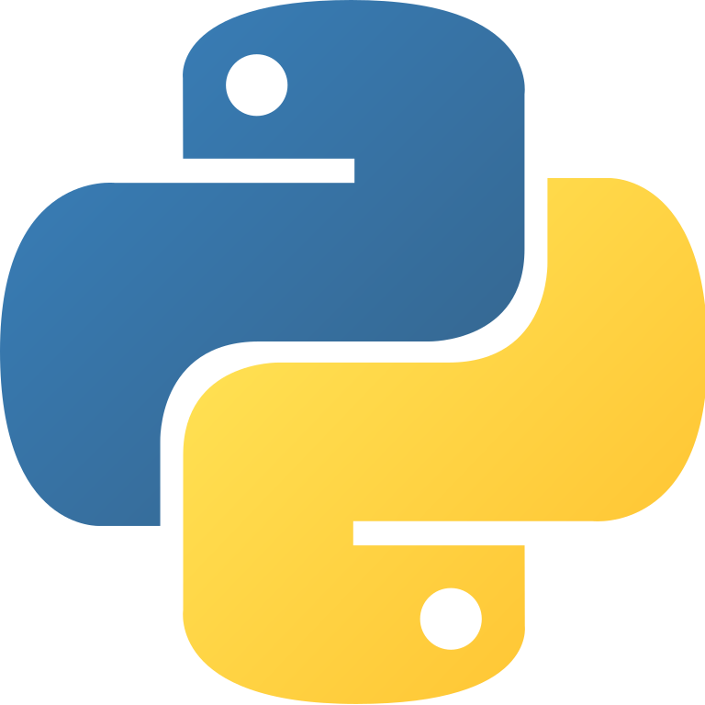
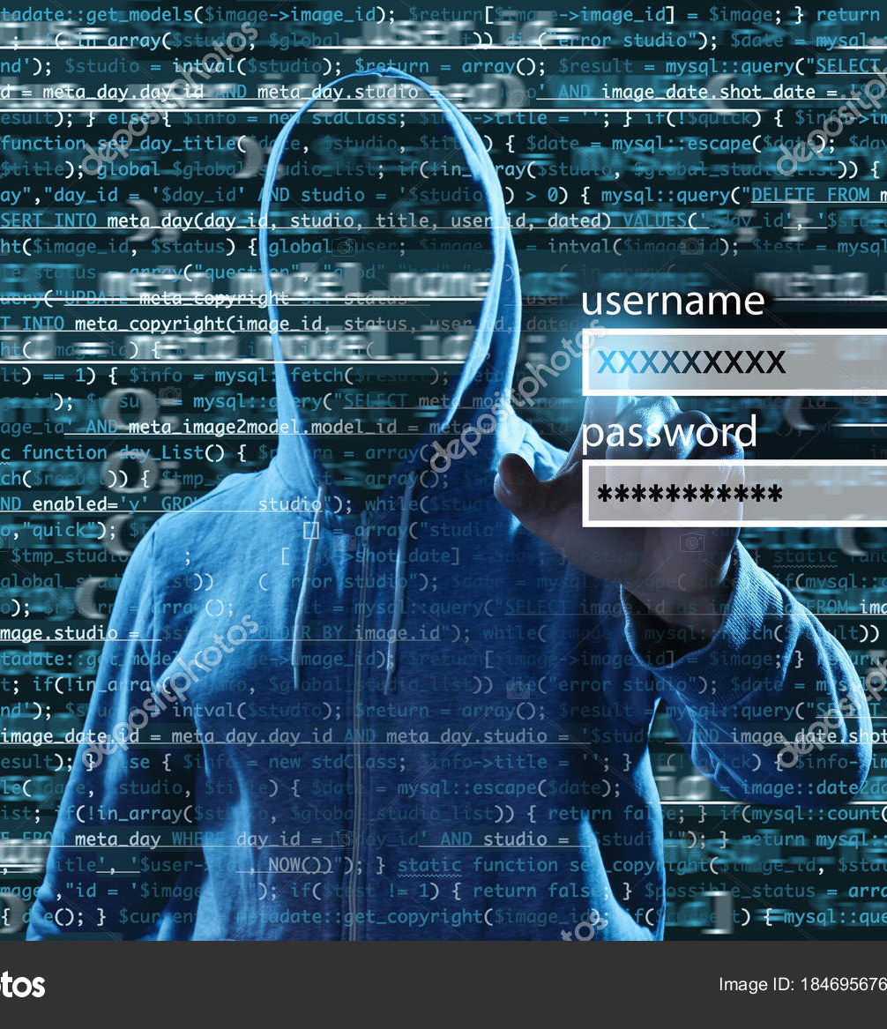

Introductory python
IP
Introductory Phyton
Lecture 1

Slide 2
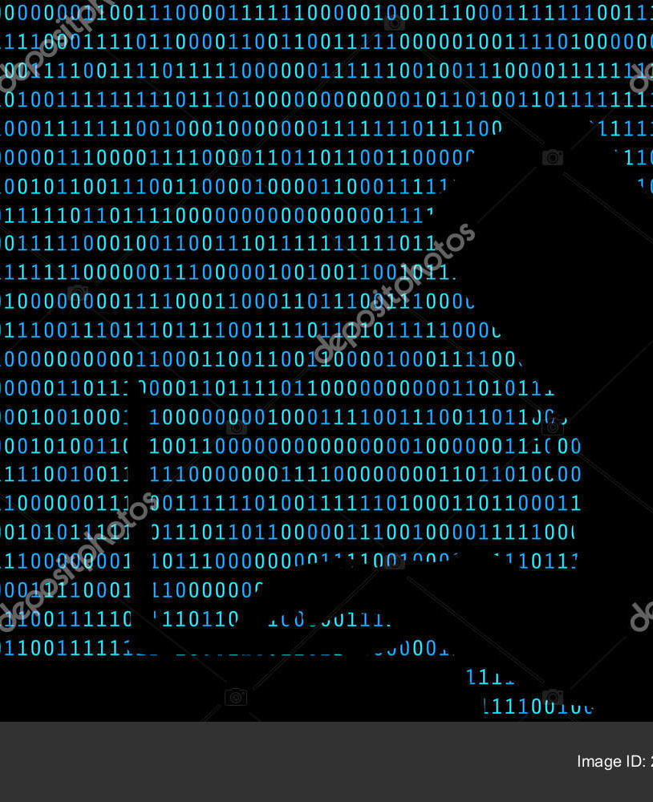
Contents:
Why python?
How we can install python
Familiarizing with editors
1.Print
2.Values & Variables
3.input
4.operation

Slide 3
Why python?
Applications:
A.I & machine learning
Applications
Automation
Websites(Dropbox, Instagram)

Slide 4
Install latest version of python
Windows/Mac OS/Linux
Linux
Python.org
Downloads
Choosing your operation system
Downloads
Sudo apt install python
Notice: add python to PATH

Slide 5
Editor
Some editors
Jupiter notebook
VS code
Atom
Jupiter notebook
Google colab
PyCharm
…
Anacoda.com
Downloads
Chose your operation system
Download prepare anaconda according to the version of python that you have installed it
Install Notice: add to PATH
Search Anaconda prompt
Search Jupiter notebook

