Slide 1

Département Mathématiques et Informatique
SOUTENANCE DE PROJET DE FIN D’ÉTUDES
Pour l’obtention du diplôme de Master Professionnel
en « Big Data & Cloud Computing » — BDCC
AI-Assisted Generation of Selenium Page Objects
A Structured Pipeline Compared Against Direct Large Language Model Generation
Soutenu le
Encadré par
Membres du jury
[ defence date ]
par : [ YOUR NAME ]
[ supervisor name(s) ]
[ jury member 1 ]
[ jury member 2 ]
[ jury member 3 ]
ANNÉE UNIVERSITAIRE 2025 – 2026
Notes:
Good morning. My name is [name], and this is my end-of-studies project for the Master in Big Data and Cloud Computing, supervised by [supervisor]. Thank you to the members of the jury.
The project asks one question: when you automate the writing of Selenium page objects, how much of that job should a language model actually do?
The answer I'll give is not an opinion. I built both approaches, ran them under identical conditions, and measured them against a metric set fixed before any measuring began.

Slide 2
PLAN
PLAN
INTRODUCTION
1
GENERAL CONTEXT AND PROBLEM STATEMENT
2
METHODOLOGY, PLANNING AND EVALUATION PROTOCOL
3
FUNCTIONAL DESIGN
4
TECHNICAL DESIGN
5
IMPLEMENTATION
6
EXPERIMENTAL EVALUATION
PERSONAL ASSESSMENT · PERSPECTIVES · CONCLUSION
SOUTENANCE DE PROJET DE FIN D’ÉTUDES – [ YOUR NAME ]
2
Notes:
Here is how I'll proceed.
The context first — why UI testing is expensive and why the obvious language-model answer deserves examining. Then the methodology and evaluation protocol, because the empirical claims later depend on it. Then the design of the system, the implementation, and finally the experimental evaluation, which is where the contribution lives.
About twenty-five minutes.

Slide 3
INTRODUCTION
INTRODUCTION
SOUTENANCE DE PROJET DE FIN D’ÉTUDES – [ YOUR NAME ]
3
Notes:
Let me begin with the problem.

Slide 4
INTRODUCTION
A language model can write a page object.
The question is whether it should write all of it.
What is not in dispute
What this project examines
A modern model reads HTML and produces plausible Java.
I built it. It works. You will see its output.
The idea is being pursued commercially.
The task looks like one job. It is two.
Structure: which elements exist, how they repeat, how to address them.
Semantics: what a thing should be called.
The two have different economics.
This project divides the task — and measures the division.
SOUTENANCE DE PROJET DE FIN D’ÉTUDES – [ YOUR NAME ]
4
Notes:
Here is the whole talk in one sentence.
Nobody disputes that a model can read HTML and produce a plausible page object. I built that; it works; you'll see its output.
The interesting question is the second one. The task looks like one job but it's two. Structure — which elements exist, how they repeat, how to address them durably. Semantics — what a thing should be called. Those have different economics, and a system respecting the boundary beats either pure approach.

Slide 5
GENERAL CONTEXT AND PROBLEM STATEMENT
1
GENERAL CONTEXT AND PROBLEM STATEMENT
SOUTENANCE DE PROJET DE FIN D’ÉTUDES – [ YOUR NAME ]
5
Notes:
First, the context: why this problem is worth solving, and why the obvious answer deserves examining.

Slide 6
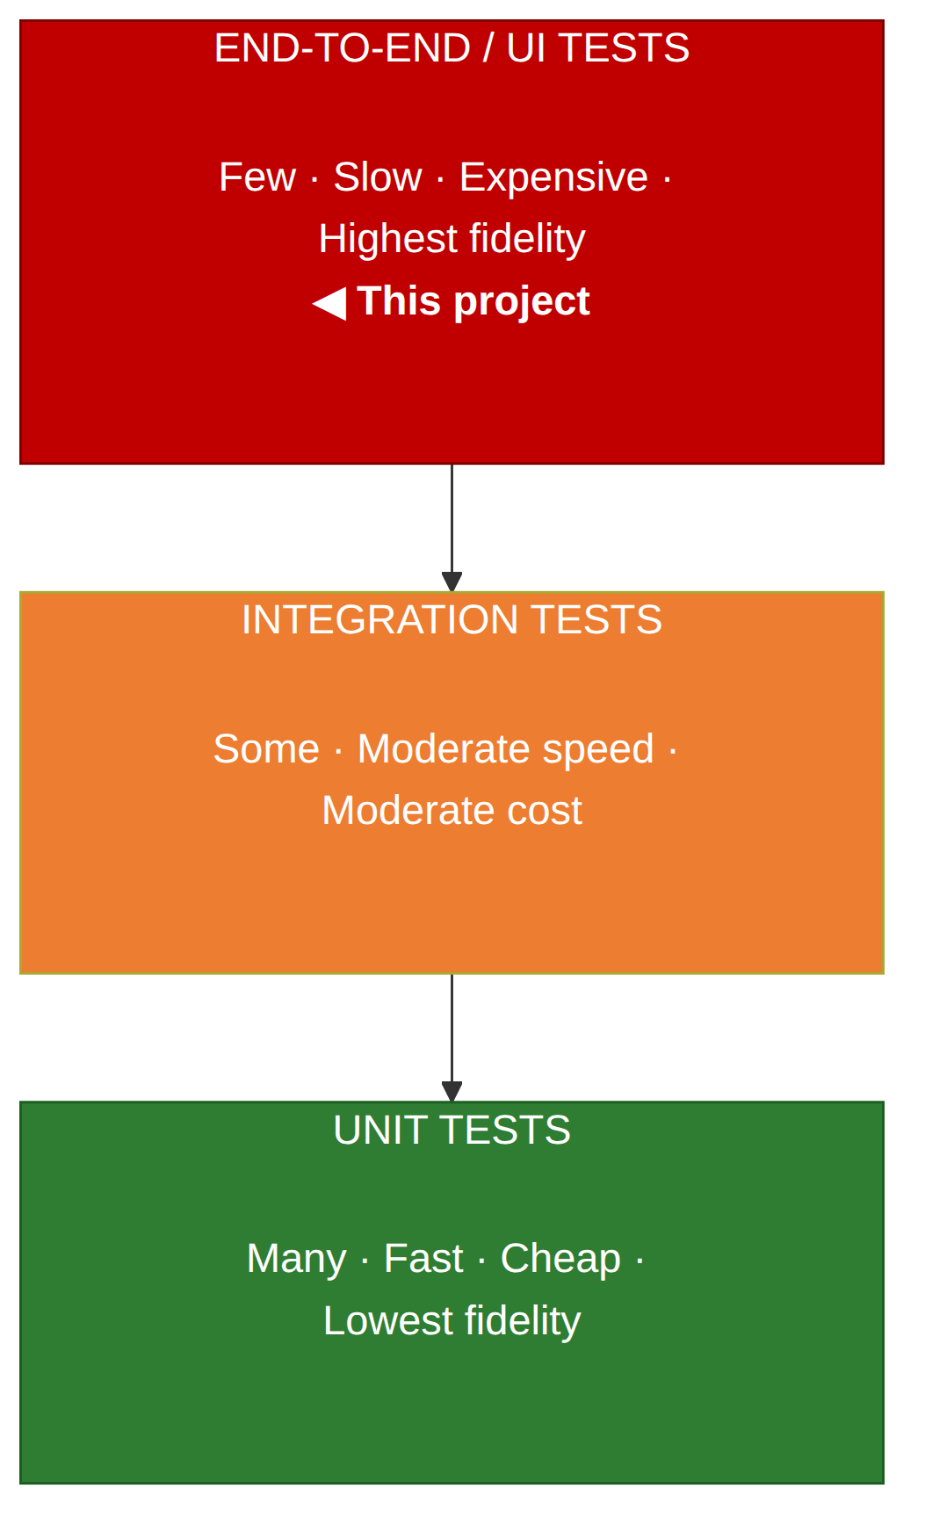
GENERAL CONTEXT
Problem statement
1
Locators must be authored.
Thirty interactive elements is thirty decisions, each needing a look at the markup. Mechanical, and unavoidable.
2
Locators are fragile.
A locator is a claim about a document’s structure. One wrapper element invalidates a positional path; a copy edit invalidates a text match.
3
Locator quality is not uniform.
A dedicated test attribute has no reason to change. Visible text has every reason to. That gradient can be encoded as a rule.
The user interface is the most valuable layer to test and the most expensive. Both follow from one operation: locating an element.
SOUTENANCE DE PROJET DE FIN D’ÉTUDES – [ YOUR NAME ]
6
Notes:
Automated testing is organised in layers — the pyramid on the right. Unit tests at the bottom: fast, numerous, cheap. End-to-end browser tests at the top: slow, few, and the only ones that exercise the system the way a user does. This project is about that top layer.
Before a test can click a button it has to find that button among several hundred DOM nodes. That one operation is where all the cost lives, and it costs in three ways: every locator has to be authored, locators break when the document changes, and — the one this project turns on — not all locators are equally fragile.
An attribute put there for testing has no reason to change when the page is restyled. Visible text is the least stable thing on the page. That ordering is settled knowledge; it doesn't require judgement. It can be written down as a rule — and if it can be written down as a rule, a program can apply it.

Slide 7
GENERAL CONTEXT
The Page Object Model relocates the cost — it does not remove it
What it fixes
What it leaves behind
No test contains a locator.
All structural knowledge in one class per page.
A changed identifier is a one-line change.
Every page still needs a class.
Every element still needs a locator and a method.
The work is regular: find, choose, emit, repeat.
Work that regular is a natural candidate for automation.
That observation is the origin of this project.
SOUTENANCE DE PROJET DE FIN D’ÉTUDES – [ YOUR NAME ]
7
Notes:
The standard engineering answer to locator fragility is the Page Object Model, and it's a good answer: no test contains a locator, all structural knowledge sits in one class per page. When the login button's identifier changes, one line changes and every test keeps passing.
But notice what it does. It makes the cost maintainable; it doesn't make it small. Every page still needs a class, every element still needs a locator and a method. And the work is extremely regular — find, choose, emit, repeat. Anything that regular is a candidate for automation. That's where this project starts.

Slide 8
GENERAL CONTEXT
The obvious solution — and four reasons to examine it rather than adopt it
Non-determinism
Hallucination
The same prompt twice may give different code. An artefact that varies between invocations cannot be meaningfully diffed or reviewed.
Models reference APIs that do not exist, because such code is statistically plausible. It looks right; only compilation reveals otherwise.
Cost scales with page size
No traceability
The whole document is submitted every time. A recurring bill proportional to the application, not to the number of hard decisions.
When a rule picks a locator, the reason is recoverable. When a model picks one, no account is available.
None of these says the model should not be used. They say where and how it is used has consequences — and that the question is answerable by measurement.
SOUTENANCE DE PROJET DE FIN D’ÉTUDES – [ YOUR NAME ]
8
Notes:
So the obvious proposal: hand the HTML to a model and ask for the page object. It's attractive, and it's being pursued commercially.
I want to be careful here, because it would be easy to sound like I'm attacking language models, and I'm not. Four properties are worth examining rather than assuming away.
Non-determinism — the same prompt twice may give different code, which matters for an artefact that goes into version control. Hallucination — invented method names are plausible in context, and only the compiler finds out. Cost proportional to input — you pay for the whole document, every regeneration. And no traceability — when a rule picks a locator I can tell you which rule fired; when a model picks one, there's no such account.
None of these says don't use a model. They say where you use it is a design decision with consequences — and that the question is empirical.

Slide 9
GENERAL CONTEXT
Objectives and research questions
RQ1
Can a deterministic pipeline, working from a live page’s rendered HTML, produce page objects of a quality comparable to a language model given the same page?
RQ2
Where the deterministic layer cannot find a stable locator, can it detect that condition itself — and does escalating only those cases beat sending the whole page?
RQ3
On which measurable dimensions does each approach dominate, and what does that imply for how such systems should be built?
RQ2 is the contribution. Note that it has two halves: can the layer detect its own weakness, and is acting on that detection worth it?
SOUTENANCE DE PROJET DE FIN D’ÉTUDES – [ YOUR NAME ]
9
Notes:
Three research questions.
RQ1 is the baseline comparison: can rules match a model on quality, given the same page?
RQ2 is the actual contribution, and it's worth reading carefully because it has two halves. Can the deterministic layer detect its own weakness — not "is it weak", but "does it know when it is weak"? And if it can, does escalating only those cases beat submitting the whole page?
RQ3 is the honest question. Not "which one wins", which would be the wrong shape of question, but on which dimensions each wins, and what we should build as a result.
I'll answer all three with measurements at the end.

Slide 10
GENERAL CONTEXT
Functional requirements
Test automation framework
Generation pipeline
Drive a real browser against a live application.
Two browsers, selectable without touching test code.
Headless by default — local and CI identical.
Page Object Model; no locator in any test.
Reusable multi-page journeys (flows).
All URLs, credentials and messages externalised.
HTML report, screenshot on failure.
API tests alongside UI tests.
Runs on every push through CI.
Retrieve fully rendered HTML, including behind a login.
Extract interactive elements; exclude hidden fields.
Decompose into header, footer and body.
Detect repeating components; model each once.
Select the most durable locator by fixed priority.
Record which rule produced each locator.
Mark as low-confidence anything matched only by text.
Emit compilable Java extending the same base class.
Escalate only low-confidence elements to a model.
Two model backends behind one interface.
Degrade gracefully on model failure.
Provide the naive baseline mode for comparison.
SOUTENANCE DE PROJET DE FIN D’ÉTUDES – [ YOUR NAME ]
10
Notes:
Two subsystems, and the requirements split along that line. On the left a conventional test framework — which is the validation harness, not scaffolding. On the right the generation pipeline.
Three on the right are worth pointing at: record which rule produced each locator, which makes the output traceable; mark as low-confidence anything matched only by text, which is the gate; and degrade gracefully on model failure — if the model is unreachable you lose the review, not the page object.

Slide 11
GENERAL CONTEXT
Non-functional requirements
Determinism
Build safety
Identical input must produce identical output.
Unvalidated model output can never break the build.
Traceability
Portability
Every locator attributable to an explicit rule.
Runs unmodified locally, on cloud CI and a self-hosted agent.
Cost proportionality
Secret hygiene
Model cost scales with ambiguity, not page size.
Credentials supplied by environment, never committed.
Isolation
Build safety was added mid-project, after it was recognised that writing unvalidated model output into the compiled source tree would let a single non-compiling response break the whole build, including CI.
Generated artefacts separated from reviewed code.
SOUTENANCE DE PROJET DE FIN D’ÉTUDES – [ YOUR NAME ]
11
Notes:
Seven non-functional requirements. The first three are what the architecture exists to satisfy, and what I measure in the evaluation: determinism, traceability, and cost proportional to ambiguity.
The note bottom-right is an engineering decision I got wrong first. Baseline output originally went into the source tree — until I realised a single non-compiling response would break the build for the whole project, including CI. So build safety became a requirement mid-project. It's recorded as added during the work rather than quietly corrected, because the reasoning is part of the account.

Slide 12
METHODOLOGY, PLANNING AND EVALUATION PROTOCOL
2
METHODOLOGY, PLANNING AND EVALUATION PROTOCOL
SOUTENANCE DE PROJET DE FIN D’ÉTUDES – [ YOUR NAME ]
12
Notes:
How the work was carried out, and — at greater length, because the empirical claims depend on it — how the evaluation was designed.

Slide 13
METHODOLOGY AND PLANNING
Development methodology
Implement the smallest useful capability → exercise it against a real, live website → observe the failures → diagnose each to its root cause → correct with a scoped change.
The insistence on real sites is methodologically significant
Every substantive defect in Chapter V was found this way. None would have surfaced on a clean, tutorial-quality test page.
A product named test.allTheThings() T-Shirt (Red) produced attribute values that are not legal in Java identifiers.
The second target site used data-qa where the first used data-test — revealing that the convention had been hard-coded rather than configured.
Two target applications, chosen deliberately: SauceDemo is purpose-built and cleanly instrumented — a favourable case. automationexercise.com is messier and more realistic. Evaluating both distinguishes behaviour on an idealised page from behaviour on a real one.
SOUTENANCE DE PROJET DE FIN D’ÉTUDES – [ YOUR NAME ]
13
Notes:
An incremental, evidence-driven approach rather than formal agile ceremony, which would be artificial for a single developer. Each increment: smallest useful capability, exercised against a real live site rather than a fixture, failures diagnosed to root cause.
The insistence on real sites matters more than it sounds. Two examples: a SauceDemo product is literally named "test dot allTheThings T-Shirt Red", producing attribute values with characters illegal in Java identifiers. And the second site used data-qa where the first used data-test — revealing I'd hard-coded the convention rather than configured it.

Slide 14
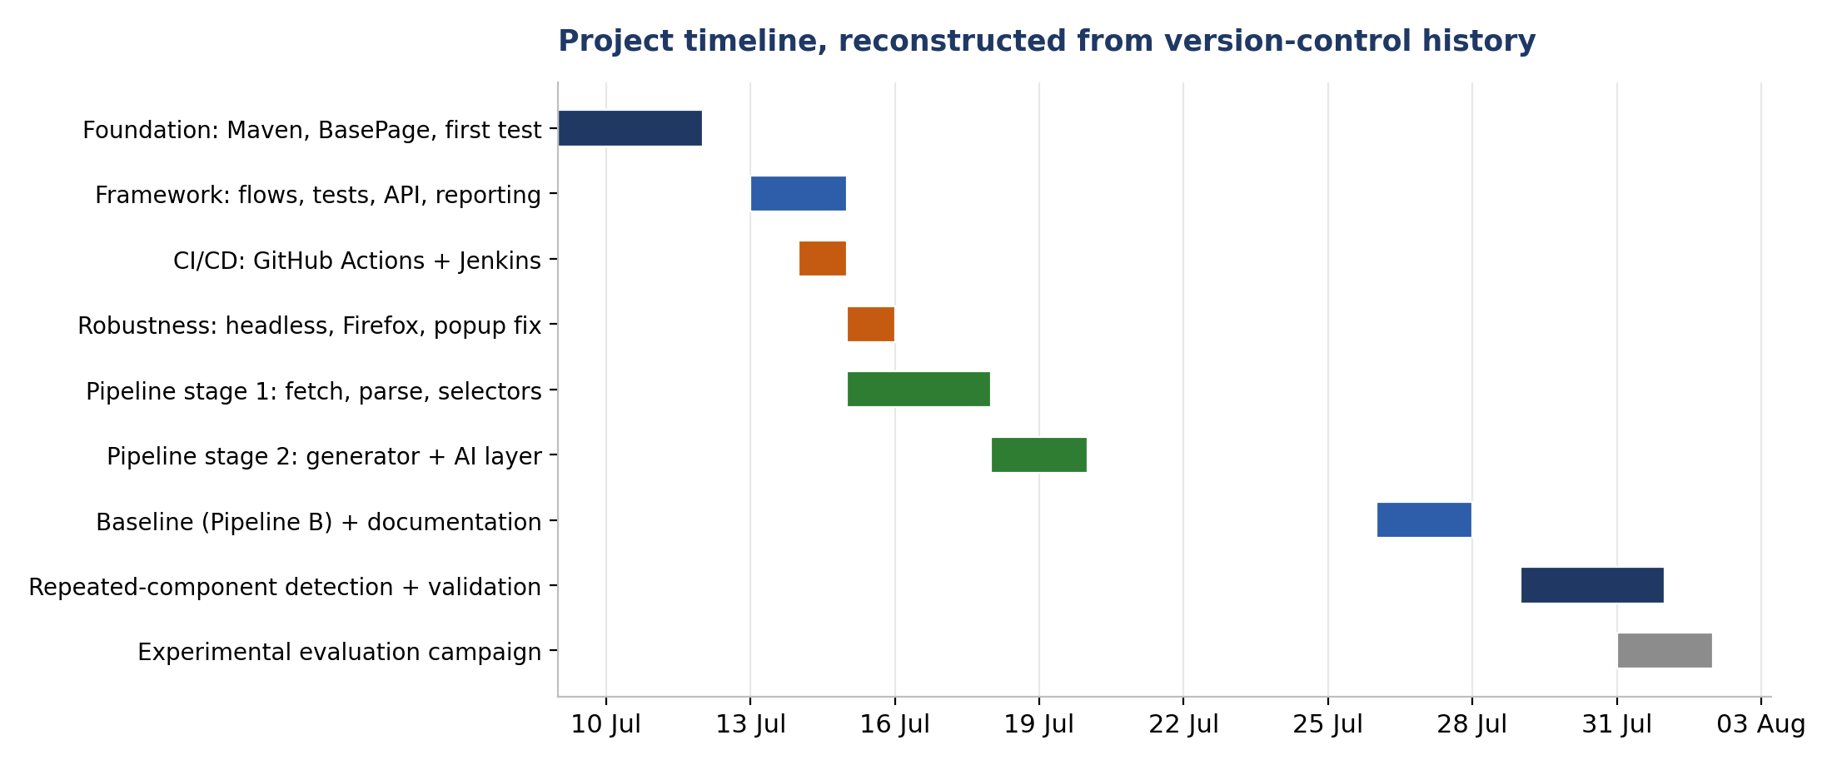
METHODOLOGY AND PLANNING
Planning
SOUTENANCE DE PROJET DE FIN D’ÉTUDES – [ YOUR NAME ]
14
Notes:
The timeline, reconstructed from version-control history rather than drawn up afterwards — so it records what happened rather than a plan.
Roughly four weeks. First the framework foundation and both CI pipelines, then a robustness pass. The second half is the generation pipeline: fetcher and parser, then generator and AI layer, then the naive baseline, then repeated-component detection with its end-to-end validation. The last rows are the measurement campaign and the post-campaign audit.

Slide 15
EVALUATION PROTOCOL
A comparison whose protocol is not stated is not a result
Nine metrics, fixed before measuring
Recall · Precision · Locator quality
Compilability · Executability · Duplication
Cost · Latency · Determinism
The conflict of interest
Pipeline A is my own system. I designed the metrics and I took the measurements.
Three commitments
Fairness of the baseline
The metric set was fixed before the campaign began.
Defects in my pipeline are logged with the same severity scale as defects in the baseline.
Every artefact is retained, so any measurement can be independently recomputed.
A genuinely helpful prompt — prefer stable attributes, skip hidden inputs, extend the same base class.
Formatting artefacts stripped before evaluation, not penalised.
Both pipelines receive identical HTML, same session, same day.
SOUTENANCE DE PROJET DE FIN D’ÉTUDES – [ YOUR NAME ]
15
Notes:
The empirical claims here rest on a comparison, so the comparison has to be defined.
Nine metrics — and this matters — fixed before I started measuring, not chosen afterwards once I knew what looked good.
Fairness of the baseline is the obvious attack on a study like this: that the author built a straw man. The prompt is genuinely helpful — prefer stable attributes, skip hidden inputs, extend the same base class. Formatting artefacts are stripped rather than penalised. And both pipelines get identical HTML from the same session.
Then the box on the right, which I'd rather raise myself than have you raise. Pipeline A is my system; I designed the metrics and did the measuring. That's a real conflict of interest and it can't be argued away — but it can be constrained, in the three ways listed. And you'll see shortly that the worst defect in this entire study is in my own pipeline.

Slide 16
EVALUATION PROTOCOL
Threats to validity
Construct
The metrics are proxies. Compilability and executability are strong evidence of usability but do not establish maintainability — the property that ultimately matters, and which could not be measured in the time available.
Internal
Ground-truth counts were established by a single observer. A second independent counter would strengthen them. A hosted model may also change without notice, independently of the experiment.
External
Two sites, one page examined in depth. Both are English-language e-commerce sites of moderate complexity. Single-page applications with heavy dynamic re-rendering, or shadow DOM, are not covered.
Reliability
Pipeline A’s output is byte-reproducible, so its measurements reproduce exactly. Pipeline B’s cannot be, by the very property under study — so its results are reported per run, and the variance is itself treated as a result.
SOUTENANCE DE PROJET DE FIN D’ÉTUDES – [ YOUR NAME ]
16
Notes:
I stated the threats up front rather than burying them at the end, because I think that's what distinguishes a measured evaluation from a demonstration.
Construct: the metrics are proxies. Compilability is strong evidence of usability, but it is not maintainability — the property that ultimately matters and which I couldn't measure in the time available.
Internal: ground truth was counted by one observer, me. And a hosted model can be updated without notice, so the baseline may drift independently of anything I did.
External: two sites, one page in depth, both English-language e-commerce sites. Single-page applications with heavy re-rendering are not covered.
Reliability: Pipeline A's measurements reproduce exactly. Pipeline B's cannot, by the very property under study — so its results are reported per run, and the variance is itself a result.

Slide 17
FUNCTIONAL DESIGN
3
FUNCTIONAL DESIGN
SOUTENANCE DE PROJET DE FIN D’ÉTUDES – [ YOUR NAME ]
17
Notes:
The design of the system, presented through UML, so the reasoning can be assessed independently of the code.

Slide 18
FUNCTIONAL DESIGN
Actors
QA Engineer
The primary human actor. Executes the suite, initiates generation, and — crucially — reviews low-confidence output. The system is designed to be human-in-the-loop, not autonomous.
CI Server
A secondary, non-human actor. Executes the suite automatically on every change. Realised by two independent implementations: GitHub Actions and Jenkins.
LLM Service
A secondary, external actor providing judgement on request. Gemini in the cloud or a local Llama via Ollama. Its availability is not guaranteed and the system is designed accordingly.
SOUTENANCE DE PROJET DE FIN D’ÉTUDES – [ YOUR NAME ]
18
Notes:
Three actors. The QA engineer is the primary human one — and note the word "reviews": this actor reviews low-confidence output rather than merely consuming it. The system is deliberately human-in-the-loop; it never silently modifies an element on a model's opinion.
The CI server is realised twice over, which also demonstrates the portability requirement. And the LLM service is external, with availability that is not guaranteed — that last clause is a design constraint, not an observation.

Slide 19
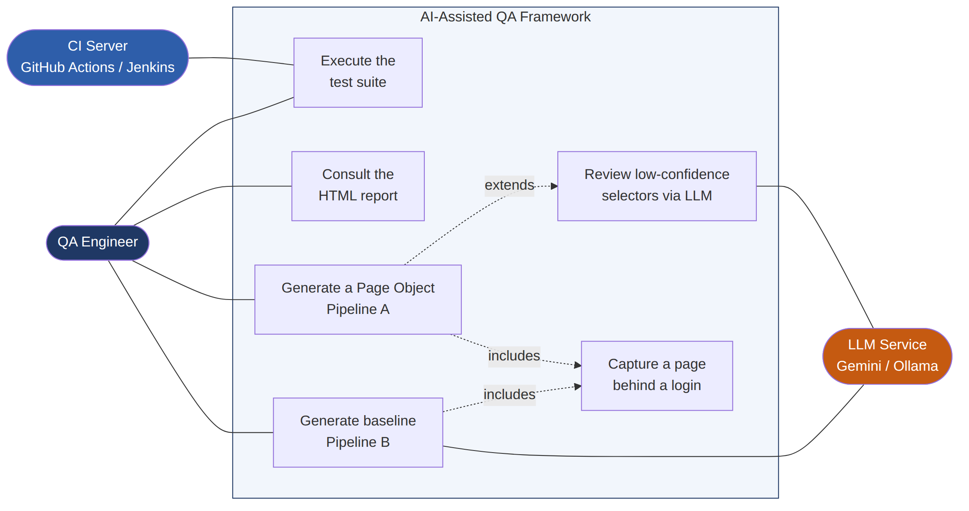
FUNCTIONAL DESIGN
Use case diagram
SOUTENANCE DE PROJET DE FIN D’ÉTUDES – [ YOUR NAME ]
19
Notes:
Six use cases: two belong to the test framework, four to the generation pipeline.
The one I'll spend a moment on is "review low-confidence selectors", because its precondition is the whole point of the architecture: extraction must have produced at least one selector matched only by text. If it hasn't, this use case never fires, no prompt is constructed, and nothing is spent.

Slide 20
FUNCTIONAL DESIGN
The contribution: confidence-gated escalation
Four strategies, tried in order
data-test / data-qa
The gate
exists only for testing — no reason to change
isLowConfidence()
id
Only elements that fell all the way to a text match are sent to the model.
intended to be unique, reasonably stable
name
The model’s cost therefore scales with ambiguity, not with page size.
carries form semantics, fairly stable
visible text
changes with a copy edit; changes entirely under translation
One field — matchedVia — records which rule produced each locator. That single field is what makes the output traceable and what makes gating possible.
On a well-instrumented page the number of model calls is zero — and so is the cost.
SOUTENANCE DE PROJET DE FIN D’ÉTUDES – [ YOUR NAME ]
20
Notes:
This is the slide that matters most. If you remember one thing, remember this one.
On the left, the priority order: a dedicated test attribute first, then id, then name, and only if all three fail, the element's visible text. That's the durability gradient from earlier, encoded as a rule.
Now the part that makes this different from just generating carefully. Every selector records which rule produced it, in one field called matchedVia. Because it records that, the pipeline can look at its own output and say: this one came from the text fallback, so I could not find a stable way to address it. That is what isLowConfidence means, and it is one line of code.
That one line is the architecture. The model isn't called on the page, or on every element. It is called only on the elements the deterministic layer has itself flagged as weak. So the number of model calls is a function of how well the page is instrumented, not of how big it is.

Slide 21
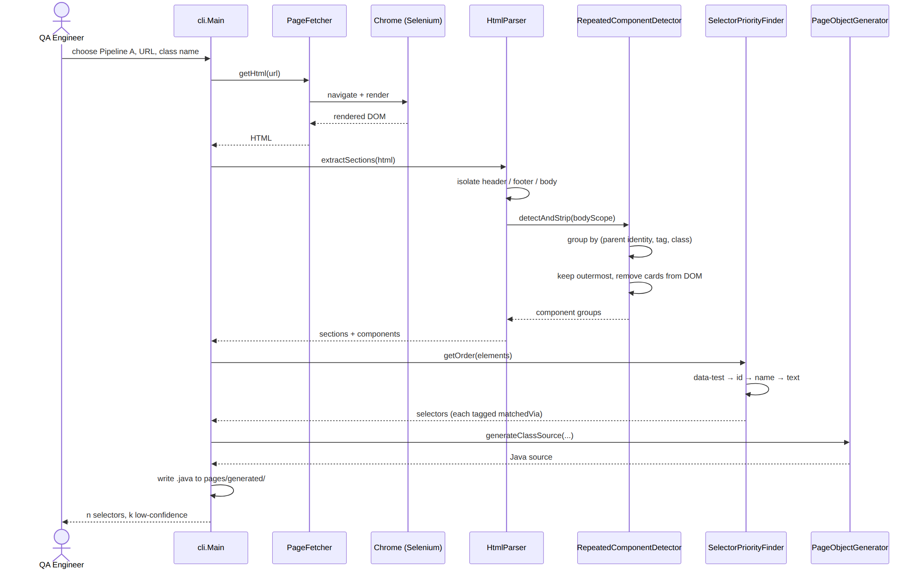
FUNCTIONAL DESIGN
Sequence diagram — Pipeline A generation
SOUTENANCE DE PROJET DE FIN D’ÉTUDES – [ YOUR NAME ]
21
Notes:
The generation sequence. The engineer supplies a URL and a class name. The fetcher renders through Selenium — the input is the DOM after JavaScript has run, which for a client-rendered app is a completely different document from the HTTP response.
The parser isolates the regions. Component detection strips the cards it finds before the flat extraction happens, so the two extractions physically cannot disagree. The priority finder tags each selector with how it was matched.
And the last message back is the one that matters: n selectors, k of them low-confidence. That k is the number the architecture exists to drive to zero.

Slide 22
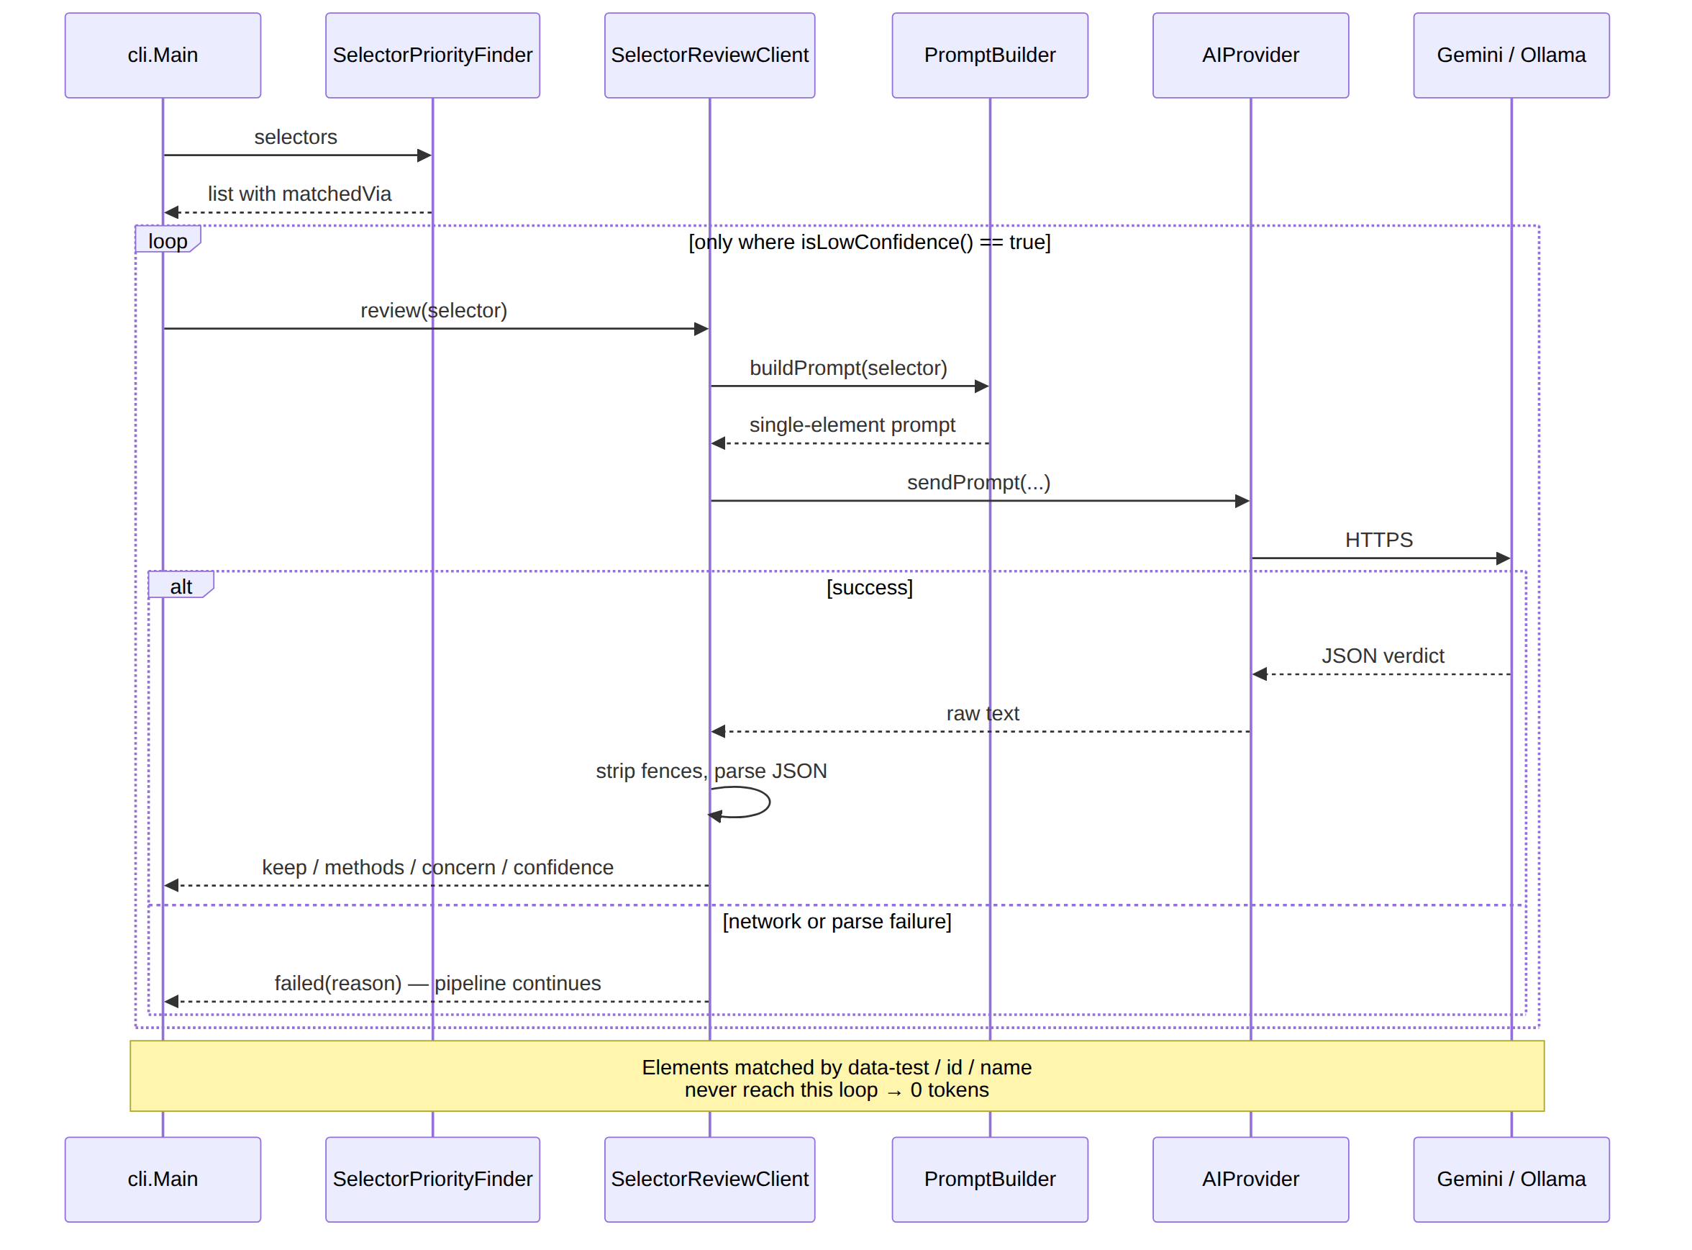
FUNCTIONAL DESIGN
Sequence diagram — confidence-gated review
SOUTENANCE DE PROJET DE FIN D’ÉTUDES – [ YOUR NAME ]
22
Notes:
This is the review path, and the thing to notice is where it starts: with a filter. Only low-confidence selectors enter this diagram at all.
Each gets a single-element prompt, not a whole-page one — a focused prompt gives a focused answer, one malformed element can't corrupt the rest, and cost scales with ambiguity.
And look at the alternative flow. If the service is unreachable or returns something unparseable, the element is reported as unreviewed and processing continues. You lose the review; you never lose the page object.

Slide 23
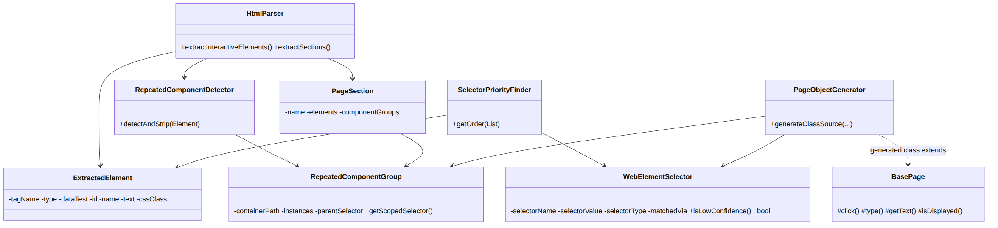
FUNCTIONAL DESIGN
Class diagram — parser and generator packages
Data carriers. ExtractedElement holds what was observed. WebElementSelector holds what was decided — including matchedVia, the field that makes gating possible.
Processors. Parser, detector, priority finder and generator: one responsibility each, none knowing the others’ internals.
The AI abstraction. AIProvider is a single-method interface; the review client depends on it alone. Substituting a cloud model for a local one is a one-line change.
SOUTENANCE DE PROJET DE FIN D’ÉTUDES – [ YOUR NAME ]
23
Notes:
Four concerns, each in its own package. Data carriers hold what was observed and what was decided — including matchedVia, the hinge of the whole system. Processors do extraction, detection, selection and emission, one responsibility each.
And the AI abstraction is a single-method interface. That's dependency inversion applied for a concrete reason rather than as decoration: swapping the cloud model for a local one is a one-line change and no other class is affected.

Slide 24
FUNCTIONAL DESIGN
Detecting structure, not just elements
The naive approach
What actually characterises a list
Group elements by CSS class. Fails on real pages: framework classes such as row, container and col-sm-4 recur across entirely unrelated regions.
Members share a parent. The key is (parent identity, tag, first class), with a threshold of three: two similar siblings are a coincidence, three are a structure.
Two further rules
Outermost wins. An inner element may repeat inside an outer one that also repeats. The outer element is the true card and already contains everything the inner one holds.
Cards are removed as they are captured. Whatever is extracted afterwards therefore cannot contain a card’s elements. No filtering pass is required, and the two extractions cannot disagree — an entire class of bug removed rather than defended against.
Result on the evaluated page: one menu component covering 4 items, one product component covering 6 — instead of thirty near-identical fields.
SOUTENANCE DE PROJET DE FIN D’ÉTUDES – [ YOUR NAME ]
24
Notes:
This is the least obvious part of the design and, I think, the most interesting.
A page showing thirty products should not produce thirty near-identical fields. It should produce one component class instantiated thirty times.
The naive way to find those is to group by CSS class. That fails on real pages, because framework classes like row and container recur across unrelated regions. What actually characterises a repeated list is that its members share a parent — so the key is parent identity, tag and first class, with a threshold of three, because two similar siblings are a coincidence and three are a structure.
Two more rules. Only the outermost boundary is kept, because the outer element is the true card. And each detected card is physically removed from the document as it's captured — so whatever is extracted afterwards cannot contain a card's elements. That removes an entire category of bug rather than defending against it.

Slide 25
TECHNICAL DESIGN
4
TECHNICAL DESIGN
SOUTENANCE DE PROJET DE FIN D’ÉTUDES – [ YOUR NAME ]
25
Notes:
The technical realisation: layers, stack, and continuous integration.

Slide 26
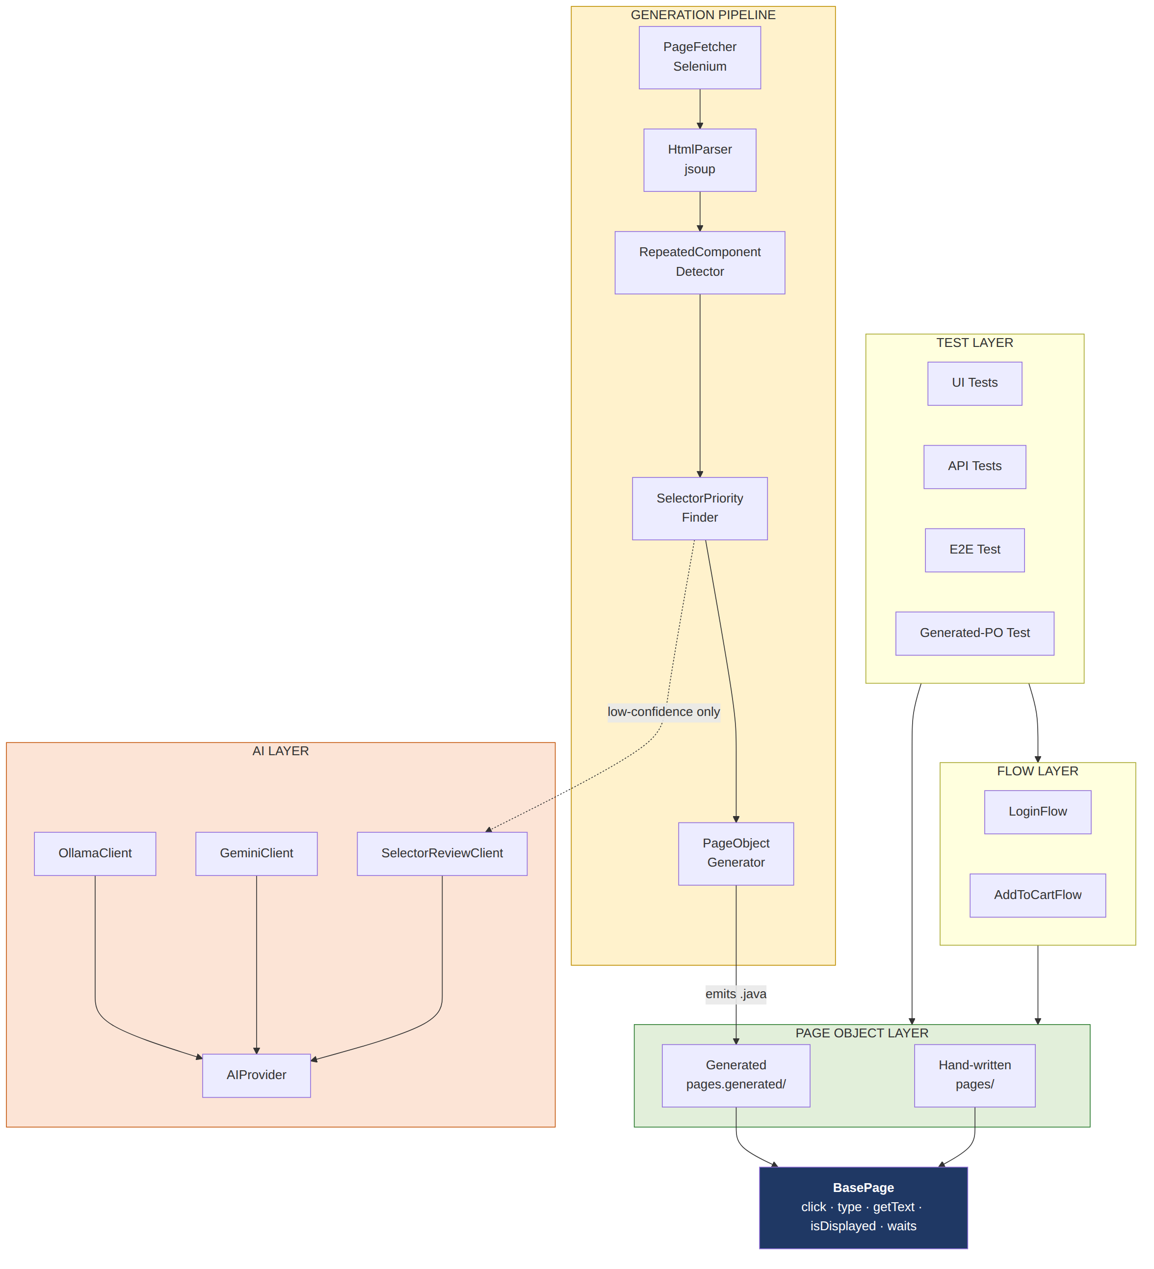
TECHNICAL DESIGN
Layered architecture
Test framework
Base page, page objects, flows, tests — UI and API — with reporting and two CI pipelines. Not decoration: it is the harness that proves generated artefacts are usable in a real suite.
AI layer
One interface, two backends — Gemini in the cloud, Llama via Ollama locally. A model failure is returned as a result, never thrown, so the deterministic output always survives.
Generation pipeline
Fetch the rendered DOM, section the page, detect repeating components, select locators, emit Java. Four stages, one responsibility each.
SOUTENANCE DE PROJET DE FIN D’ÉTUDES – [ YOUR NAME ]
26
Notes:
Three layers, and two points worth stating.
The test framework at the bottom is not scaffolding — it's the validation harness. Without it, "these page objects are usable" is a claim; with it, it's a demonstration.
And the AI layer sits above everything rather than inside it. Delete it entirely and the generator produces exactly the same page objects — you simply lose the review of elements it already told you it was unsure about.

Slide 27
TECHNICAL DESIGN
Technologies
Language / build
Java 17 · Maven
Reporting
ExtentReports 5.1
Browser automation
Selenium WebDriver 4.21
HTTP client
OkHttp 4.12
Test framework
TestNG 7.10
Cloud model
gemini-3.1-flash-lite
API testing
RestAssured 5.4
Local model
Llama 3.1 8B via Ollama
HTML parsing
jsoup 1.17
Continuous integration
GitHub Actions · Jenkins (self-hosted, Docker)
Test data
Datafaker 2.4
Version control
Git / GitHub
SOUTENANCE DE PROJET DE FIN D’ÉTUDES – [ YOUR NAME ]
27
Notes:
The stack. Java with Selenium and TestNG was retained because it remains dominant in the enterprise QA market this targets — and because the architectural contribution is not language-specific; the same gating idea would work in Playwright.
Two entries worth pointing at. The cloud model identifier is stated exactly, because an earlier phase used a different model and results from the two must never be mixed. And there are two backends, because a dependency on one hosted service was itself something I wanted to be able to remove.

Slide 28
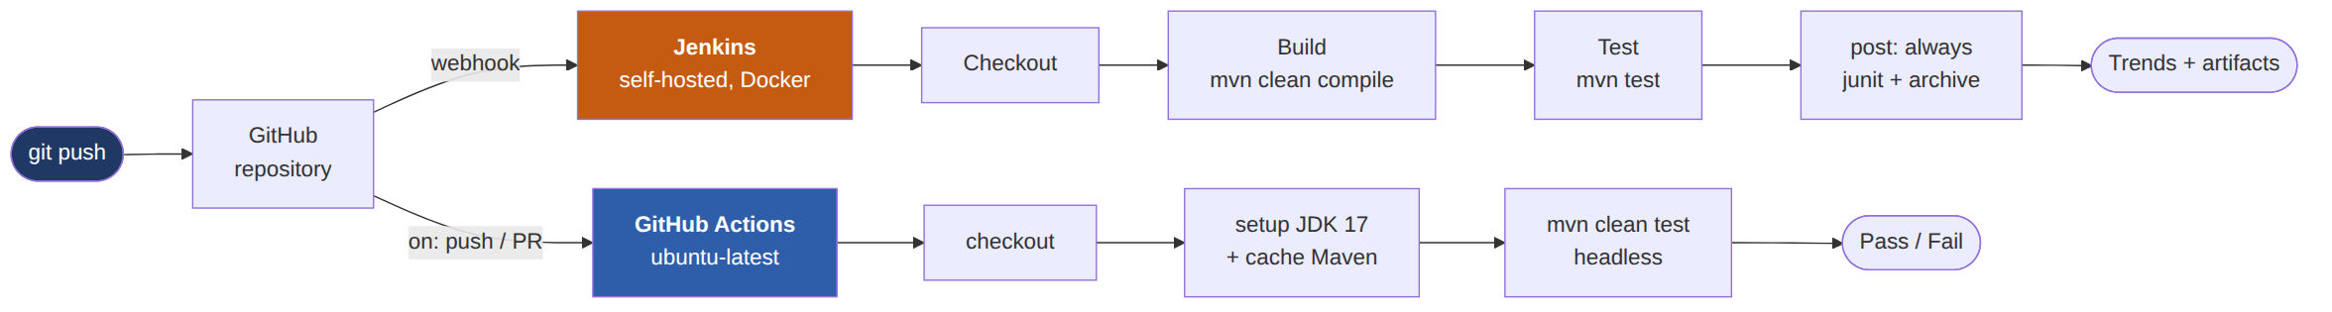
TECHNICAL DESIGN
Continuous integration and delivery
GitHub Actions runs on every push to main: a clean Ubuntu machine, JDK 17, headless. The value of a clean machine is easily understated — it proves the project builds from the repository alone.
Jenkins runs self-hosted in Docker on a webhook, with Checkout / Build / Test as separate stages so the dashboard distinguishes a compilation failure from a test failure.
A fast offline gate runs the generator’s own unit tests first — no browser, no network — so a red build immediately says which kind of failure it is.
SOUTENANCE DE PROJET DE FIN D’ÉTUDES – [ YOUR NAME ]
28
Notes:
Two independent pipelines. GitHub Actions runs on every push on a clean machine — and the value of the clean machine is easily understated: it proves the project builds from the repository alone, without depending on state that happens to exist on my laptop.
Jenkins runs self-hosted in Docker with three separate stages, so the dashboard distinguishes a compilation failure from a test failure. It presented a concrete problem — a different processor architecture shipping Chromium rather than Chrome — solved by supplying the browser paths as environment variables. One test base class serves three environments with no conditional logic in any test.

Slide 29
IMPLEMENTATION
5
IMPLEMENTATION
SOUTENANCE DE PROJET DE FIN D’ÉTUDES – [ YOUR NAME ]
29
Notes:
Now the system actually running, and what it produces.

Slide 30
IMPLEMENTATION
The generator in operation
$ mvn -q compile exec:java -Dexec.mainClass=cli.Main
1 - Pipeline A: structured extraction + generate Page Object
2 - Pipeline A + AI review of low-confidence selectors
3 - Pipeline B: naive raw-HTML AI baseline
Choose an option (1/2/3): 1
Detected 2 repeated component pattern(s):
Pattern: a.bm-item -> 4 instances
Pattern: div.inventory_item -> 6 instances
Section Body: 3 selectors, 0 low-confidence
Written: src/main/java/pages/generated/...Body.java
The last line is the measurement. Three selectors, zero low-confidence — so nothing met the escalation condition, no prompt was ever constructed, and the model was never called. Cost for this page: zero tokens.
For pages behind a login, the tool opens a visible browser, waits for the engineer to authenticate and navigate by hand, and captures whatever page they reached — rather than encoding assumptions about any particular login form, which would work for exactly one site.
SOUTENANCE DE PROJET DE FIN D’ÉTUDES – [ YOUR NAME ]
30
Notes:
This is the tool running. The engineer picks a pipeline, gives a URL and a class name.
Look at what it reports: two repeating patterns found — a four-item menu and a six-item product grid — then the summary, three flat selectors, zero low-confidence.
That zero is the measurement. Nothing met the escalation condition, so no prompt was constructed and the model was never called. This page object cost zero tokens — not small, zero.

Slide 31
IMPLEMENTATION
A generated page object
package pages.generated;
public class SauceDemoInventoryPageBody extends BasePage {
private final By byReactBurgerMenuBtn = By.cssSelector("[id='react-burger-menu-btn']");
private final By byShoppingCartLink = By.cssSelector("[data-test='shopping-cart-link']");
public void clickShoppingCartLink() { click(byShoppingCartLink); }
// "div.inventory_item" repeated 6 times on the page this was generated from.
public List<InventoryItemItem> getInventoryItemItemList() {
return driver.findElements(By.cssSelector("div.inventory_list > div.inventory_item"))
.stream().map(InventoryItemItem::new).collect(Collectors.toList());
}
Extends the same BasePage as hand-written page objects, and lands in a dedicated pages.generated package so machine output is never mistaken for reviewed code.
SOUTENANCE DE PROJET DE FIN D’ÉTUDES – [ YOUR NAME ]
31
Notes:
Real output, unedited apart from a few repeated lines removed for space.
The locators are attribute selectors, and the second uses data-test because that's what is on that element — which sounds obvious, and is a defect I'll come back to.
The class extends the same BasePage my hand-written page objects extend, so it inherits the same waiting strategy and click fallback. And the component getter returns six instances from one method — the class doesn't know how many products the shop has, and doesn't need to.

Slide 32
IMPLEMENTATION
Validated end-to-end by generated page objects alone
List<ProductsPageBody.ColSm4Item> products = body.getColSm4ItemList();
actions.moveToElement(firstProduct.getRoot()).perform(); // hover, then click
firstProduct.clickAddToCart();
body.clickContinueShopping();
...
int expectedTotal = Integer.parseInt(price) * Integer.parseInt(quantity);
Assert.assertEquals(Integer.parseInt(total), expectedTotal);
A real two-product purchase flow on automationexercise.com. Navigation and interaction use generated page objects only — no locator typed by hand. The assertion checks that price × quantity equals the displayed cart total. The cart-side assertions do use hand-written locators, because no cart page object was generated.
getRoot() is the escape hatch the generator provides for anything it could not anticipate — here, hovering a card to reveal a control that only appears on hover.
SOUTENANCE DE PROJET DE FIN D’ÉTUDES – [ YOUR NAME ]
32
Notes:
This is the validation. An end-to-end test that adds two products to a cart on the second site and verifies the contents — and the navigation and interaction are driven entirely by generated page objects. No locator in that part was typed by hand.
I want to be precise rather than overstate it: the cart-side assertions do use hand-written locators, because I never generated a cart page object. So it isn't "no hand-written locators anywhere" — it's that everything the generator produced was good enough to drive a real purchase flow on a real site.
And notice getRoot. The generator can't anticipate everything, so every component exposes its root as an escape hatch. Here the test needs it because the add-to-cart control only appears on hover. That's the abstraction admitting its own limits, which I prefer to pretending it has none.

Slide 33
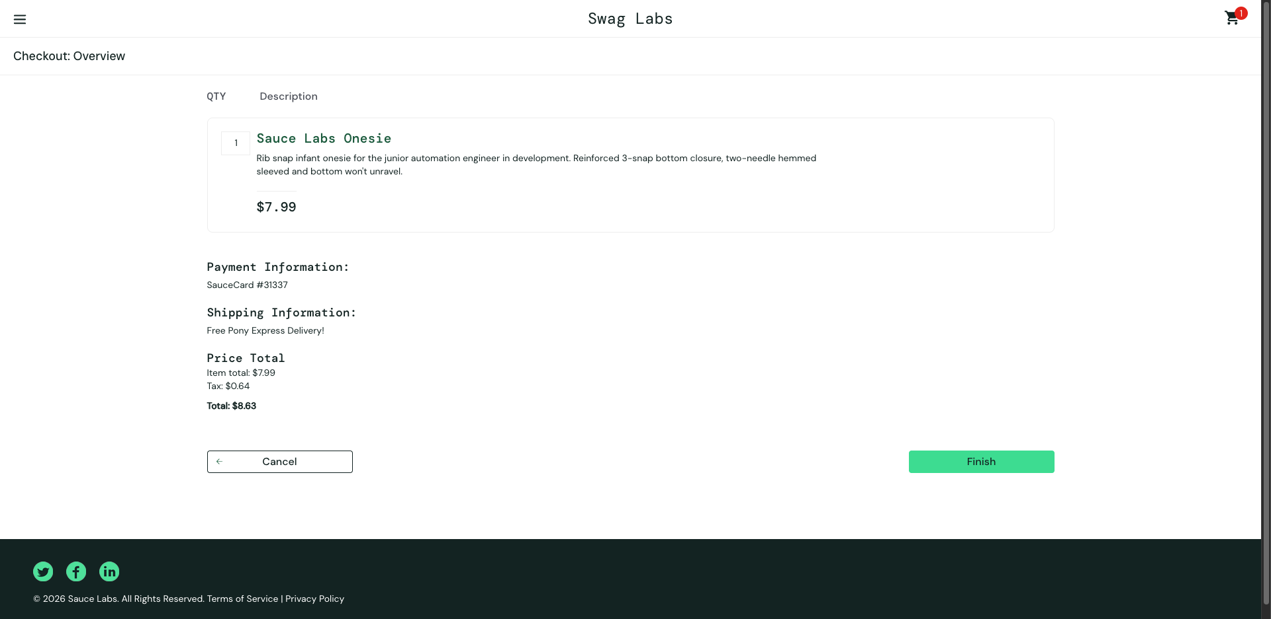
IMPLEMENTATION
Test execution and reporting
SauceDemo Automation Suite
Screenshot captured on failure
ExtentReports · 15 July 2026, 16:45
✓
loginTest
0.82 s
✓
invalidLoginTest
0.63 s
✓
loginUsingValidCredentialsTest
0.70 s
✓
loginUsingInvalidCredentialsTest
0.61 s
✓
loginUsingLockedUserTest
0.67 s
✓
logoutCorrectlyTest
11.19 s
✓
addingItemsToCartTest
0.86 s
✓
fillingCustomerInfoTest
1.08 s
The listener captures the browser state at the moment of failure and attaches it to the report. It obtains the driver by reflection over the test’s base class — the framework’s weakest point, acknowledged in the report rather than concealed, and recorded as future work.
✓
getThankYouMessage
1.06 s
✓
PingTest
1.52 s
✓
checkout
1.92 s
11 tests · 11 passed · 0 failed
⟦ Replace the left panel with your own screenshot of reports/ExtentReport.html — it renders fully styled when you open it locally. ⟧
SOUTENANCE DE PROJET DE FIN D’ÉTUDES – [ YOUR NAME ]
33
Notes:
Reporting goes through a TestNG listener, so no test class contains any reporting code — adding a test costs nothing in reporting effort.
On the left, the retained run: eleven tests, all passing. On the right, a screenshot the framework captured itself.
I'll be honest about the mechanism. The listener obtains the driver by reflection over the test's superclass — which works, but assumes a particular hierarchy. It's the framework's weakest point, and it's recorded as future work rather than hidden.

Slide 34
IMPLEMENTATION
Testing the generator itself
37
0
3
unit tests
browsers, networks or live sites required
stages covered: extraction, locator selection, code emission
A project about testing whose own generator is untested is in an awkward position. For most of this project, this one was.
Written against behaviour that has actually been wrong
that a data-qa element yields a data-qa selector;
that a card which is itself the interactive element is addressed directly;
that an apostrophe in page text does not produce a broken XPath literal;
that text differing between instances of a component names neither the method nor the locator.
SOUTENANCE DE PROJET DE FIN D’ÉTUDES – [ YOUR NAME ]
34
Notes:
A project about testing whose own generator is untested is in an awkward position, and for most of this project mine was. That's now corrected.
Thirty-seven unit tests cover the three stages that contain the logic. They run against small hand-written fixtures — no browser, no network, no live site. That matters for a specific reason: a failure is always a defect in this project rather than an outage somewhere else. CI runs them first, as a fast gate.
And they're written against behaviour that has actually been wrong, not against the implementation. Each defect I'm about to show you has a test named after the property it violated.

Slide 35
EXPERIMENTAL EVALUATION
6
EXPERIMENTAL EVALUATION
SOUTENANCE DE PROJET DE FIN D’ÉTUDES – [ YOUR NAME ]
35
Notes:
And now the measurements, which are the heart of this work.

Slide 36
EXPERIMENTAL EVALUATION
Experimental setup
Date of runs
31 July 2026
Reproducibility
Model
gemini-3.1-flash-lite
The rendered DOM both pipelines consumed was captured during the campaign and is retained, together with every generated artefact and the console telemetry.
Target page
SauceDemo inventory page (authenticated)
Scripts accompanying the report re-derive the element counts, the locator resolution, the compilability results and the digests from those files alone — no network, no model call.
Section scope, Pipeline A
Body region
Runs per pipeline
3, consecutive, no intervening change
Environment
JDK 17 · Chrome 150 · macOS
Scope, stated plainly: one page examined in depth, three runs per pipeline. Enough for categorical findings. Not enough for quantitative generalisation — and none is claimed.
SOUTENANCE DE PROJET DE FIN D’ÉTUDES – [ YOUR NAME ]
36
Notes:
One page, three runs per pipeline, same day, same environment, model identifier stated exactly.
The box on the right is what I'd most like noted. Everything both pipelines consumed and produced is retained, and the report ships with scripts that recompute the counts, the resolution, the compilability and the digests from those files alone, offline. Nobody has to take my word for any figure that follows.
And the red box, before you ask: one page in depth. Enough for categorical findings. Not enough for generalisation, and none is claimed.

Slide 37
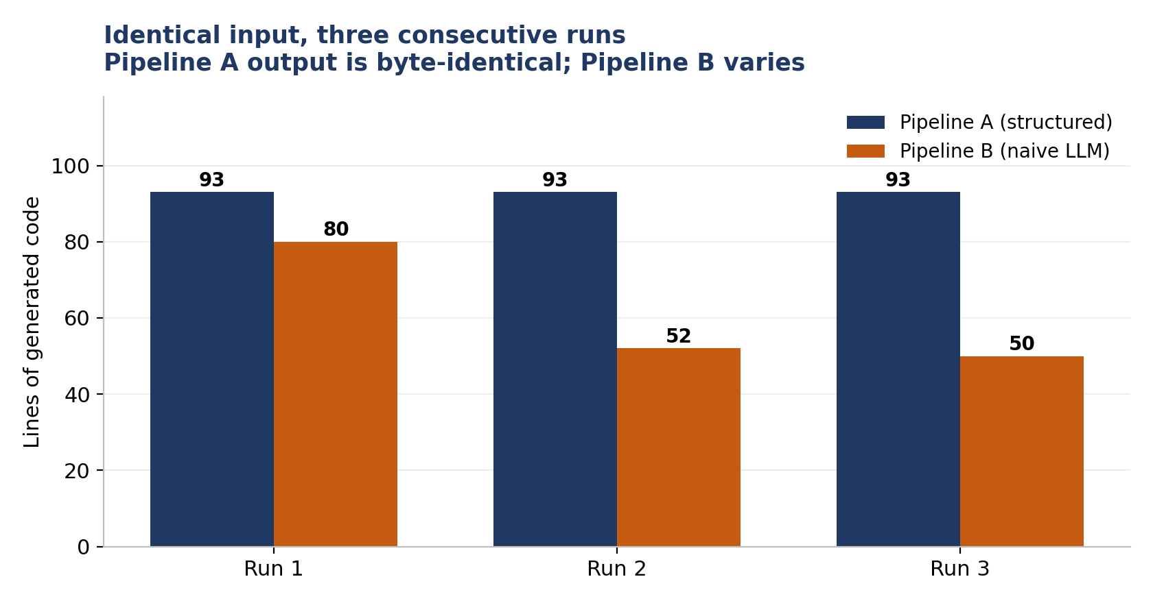
EXPERIMENTAL EVALUATION
Result 1 — determinism: the same command, run three times
Pipeline A
byte-identical
420c015a… · 420c015a… · 420c015a…
Pipeline B
all three differ
19ea0a03… · dedd5d21… · 65662d40…
The variation is not marginal: 80 / 52 / 50 lines of code, 11 / 17 / 17 declared fields — and run 2 declared a different package, so the artefact would land in a different directory on every regeneration.
Prompt tokens were identical on all three runs (13,115). The input did not vary. The output did.
SOUTENANCE DE PROJET DE FIN D’ÉTUDES – [ YOUR NAME ]
37
Notes:
Result one. Each pipeline run three times on the same page, nothing changed in between, outputs hashed after normalising the class name — the only difference between runs that is intended.
Pipeline A: the same digest three times. Byte-identical. Five artefacts of that page are retained and all five give that digest.
Pipeline B: three different digests. Not slightly different — eighty lines, then fifty-two, then fifty.
The detail I'd point at is the package declaration. Run two used a different package from runs one and three, so in a real project the generated file would land in a different directory each time you regenerate.
And the footnote matters: prompt tokens were identical on all three runs, which confirms the input genuinely did not vary. The variation is entirely on the output side.

Slide 38
EXPERIMENTAL EVALUATION
Result 2 — a Selenium method that does not exist
private final By inventorySidebarLink = By.dataTest("inventory-sidebar-link");
org.openqa.selenium.By declares exactly eight static factory methods. dataTest is not one of them.
11 ×
15 ×
3 / 3
1 / 3
occurrences, run 1
occurrences, run 2
Pipeline A compiles
Pipeline B compiles
Pipeline A cannot produce this defect. It writes By.cssSelector and By.xpath from a fixed template, over selectors observed in the document. There is no mechanism by which a non-existent method could enter its output. That is the difference between emitting code and predicting it.
SOUTENANCE DE PROJET DE FIN D’ÉTUDES – [ YOUR NAME ]
38
Notes:
Result two. The baseline invented a Selenium API. By.dataTest does not exist — the By class declares exactly eight static factory methods, and I verified that against the official javadoc rather than from memory.
Eleven occurrences in run one, fifteen in run two. Both artefacts fail to compile. Run three expressed the same intent correctly — which tells you it isn't that the model doesn't know how. It's that whether it knows varies between invocations.
Three of three compile for the structured pipeline; one of three for the baseline.
And the box at the bottom is the structural point rather than a scoreboard point. Pipeline A cannot make this mistake. Not "did not" — cannot. It writes By.cssSelector and By.xpath from a fixed template over selectors observed in the document. There's no code path by which a method that doesn't exist could enter its output.

Slide 39
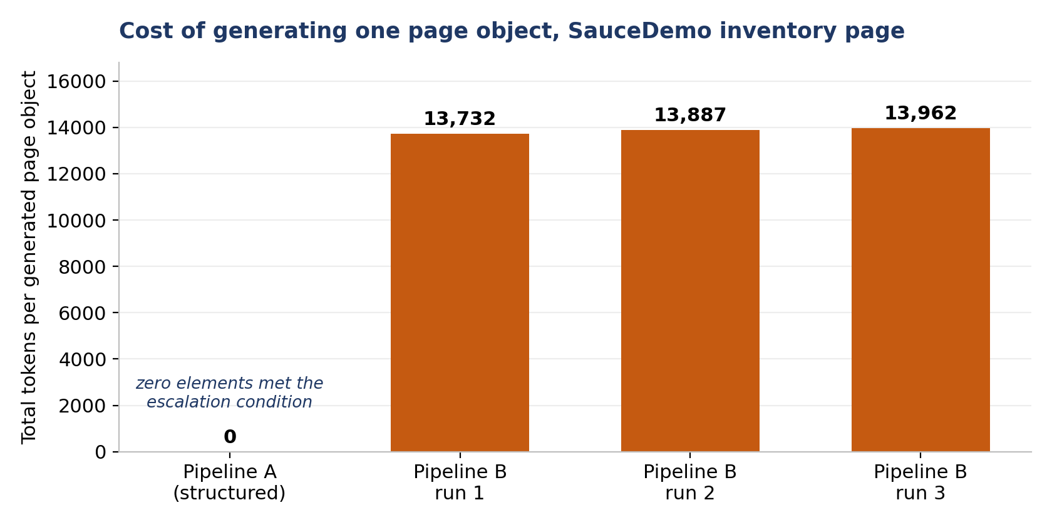
EXPERIMENTAL EVALUATION
Result 3 — cost scales with ambiguity, not with page size
0
13,732
tokens — Pipeline A
tokens — Pipeline B, one run
Pipeline A consumed nothing because the page yielded zero low-confidence selectors: every element was addressable by a test attribute or an id, so nothing met the escalation condition. This is the gate operating exactly as designed.
In currency. At the published price for this model, the three baseline runs cost $0.0042, $0.0044 and $0.0046 — $0.0132 together, against $0.00. Trivial for one page. But the baseline’s prompt cost is a function of document size and is paid on every regeneration, while Pipeline A’s would rise only if the page became less well instrumented. Two hundred page objects regenerated weekly is on the order of 140 million input tokens a year, against zero.
SOUTENANCE DE PROJET DE FIN D’ÉTUDES – [ YOUR NAME ]
39
Notes:
Result three, and this is where the gate pays off.
Pipeline A consumed zero tokens on this page. The reason is exactly the mechanism from the design chapter: zero low-confidence selectors, so nothing met the escalation condition, so no model call was made.
The baseline consumed 13,732 tokens for a single generation of the same page — about 13,100 of that just the HTML going up as prompt.
In money, three baseline runs cost about one and a third cents. I'd rather say plainly that's trivial for one page than dress it up. The point is the shape, not the size: the baseline's cost is a function of document size and is paid on every regeneration, while Pipeline A's would rise only if the page became less well instrumented.

Slide 40
EXPERIMENTAL EVALUATION
Result 4 — comparable coverage, different structure
Pipeline A
Pipeline B
3 page-level selectors, plus two component classes: a menu covering 4 items and a product card covering 6, each scoped to one card’s root element.
6 individually hard-coded methods — addBackpackToCart(), addBikeLightToCart() — one per product present at the moment of generation.
Indifferent to how many products exist.
The catalogue is encoded into the interface.
Add a seventh product and the baseline’s class is silently incomplete.
Remove one and it has a method that can no longer work.
The functional coverage is comparable. The structural quality is not.
SOUTENANCE DE PROJET DE FIN D’ÉTUDES – [ YOUR NAME ]
40
Notes:
Result four is about structure rather than counting.
Pipeline A produced three page-level selectors plus two component classes — a menu covering four items, a product card covering six. Pipeline B produced six individually hard-coded methods, one per product that happened to be on the page at that moment.
Functionally these are comparable; both let you add any product to the cart. Structurally they are not the same thing. The baseline encoded the shop's catalogue into the page object's public interface. Add a seventh product and the class is silently incomplete; remove one and there's a method that can no longer work.
Pipeline A's abstraction is indifferent to the number of products, because it addresses the repeating structure rather than its instances.

Slide 41
EXPERIMENTAL EVALUATION
Defects in my own pipeline
Reporting only the baseline’s defects would make this an advertisement rather than an evaluation.
public void clickAllItems() {
WebElement el = root.findElement(By.cssSelector("a.bm-item")); // root IS the a.bm-item
jsoup’s select() includes the element itself; Selenium’s findElement() searches descendants only. The generated locator searches inside an anchor for another anchor.
0 / 4
1 / 6
19 / 19
instances resolved — every call throws
a second defect: a component role named from one card’s product text
and the one baseline run that compiled had every locator correct
It was not caught during the campaign because no test ever executed that component. An artefact that compiles, reads correctly and is never run will not reveal a defect of this kind.
SOUTENANCE DE PROJET DE FIN D’ÉTUDES – [ YOUR NAME ]
41
Notes:
Now the part I care most about getting right.
If I showed you only the baseline's defects this would be an advertisement. So here are mine — and the worst defect found anywhere in this study is in my own pipeline.
The code on screen was generated by Pipeline A. It looks reasonable. It compiles. And it can never work: the repeating card is itself an anchor with class bm-item, and the locator searches inside that anchor for another anchor with the same class. The cause is a mismatch between two libraries — jsoup's select includes the element you call it on, Selenium's findElement searches descendants only. Zero of four instances resolve.
Why didn't I catch it? Because no test ever executed that component. It compiled, it read correctly, and nobody ran it. That is itself a finding, and an uncomfortable one for a project about testing.
And the number on the right cuts against me too: the one baseline run that compiled had all nineteen locators correct. So the claim narrows, and I think correctly — the deterministic layer is not better at reading markup. It is better at being reproducible while doing so.

Slide 42
EXPERIMENTAL EVALUATION
What the measurements support
Structure
Semantics
Which elements exist · how they repeat · how to address them durably
What a thing should be called · what an unfamiliar convention means
Better solved deterministically. Determinism buys reproducibility, traceability and zero marginal cost.
Where a language model contributes something rules cannot supply. It named things well, and inferred a convention unprompted.
click6Polo() getText5HM()
addBackpackToCart()
The two approaches fail in different places. Neither result is a verdict on language models — it is a boundary.
RQ1: yes, with one qualification. RQ2: decisively, on this page. RQ3: each dominates on different dimensions.
SOUTENANCE DE PROJET DE FIN D’ÉTUDES – [ YOUR NAME ]
42
Notes:
So what do the measurements support? Not "language models are unsuited to this". Something more specific: the task decomposes, and the two approaches fail in different places.
Pipeline A is strong on structure and weak on semantics — its own names show that better than I could argue it: click6Polo, getText5HM. Pipeline B is the mirror image. It named things well, and on the second site inferred the data-qa convention unprompted, which my pipeline could only do because I configured it to. And it produced code that doesn't always compile and never reproduces.
Taking the questions in order: RQ1, yes, with the qualification that two of my component locators didn't resolve. RQ2, decisively on this page. RQ3, each dominates on different dimensions — and that is the useful answer.

Slide 43
PERSONAL ASSESSMENT
Personal and professional assessment
Diagnostic reasoning
Every defect in Chapter V was traced to a root cause rather than patched at the symptom — including one where the cause turned out to be outside the DOM entirely.
Working against reality
Real sites, not fixtures. Every substantive defect was found that way, and none would have appeared on a tutorial page.
Measuring rather than asserting
Fixing a metric set before measuring, and reporting the results that went against my own system.
New technologies
Selenium, TestNG, jsoup, two CI platforms, and two model backends behind one interface.
⟦ Rewrite these four in your own words before the defence — the jury listens closely to this slide, and it must sound like you. ⟧
SOUTENANCE DE PROJET DE FIN D’ÉTUDES – [ YOUR NAME ]
43
Notes:
⟦ THIS SLIDE IS YOURS TO REWRITE. What follows is a starting point, not a script — the jury can tell, and this is the one moment where they're listening to you rather than to the work. ⟧
What I take away is mostly about method rather than technology.
The diagnostic habit is the biggest one. The password-dialog defect took several attempts, and what solved it was not another flag but realising the dialog was not part of the page at all — Selenium drives the DOM, and that dialog is browser chrome. I wouldn't have got there by trying more things.
Second, working against real sites rather than fixtures. Everything interesting I found came from a real page being messier than I expected.
And third, measuring rather than asserting. Fixing the metric set before running anything, then reporting the results that went against my own system, was uncomfortable and is the part of this work I'm most confident in.

Slide 44
PERSPECTIVES
Perspectives
Deterministic layer builds the skeleton → the model names and prunes it
The architecture neither pipeline implements — and the principal recommendation of this work
Why this is the right shape
Also next
The model receives a compact structured description, not raw markup — a fraction of the token cost.
Its output is names, not code — so a hallucinated method cannot enter the artefact at all.
The pipeline already knows exactly which names it could not derive.
Extend the campaign to the full six-page set, enabling quantitative rather than categorical claims.
Golden-file tests over whole saved pages.
Support for <select> through Selenium’s Select class — the one dimension where the baseline had broader coverage.
Self-healing locators at runtime.
SOUTENANCE DE PROJET DE FIN D’ÉTUDES – [ YOUR NAME ]
44
Notes:
The principal recommendation, and an architecture neither pipeline implements.
Use the deterministic layer to build the skeleton, then hand that skeleton to the model and ask for names and pruning.
Three reasons. The model gets a compact structured description instead of raw markup, so the cost collapses. Its output is names rather than code, so a hallucinated method physically cannot enter the artefact. And the pipeline already knows exactly which names it could not derive — that set is the natural thing to escalate.
It's the confidence gate applied one level up.

Slide 45
CONCLUSION
Conclusion
The boundary between the two approaches is the boundary
between structure and semantics.
A system that respects that boundary is better than either pure approach. Identifying where it falls — with measurements rather than assertion — was the objective of this work.
Pipeline A wins on
Pipeline B wins on
Determinism · cost · reliability · traceability · structural abstraction
Method naming · inferring an unfamiliar convention unprompted
Both produced defects. Both are reported.
SOUTENANCE DE PROJET DE FIN D’ÉTUDES – [ YOUR NAME ]
45
Notes:
To close.
The boundary between the two approaches turns out to be the boundary between structure and semantics. Structure is better handled deterministically, because determinism purchases three things a model cannot give you: reproducibility, traceability, and zero marginal cost. Semantics is where a model contributes something rules cannot supply.
Pipeline A won on determinism, cost, reliability, traceability and structural abstraction. Pipeline B won on naming, and on inferring a convention I had not told it about. Both produced defects, and both sets are reported at the same severity.
The result supports neither an endorsement nor a rejection of language models for this task. It supports a division of labour between them, along a line the measurements make visible.
Thank you for your attention. I'm happy to take your questions.

Slide 46
Merci pour votre attention
Questions
All artefacts, the measurement scripts and the evaluation workbook accompany the report.
Every figure in Chapter VI can be recomputed offline from the retained files.
SOUTENANCE DE PROJET DE FIN D’ÉTUDES – [ YOUR NAME ]
Notes:
Thank you.
Two questions I'd expect, with short answers ready.
"Your evaluation covers one page — why should I believe it?" Because the findings that rest on it are categorical, not statistical. Non-determinism, a hallucinated API, zero escalation cost — each established by direct observation. And the report never states a rate; it says "these three runs".
"You designed the metrics, built one of the systems, and did the measuring." Yes. Three constraints: the metric set was frozen before the campaign; the worst defect in the study is in my own pipeline and is reported at the same severity as the baseline's; and every artefact is retained with scripts, so anyone can recompute the numbers without trusting me.

Slide 47
BACKUP — DETAIL SLIDES FOR QUESTIONS
BACKUP — DETAIL SLIDES FOR QUESTIONS
SOUTENANCE DE PROJET DE FIN D’ÉTUDES – [ YOUR NAME ]
46
Notes:
Everything after this point is backup for questions. Do not present these.

Slide 48
BACKUP
All measurements, page P1
Metric | Pipeline A | Pipeline B
Determinism (3 runs) | byte-identical | all three differ
Compiles unmodified | 3 / 3 | 1 / 3
Prompt tokens | 0 | 13,115 per run
Output tokens | 0 | 617 / 772 / 847
Latency | no model call | 3,125 / 3,342 / 2,918 ms
Cost, 3 runs | $0.00 | $0.0132
Elements addressed (body scope) | 25 / 25 | —
Locators resolving | 5 / 7 → 7 / 7 after fixes | run 3: 19 / 19
API calls | 0 | 1 per run
Ground truth: 29 interactive elements page-wide; 26 in the body region, of which 25 are of the kinds the parser collects.
SOUTENANCE DE PROJET DE FIN D’ÉTUDES – [ YOUR NAME ]
47
Notes:
Backup: the full metric table for page P1.

Slide 49
BACKUP
Defect log — both pipelines, same severity scale
ID | Pipeline | Defect
D1 | B | Hallucinated By.dataTest — 11× run 1, 15× run 2. Neither compiles.
D2 | B | Non-deterministic output from identical input; three different digests.
D3 | B | type() called on a <select>; all three runs. A systematic error, not sampling noise.
D4 | B | Fabricated a locator and documented the guess in a comment.
D5 | B | A 503 from the model service destroyed a complete run, including the manual login.
D6 | A | Component role named from one card’s product text: 1 of 6 instances resolve.
D8 | A | Card that IS the interactive element searched inside itself: 0 of 4 resolve.
D9 | A | data-qa element emitted a [data-test=…] locator. Latent — never fired on either site.
D11 | A | No escaping of quotes in emitted XPath / Java literals. Latent.
D12 | B | When it compiled, all 19 of its locators were correct.
D8–D12 were found in a systematic post-campaign audit. All four Pipeline A defects have since been fixed, each with a regression test.
SOUTENANCE DE PROJET DE FIN D’ÉTUDES – [ YOUR NAME ]
48
Notes:
Backup: the full defect log.

Slide 50
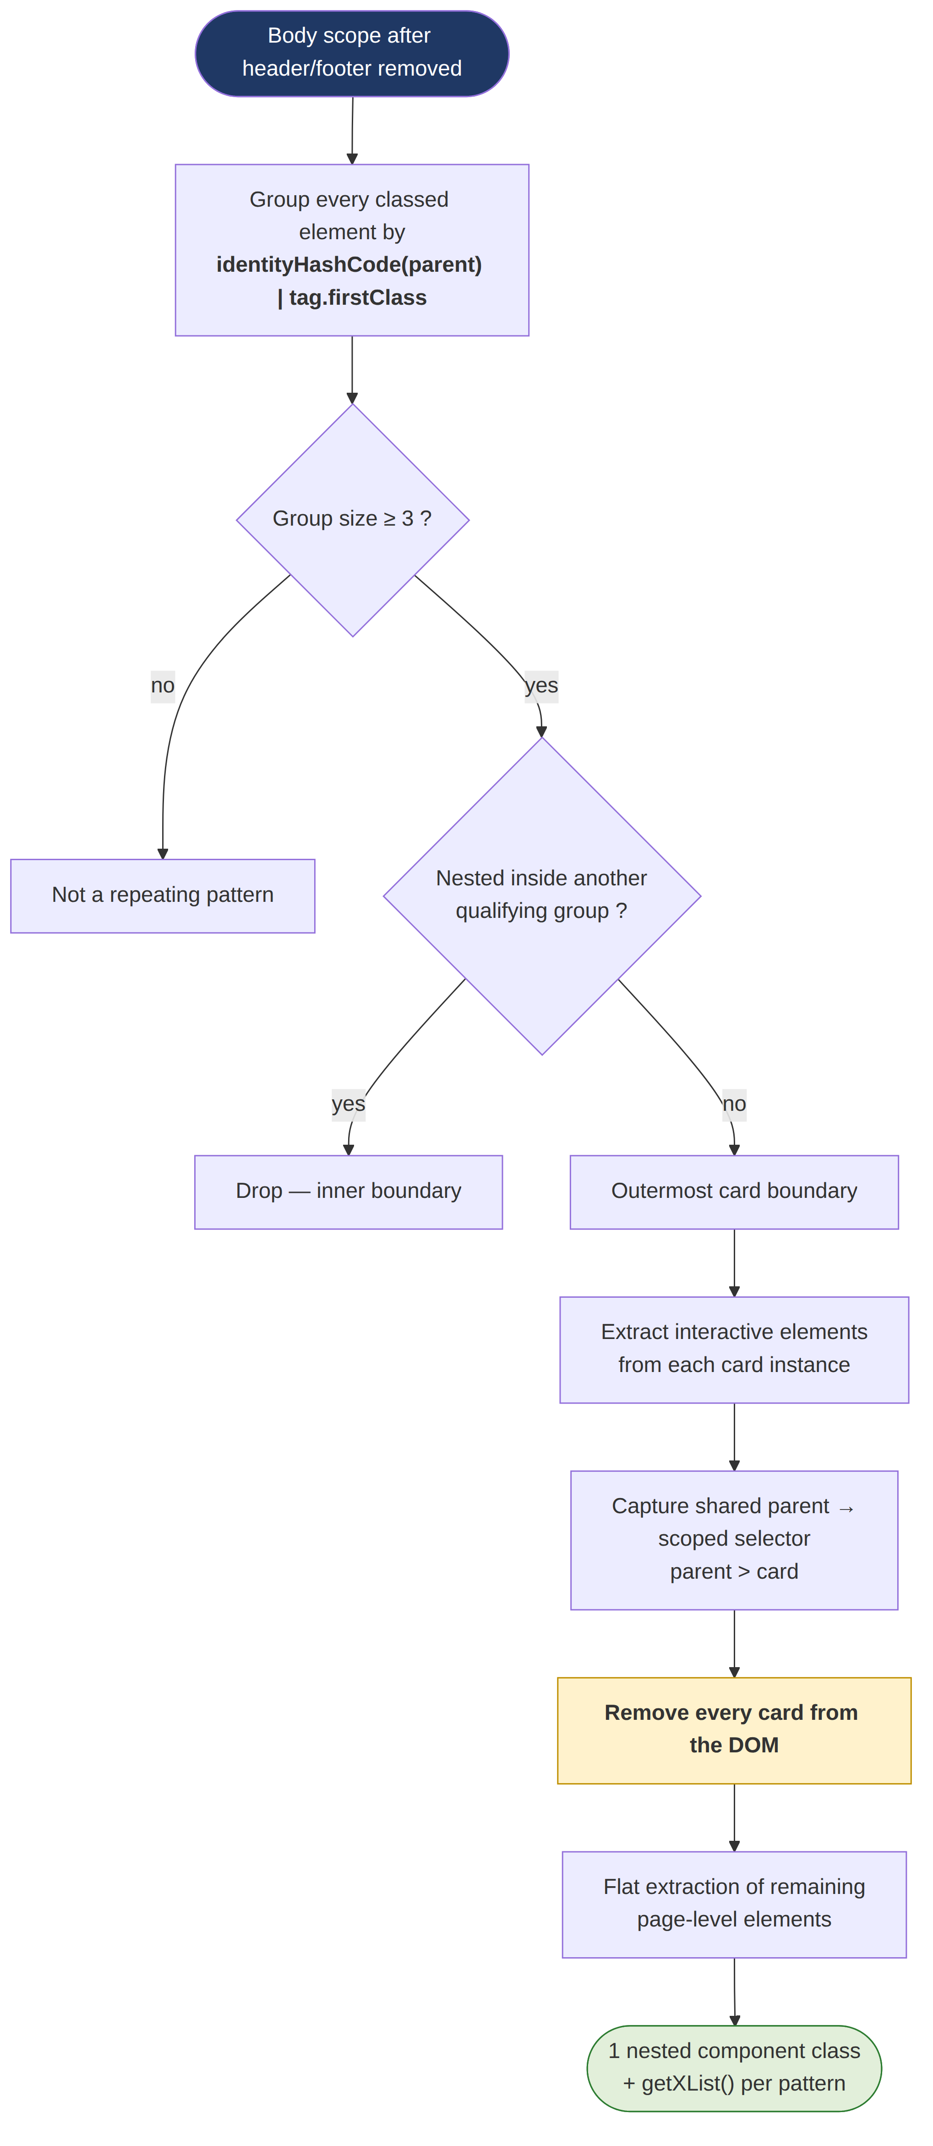
BACKUP
Repeated-component detection — activity diagram
SOUTENANCE DE PROJET DE FIN D’ÉTUDES – [ YOUR NAME ]
49
Notes:
Backup: the detection algorithm in full, if asked.

