Slide 1
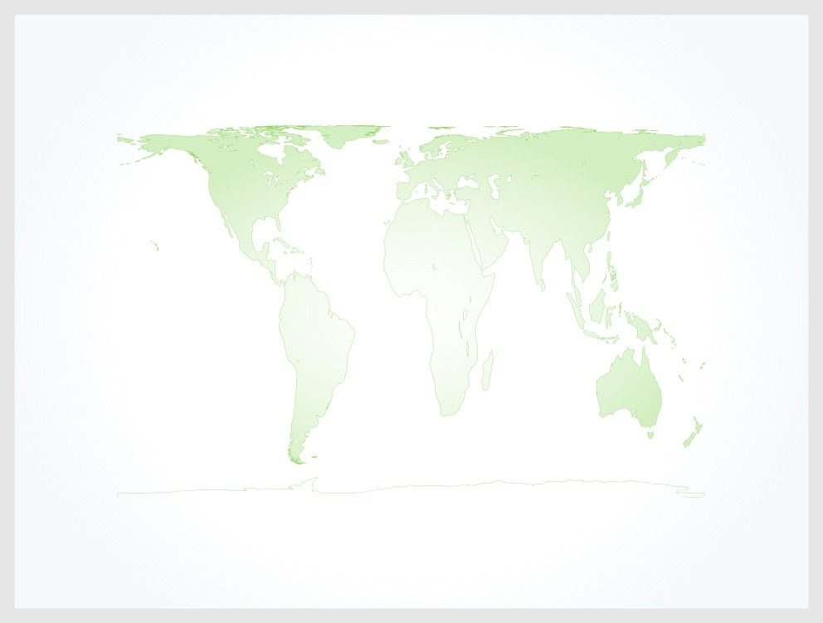
Gall-Peters Projection

Slide 2
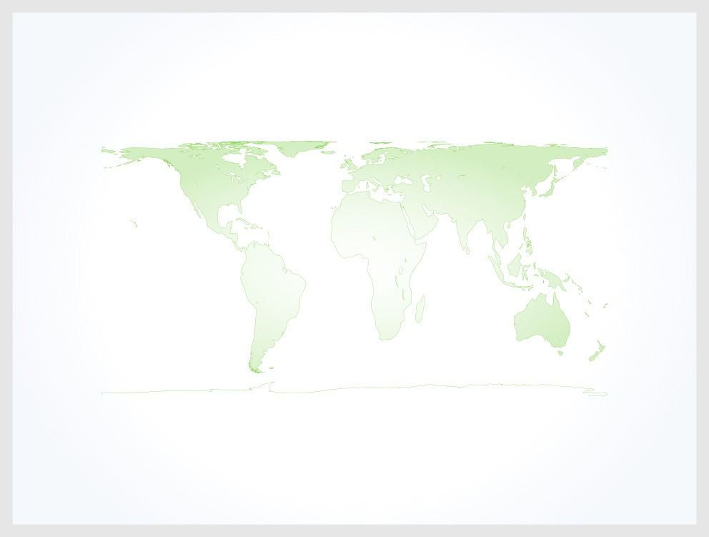
Hobo-Dyer Projection

Slide 3

Winkel-Tripel Projection

