Slide 1
BarcodeID
Machine learning vs phylogenetic trees for DNA barcode species identification
What happens when the species is not in the database?
European dragonflies and damselflies (Odonata) · COI barcodes from BOLD
Project team: Data & Phylogenetics · Machine Learning · Experiments & Report
Notes:
Introduce the project in one sentence: we compared a classic phylogenetic tree with machine-learning classifiers for identifying dragonflies and damselflies from DNA barcodes, and focused on what happens when the species is not in the reference database.

Slide 2
The question: which method can you trust?
A barcode is a ~650-letter piece of the COI gene. We identify a specimen by comparing it with reference barcodes of known species, but reference databases are never complete.
A
Condition A: full coverage
B
Condition B: incomplete coverage
Every test species is in the reference database. The usual benchmark.
Some species are removed from the database entirely, then queried as 'unknown'. This is our focus.
Fails safely: says 'unknown', or at least names the right genus
Fails dangerously: confidently names the wrong species
2
Notes:
Reference databases are never complete. Most studies only test species that are in the database. We test both: Condition A, every test species is in the database; Condition B, some species are removed entirely. A safe method says 'unknown' or at least the right genus. A dangerous method confidently names the wrong species.

Slide 3
Data: 779 clean barcodes of 45 species
4,477
779
45
30
raw BOLD records
(all European Odonata)
clean, unique
COI barcodes
species in 14 genera,
2 families
European countries
searched
1
2
3
4
5
6
Download
from BOLD
Keep COI-5P,
2 families
Remove
mislabels
Trim to
barcode
Remove duplicates
& outliers
≥ 3 sequences
per species
Libellulidae (skimmers) and Coenagrionidae (narrow-winged damselflies): many closely related species, so 'is this a close relative?' can be tested.
3
Notes:
Data came from BOLD Systems, the public barcode database. All Odonata was far too large, so we took two families with many close relatives, from 30 European countries. Cleaning was logged at every step: from 4,477 raw records to 779 clean, unique barcodes of 45 species. We removed mislabels, trimmed overlong sequences, removed duplicates and 7 likely contaminants, and kept species with at least 3 sequences.

Slide 4
Four methods, the same queries
NJ
kNN
RF
BCM
Neighbor-Joining tree
k-nearest neighbours
Random forest
Best close match
Build a tree of reference + query barcodes. Answer = the species in the smallest clade around the query.
Compare k-mer profiles; the 5 most similar reference barcodes vote.
500 decision trees learn which k-mer patterns point to which species.
Classic barcoding rule: species of the closest reference barcode (K2P distance).
Unknown? Only 'ambiguous' if that clade has several species
Unknown? If the nearest reference is too far away
Unknown? If its top probability is too low
Unknown? If the closest one is beyond a cut-off
k-NN and RF use k-mer frequencies (k = 4 and k = 6); 'unknown' thresholds are calibrated on training data only, accepting 95% of known species.
4
Notes:
Four methods, all given exactly the same queries. The NJ tree uses an explicit rule we fixed in advance; its only way to abstain is 'ambiguous'. k-NN and random forest use k-mer frequencies, the counts of short letter patterns, and get an 'unknown' threshold calibrated on training data only: flag a query when the model is less confident than for 95% of known species. Best close match is the classic barcoding rule from Meier et al. 2006, added to test whether any advantage is machine learning or just the cut-off.

Slide 5
Experiment: from one split to every species
1
2
3
4
Condition A
Condition B
3 more seeds
Every species once
70/30 split within each species
543 train · 236 test queries
8 species removed entirely
139 unknown queries
new splits and new
held-out species
each of 39 species held out
alone: no luck involved
Also: species-level confidence intervals and McNemar tests · thresholds at 90/95/99% · runtime on the same laptop
5
Notes:
Condition A: a 70/30 split within each species, 543 training and 236 test sequences. Condition B: one species per genus removed from training, 139 unknown queries. Then two robustness checks: three more random splits, and the strongest one, holding out every one of the 39 eligible species on its own, with a new tree and retrained models each time, so the result cannot depend on a lucky choice of species.

Slide 6
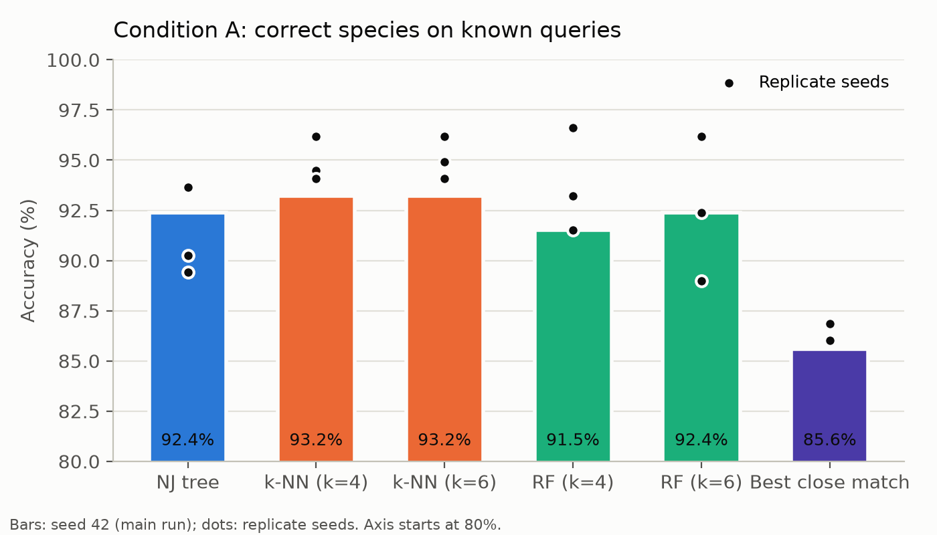
Known species: all methods are equally good
~92%
correct for the NJ tree, k-NN
and random forest (Condition A)
No significant difference between the tree and any classifier (Holm p = 1.0).
Their errors are all between species that share a barcode with a close relative. Best close match is lower: it answers 'ambiguous' for those.
6
Notes:
On species that ARE in the database, everything works about equally well: the NJ tree 92.4%, k-NN 93.2%, random forest 92.4%. The statistics say these differences are noise: Holm-corrected McNemar p = 1.0. The dots are the three replicate splits. Every remaining error is between species that share the same barcode.

Slide 7
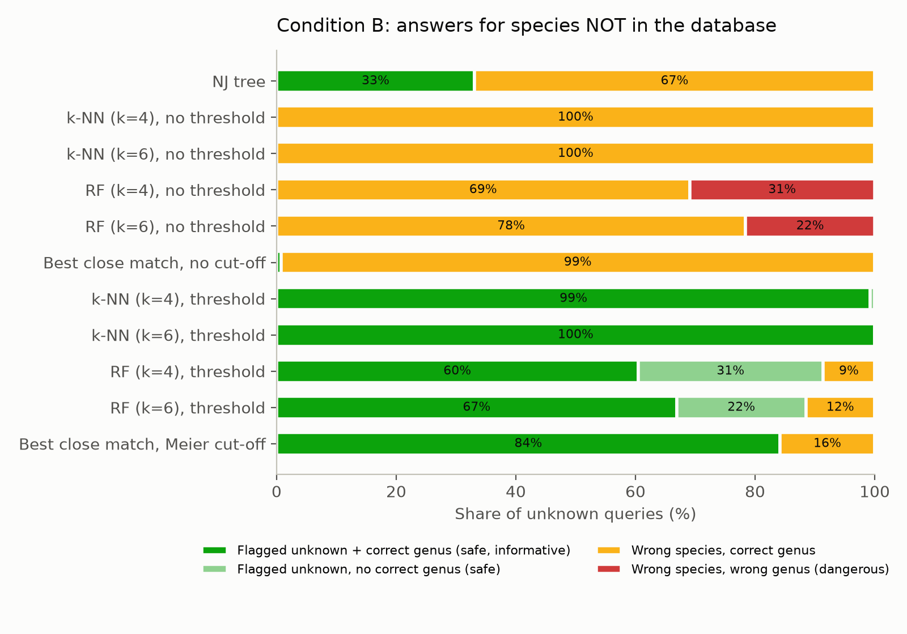
Unknown species: the methods split apart
67%
NJ tree: unknown species
given a wrong name
0%
k-NN with its threshold:
all flagged 'unknown'
Main run: 8 held-out species, 139 unknown queries
7
Notes:
Now the species is missing from the database. Read the colours: green is safe, yellow a wrong species in the right genus, red a wrong genus. The NJ tree named a wrong species for 67% of unknown queries. Without a threshold the classifiers always name a known species, and random forest even picks the wrong genus. With the calibrated threshold, k-NN flagged every unknown query and still gave the correct genus.

Slide 8
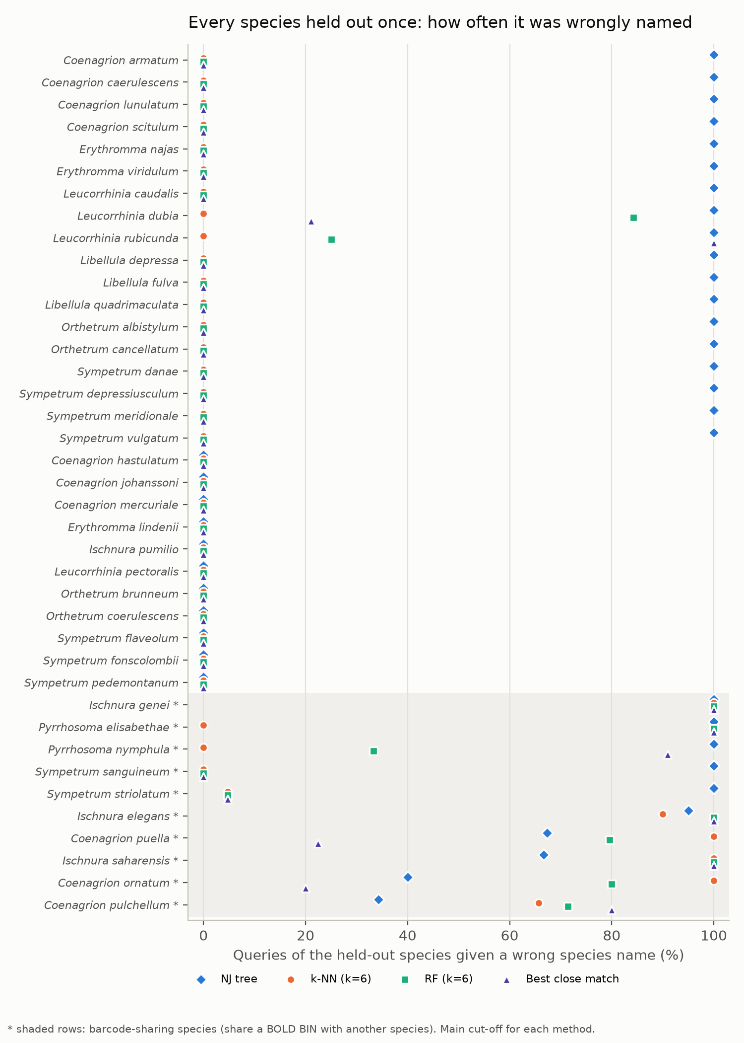
Every species held out once
All 39 species
67%
14%
NJ tree wrongly named
k-NN wrongly named
29 species without barcode sharing
62%
0%
NJ tree wrongly named
k-NN wrongly named
(correct genus 99%)
8
Notes:
Is that just a lucky choice of 8 species? We removed every one of the 39 eligible species on its own. Averaged over species, the tree wrongly named the missing species 67% of the time, k-NN 14%. For the 29 species that do not share their barcode, k-NN never named a wrong species, not for a single query, and still gave the correct genus 99% of the time. The tree even put two species into the wrong genus.

Slide 9
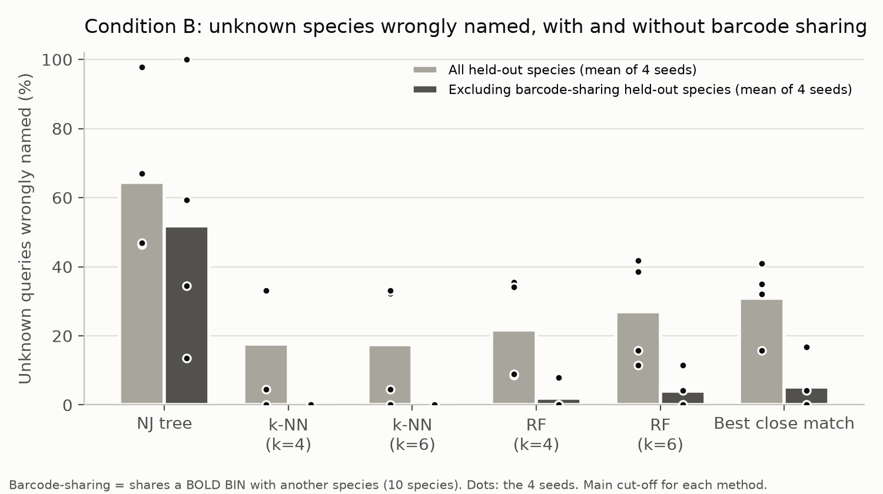
Why methods fail: shared barcodes
10 species share a BOLD BIN with a close relative (e.g. Coenagrion puella and C. pulchellum).
Without them, k-NN made no false identifications in any run.
With them, every method fails often across the 4 runs (k-NN up to 72%, NJ up to 100%).
9
Notes:
Why do even the good methods sometimes fail? 10 species share their barcode with a close relative; BOLD puts them in the same BIN. If a missing species looks exactly like one in the database, no method using the barcode alone can tell it is missing. Remove those species and the failures of k-NN disappear completely. This is a limit of the barcode, not of the method.

Slide 10
Where does the safety come from?
Best close match
k-NN
The safety comes from the cut-off, not from machine learning itself.
What k-NN adds: far fewer losses on known species: its vote among five neighbours resolves near-ties that the plain distance rule calls 'ambiguous'.
Condition B, main run.
same cut-off as k-NN
calibrated cut-off
100%
100%
unknown species flagged
unknown species flagged
77%
88%
known species still correct
known species still correct
10
Notes:
Is it machine learning that makes k-NN safe? We tested the classic best-close-match rule with the same kind of cut-off: it also flagged 100% of unknown species. So the safety comes from having a calibrated distance cut-off. What k-NN adds is that it loses fewer known species at the same safety: 88% correct versus 77%.

Slide 11
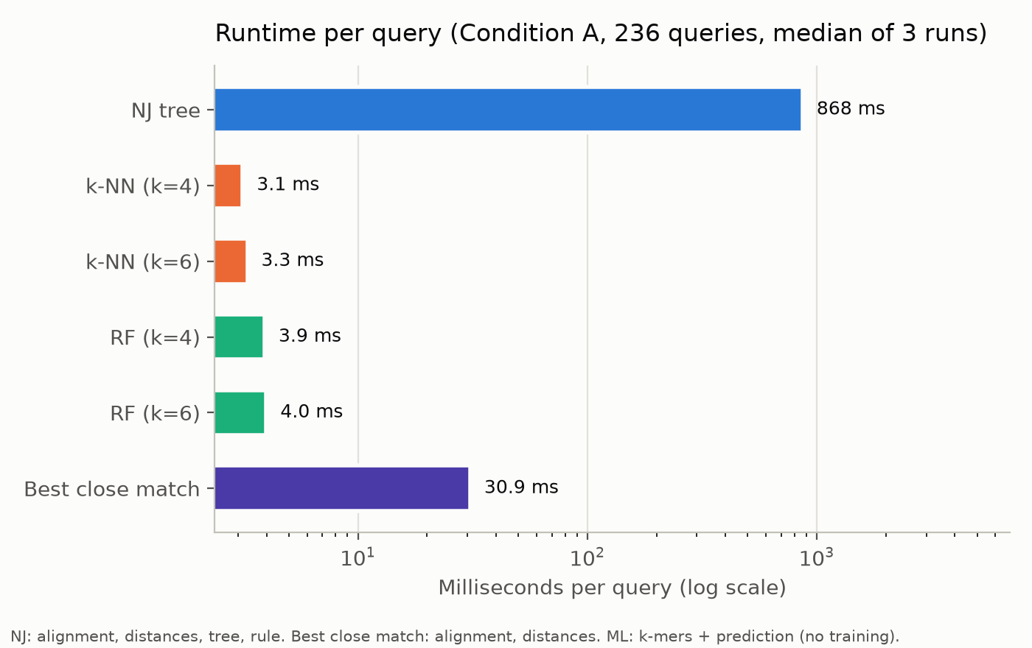
Speed: about 260 times faster
264×
faster per query:
k-NN vs the NJ tree
NJ: 868 ms per query, and the whole tree must be rebuilt for new queries.
k-NN: 3.3 ms per query after ~1 second of training.
11
Notes:
Speed, measured on the same laptop for the same 236 queries: the tree pipeline takes 868 ms per query, k-NN 3.3 ms, about 264 times faster. The tree has no training, but it must be rebuilt with all reference barcodes whenever new queries arrive, and that cost grows steeply with the database. Training a classifier takes about one second.

Slide 12
Limitations
1
One group, one gene
2
Small dataset
Two European Odonata families, COI only, BOLD data of 9 Oct 2026.
779 sequences of 45 species; some species have only 3.
3
Barcode sharing
4
Tree not fully like-for-like
10 species can't be separated by any barcode-only method.
NJ had no extra 'unknown' threshold; one tree for all queries.
12
Notes:
Be honest about the limits. One group, one gene, one region. A small dataset. Barcode sharing that no barcode-only method can solve. And the comparison is not perfectly like-for-like: we gave the tree no extra 'unknown' threshold, on purpose, to test the method as usually applied. A distance threshold on the tree could make it safer.

Slide 13
Conclusion
Machine learning matched the tree on known species (93% vs 92%) but wrongly named unknown species over four times less often (14% vs 67%, 39 species) and was ~264× faster.
Use a distance-aware method with a calibrated 'unknown' threshold, not a species name read off a tree.
Report barcode-sharing groups at genus level: no barcode-only method separates them.
Questions?
13
Notes:
Our one-sentence answer, and the practical advice: for identification, use a distance-aware method with a calibrated 'unknown' threshold, such as k-NN, rather than reading a species name off a tree; report barcode-sharing groups at genus level. Then invite questions.

