Slide 1


Slide 2

EduNexus
Virtual Classroom Reminder App
CS519
Associate Degree Program (ADP)

Slide 3
Introduction
Name: Hafiz Muhammad Hammad
VU ID: BC230209354

Slide 4

INTRODUCTION OF PROJECT
EduNexus is a web-based Virtual Classroom Reminder App designed to enhance productivity and time management.
It enables teachers and students to set, manage, and receive notifications for classroom activities.
The project aims to simplify scheduling and improve communication in educational settings.

Slide 5
INTRODUCTION OF PROJECT
Project Objective
To assist users in effectively managing assignments, exams, and events.
To provide a responsive and user-friendly platform for setting and tracking reminders.

Slide 6
INTRODUCTION OF PROJECT
Key Features
User Management: Secure user registration and authentication system.
Dashboard: Displays categorized reminders (Upcoming, Completed, Overdue).
Reminder Management: Create, edit, assign, and delete reminders.
Notifications: Timely alerts via email or in-app notifications.

Slide 7
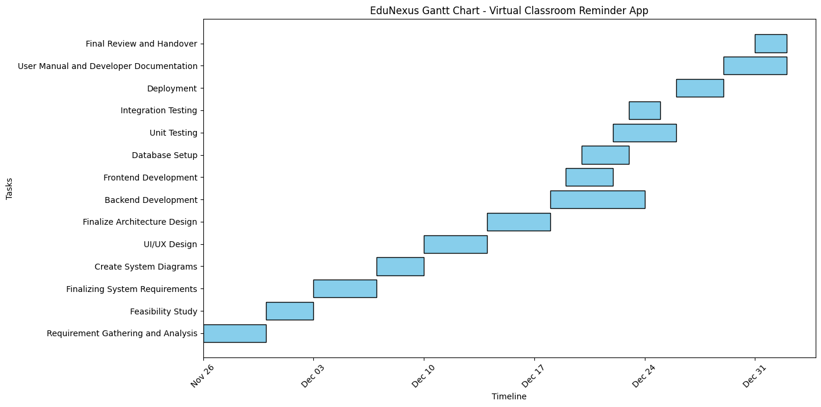
Project Schedule

Slide 8
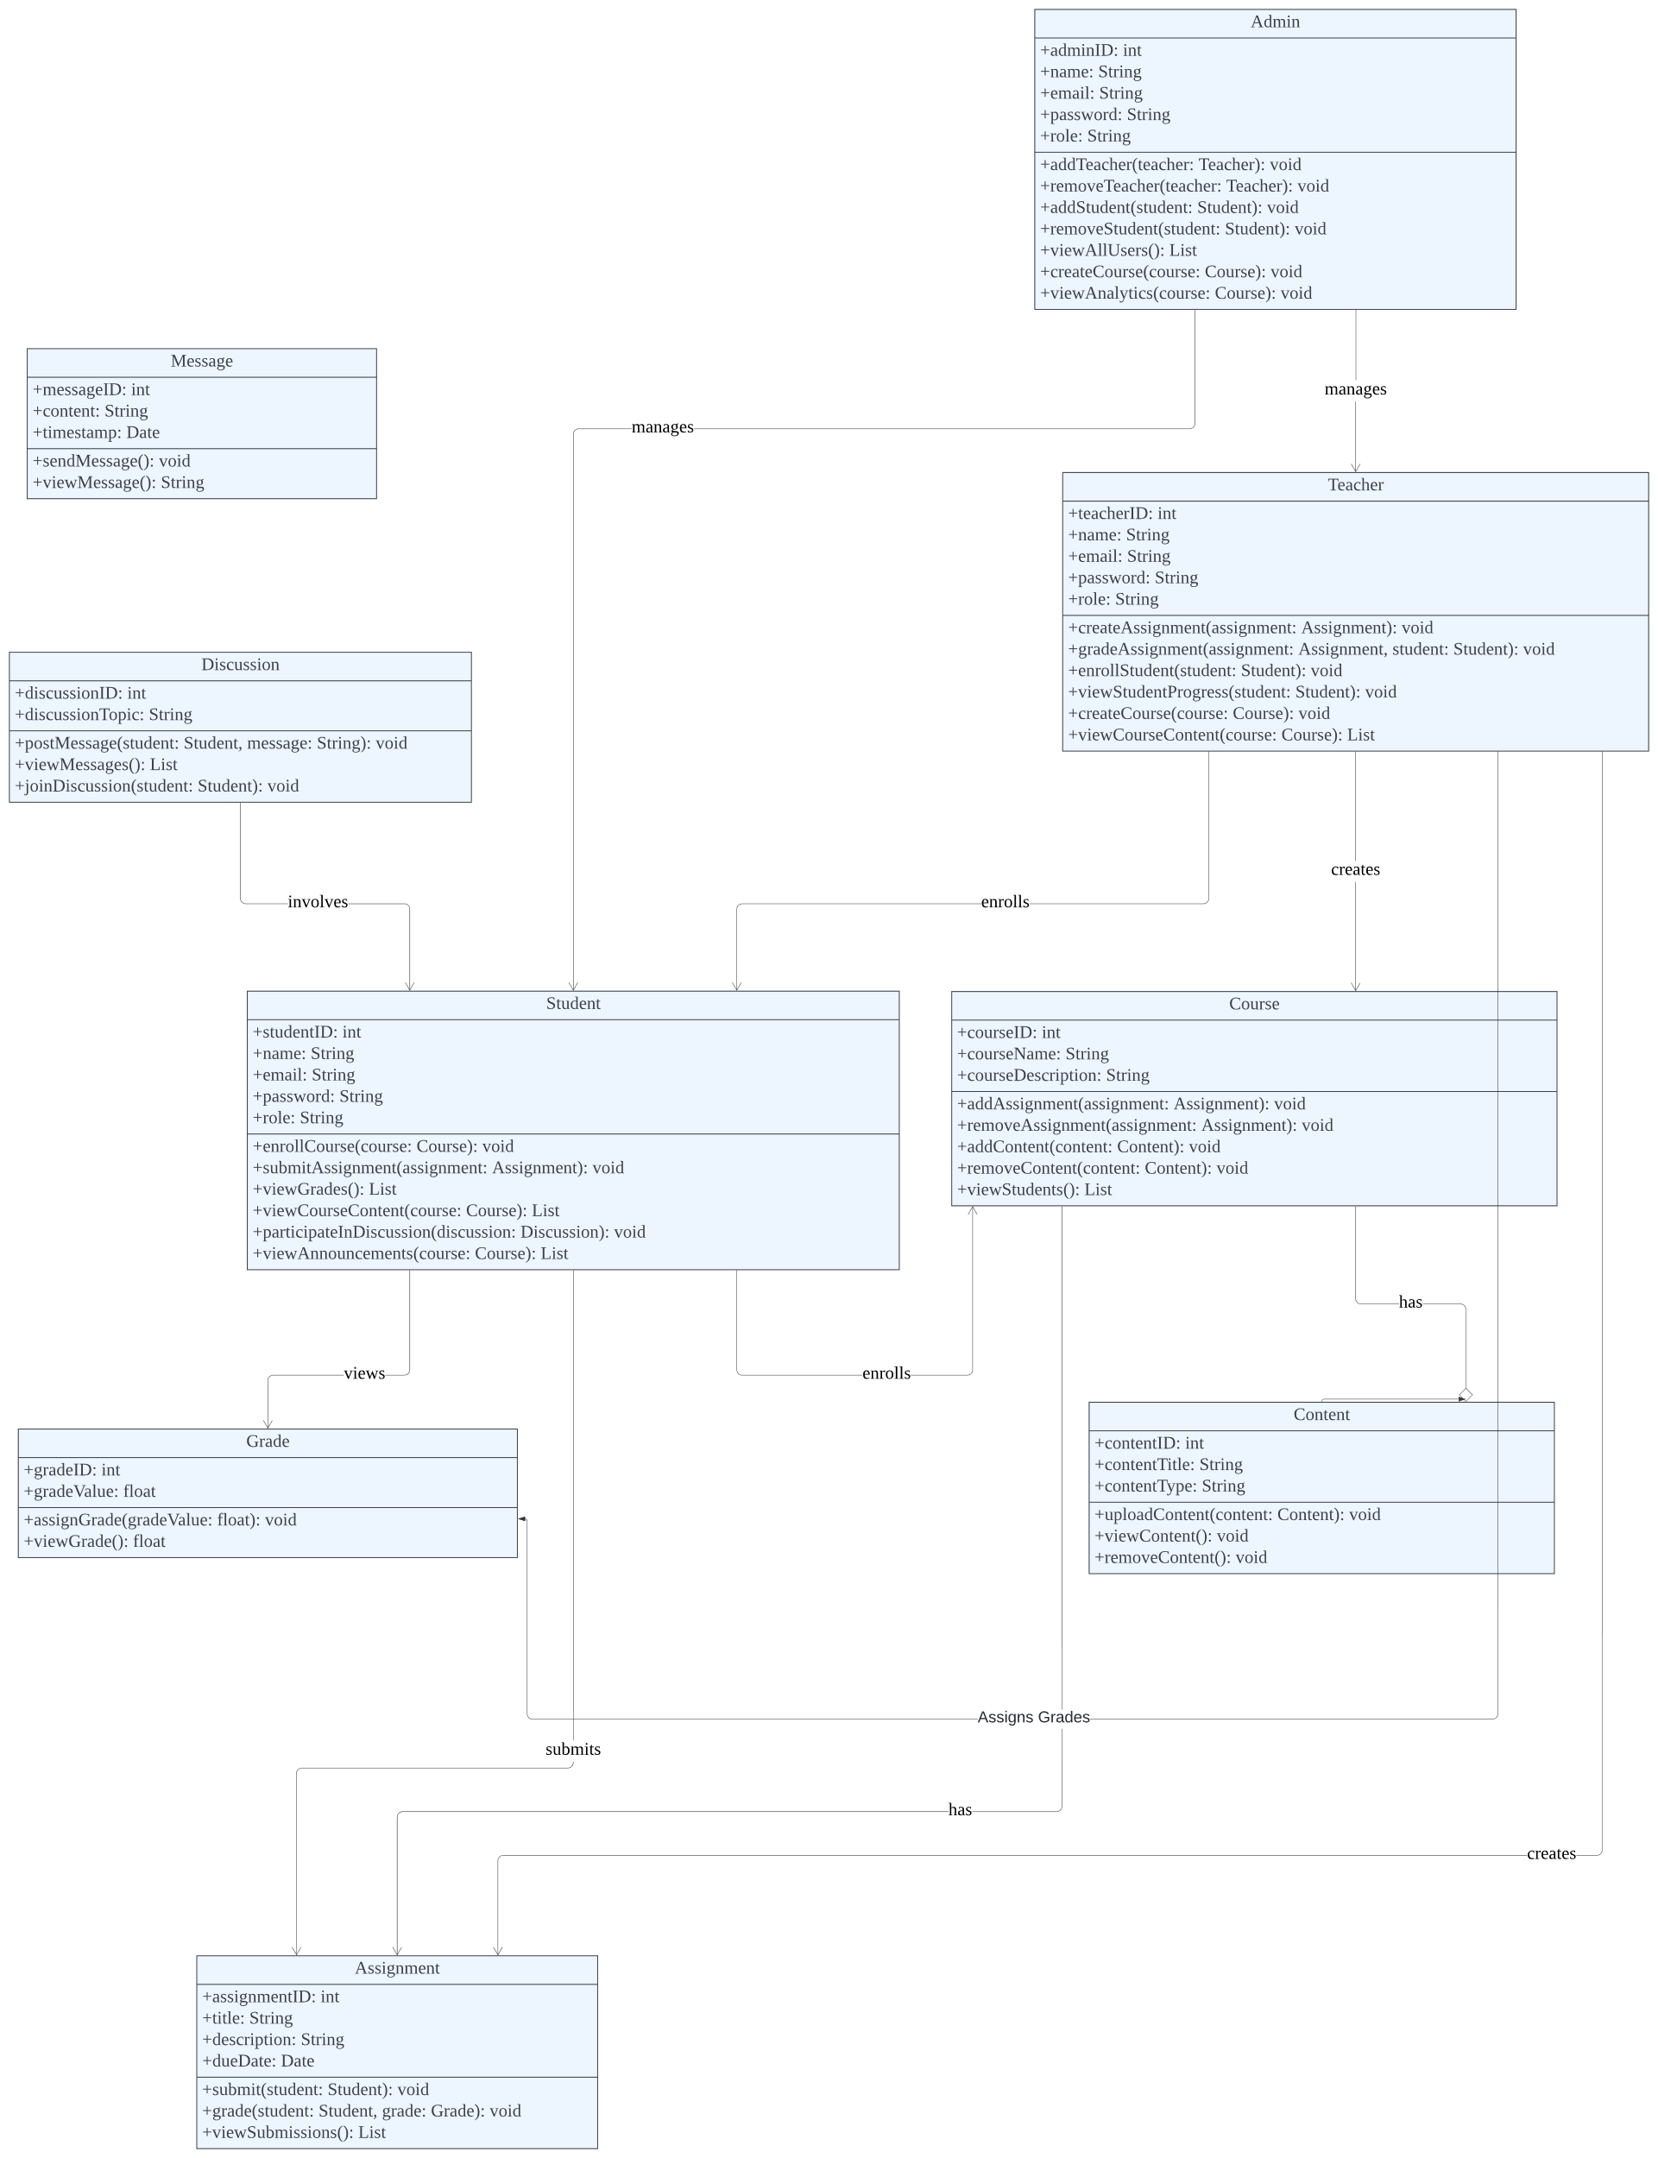
Use Case Diagram
Notes:
Can be zoomed in

Slide 9
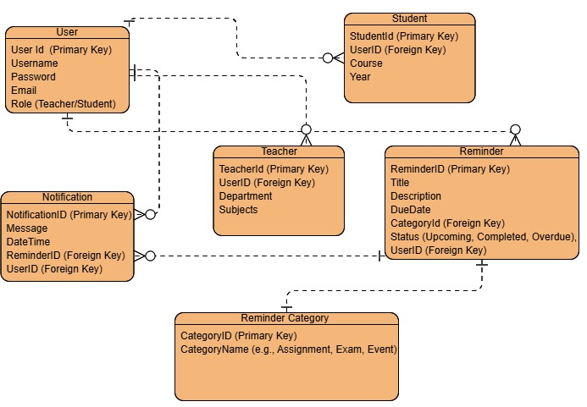
Entity-Relationship Diagram

Slide 10
Relational Schema
User Table
Field Name | Data Type | Constraints
UserID | INT | PRIMARY KEY, AUTO_INCREMENT
Name | VARCHAR | NOT NULL
Email | VARCHAR | UNIQUE, NOT NULL
Password | VARCHAR | NOT NULL
Role | ENUM | NOT NULL (Teacher/Student)
Reminder Table
Field Name | Data Type | Constraints
ReminderID | INT | PRIMARY KEY, AUTO_INCREMENT
Title | VARCHAR | NOT NULL
Description | TEXT
DueDate | DATETIME | NOT NULL
Category | ENUM | NOT NULL (Assignment/Exam/Event)
UserID | INT | FOREIGN KEY REFERENCES User(UserID)
Notification Table
Field Name | Data Type | Constraints
NotificationID | INT | PRIMARY KEY, AUTO_INCREMENT
Message | TEXT | NOT NULL
SentDate | DATETIME | NOT NULL
ReminderID | INT | FOREIGN KEY REFERENCES Reminder(ReminderID)
UserID | INT | FOREIGN KEY REFERENCES User(UserID)
Assignment Table
Field Name | Data Type | Constraints
AssignmentID | INT | PRIMARY KEY, AUTO_INCREMENT
Title | VARCHAR | NOT NULL
Details | TEXT
DueDate | DATETIME | NOT NULL
TeacherID | INT | FOREIGN KEY REFERENCES User(UserID)
Student Assignment Table
Field Name | Data Type | Constraints
StudentAssignmentID | INT | PRIMARY KEY, AUTO_INCREMENT
AssignmentID | INT | FOREIGN KEY REFERENCES Assignment(AssignmentID)
StudentID | INT | FOREIGN KEY REFERENCES User(UserID)

Slide 11
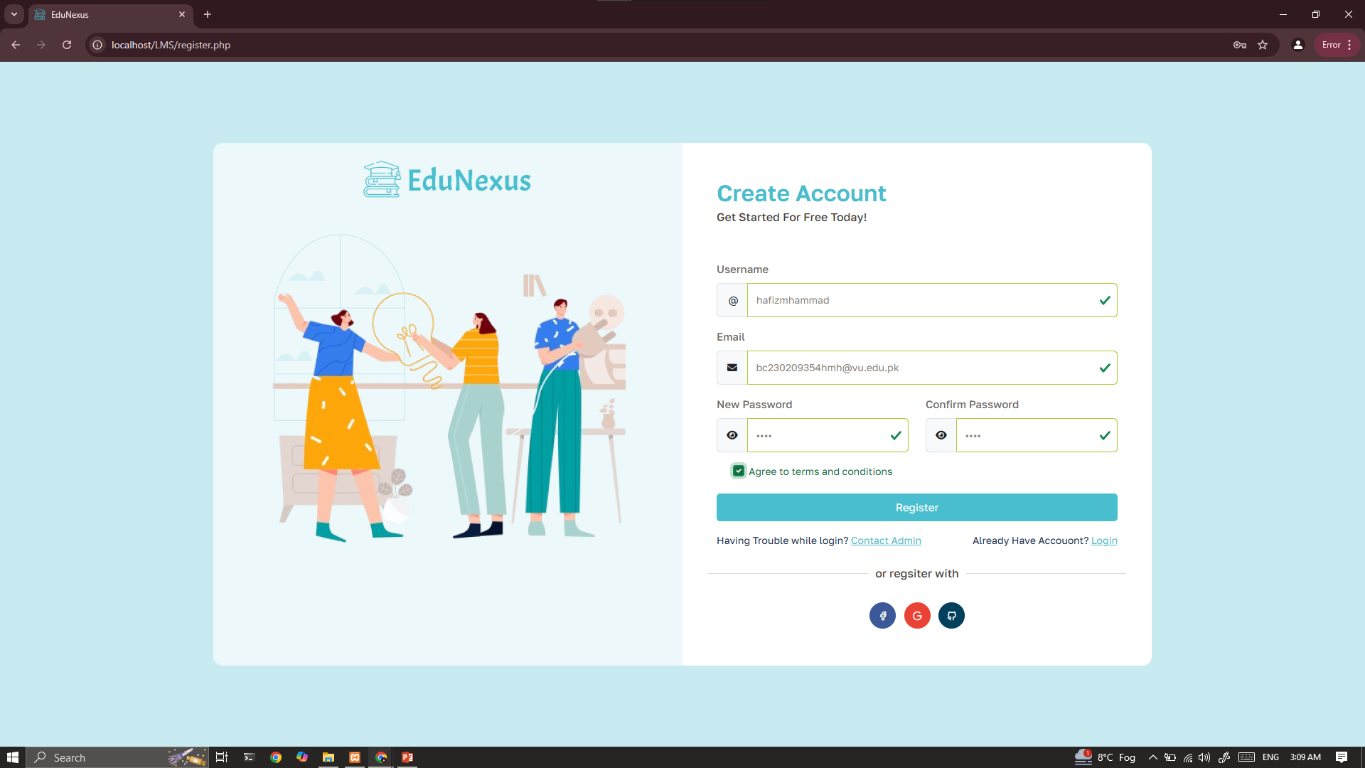
User Interfaces

Slide 12
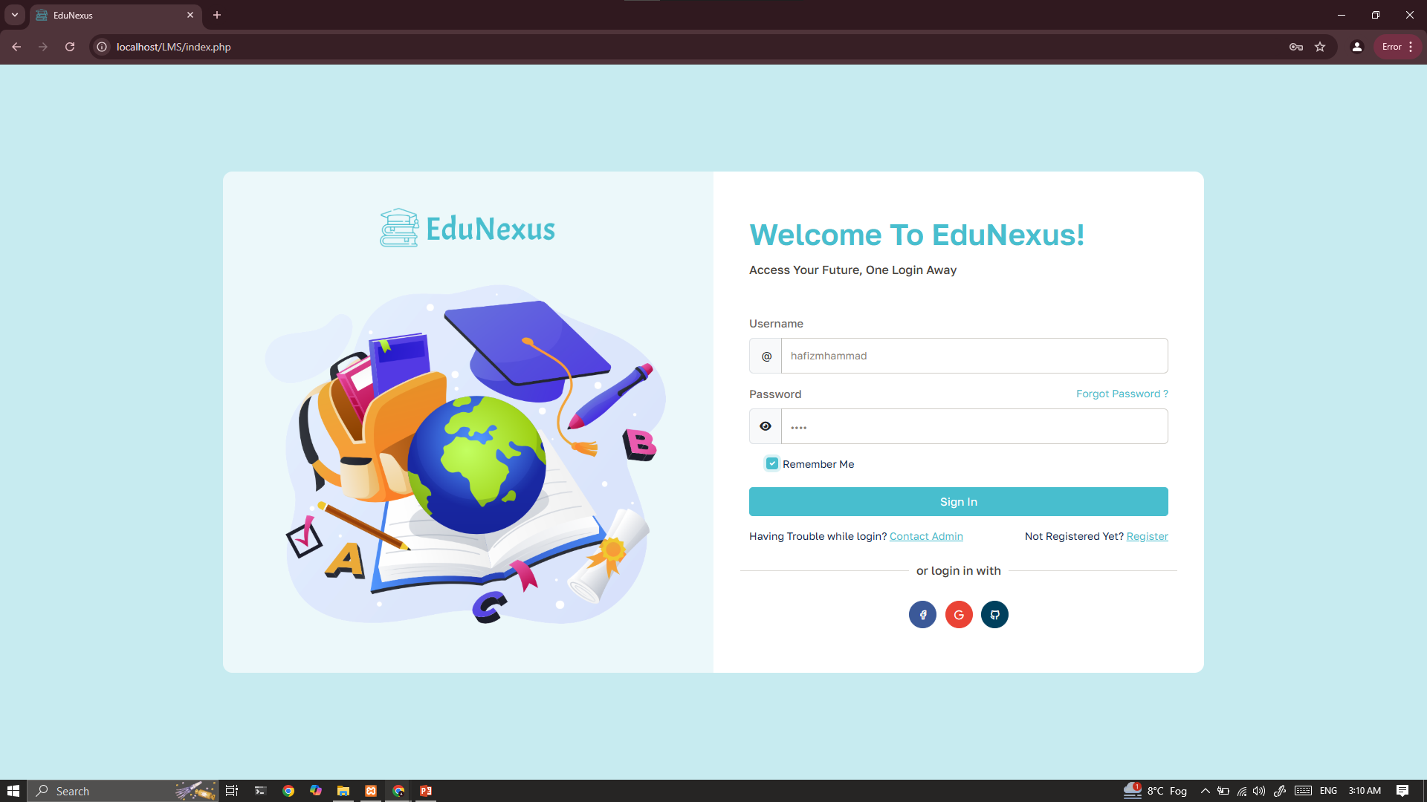
User Interfaces

Slide 13
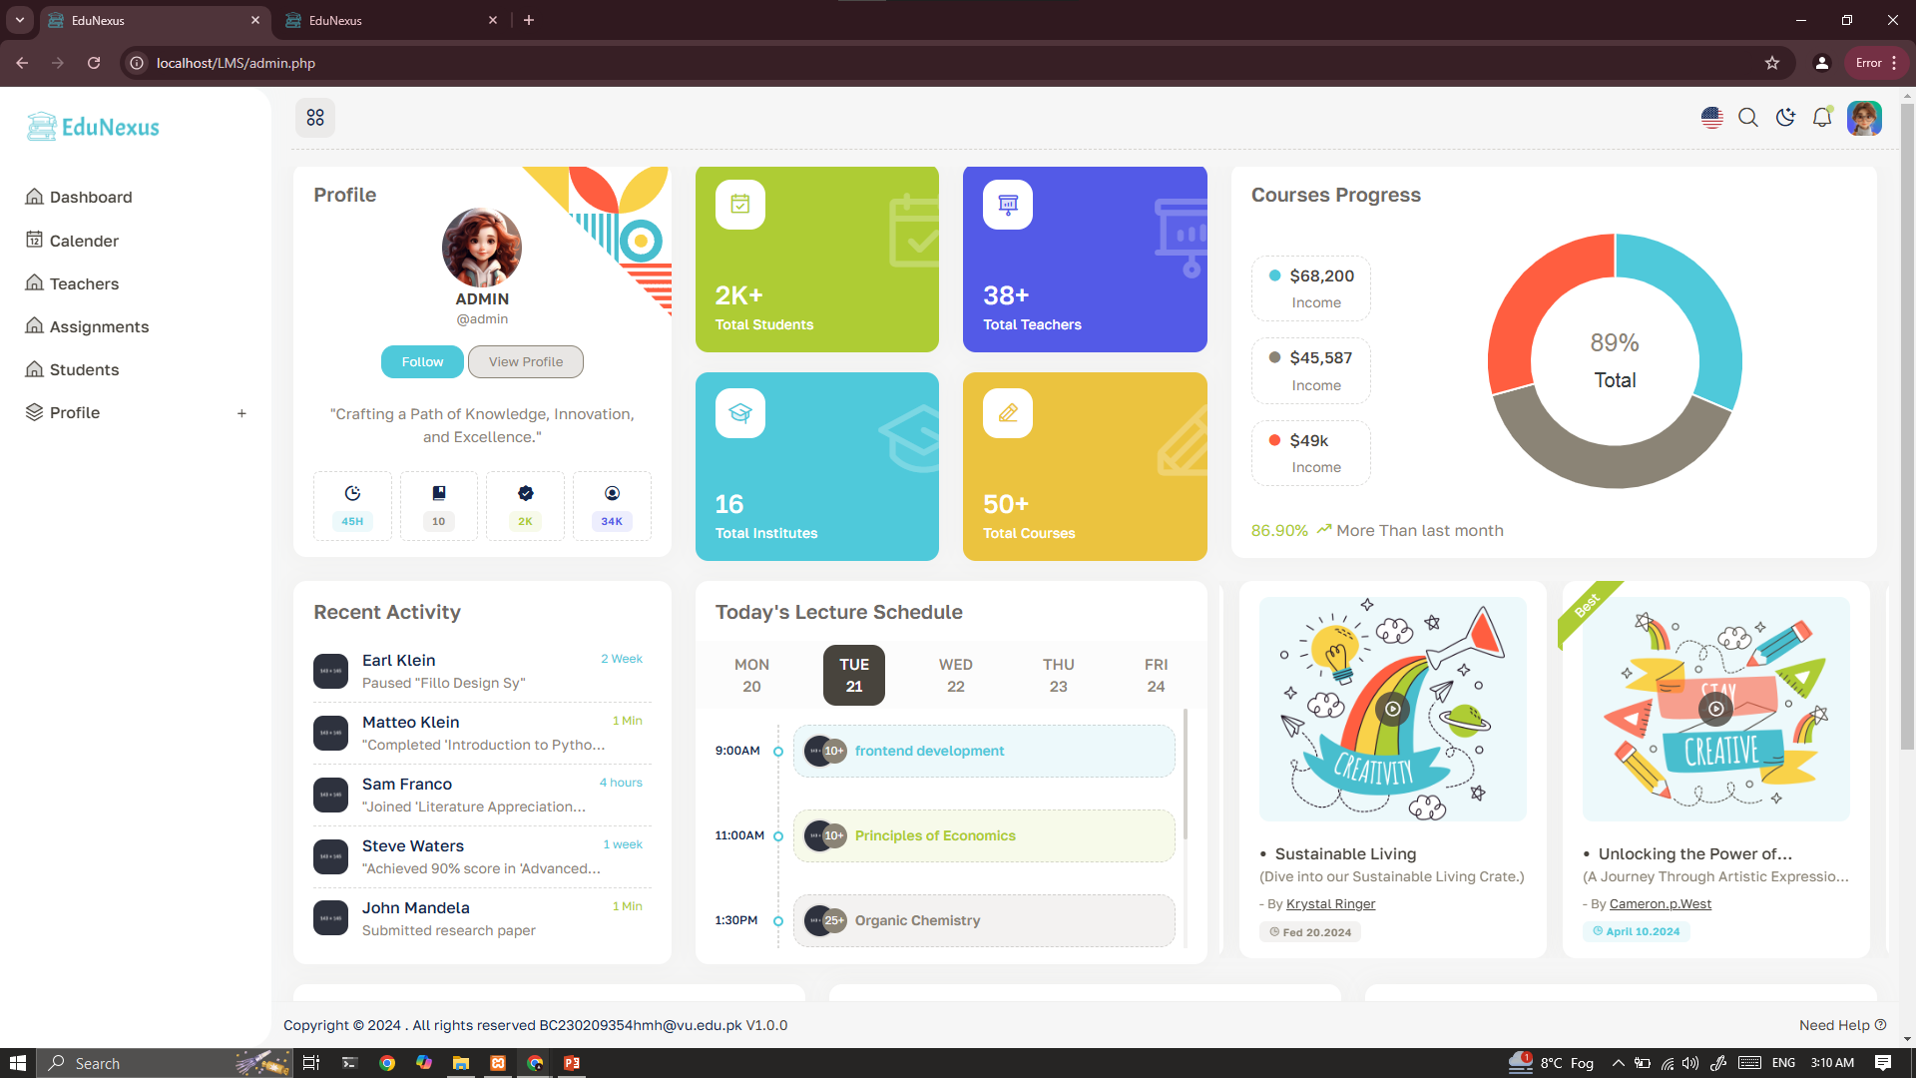
User Interfaces

Slide 14
Results
Provide here the screen shots of results which are generated after applying database queries.

Slide 15
Tools
Front-End Technologies:
HTML:
To prepare structure of web pages (e.g., headers, paragraphs, links, forms, etc.). And provide the basic layout and content.
CSS:
To style the structure to make the web pages look appealing. And Is responsible for color schemes, fonts, spacing, and responsive layouts.
JavaScript:
To add interactivity to the site (e.g., dynamic course lists, real-time form validation).

Slide 16
Tools
Back-End Technologies:
PHP:
Server-side scripting for handling logic such as user authentication, course creation, and assignment management.
To handle form submissions, database queries, and dynamic page rendering.

Slide 17
Tools
Database and Server:
XAMPP:
Local server environment used to run the PHP code, MySQL database, and Apache server on the computer.
To include MySQL for storing course information, assignments, grades, etc.
Apache (To be integrated in future versions):
Web server that processes the PHP code and serves the website to the user. And to handle HTTP requests and serves content.

Slide 18
Thank you

