Slide 1






TRAVEL MANAGEMENT SYSTEM
DATABASE PROJECT

Slide 2



PRESENTERS
SYEDA HUMAIMA BUKHARI
ZAINAB
ASIF
HAFSA KHURRAM

Slide 3


PROJECT OVERVIEW
Admin Dashboard
User login
Admin

Slide 4
PROJECT OVERVIEW
Hotel
Reservation
Travel Packages
Bus Reservation

Slide 5


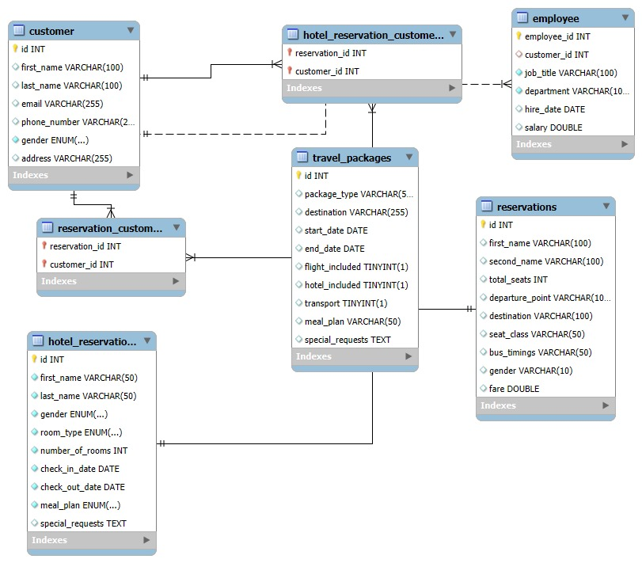
EERD

Slide 6

FUNCTIONALITIES
Booking management
Travel packages
Admin
  Admin can view approve or cancel customer bookings.
  Admin can create Edit and delete travel packages.
  Create update and manage travel packages.

Slide 7




THANK YOU!

