Slide 1

Predicting Customer Churn at SyriaTel

Slide 2
Agenda
Business Context
Data Understanding
Key Insights
Business Impact & Recommendation
Next steps & Improvement

Slide 3

Business Understanding What is Customer Churn and Why Should We Care?
Customer churn occurs when a customer cancels their services or switches to another provider. For Syriatel, this represents a serious threat to profitability and long-term sustainability. In the highly competitive telecommunications industry, where churn rates typically range from 15% to 25%, churn is one of the most critical performance metrics to monitor and reduce.
Retaining customers is a central part of Syriatel’s strategy. This is because it is significantly more cost-effective to keep existing customers than to acquire new ones. Research shows that acquiring a new customer can be 5 to 10 times more expensive than retaining an existing one.
Syriatel is one of Syria’s leading telecommunications providers, offering mobile and data services to millions of customers across the country. However, due to the competitive nature of the industry, retaining customers is increasingly challenging. To maintain its market position and continue delivering high-quality services, Syriatel must find effective ways to understand and reduce customer churn.
The objective of this project is to analyse customer behaviour and predict churn using machine learning techniques. By identifying customers at high risk of churning, Syriatel can apply targeted retention strategies to improve customer satisfaction and loyalty.

Slide 4

Stakeholders: Who this helps?
Syriatel Management → To strategize & Implement Customer retention programsSeamless integration
Marketing → Targeted retention campaigns
Customer Service → Improve support experience
Finance → Revenue forecasting & budget allocation to customer retention
Business Objectives
Predicting whether a customer will stay or churn
Understanding the key reasons behind churn
Recommending actionable solutions

Slide 5
Data Understanding:
The dataset used for this project is from Kaggle
it has 3333 rows which represents customers and 21 column which captures features that influence their decision to stay (Not churned) or leave (Churned) the service.
Feature Overview:
Customer Info: State, Area Code, Phone number
Tenure: Account Length
Service Plans: Voice mail & International Plan
Usage Patterns: Day/Night/Evening/International calls & minutes
Billing: Charges by time period (Day, Night, Evening, International)
Support: Number of Customer Service Calls
Data Limitation:
Class Imbalance: about 85.5% of the customers did not churn, while only 14.5% did. This imbalance can affect model performance by making it biased toward predicting the majority class.

Slide 6
Exploratory Data Analysis (EDA):
Data Preparation :
Explored dataset structure and key statistics
Handled missing values and removed duplicates
Dropped irrelevant features (e.g., phone numbers)
Corrected data types and addressed outliers
Encoded categorical variables
Normalized numerical features for modelling
Key Data Insight:
To better understand what drives customers to leave, I grouped the variables into thematic areas and explored their impact on churn. These factors include:
a) Tenure (Account Length) - to understand if longer-term customers are more or less likely to churn.
b) Geographical Factors(State) - to detect regional or location-based trends in churn.
c) Service Plan Subscriptions (International Plan & Voice Mail Plan) — Does having specific plans influences churn likelihood
d) Usage Behaviour (Call & Minute Usage during all period of time) — Does high or low usage patterns are linked to churn.
e) Financial Impact (Charges): to evaluate if higher billing is associated with customer dissatisfaction and churn.
f) Customer Service Interaction (Number of Customer Service Calls) — Does frequent service contact signals dissatisfaction.

Slide 7
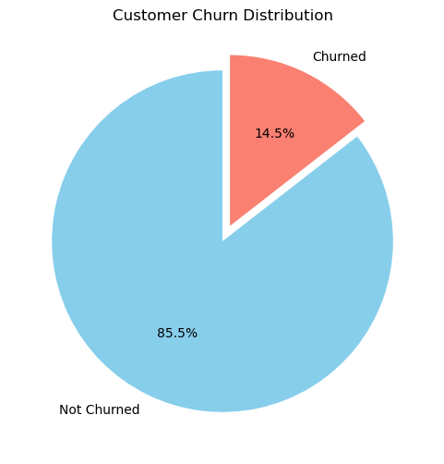
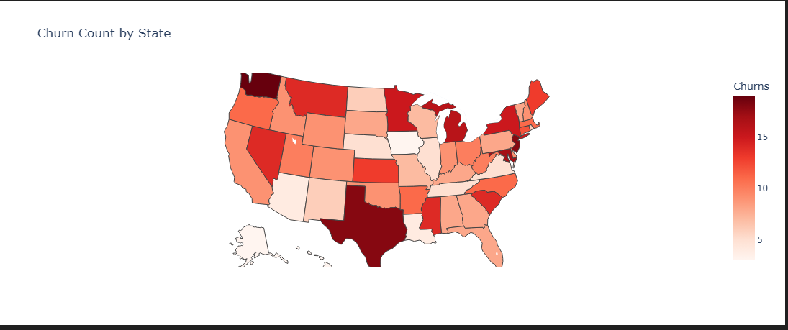
Understand the key reasons behind churn:
a) Churn Distribution : we observe that 85.5% of the customers did not churn while only 14.5% churned. This shows a significant class imbalance.
b) Geographical analysis : To support the company’s location-based retention strategy, I identified which states have the highest number of churned customers.
I visualized the churn intensity to helps the company to prioritize outreach efforts and marketing campaigns in high-churn states and design targeted interventions by region.
Washington, New jersey & Texas have the highest customers who have churned
Majority of other states reflect a moderate level of churn and shouldn't be overlooked when designing region-specific retention strategies

Slide 8
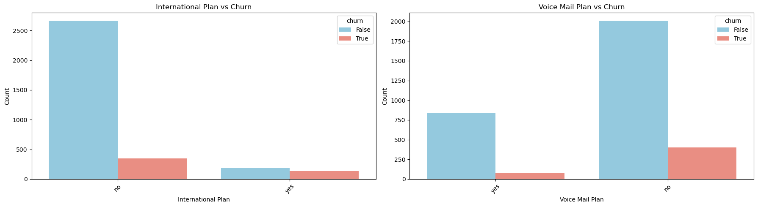
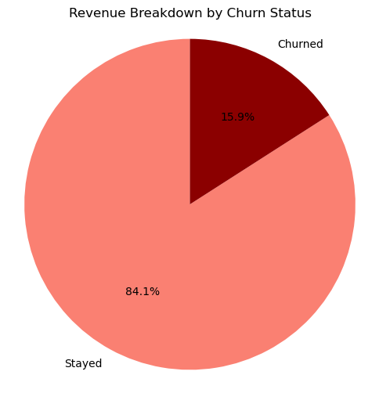
c) Service Plan : To understand the impact of service subscriptions on churn, I examined whether having an international plan or a voice mail plan made customers more or less likely to churn.
d) Financial Impact: I compared the total revenue from churned vs. non-churned customers and shows what percentage of overall revenue each group contributes.
Customers with an international plan are significantly more likely to churn compared to those without.
Customers with a voice mail plan are less likely to churn.
The highest risk group is international plan customers with no voicemail Services and the company should have immediate action for these group of customers
Churned customers account for 15.9% of the company’s total revenue loss. On average, each customer who leaves contributes approximately 1.4% to that lost revenue.

Slide 9
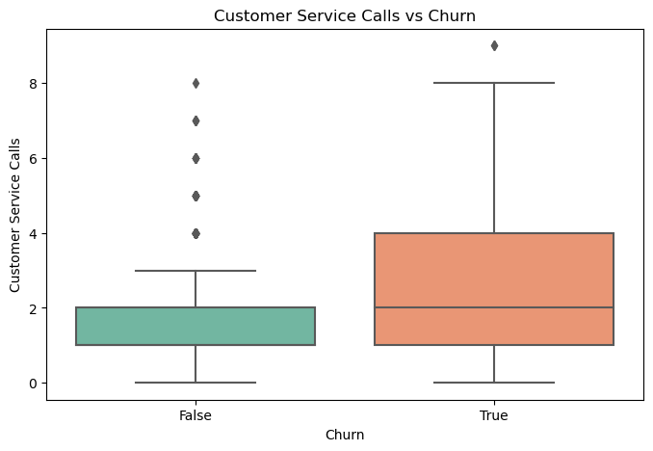
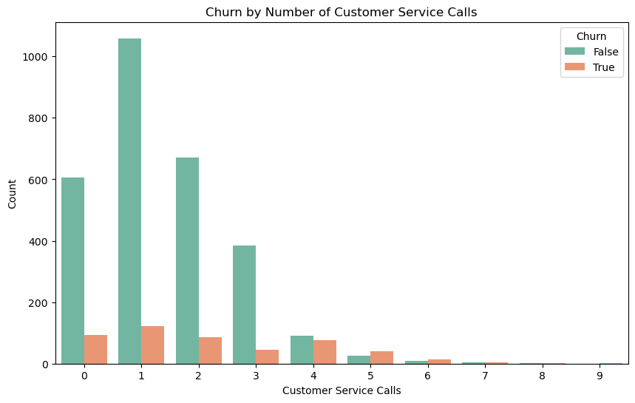
e) Customer Service Calls : To assess whether customer dissatisfaction drives churn, I examined the number of customer service calls made, as repeated contact without support may indicate unresolved issues or frustration.
Average call made by customers who churned was 2.23 while those who stayed made an average of 1.45 calls.
The difference of just one extra call on average suggests a thin line between staying and churning, even a small increase in service issues can tip a customer toward leaving.
The churn rate increases sharply with the number of service calls therefore the company should work on the first contact resolution
Once customers hit 5 or more service calls, churn shoots up (above 50%+) indicating rising dissastifaction.

Slide 10
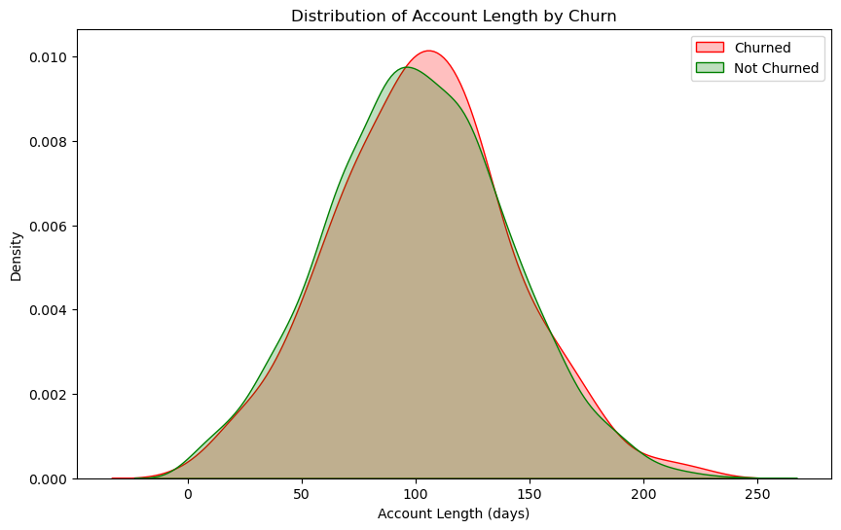
e) Tenure: To understand how customer longevity influences churning, I analyzed how long each customer has been with the company (in days).
The spread and median of tenure for churned and non-churned customers look very similar.
Both groups have a median around 100 days.
Churned customers do not appear to have dramatically shorter or longer tenures compared to loyal ones.

Slide 11
Modelling:
Objective: The goal is to predict customer churn for SyriaTel using available customer data. This helps the company proactively retain customers likely to stop using the service.
Models used
Logistic Regression (No resampling): checking how well logistic regression works without doing anything about imbalanced data (if some classes appear much more than others).
Logistic Regression + SMOTE : Using SMOTE, which artificially creates more examples of the minority class to improve fairness of the model. This helps the model learn both classes more equally.
Random Forest Classifier: Performed significantly better with high accuracy and good recall for churners, making it suitable for deployment.
Model Comparison:
Model Interpretation
Logistic no resampling: has high accuracy, but very poor recall and F1 for the minority class. It misses many potential churners, making it less suitable for identifying at risk customers.
Logistic + SMOTE improves recall for churners a lot, but loses accuracy by catching churners, but misclassifies many non-churners.
Random Forest + SMOTE gives the best of both worlds because it has the highest overall accuracy, recall and F1- score for churners
Model | Confusion Matrix | Accuracy | Recall | F1- Score
Logistic (No Smote) | [[552, 22], [75, 18]] | 0.85 | 0.19 | 0.27
Logistic + Smote | [[402, 172], [18, 75]] | 0.72 | 0.81 | 0.44
Random Forest + Smote | [[543, 31], [17, 76]] | 0.93 | 0.82 | 0.76

Slide 12
Modelling:
Objective:
The goal is to predict customer churn for SyriaTel using available customer data. This helps the company proactively retain customers likely to stop using the service.
Models used
Logistic Regression (No resampling): checking how well logistic regression works without doing anything about imbalanced data (if some classes appear much more than others).
Logistic Regression + SMOTE : Using SMOTE, which artificially creates more examples of the minority class to improve fairness of the model. This helps the model learn both classes more equally.
Random Forest Classifier: Performed significantly better with high accuracy and good recall for churners, making it suitable for deployment.
Model Comparison:
Model | Confusion Matrix | Accuracy | Recall | F1- Score
Logistic (No Smote) | [[552, 22], [75, 18]] | 0.85 | 0.19 | 0.27
Logistic + Smote | [[402, 172], [18, 75]] | 0.72 | 0.81 | 0.44
Random Forest + Smote | [[543, 31], [17, 76]] | 0.93 | 0.82 | 0.76

Slide 13

Market overview

Slide 14
Market comparison
Innovation in action
Stands out in market
Innovative features
Provides unique solution
Edge over competitors
User-focused design
Unlike others
Prioritizes user experience
Smooth interface
Optimal functionality for all

Slide 15
Competitive landscape
Market presence
Positioned as a market leader
Leverage a robust infrastructure
Dedicated team of experts
Outperform competitors
Agility and adaptability
Competitive edge
Ability to adapt swiftly
Stay ahead of the curve
Continuously improve offerings

Slide 16
Growth strategy
Expand market reach through strategic partnerships
Enhance product features based on user feedback
Explore international market opportunities
Objective
Results
How we apply it
Key Findings
What we learned

Slide 17
Traction
Milestone | Date
Product launch | Q1
10,000-user milestone | Q2
Strategic partnership | Q3
Product launch
Successful introduction of our product to market
10,000-user milestone
Substantial user base, indicating growing demand
Strategic partnership
Expanding market presence and capabilities

Slide 18
Financials
Quarter | Revenue ($) | Expenses ($) | Net profit ($)
Q1 | $200,000 | $150,000 | $50,000
Q2 | $300,000 | $200,000 | $100,000
Q3 | $400,000 | $250,000 | $150,000
Q4 | $300,000 | $200,000 | $100,000

Slide 19
Summary
With this product, Adatum Corporation is positioned for success in the dynamic market. With a focus on innovation, user experience, and strategic growth, we anticipate reaching new heights in the coming year.
Strong market positioning
Robust growth strategy
Commitment to user satisfaction

Slide 20

Thank you
Eugenia Lopez
606-555-0156
eugenia@adatum.com
www.adatum.com

