Slide 1


Slide 2

NLP Chatbot Development using Dialogflow

Slide 3
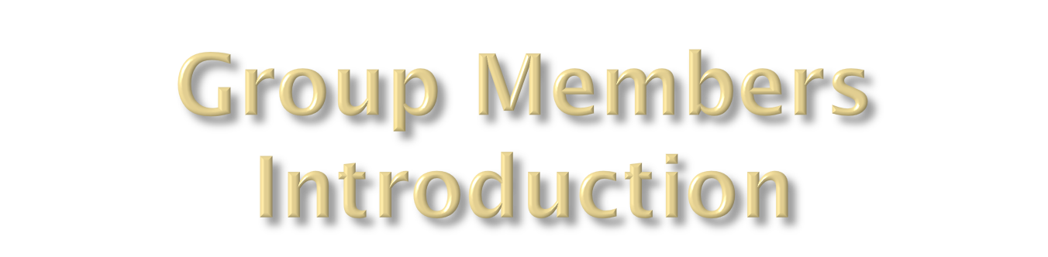
BC230211251

Slide 4
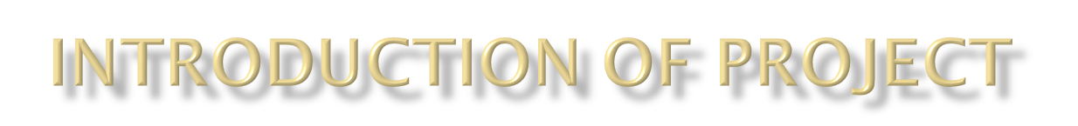

The primary purpose of this project is to develop an AI-powered chatbot using Google Dialogflow to automate customer interactions and enhance user experience in a restaurant setting. The chatbot will leverage natural language processing to understand and respond to customer inquiries effectively, thereby improving operational efficiency and customer satisfaction.

Slide 5
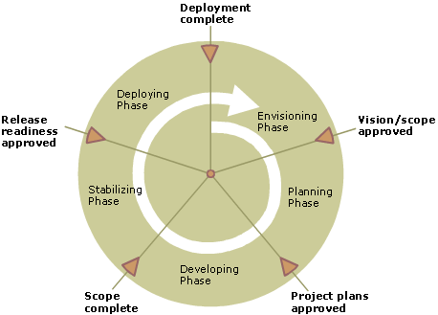
Diagram of Process Model.

Slide 6
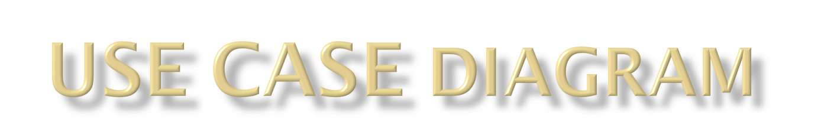
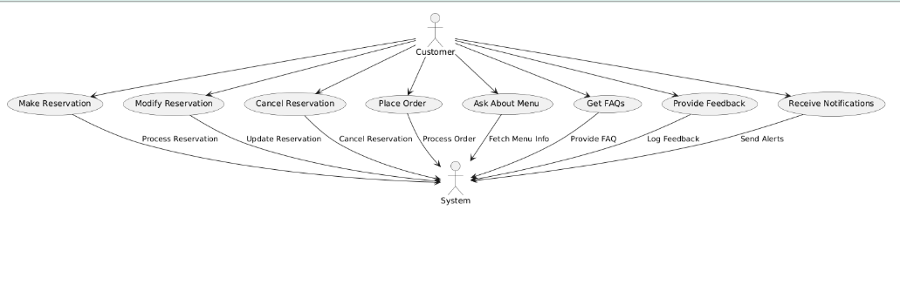

Slide 7
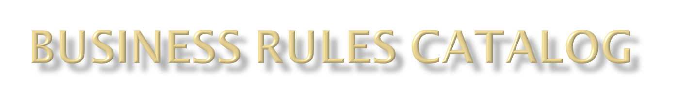
User Interaction:
• The chatbot will engage users in a conversational manner, providing relevant responses to their queries about the restaurant.
• It will guide users through various options and help them find the information they need.
Reservation Management:
• The chatbot will handle table reservations, allowing customers to check availability and book tables.
• It will confirm reservations and send reminders to customers.
Order Processing:
•The chatbot will assist in taking orders for dine-in or takeout, ensuring accuracy and efficiency.
• It will allow customers to customize their orders and provide real-time updates on order status.

Slide 8
Menu Navigation:
• The chatbot will help customers navigate the menu, providing details about dishes, ingredients, and specials.
• It will suggest popular items and accommodate dietary preferences.
Customer Support:
• The chatbot will address frequently asked questions (FAQs) related to the restaurant's services, hours of operation, and policies.
FEEDBACK
• It will handle customer complaints and feedback, escalating issues to human staff when necessary.

Slide 9

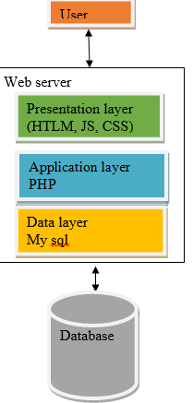

Slide 10

Group Id: < F24PROJECTF99DD >

Slide 11

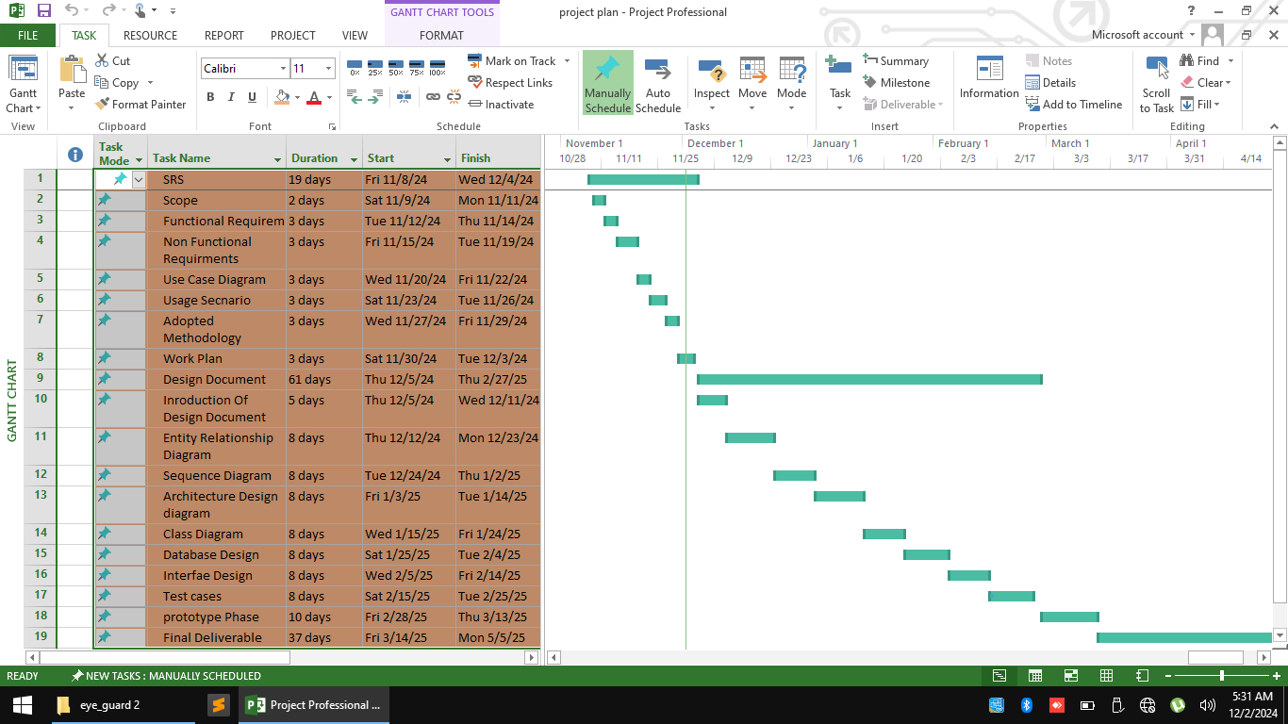

Slide 12

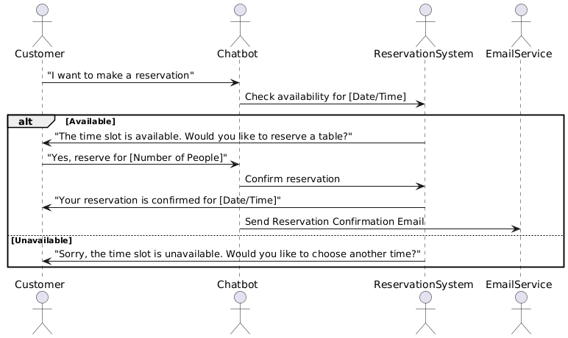

Slide 13

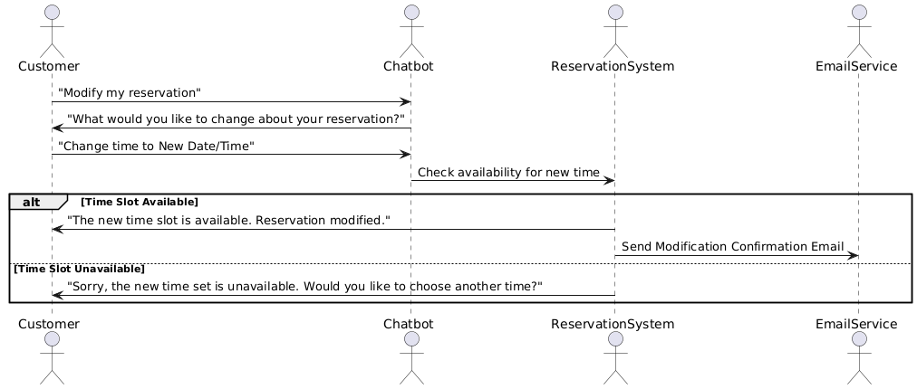

Slide 14

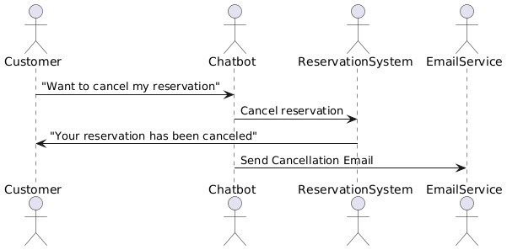

Slide 15

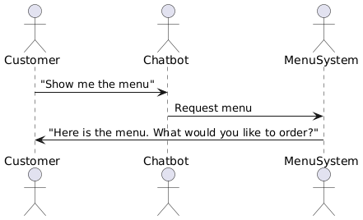

Slide 16

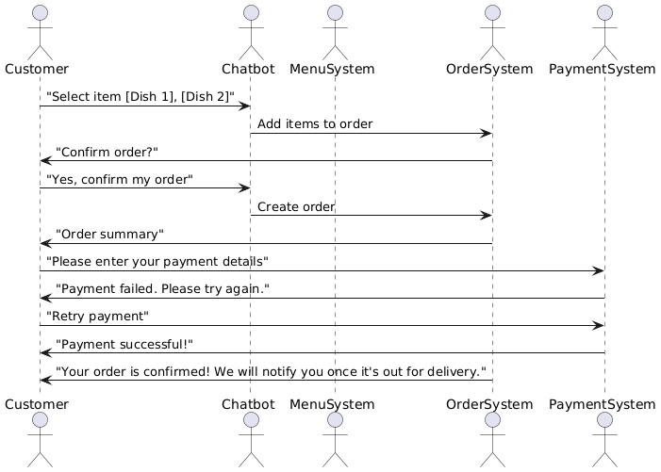

Slide 17

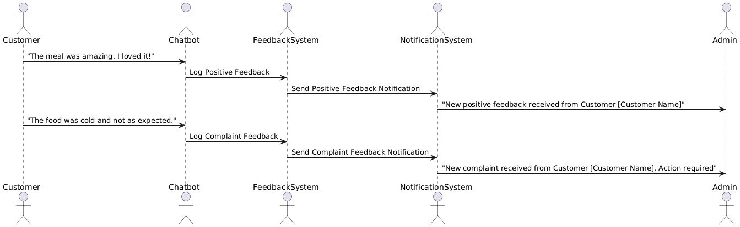

Slide 18
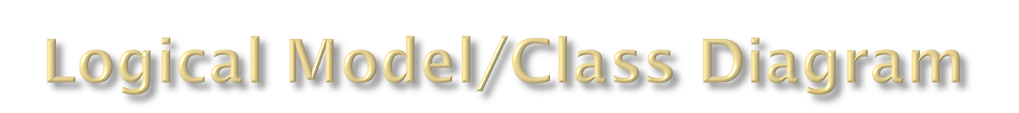
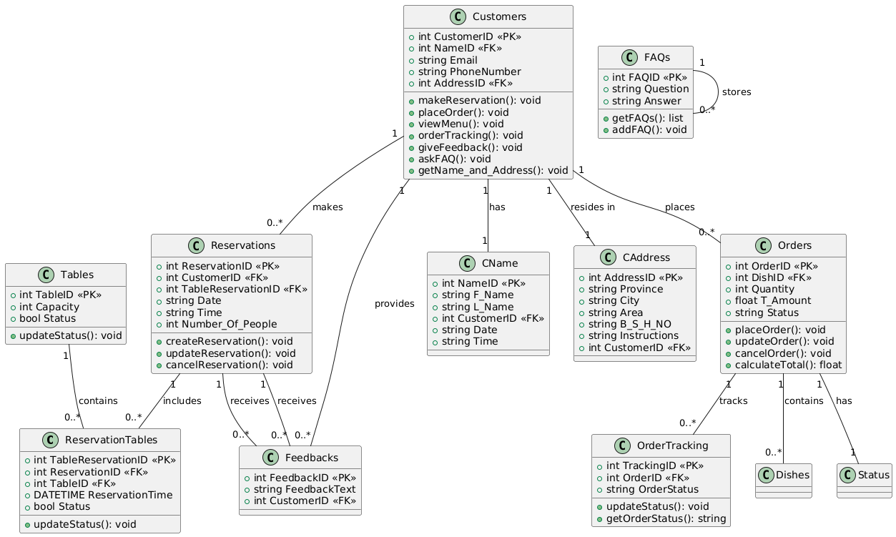

Slide 19
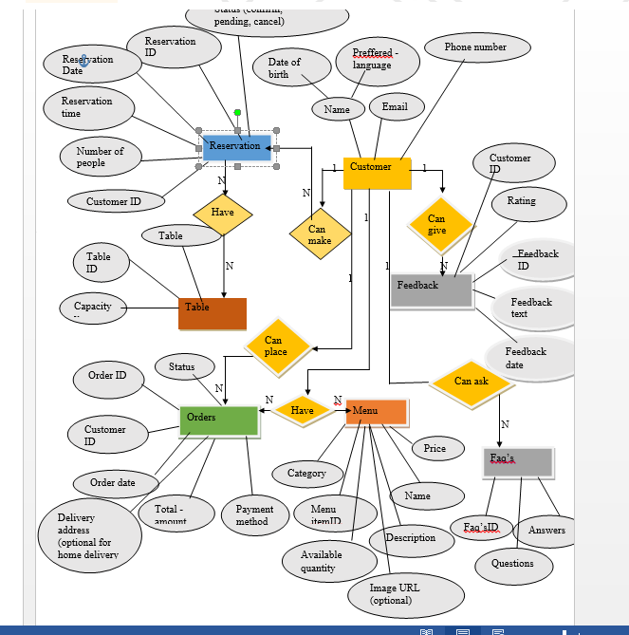

Slide 20

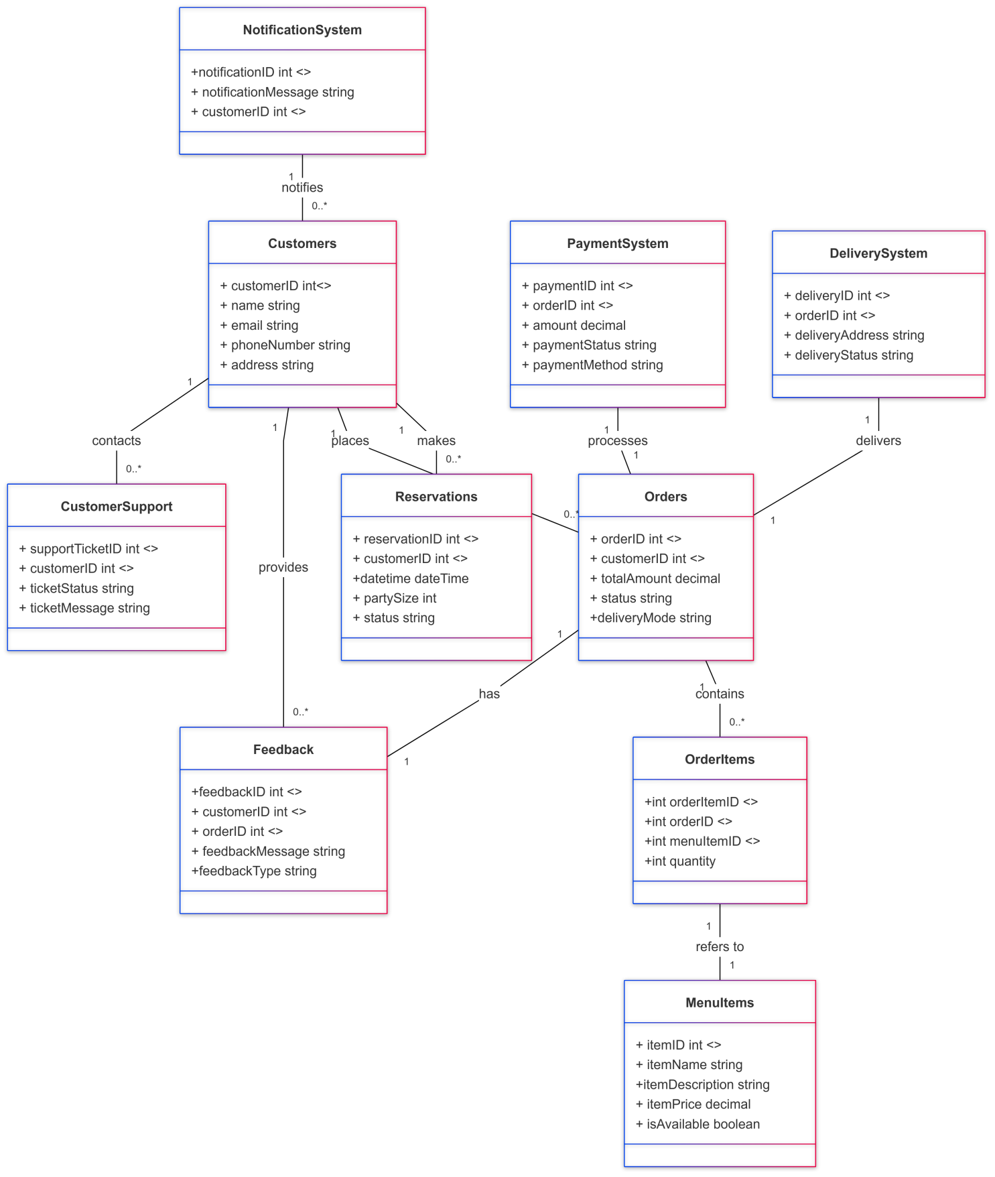

Slide 21

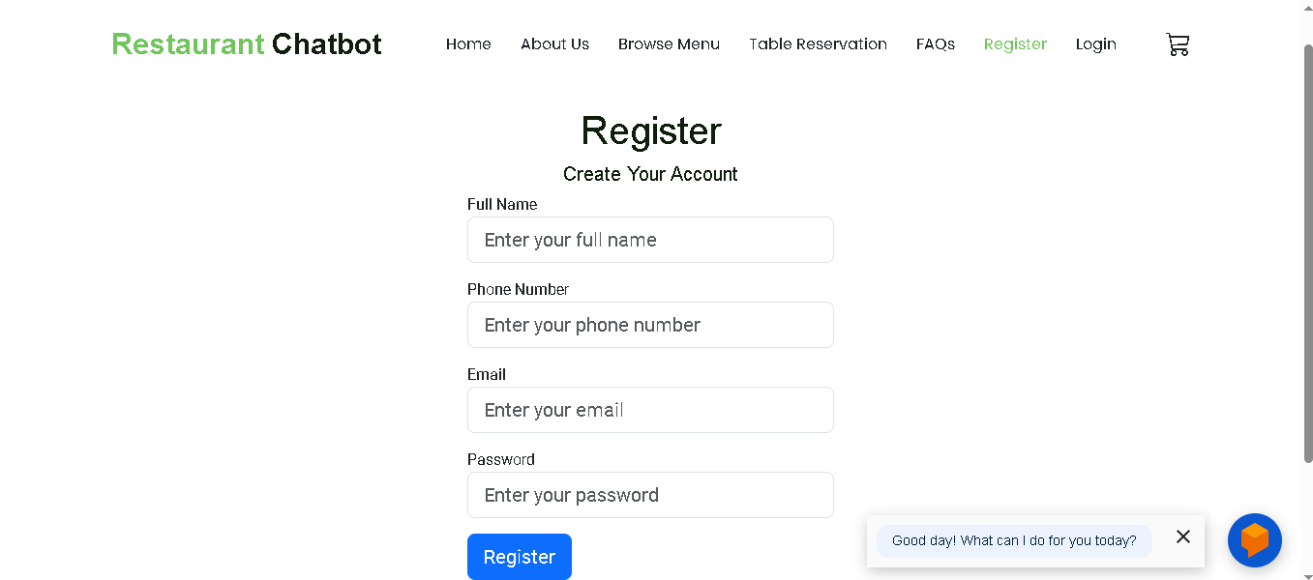

Slide 22
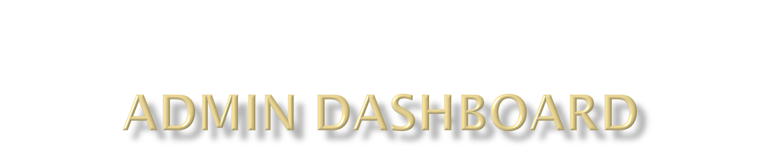
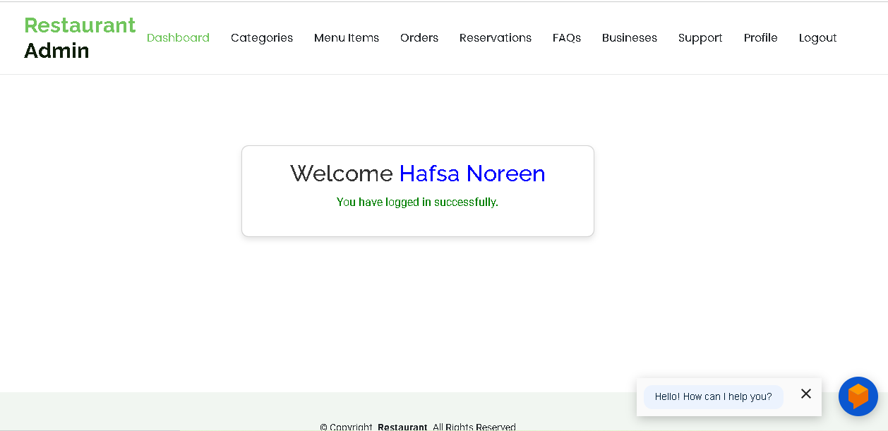

Slide 23

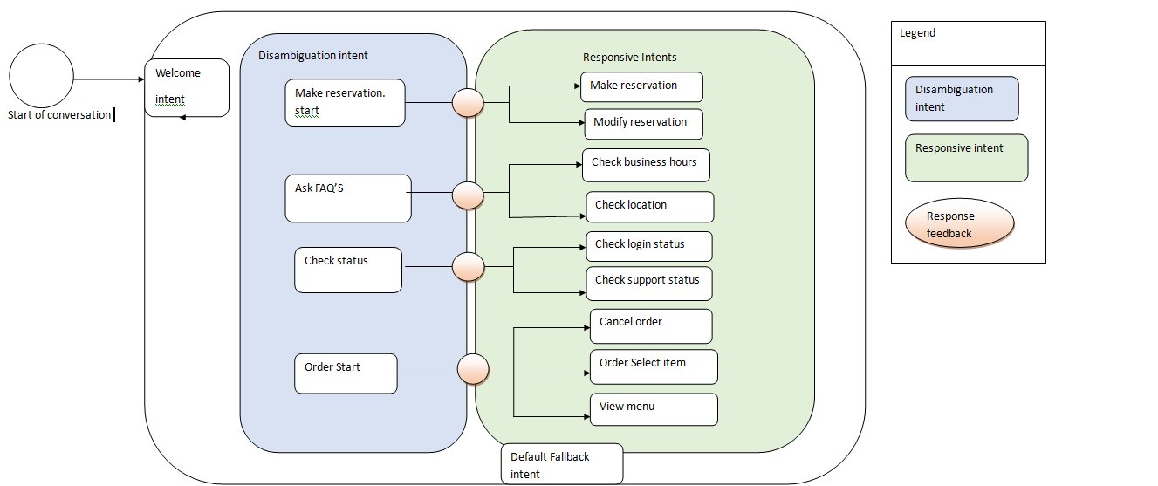

Slide 24

Php
Xammp server
HTML
CSS
JS
Mysql database
Sublime text editor

