Slide 1

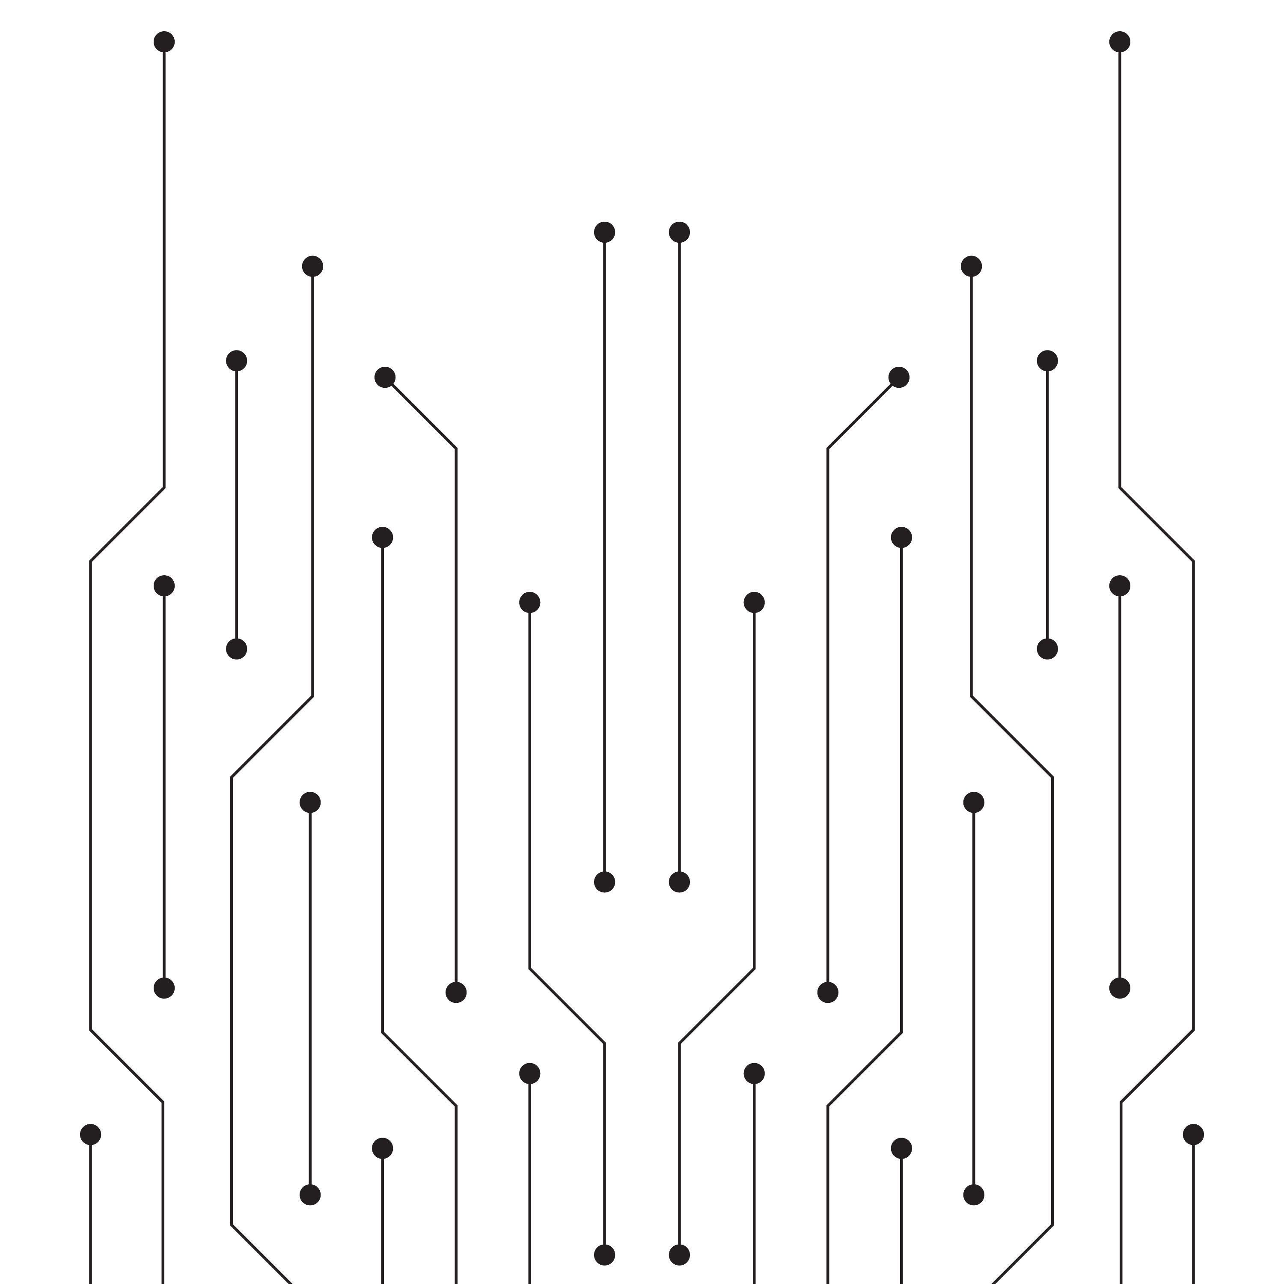
PUKAAR:
Breaking the Language Barrier in Emergency Response
A real-time AI translation bridge for regional dialects (Pashto, Sindhi, Saraiki) to Urdu and English

Slide 2

When Seconds Cost Lives, Language Shouldn't Be the Barrier
Emergency services (15, 1122, 115) often struggle to understand callers speaking in native regional dialects.
Valuable time (often minutes) is lost trying to find a translator while lives are at stake
The Goal: Reduce response time to just 5–8 seconds using AI.

Slide 3
Pukaar – Your Real-Time Emergency Dialect Translator

Slide 4
Multi-Dialect Support: Instant translation for Pashto, Sindhi and Saraiki.
Bidirectional Communication: Translates the caller's regional dialect to the dispatcher's Urdu/English, and converts the dispatcher's response back to the caller's native language .
High Speed: Complete end-to-end processing in under 8 seconds.

Slide 5

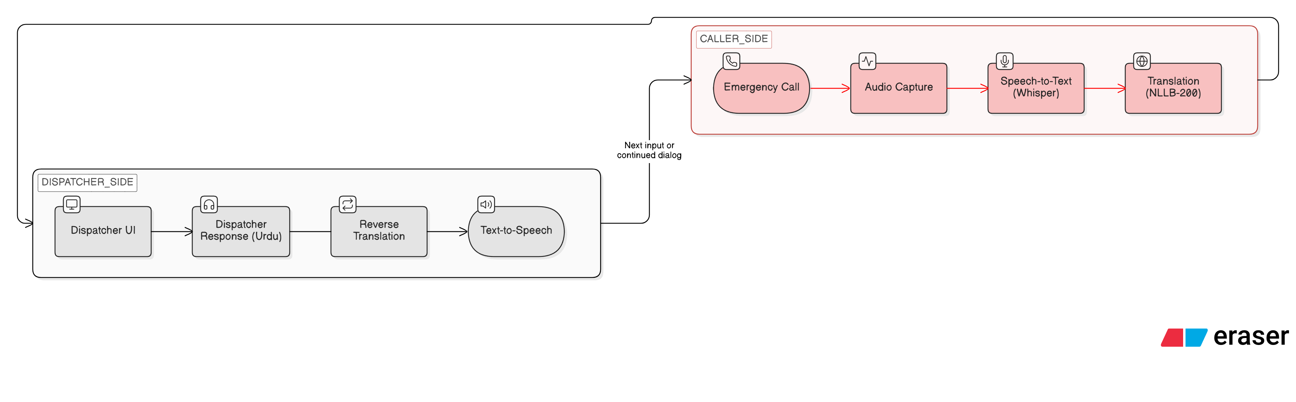
The 8-Step Emergency Intelligence Pipeline
.

Slide 6

The Technology Stack
ASR Engine: OpenAI Whisper (Base Model) for high-accuracy dialect detection.
Translation Engine: Meta’s NLLB-200 (No Language Left Behind).
TTS Engine: Bark or Coqui for natural-sounding speech generation.
Interface: Gradio-based professional dashboard.
Environment: Hosted on Google Colab using T4 GPU acceleration

Slide 7

Designed for High-Stress Environments
Live transcription and translation side-by-side.
Emergency type identification (Fire, Medical, Theft, Accident) .
One-click response triggers.

Slide 8

Linguistic Equality: Provides 100M+ regional speakers with 24/7 access to emergency protection.
Faster Response: Eliminates language delays in 5–8 seconds to increase survival rates in critical crises.
Dispatcher Support: Minimizes stress and error rates through real-time, accurate Urdu translation .
Digital Inclusivity: Uses AI to ensure marginalized communities are never left behind in a disaster .
Social Impact: Saving Lives with Inclusivity

Slide 9

The Team
Hafsa Javed: TTS Lead & Team Lead.
Haseeb Ullah Khan: Audio Collection Lead.
Hafsa Bibi: ASR Lead
Iqra Rashid: Translation Lead.
Alisha Rubab: UI Lead.
Muhammad Behram Hassan: Integration Lead.

Slide 10

Thank You! | Questions?
"Pukaar: Because every second counts and every language matters."
Links…….

