Slide 1



GlobalSuperStore
View in Power BI
Last data refresh:
9/6/2023 7:45:22 PM UTC
Downloaded at:
10/1/2023 8:50:33 AM UTC

Slide 2
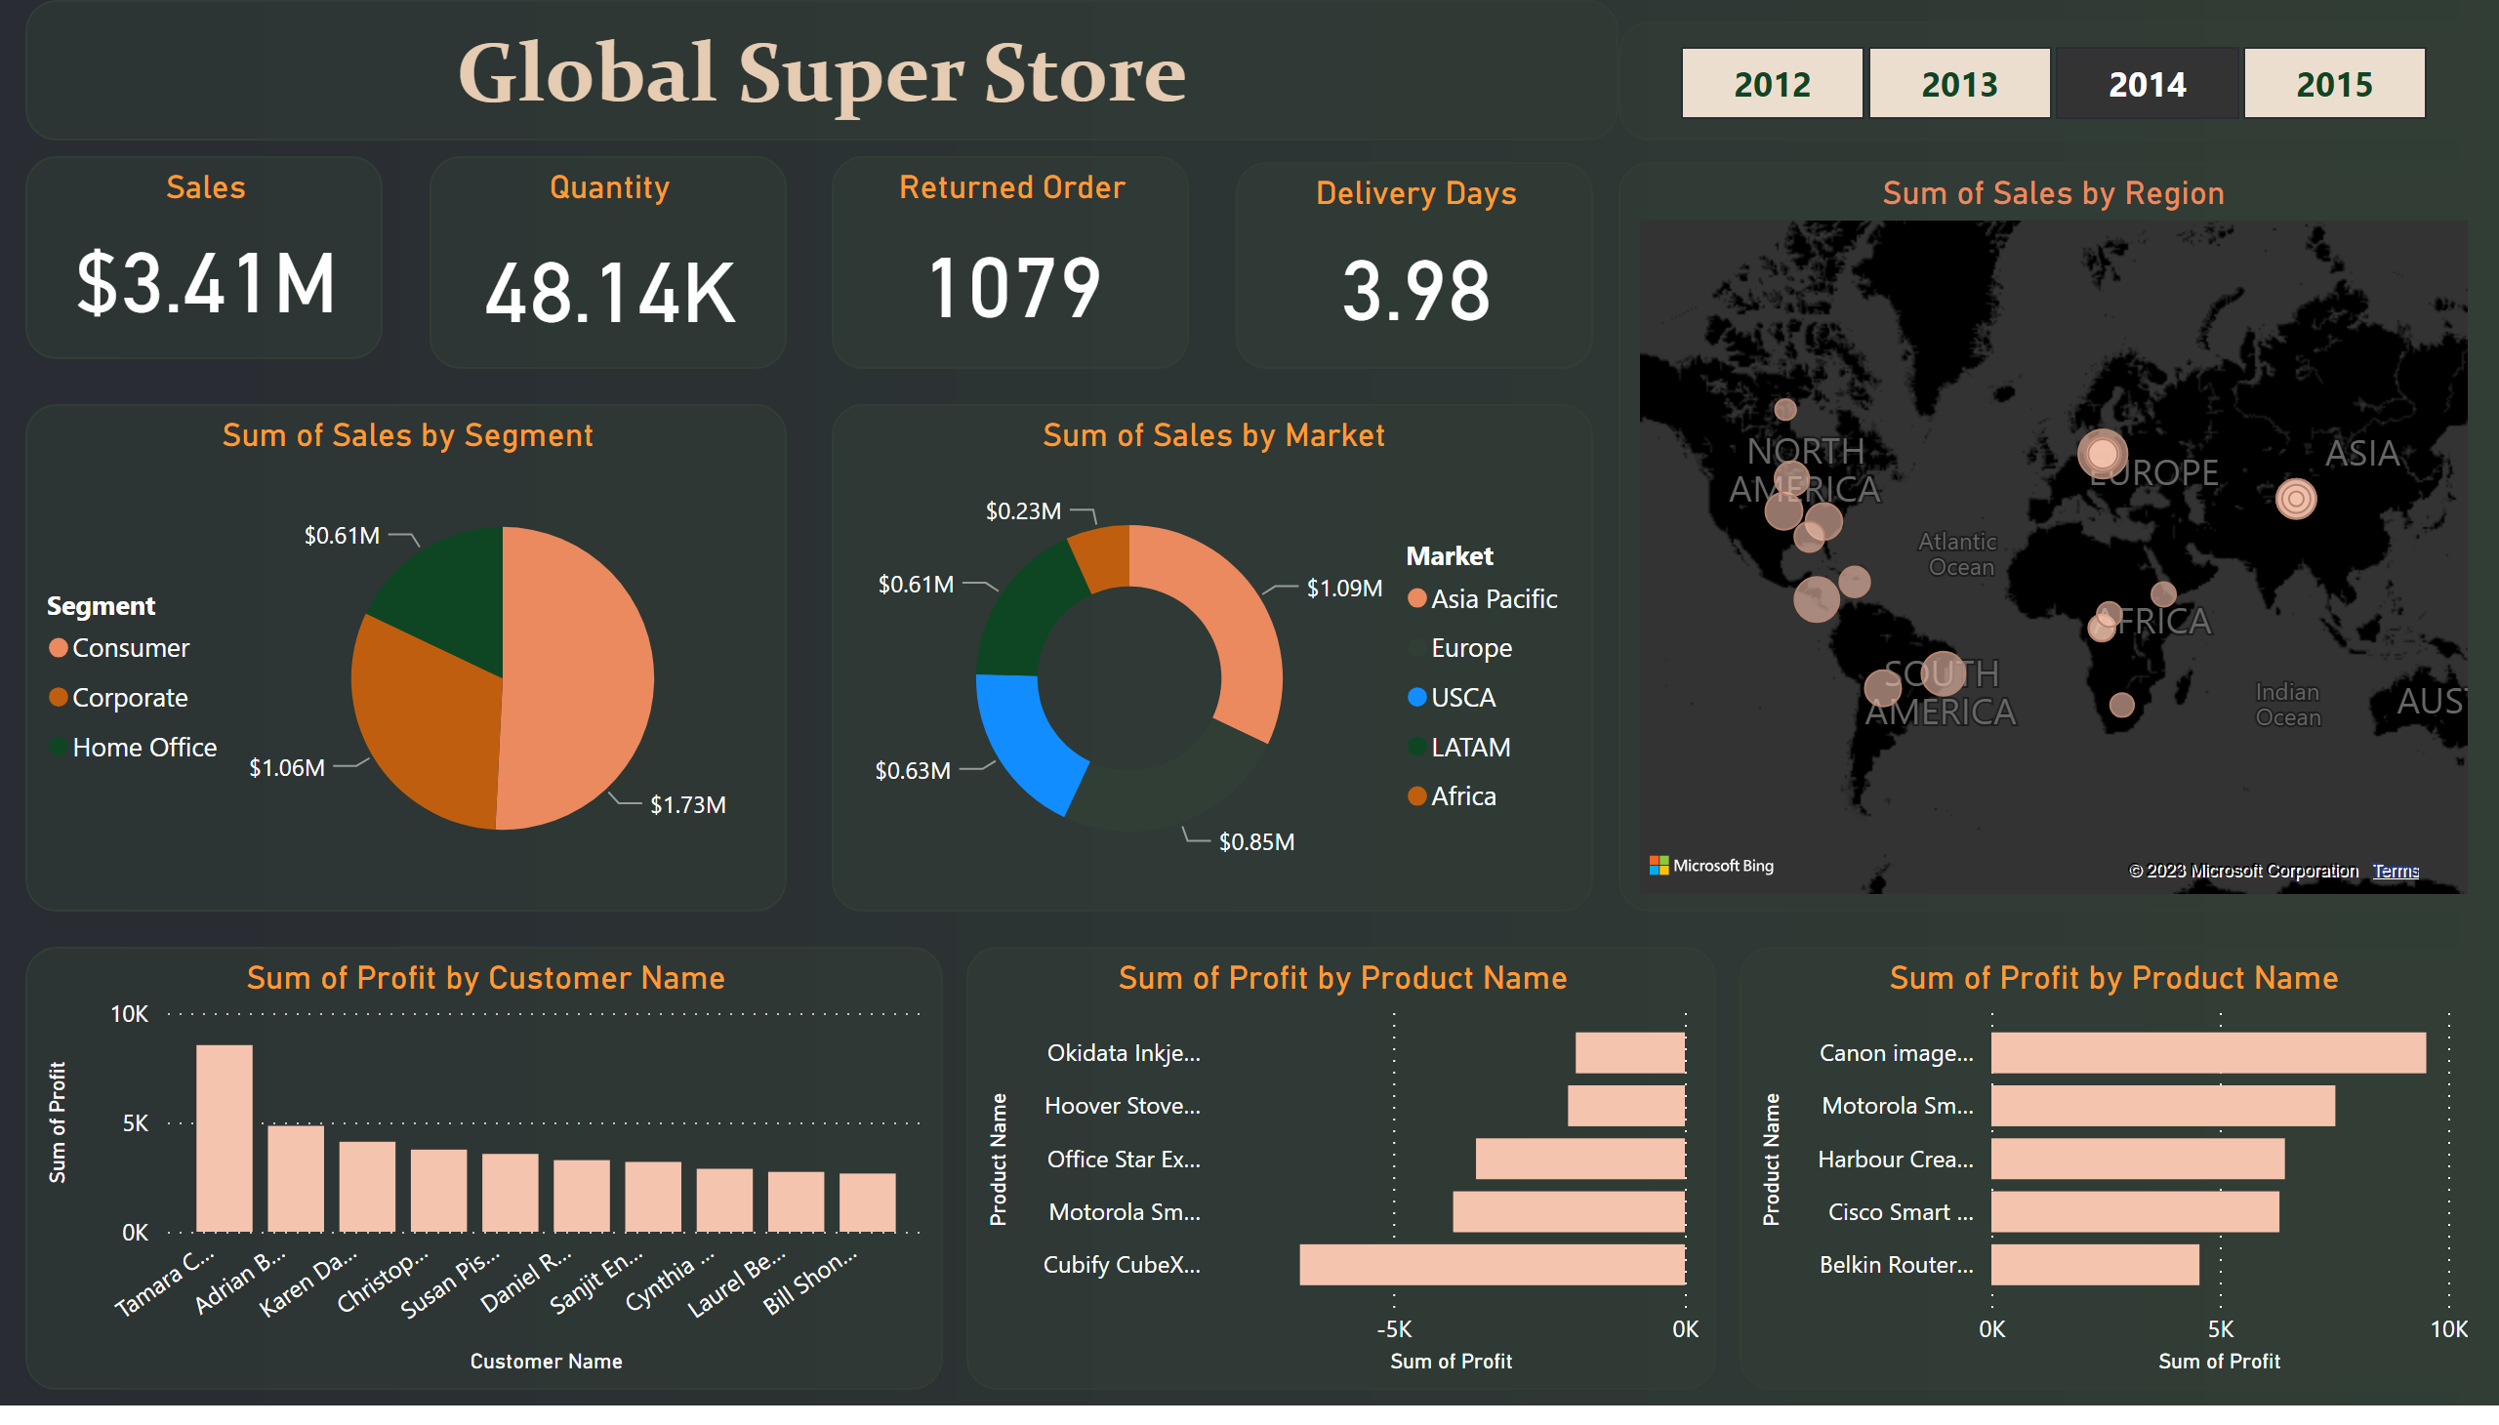
Page 1
Notes:
clusteredBarChart
No alt text provided
textbox
No alt text provided
clusteredColumnChart
No alt text provided
donutChart
No alt text provided
pieChart
No alt text provided
clusteredBarChart
No alt text provided
map
No alt text provided
slicer
No alt text provided
Returned Order
No alt text provided
Delivery Days
No alt text provided
Quantity
No alt text provided
Sales
No alt text provided

