Slide 1
Python Programming and Basic Data Science
EDGE
Lecture-1: Setting up the Environment
Prof. Dr. G M Atiqur Rahaman
Computer Science and Engineering Discipline

Slide 2
Contents
Jupyter Notebook
Anaconda Installation
Launching Jupyter Notebook
Creating a new Notebook
Working with cells
Types of Cells
Add Headings
Show line numbers
Setup Numpy
Setup Pandas
Setup Matplotlib
Downloading Notebook in multiple formats
Importing Notebook
Open already created Notebook
Keyboard shorcuts

Slide 3
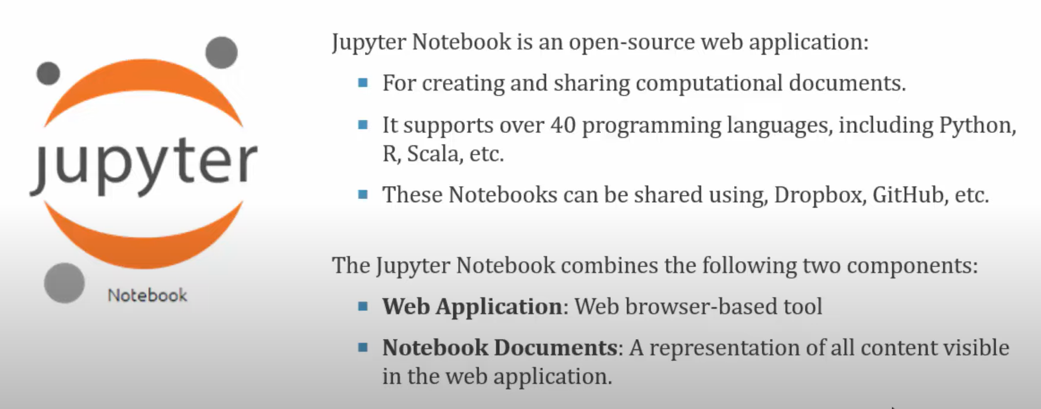
Jupyter Notebook https://jupyter.org/ https://github.com/jupyter/jupyter/wiki#a-gallery-of-interesting-jupyter-notebooks https://colab.research.google.com/

Slide 4
Installation of Anaconda
https://docs.anaconda.com/free/miniconda/
https://anaconda.org/

Slide 5
Launch Jupyter Notebook

Slide 6
Create a new Notebook in Jupyter

Slide 7
Working with Cells

Slide 8
Type of Cells

Slide 9
Add Headings in Cells

Slide 10
Show line numbers

Slide 11
Setup Numpy
!pip install numpy
Import numpy as np
n = np.array((1,2,3))
Print(n)
Print((type(n))

Slide 12
Setup Pandas
!pip install pandas
import pandas as pd
print(pd)
Data = [1,2,3]
pd.series (data=data)
Print(pd)
# Python code demonstrate creating
# DataFrame from dict narray / lists
# By default addresses.
import pandas as pd
# initialise data of lists.
data = {'Name':['Tom', 'nick', 'krish', 'jack’],
'Age':[20, 21, 19, 18] }
# Create DataFrame
df = pd.DataFrame(data)
# Print the output.
print(df)

Slide 13
Setup Matplotlib
! pip install matplotlib
import matplotlib.pyplot as plt
# data to display on plots
x = [3, 1, 3]
y = [3, 2, 1]
# This will plot a simple line chart
# with elements of x as x axis and y
# as y axis
plt.plot(x, y)
plt.title("Line Chart")

Slide 14
Download Notebook in Various formats

Slide 15
Import Notebook

Slide 16
Open already created Notebook

Slide 17
Keyboard Shortcuts
Output: Shift +Enter
dir()---all the available variables and functionalities
del(x)– delete variables
help(len)
len?

Slide 18
TRY IT YOURSELF!!
1-1. python.org: Explore the Python home page (https://python.org) to find topics that interest you. As you become familiar with Python, different parts of the site will be more useful to you.
1-2. Hello World Typos: Open the hello_world.py file you just created. Make a typo somewhere in the line and run the program again. Can you make a typo that generates an error? Can you make sense of the error message? Can you make a typo that doesn’t generate an error? Why do you think it didn’t make an error?
1-3. Infinite Skills: If you had infinite programming skills, what would you build? You’re about to learn how to program. If you have an end goal in mind, you’ll have an immediate use for your new skills; now is a great time to write brief descriptions of what you want to create. It’s a good habit to keep an “ideas” notebook that you can refer to whenever you want to start a new project. Take a few minutes now to describe three programs you want to create.

Slide 19
print(‘Hello World!’) print(‘CSE Discipline, Khulna University’)
1+1
print(2*2)

