Slide 1
Python Programming and Basic Data Science
EDGE
Lecture-2: Setting up the Environment (cont.)
Prof. Dr. G M Atiqur Rahaman
Computer Science and Engineering Discipline

Slide 2
Contents (Lec-1)
Jupyter Notebook
Anaconda Installation
Launching Jupyter Notebook
Creating a new Notebook
Working with cells
Types of Cells
Add Headings
Show line numbers
Setup Numpy
Setup Pandas
Setup Matplotlib
Downloading Notebook in multiple formats
Importing Notebook
Open already created Notebook
Keyboard shorcuts

Slide 3
Contents (Lec-2)
help(len)
len?

Slide 4
For a technologically-minded person, most of the time it's less a matter of knowing the answer of a computer problem as much as knowing how to quickly find an unknown answer.
Being an effective practitioner of data science is less about memorizing the tool or command for every possible situation---it is more about learning to effectively find the information you don't know, whether through a web search engine or another means.

Slide 5
An amazing amount of information can be found through IPython alone. Some examples of the questions IPython can help answer in a few keystrokes:
How do I call this function? What arguments and options does it have?
What does the source code of this Python object look like?
What is in this package I imported? What attributes or methods does this object have?

Slide 6
Accessing Documentation with ?
Every Python object contains doc string, which contains a concise summary of the object and how to use it.
Built-in help() function can access this information and print.
e.g.: to see the documentation of the built-in len function, do the following:
In [1]: help(len)
In [2]: len? # ? shorthand for accessing this documentation and other relevant information:

Slide 7
Accessing Documentation with ?
This notation works for just about anything, including object methods:
In [3]: L = [1, 2, 3]
In [4]: L.insert?
or even objects themselves, with the documentation from their type:
In [5]: L?

Slide 8
Accessing Documentation with ?
Importantly, this will even work for functions or other objects you create yourself! Here we'll define a small function with a docstring:
In [6]: def square(a):
....: """Return the square of a."""
....: return a ** 2
....:
In [7]: square?

Slide 9
Accessing Source Code with ??
A shortcut to the source code with the double question mark (??):
In [8]: square??

Slide 10
Accessing Source Code with ??
Sometimes the ?? suffix doesn't display any source code: if the object in question is not implemented in Python, but in C or some other compiled extension language.
Then the ?? suffix gives the same output as the ? suffix. This particularly true with many of Python's built-in objects and types, for example len:
In [9]: len??
Using ? and/or ?? gives a powerful and quick interface to know what any Python function or module does.

Slide 11
Exploring Modules with Tab-Completion
Using the tab key auto-completes and explores the contents of objects, modules, and name-spaces.
To see a list of all available attributes of an object, type the name of the object followed by a period (".") and the Tab key:
In [10]: L.<TAB>
To narrow-down the list, type the first character or several characters of the name, and the Tab key will find the matching attributes and methods:
In [10]: L.c<TAB>
In [10]: L.co<TAB>
In [10]: L.cou<TAB>

Slide 12
Private/Public attributes?
Python has no strictly-enforced distinction between public/external attributes and private/internal attributes, by convention a preceding underscore is used to denote such methods.
For clarity, these private methods and special methods are omitted from the list by default, but it's possible to list them by explicitly typing the underscore:
In [10]: L._<TAB>
(often nicknamed "dunder" methods

Slide 13
Tab completion when importing
To find all possible imports in the itertools package that start with co:
In [10]: from itertools import co<TAB>
Use tab-completion to see which imports are available on your system:
In [10]: import <TAB>

Slide 14
Beyond tab completion: wildcard matching
To match characters at the middle or end of the word wildcard matching can be used using the * character.
e.g. use this to list every object in the namespace that ends with Warning:
In [10]: *Warning?
Similarly, suppose we are looking for a string method that contains the word find somewhere in its name. We can search for it this way:
In [10]: str.*find*?

Slide 15
Useful for finding a particular command when getting to know a new package or reacquainting overself with a familiar one.

Slide 16
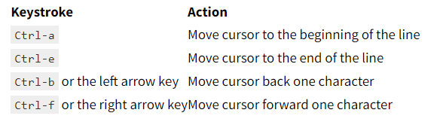
Keyboard Shortcuts in the IPython Shell
Navigation shortcuts

Slide 17
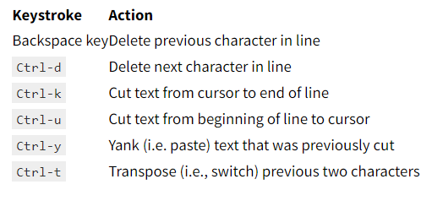
Keyboard Shortcuts in the IPython Shell
Text Entry shortcuts

Slide 18
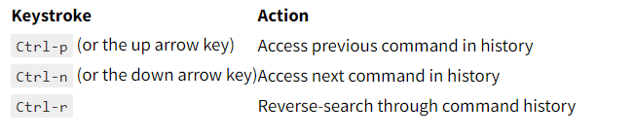
Keyboard Shortcuts in the IPython Shell
Command History Shortcuts

Slide 19
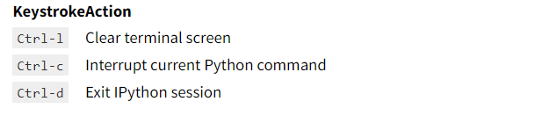
Keyboard Shortcuts in the IPython Shell
Miscellaneous Shortcuts

Slide 20
IPython Magic Commands
The enhancements that IPython adds on top of the normal Python syntax…. are known as magic commands, and are prefixed by the % character.
Magic commands come in two flavors: line magics, which are denoted by a single % prefix and operate on a single line of input, and cell magics, which are denoted by a double %% prefix and operate on multiple lines of input.

Slide 21
IPython Magic Commands
We use IPython for interactive exploration and a text editor to store code to reuse. Rather than running this code in a new window, it can be convenient to run it within a IPython session. This can be done with the %run magic.

Slide 22
IPython Magic Commands
Imagine you've created a myscript.py file with the following contents:
#-------------------------------------
# file: myscript.py
def square(x):
"""square a number"""
return x ** 2
for N in range(1, 4):
print(N, "squared is", square(N))

Slide 23
IPython Magic Commands
You can execute this from your IPython session as follows:
>>> %run myscript.py
After you've run this script, any functions defined within it are available for use in your IPython session:
>>> square(5)
There are several options to fine-tune how your code is run; you can see the documentation in the normal way, by typing %run? in the IPython interpreter.

Slide 24
Timing Code Execution: %timeit
%timeit, automatically determines the execution time of the single-line Python statement that follows it. E.g.: we may want to check the performance of a list comprehension:
>>> %timeit L = [n ** 2 for n in range(1000)]

Slide 25
Timing Code Execution: %timeit
%timeit automatically performs multiple runs in order to attain more robust results.
For multi line statements, adding a second % sign will turn this into a cell magic that can handle multiple lines of input. For example, here's the equivalent construction with a for-loop:
%%timeit
L = []
for n in range(1000):
L.append(n ** 2)

Slide 26
Help on Magic Functions: ?, %magic, and %lsmagic
To read the documentation of the %timeit magic simply type this
>>> %timeit?
To access a general description of available magic functions, including some examples, you can type this:
>>> %magic
For a quick and simple list of all available magic functions, type this:
>>> %lsmagic

Slide 27
Input and Output History
In/Out: can access previous inputs and outputs in the current session
In [1]: import math
In [2]: math.sin(2)
Out[2]: 0.9092974268256817
In [3]: math.cos(2)
IPython actually creates some Python variables called In and Out that are automatically updated to reflect this history.

Slide 28
Input and Output History
In [4]: print(In)
['', 'import math', 'math.sin(2)', 'math.cos(2)', 'print(In)’]
In [5]: Out
Out[5]: {2: 0.9092974268256817, 3: -0.4161468365471424}
The In object is a list, which keeps track of the commands in order (the first item in the list is a place-holder so that In[1] can refer to the first command):
>>> print(In[1])
The Out object is not a list but a dictionary mapping input numbers to their outputs (if any):
>>> print(Out[2])

Slide 29
Underscore Shortcuts and Previous Output
for accessing previous output; the variable _ (i.e., a single underscore) is kept updated with the previous output;
>>> print(_)
>>> print(__)
>>> print(___)
a shorthand for Out[X] is _X (i.e., a single underscore followed by the line number):
>>> Out[2]
>>> _2

Slide 30
Suppressing Output
>>> math.sin(2) + math.cos(2);
Note that the result is computed silently, and the output is neither displayed on the screen or stored in the Out dictionary:

Slide 31
Related Magic Commands
>>> %history -n 1-4

Slide 32
TRY IT YOURSELF!!

