Slide 1
Python Programming Language
Lecture 2: Variables and Data Types
Hafsa Sultana
Computer Science and Engineering
Khulna University

Slide 2
Today’s Learning Objectives
Variables,
Naming Variables,
Creating Variables,
Data Types,
More on Data Types,
Expressions,
Statements,
Assignment Statements,
Multiple Assignment,
User Input,
Advanced User Input,
Variable Scope,
Local Variables,
Global Variables,
Casting,
Practical Examples,
Practical Exercises,
Debugging Tips,
Hafsa Sultana, CSE, KU

Slide 3
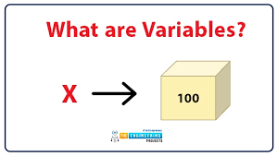
What is a Variable
Technically, variables act as an address where data is stored in memory.
A container for storing data values.
For example, x = "apples" can then be x = 5.
[Think of it like a box with a label or address of a house to find the specific value.]
Hafsa Sultana, CSE, KU

Slide 4
Naming Variables
Rules for Python variable naming:
Must start with a letter or the underscore character
Cannot start with a number
A variable name can only contain alpha-numeric characters and underscores (A-z, 0-9, and _ )
Variable names are case-sensitive (age, Age, and AGE are three different variables)
Cannot use keywords.
Examples: my_variable, age, _name
Hafsa Sultana, CSE, KU

Slide 5
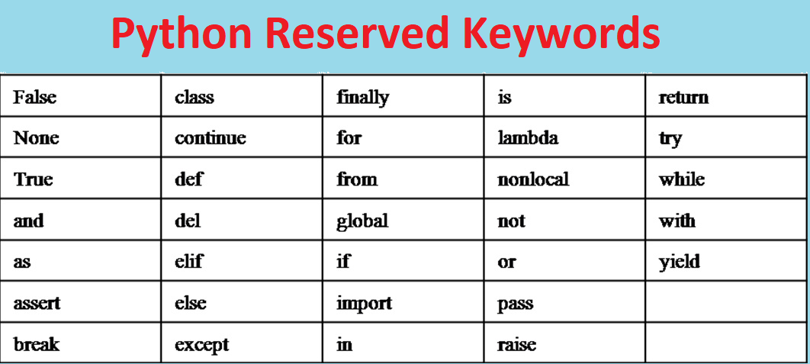
Keywords
Python has a set of keywords that are reserved words that cannot be used as variable names, function names, or any other identifiers:
Hafsa Sultana, CSE, KU

Slide 6
Creating Variables
Simply assign a value to a name.
Example:
x = 5,
Num = 4.7
name = 'Alice’
2myvar = “Kabir"
my-var = “Aysha"
my var = “Rajjak"
myvar = " 'Alice "
my_var = " 'Alice "
_my_var = " 'Alice "
myVar = " 'Alice "
MYVAR = " 'Alice "
myvar2 = " 'Alice "
Hafsa Sultana, CSE, KU

Slide 7
Data Types
Integer: int (e.g., 5)
Floating-Point: float (e.g., 3.14)
Strings: str (e.g., 'hello')
Booleans: bool (e.g., True or False)
Hafsa Sultana, CSE, KU

Slide 8
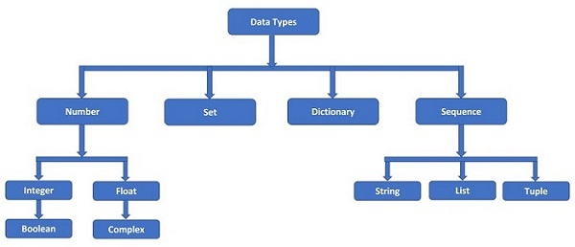
Data Types
Hafsa Sultana, CSE, KU

Slide 9
More Data Types
Lists: list (e.g., [1, 2, 3])
Dictionaries: dict (e.g., {'name': 'Alice', 'age': 10})
Tuples: tuple (e.g., (1, 2, 3))
Set: set (e.g., ({1,2,3})
Hafsa Sultana, CSE, KU

Slide 10
Expressions
A combination of values, variables, operators, and function calls that can be evaluated to produce a result.
An expression always returns a value.
Examples:
  2 + 3
  x * y
  len("hello")
Hafsa Sultana, CSE, KU

Slide 11
Types of Expressions
Arithmetic Expressions:
Examples: 5 + 3, 10 - 2, 7 * 4, 8 / 2
String Expressions:
Examples: "Hello, " + "World!", "Python" * 3
Boolean Expressions:
Examples: 5 > 3, 10 == 10, x != y
Hafsa Sultana, CSE, KU

Slide 12
Statements
Instruction that Python can execute.
Example: print('Hello, World!’)
Type of Statements:
Assignment Statements:
  Assign a value to a variable.
  Example: x = 10
Conditional Statements:
  Perform actions based on conditions.
  Example: if x > 0:
print("Positive")
Hafsa Sultana, CSE, KU

Slide 13
Statements
Type of Statements:
Loop Statements:
  Repeat actions
  Example: for i in range(5):
  print(i)
Functional Statements
  def greet(name):
  print("Hello, " + name + "!")
  greet("Alice")
Break, continue, import, return, del
Hafsa Sultana, CSE, KU

Slide 14
Multiple Assignment
Assign values to multiple variables in one line.
Example:
a, b, c = 1, 2, 3
print(a)
print(b)
print(c)
x, y, z = "Orange", "Banana", "Cherry"
print(x)
print(y)
print(z)
Hafsa Sultana, CSE, KU

Slide 15
User Input
Use input() function to get input from the user.
Example:
name = input('What is your name? ')
print('Hello, ' + name)
Hafsa Sultana, CSE, KU

Slide 16
Advanced User Input
Getting numbers from the user.
Example:
age = int(input('Enter your age: '))
height = float(input('Enter your height: '))
Hafsa Sultana, CSE, KU

Slide 17
Variable Scope
Determines where a variable can be used.
Local vs Global variables.
Hafsa Sultana, CSE, KU

Slide 18
Local Variables
Declared inside a function.
Only accessible within that function.
Example:
def my_function():
x = 10
print(x)
Hafsa Sultana, CSE, KU

Slide 19
Global Variables
Declared outside any function.
Accessible anywhere in the code.
Example:
x = 10
def my_function():
print(x)
Hafsa Sultana, CSE, KU

Slide 20
Casting
Converting a variable from one type to another.
Example: str(3) converts integer 3 to string '3'
x = float(1) # x will be 1.0
y = float(2.8) # y will be 2.8
z = float("3") # z will be 3.0
w = float("4.2") # w will be 4.2
print(x)
print(y)
print(z)
print(w)
x = int(1)
y = int(2.8)
z = int("3")
print(x)
print(y)
print(z)
x = str("s1") # x will be 's1'
y = str(2) # y will be '2'
z = str(3.0) # z will be '3.0'
print(x)
print(y)
print(z)
Hafsa Sultana, CSE, KU

Slide 21
Practical Examples
Create variables of different types.
Example:
age = 10
pi = 3.14
name = 'Alice'
is_student = True
Hafsa Sultana, CSE, KU

Slide 22
Practical Exercises
1. Concatenate Two Strings
Input: Enter the first word: Hello
Enter the second word: World
Output: HelloWorld
2. Print the First and Last Character
  Input: Enter a word: Python
Output: First character: P
Last character: n
Hafsa Sultana, CSE, KU

Slide 23
Practical Exercises
3. Length of a String
Input: Enter a sentence: Python is great!
Output: 16
4. Average of Three Numbers
Input: Enter the first number: 3
Enter the second number: 4
Enter the third number: 5
Output: 4.0
Hafsa Sultana, CSE, KU

Slide 24
Practical Exercises
5. Area of a Rectangle
Input: Enter the width of the rectangle: 5
Enter the height of the rectangle: 10
Output: The area is: 50
6. Celsius to Fahrenheit (F = C * 9/5 + 32)
Input: Enter temperature in Celsius: 0
Output: The temperature in Fahrenheit is: 32.0
Hafsa Sultana, CSE, KU

Slide 25
Practical Exercises
7. Draw:
*
**
***
****
*****
8. Draw:
*
***
*****
*******
*********
7 Sln:
print("*")
print("**")
print("***")
print("****")
print("*****")
8 Sln:
print(" * ")
print(" *** ")
print(" ***** ")
print(" ******* ")
print("*********")
9. Draw:
*
***
*****
*******
*********
*******
*****
***
*
9 Sln:
print(" * ")
print(" *** ")
print(" ***** ")
print(" ******* ")
print("*********")
print(" ******* ")
print(" ***** ")
print(" *** ")
print(" * ")
Hafsa Sultana, CSE, KU

Slide 26
Debugging Tips
Use print statements to debug.
Check variable values and types.
Hafsa Sultana, CSE, KU

Slide 27
Any Question?

Slide 28
References
https://www.w3schools.com/python/
https://www.futurelearn.com/info/courses/introduction-to-programming-with-python-fourth-rev-/0/steps/264867
Hafsa Sultana, CSE, KU

