Slide 1
Python Programming Language
Lecture 3: Variables, String and Operator
Hafsa Sultana
Computer Science and Engineering
Khulna University

Slide 2
Today’s Learning Objectives
Keywords
Expressions,
Delete Variable
Variable Scope,
Local Variables,
Global Variables,
Casting
Advanced user input,
Constants
String
Operator
Practical Exercises,
Debugging Tips,
Hafsa Sultana, CSE, KU

Slide 3
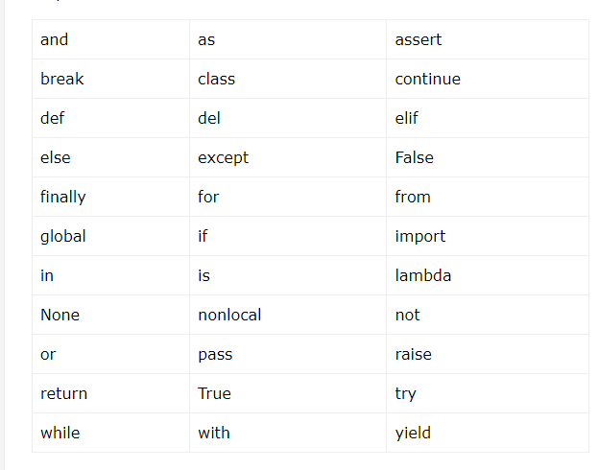
Keywords
Python has a set of keywords that are reserved words that cannot be used as variable names, function names, or any other identifiers:
Hafsa Sultana, CSE, KU

Slide 4
Expressions
A combination of values, variables, operators, and function calls that can be evaluated to produce a result.
An expression always returns a value.
Examples:
2 + 3
x * y
len("hello")
Hafsa Sultana, CSE, KU

Slide 5
Types of Expressions
Arithmetic Expressions:
Examples: 5 + 3, 10 - 2, 7 * 4, 8 / 2
String Expressions:
Examples: "Hello, " + "World!", "Python" * 3
Boolean Expressions:
Examples: 5 > 3, 10 == 10, x != y
Hafsa Sultana, CSE, KU

Slide 6
Variable Features
Redeclaration
Multiple Assignment
num1 = 5
num1 = 3.45
num1, num2, stri = 4, 5, "okay"
num1 = num2 = num3 = 10
print(num1, num2, num3)
x, y, z = "Orange", "Banana", "Cherry"
print(x)
print(y)
print(z)
Hafsa Sultana, CSE, KU

Slide 7
Delete Variable
Num1 = 10
print(id(num1)) #Shows the RAM location where this is saved
del num1
print(num1)
TRY to Delete a variable
Hafsa Sultana, CSE, KU

Slide 8
Variable Scope
Determines where a variable can be used.
Local vs Global variables.
Hafsa Sultana, CSE, KU

Slide 9
Local Variables
Declared inside a function.
Only accessible within that function.
Example:
def my_function():
x = 10
print(x)
Hafsa Sultana, CSE, KU

Slide 10
Global Variables
Declared outside any function.
Accessible anywhere in the code.
Example:
x = 10
def my_function():
print(x)
Hafsa Sultana, CSE, KU

Slide 11
Casting
Converting a variable from one type to another.
Example: str(3) converts integer 3 to string '3'
x = float(1) # x will be 1.0
y = float(2.8) # y will be 2.8
z = float("3") # z will be 3.0
w = float("4.2") # w will be 4.2
print(x)
print(y)
print(z)
print(w)
x = int(1)
y = int(2.8)
z = int("3")
print(x)
print(y)
print(z)
x = str("s1") # x will be 's1'
y = str(2) # y will be '2'
z = str(3.0) # z will be '3.0'
print(x)
print(y)
print(z)
Hafsa Sultana, CSE, KU

Slide 12
Advanced User Input
Use input() function to get input from the user.
Converting input to other data types.
Example:
name = input('What is your name? ')
print('Hello, ' + name)
Hafsa Sultana, CSE, KU

Slide 13
Constant
Python doesn't have any formally defined constants,
However you can indicate a variable to be treated as a constant by using all-caps names with underscores.
For example, the name PI_VALUE indicates that you don't want the variable redefined or changed in any way.
PI_VALUE = 3.1416
Hafsa Sultana, CSE, KU

Slide 14
String
A string is a non-numeric data type
Slicing: Subsets of strings can be taken using the slice operator ([ ] and [:] ) with indexes starting at 0 in the beginning of the string and working their way from -1 at the end.
Concatenation: The plus (+) sign is the string concatenation operator and the asterisk (*) is the repetition operator in Python.
Hafsa Sultana, CSE, KU

Slide 15
String
str = 'Hello World!'
print (str) # Prints complete string
print (str[0]) # Prints first character of the string
print (str[2:5]) # Prints characters starting from 3rd to 5th
print (str[2:]) # Prints string starting from 3rd character
print (str * 2) # Prints string two times
print (str + "TEST") # Prints concatenated string
Hafsa Sultana, CSE, KU

Slide 16
String
Output:
print (str) # Hello World!
print (str[0]) # H
print (str[2:5]) #llo
print (str[2:]) # llo World!
print (str * 2) # Hello World!Hello World!
print (str + "TEST") # Hello World!TEST
Hafsa Sultana, CSE, KU

Slide 17
Python Operators
Operators are used to perform operations on variables and values.
Examples: +, -, *, /, ==, !=
Types of Operators:
Arithmetic Operators
Comparison (Relational) Operators
Assignment Operators
Logical Operators
Bitwise Operators
Membership Operators
Identity Operators
Hafsa Sultana, CSE, KU

Slide 18
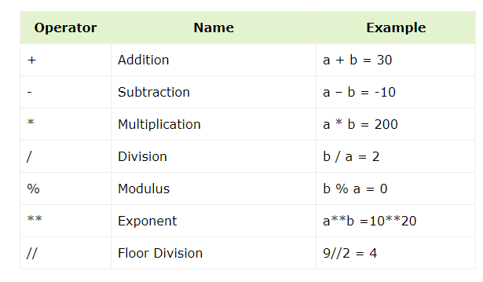
Python Operators
1. Arithmetic Operators:
Hafsa Sultana, CSE, KU

Slide 19
Arithmetic Operators:
Hafsa Sultana, CSE, KU

Slide 20
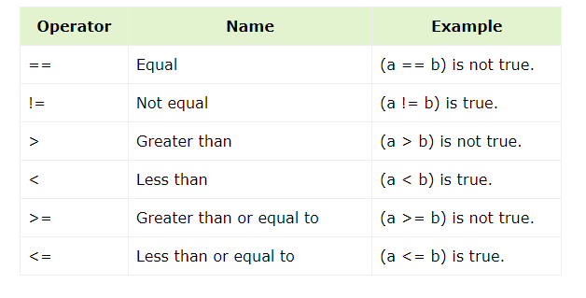
Comparison Operators:
Hafsa Sultana, CSE, KU

Slide 21
Practical Exercises
1. Square of a Number
Input: Enter a number: 5
Output: 25
2. Power of a number
Input: Enter the number: 4
Enter the power number:3
Output: 64
Hafsa Sultana, CSE, KU

Slide 22
Practical Exercises
3. Concatenate Two Strings
Input: Enter the first word: Hello
Enter the second word: World
Output: HelloWorld
4. Print the First and Last Character
Input: Enter a word: Python
Output: First character: P
Last character: n
Hafsa Sultana, CSE, KU

Slide 23
Practical Exercises
5. Extract a Substring
Input: Enter the String: " Believe in Yourself!“
Output: The area is: Believe
6. Skip Characters in a String
Input: Enter the String: "hello, How are you??“
Output: The area is: How are you??“
Hafsa Sultana, CSE, KU

Slide 24
Practical Exercises
7. Draw:
*
**
***
****
*****
8. Draw:
*
***
*****
*******
*********
9. Draw:
*
***
*****
*******
*********
*******
*****
***
*
10. Draw:
*****
* *
* *
* *
*****
11. Draw:
* *
* *
*
* *
* *
12. Draw:
*
* *
* *
* *
* *
* *
* *
* *
*
13. Draw: (W)
* * * *
* * * * * *
* * * * * *
* * *
Hafsa Sultana, CSE, KU

Slide 25
Any Question?

Slide 26
References
https://www.w3schools.com/python/
https://www.futurelearn.com/info/courses/introduction-to-programming-with-python-fourth-rev-/0/steps/264867
https://www.tutorialspoint.com/python/
Hafsa Sultana, CSE, KU

