Slide 1
Python Programming Language
Lecture 6: If –Else and Problem Solving
Hafsa Sultana
Computer Science and Engineering
Khulna University

Slide 2
Today’s Learning Objectives
Decision Making
Conditional Statements
If-Else Constructs
Practical Exercises
Hafsa Sultana, CSE, KU

Slide 3
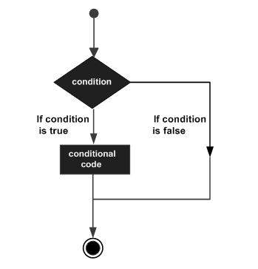
Decision Making
Decision structures evaluate multiple expressions that produce TRUE or FALSE as outcome.
Hafsa Sultana, CSE, KU

Slide 4
What are Conditional Statements?
Definition: Instructions that only run when a certain condition is true.
Importance: Allows programs to make decisions and execute different code paths.
Logical conditions:
Equals: a == b
Not Equals: a != b
Less than: a < b
Less than or equal to: a <= b
Greater than: a > b
Greater than or equal to: a >= b
Hafsa Sultana, CSE, KU

Slide 5
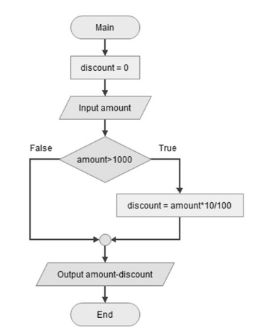
If Statement
Let us consider an example of a customer entitled to 10% discount if his purchase amount is > 1000; if not, then no discount is applicable.
Hafsa Sultana, CSE, KU

Slide 6
Simple If Statement
Syntex: if expression:
statement(s)
if condition:
# code to execute if the condition is true
Example: Check if a number is positive
num = 5
if num > 0:
print("The number is positive")
Hafsa Sultana, CSE, KU

Slide 7
If-Else Statement
Syntax:
if condition:
# code to execute if condition is true
else:
# code to execute if condition is false
Example: Check if a number is even or odd.
num = 4
if num % 2 == 0:
print("The number is even")
else:
print("The number is odd")
Hafsa Sultana, CSE, KU

Slide 8
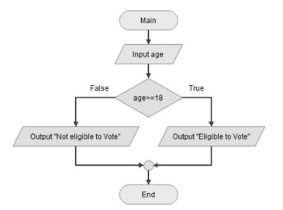
If-Else Statement
Example: The variable age can take different values. If the expression "age > 18" is true, the message you are eligible to vote is displayed otherwise not eligible message should be displayed.
Code:
age=25
print ("age: ", age)
if age >=18:
print ("eligible to vote")
else:
print ("not eligible to vote")
Hafsa Sultana, CSE, KU

Slide 9
Short Hand If ... Else
Example:
a = 2
b = 330
print("A") if a > b else print("B")
Hafsa Sultana, CSE, KU

Slide 10
Using Boolean Operators
Boolean operators: and, or, not
Example: Check if a number is positive and less than 10.
num = 7
if num > 0 and num < 10:
print("The number is positive and less than 10")
Hafsa Sultana, CSE, KU

Slide 11
If-Else with Strings
Example: Check if a string is empty.
my_string = “”
if my_string == “”:
print("The string is empty")
else:
print("The string is not empty")
Hafsa Sultana, CSE, KU

Slide 12
Practical Example 1
Check if a user is old enough to vote.
Input: age
Output: if age>=18 then print "You are old enough to vote" otherwise print "You are not old enough to vote“.
Hafsa Sultana, CSE, KU

Slide 13
Practical Example 2
Determine if the temperature is hot, cold, or just right.
temperature = 25
if temperature > 30:
print("It's hot")
elif temperature < 15:
print("It's cold")
else:
print("The temperature is just right")
Hafsa Sultana, CSE, KU

Slide 14
Common Mistakes
Forgetting the colon: after the condition.
Incorrect indentation.
Using = instead of == for comparison.
Hafsa Sultana, CSE, KU

Slide 15
Debugging Tips
Use print statements to check variable values.
Carefully read error messages.
Test each condition separately.
Hafsa Sultana, CSE, KU

Slide 16
Practical Exercise 3
Title: Guessing Game
Write a program that
The secret number is predefined as 7.
The user is prompted to enter their guess.
The program checks if the guess is equal to the secret number.
If the guess is correct, it prints "You guessed it!".
If the guess is incorrect, it prints "Try again!".
Input1: Guess the number: 7
Output: You guessed it!
Input2: Guess the number: 3
Output: Try again!
Hafsa Sultana, CSE, KU

Slide 17
Practical Exercise 4
Title: Password Check
Write a program that asks the user to enter a password. If the password matches the predefined password, print "Access granted". If it does not match, print "Access denied".
Input1: Enter the password: python123
Output: Access granted
Input2: Enter the password: wrong12password
Output: Access denied
Hafsa Sultana, CSE, KU

Slide 18
Practical Exercise 5
Title: Leap year
Write a program that prompts the user to enter a year and checks if the year is a leap year. A year is a leap year if:
If a year is evenly divisible by 4 means having no remainder then go to the next step. If it is not divisible by 4. It is not a leap year. For example: 1997 is not a leap year.
If a year is divisible by 4, but not by 100. For example: 2012, is a leap year. If a year is divisible by both 4 and 100, go to the next step.
If a year is divisible by 100, but not by 400. For example: 1900, then it is not a leap year. If a year is divisible by both, then it is a leap year. So 2000 is a leap year.
Input1: Enter a year: 2020
Output: The year is a leap year.
Input2: Enter a year: 1900
Output: The year is not a leap year.
Hafsa Sultana, CSE, KU

Slide 19
Recap
Conditional Statements
If-Else Constructs
Elif and Nested If Statements
Practical Examples
Hafsa Sultana, CSE, KU

Slide 20
Any Question?

Slide 21
References
https://www.w3schools.com/python/
https://www.tutorialspoint.com/python/
Hafsa Sultana, CSE, KU

