Slide 1
Backtracking
Md Mehrab Hossain Opi

Slide 2
Permutation Generation
Let’s start with a basic problem.
Find all possible permutations of integers from 1 to n.
For example, when n = 3
We get
{1,2,3}
{1,3,2}
{2,1,3}
{2,3,1}
{3,1,2}
{3,2,1}

Slide 3
Permutation Generation
We can solve the problem recursively.
The recursion tree will look like this.
root
1
2
3
Every path from root to leaf
is a permutation.
2
3
1
3
1
2
3
2
3
1
2
1

Slide 4
Permutation Generation
We need to know
How we can generate the tree.
How we can keep track of items.
We can use backtracking.

Slide 5
Backtracking
General algorithmic technique.
Useful for problems where you need to find a solution through a series of choices
But some choices may lead to dead ends.
Works by incrementally building a solution one piece at a time
If at any point a chosen path does not lead to a valid solution it backs up to the previous step.

Slide 6
Permutation Generation Using Backtracking
We will create a dfs-like function.
We need two additional data structure
One to maintain current element in the permutation.
One to maintain available numbers we can consider.

Slide 7
Permutation Generation using Backtracking
Pseudocode
procedure generate(idx)
if idx == n
print position
return
for i from 0 to n
if taken[i] == False
taken[i] = true
position[idx] = i
generate(idx+1)
taken[i] = false

Slide 8
Permutation Generation Simulation
root
Visited Array
1 | 2 | 3
0 | 0 | 0
Permutation Array
1 | 2 | 3
- | - | -

Slide 9
Permutation Generation Simulation
root
Visited Array
1 | 2 | 3
1 | 0 | 0
1
Permutation Array
1 | 2 | 3
1 | - | -

Slide 10
Permutation Generation Simulation
root
Visited Array
1 | 2 | 3
1 | 1 | 0
1
Permutation Array
2
1 | 2 | 3
1 | 2 | -

Slide 11
Permutation Generation Simulation
root
Visited Array
1 | 2 | 3
1 | 1 | 1
1
Permutation Array
2
1 | 2 | 3
1 | 2 | 3
3

Slide 12
Permutation Generation Simulation
root
Visited Array
1 | 2 | 3
1 | 1 | 0
1
Permutation Array
2
1 | 2 | 3
1 | 2 | -
3

Slide 13
Permutation Generation Simulation
root
Visited Array
1 | 2 | 3
1 | 0 | 0
1
Permutation Array
2
1 | 2 | 3
1 | - | -
3

Slide 14
Permutation Generation Simulation
root
Visited Array
1 | 2 | 3
1 | 0 | 1
1
Permutation Array
2
3
1 | 2 | 3
1 | 3 | -
3

Slide 15
Permutation Generation Simulation
root
Visited Array
1 | 2 | 3
1 | 1 | 1
1
Permutation Array
2
3
1 | 2 | 3
1 | 3 | 2
3
2

Slide 16
Permutation Generation Simulation
root
Visited Array
1 | 2 | 3
1 | 0 | 1
1
Permutation Array
2
3
1 | 2 | 3
1 | 3 | -
3
2

Slide 17
Permutation Generation Simulation
root
Visited Array
1 | 2 | 3
1 | 0 | 0
1
Permutation Array
2
3
1 | 2 | 3
1 | - | -
3
2

Slide 18
Permutation Generation Simulation
root
Visited Array
1 | 2 | 3
0 | 0 | 0
1
Permutation Array
2
3
1 | 2 | 3
- | - | -
3
2
The process continues until all path are discovered.

Slide 19
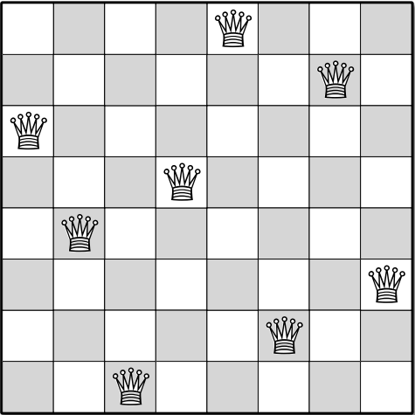
N-Queen Problem
Place N queens in a N*N chess board.
No two queens should attack each other.

Slide 20
N-Queen Problem
Let’s try to solve the problem using backtracking.
What kind of data structure do we need now?
A 2D matrix that indicates the position of the queens.

Slide 21
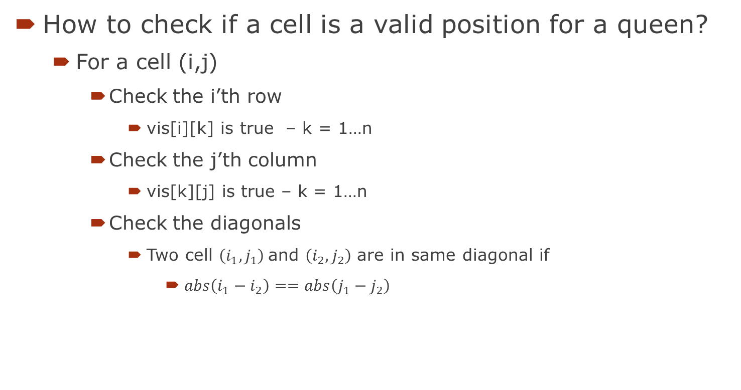
N-Queen Problem
How to check if a cell is a valid position for a queen?
For a cell (i,j)
Check the i’th row
vis[i][k] is true – k = 1…n
Check the j’th column
vis[k][j] is true – k = 1…n
Check the diagonals
Two cell $\left(i_{1},j_{1}\right)$and $\left(i_{2},j_{2}\right)$ are in same diagonal if
$abs\left(i_{1}−i_{2}\right)==abs\left(j_{1}−j_{2}\right)$

Slide 22
Implementation
8-Queen Problem - Pastes.io

