Slide 1

SimpleTutors
Subtitle

Slide 2

Academic Obstacles
Studying individually has its perks: it’s a comfortable, low-pressure environment. However, there are a few reasons it can be difficult to study on your own; with so many distractions, it’s easy to procrastinate—when you do start, it’s easy to get off track.
Tutoring can help strengthen subject understanding, boost confidence, and build important learning skills . Tutoring gives students individualized attention that they don't get in a crowded classroom. This helps children who struggle to keep up, as well as those who aren't challenged enough.

Slide 3
SimpleTutors - Advantages
Easily view tutor profiles and request for tutoring
Leave feedback on tutoring as a student
Chatting Between Student and Tutors
Create Tutor profile
Create Student profile

Slide 4
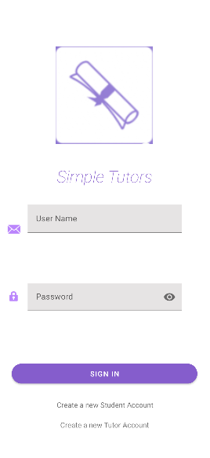
Log-In
Features:
Hidden Password
Create New Student Account
Create New Tutor Account

Slide 5

Create User Profile

Slide 6
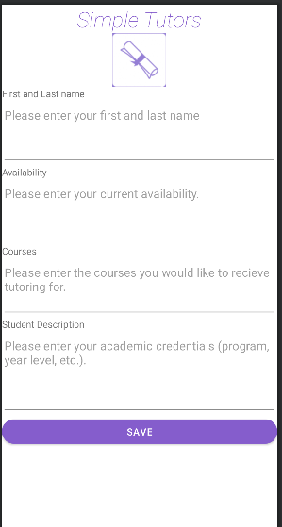
Student Profile Data
Student Name
Availability
Courses
Academic Background

Slide 7
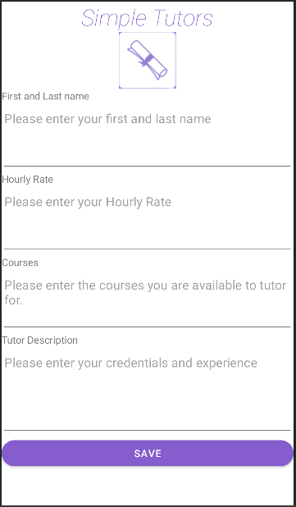
Tutor Profile Data
Tutor Name
Hourly Rate
Courses
Experience/Background

Slide 8

Student Landing Page
Browse Tutors
Chat with a Tutor
Send Feedback
Request Tutor
Log Out

Slide 9

Tutor Landing Page
Chat with Students
Update Account Profile
Log Out

Slide 10
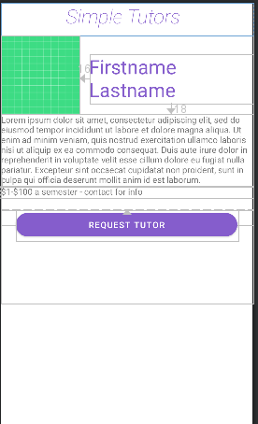
Student – Tutor Request

Slide 11
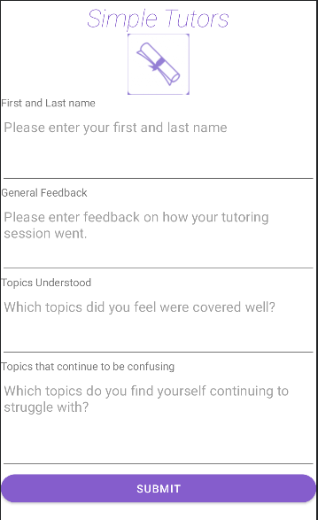
Student Feedback Form

Slide 12
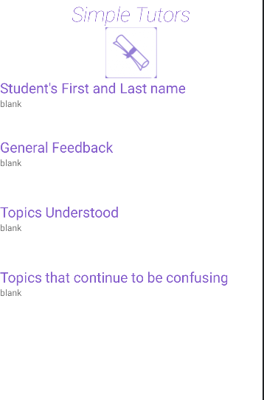
Tutor – View Student Feedback

Slide 13
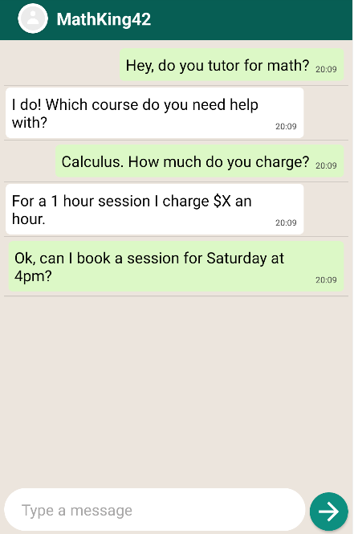
Chat Window

Slide 14
THANK YOU!!!

