Slide 1

Covid-19 Project
Hagar El-Bayuomy

Slide 2
Table of content
Introduction
Data Exploration
Data load and transformation
Data Analysis
Data visualization

Slide 3

Introduction
Beyond headlines and case counts, the true story of the pandemic lies hidden in the shadows: excess deaths. In 2020 and 2021, across continents, an additional 10.23M lives were lost than would have been expected under normal circumstances. These numbers, more than just a cold statistic, represent untold stories of grief and loss. Today, we'll embark on a data-driven journey to unveil this hidden toll, understand its patterns, and uncover the human stories buried within these figures.

Slide 4
Data Exploration
My first strategic move was to divide the dataset into two tables: 'CovidDeaths' and 'CovidVaccinations.' This separation lays the groundwork for a focused exploration, allowing us to dissect and analyze each aspect of the pandemic individually.
Checking Structure: Utilized SELECT * to peek into the content of each table, gaining an initial understanding of the dataset's structure.
Employed stored procedures, specifically sp_help, to delve deeper into data types and overall structural characteristics. This step provided a foundational understanding of the dataset's architecture.
Initial Exploration:Applied aggregated functions to garner insightful information. Techniques like grouping, summing, and counting were instrumental in revealing patterns within the data.

Slide 5

Data Exploration(Question answered to explore the data).
1. Setting the Stage:
Total Cases Vs. Populations
What percentage of the population got COVID?
2. Understanding Impact:
Total Cases Vs. Total Deaths
Likelihood of dying if you contract COVID in your Country.
3. Identifying Hotspots:
Countries with the highest infection rate compared to the population
Countries with the highest death count per population
4. Continental Breakdown:
Break things down by Continent
Continents with the highest death count per population

Slide 6
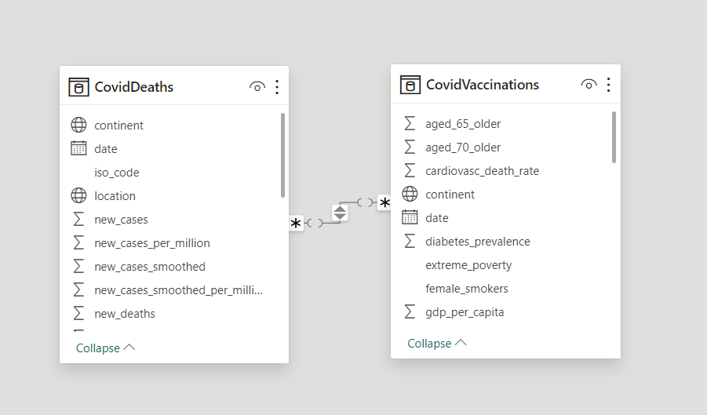
Data load and Transformation
Used power Bi and power query editor
Deleted unnecessary columns
Created a relation between two tables

Slide 7
Data Analysis
DAX Measures for Essential Insights:
1 Total Cases:
Using DAX measures, I've precisely calculated the total number of COVID-19 cases—a fundamental metric that serves as our baseline for understanding the scale of the pandemic.
2 Total Dying:
Another critical measure accounts for the total number of deaths, providing insight into the human toll of the virus.
3 Percentage of Death:
Calculating the death percentage offers a nuanced perspective on the severity of the pandemic.
4 Percentage of Infected rate:
The infection rate, derived through DAX measures, gives us a dynamic measure of how the virus has spread within different regions.

Slide 8
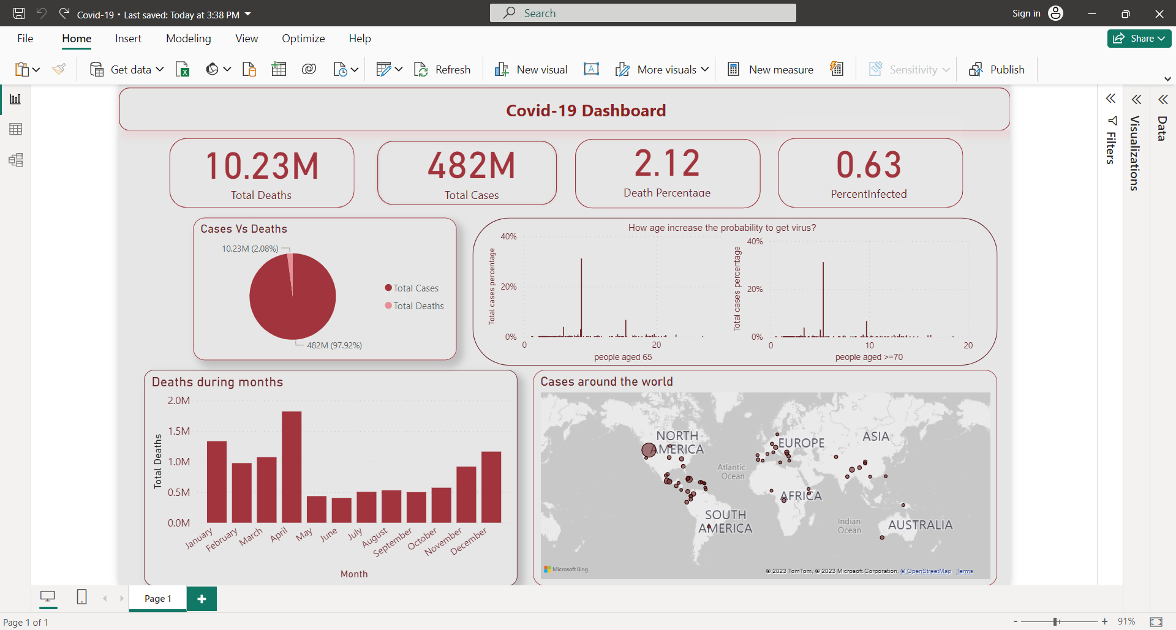
Analytical Viewpoints:
How many cases there was?
How many deaths ?
What is the death percentage?
What is the infection rate?

Slide 9
Analytical Viewpoints cont.
How cases were around the world?

Slide 10
Analytical Viewpoints cont.
How many of cases died?

Slide 11
Analytical Viewpoints cont.
During the duration between 2020:2021 how deaths was ?

Slide 12
Analytical Viewpoints cont.
Does the age increasing the probability to get the virus?

Slide 13
Data visualization
Full Dashboard

Slide 14
Thanks

