Slide 1
Hypothesis
Team: September
Team Members:
Omnia Mohyee
Reham Hamdy
Zeinab Rabie
Hagar Haytham

Slide 2
Introduction
Hypothesis is a Python library for creating unit tests which are simpler to write and more powerful when run, finding edge cases in your code you wouldn’t have thought to look for. It is stable, powerful and easy to add to any existing test suite.
Property-based testing.

Slide 3
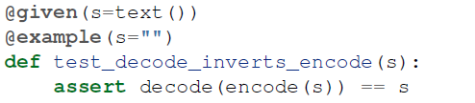
Example on property-based testing.

Slide 4
Getting Started with Hypothesis
The main important feature of hypothesis is using strategies for generating different inputs meeting some input specification.

Slide 5
Strategy
Object with methods that describe how to generate and simplify certain kinds of values.

Slide 6

Strategy
Generating inputs of generic data types ( integer , float , char , etc ….)

Slide 7
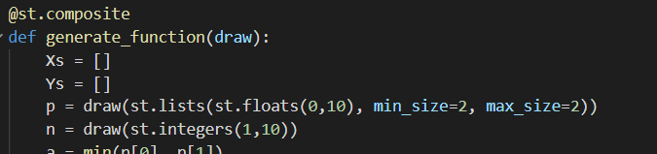
Strategy - Lists

Slide 8

Strategy - Regular Expressions

Slide 9

Strategy - Regular Expressions
Example : generated expressions

Slide 10
On using numpy function
Hypothesis offers a number of strategies for NumPy testing, available in the hypothesis.extra.numpy package.

Slide 11

assume() function
Services as a filter for unwanted test inputs.

Slide 12
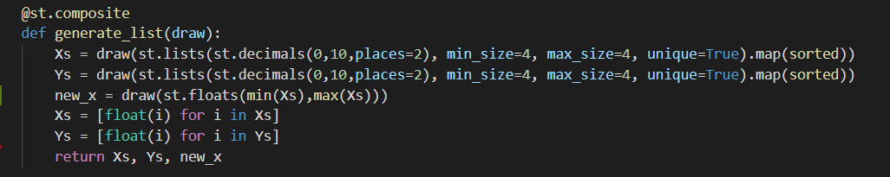
Composite decorator
Appropriate for customized strategies.
very useful for reusing the code.

Slide 13
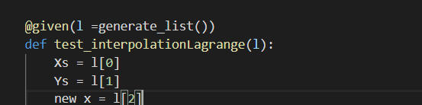
Composite decorator
How to use this function?

Slide 14
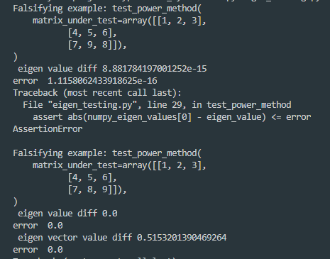
How failure appears?
Normally the output of a failing test will look something like this

Slide 15
How failure appears?
Normally the output of a failing test will look something like:

Slide 16

but this may not be enough!
* You may what to know the value of specific variable during the test.
* Using note(value) will report this value in the final execution.

Slide 17
Our Project
Numerical Analysis tool :
An integration of multiple programs that solve mathematical problems using numerical analysis techniques.

Slide 18
Project Main Functions
Interpolation
Integration ( trapezoidal - simpsons )
Eigenvalues & Eigenvectors ( power method - deflate )
Linear System of Equation
Interpolation then differentiation
Extrapolation ( Richardson )
Curve Fitting
Partial differential Equations

