Slide 1

InspireLink
Team Name:
Ayat ElHussiny
Hager Nasser
A’laa Ahmed
Under Supervisor
Omnia Abdelhamid
Technical Company
AST

Slide 2
Project Overview
Our website helps people with disabilities find job opportunities and communicate with employers to know the details of this work.
They can also communicate with their friends to exchange jobs and information and provide support to each other.
Companies can upload their available jobs to help people with disabilities.

Slide 3
Features
A person can create a profile and add his skills and data.
He can also see the jobs he applied for and the details of the job.
He can search for specific jobs by writing the job name in the search box.
He can communicate with employers and know more details about the job he applied for.
By communicating, he can know whether he was accepted for the job or not.

Slide 4
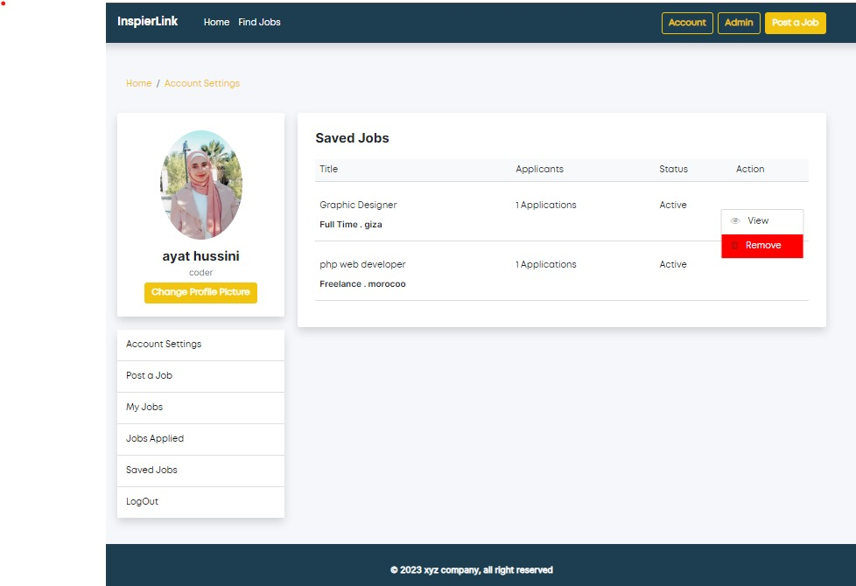
Action Of Saved Jobs
Ayat’s Part

Slide 5
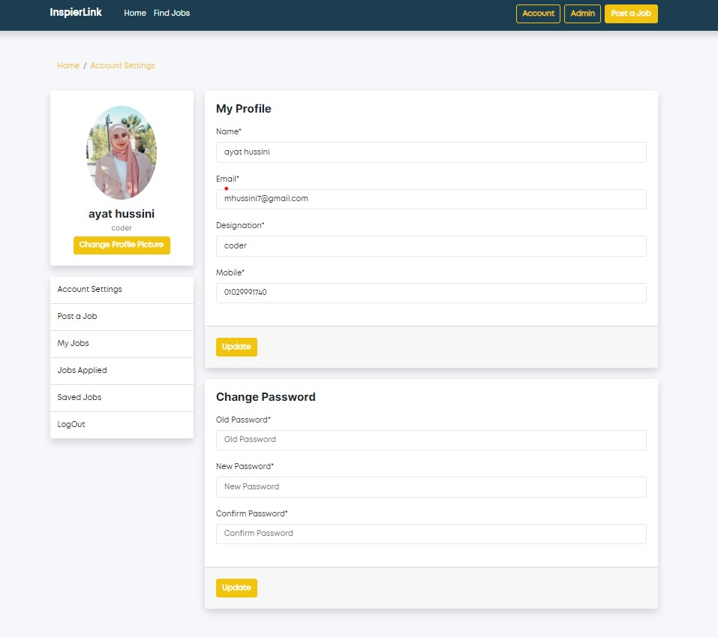
Profile Page

Slide 6
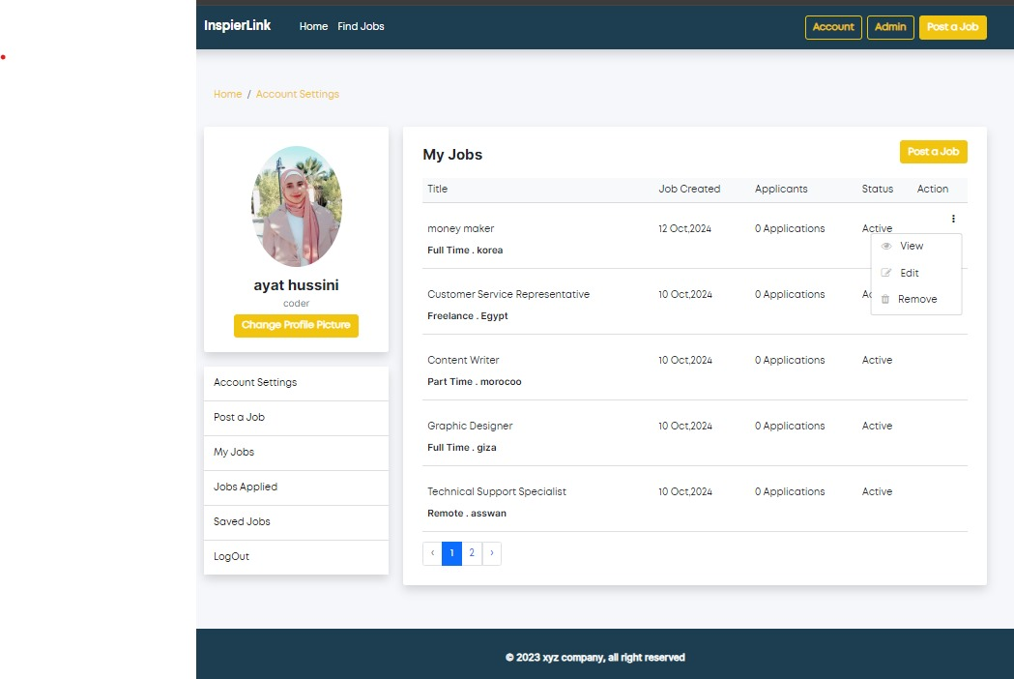
My Jobs

Slide 7
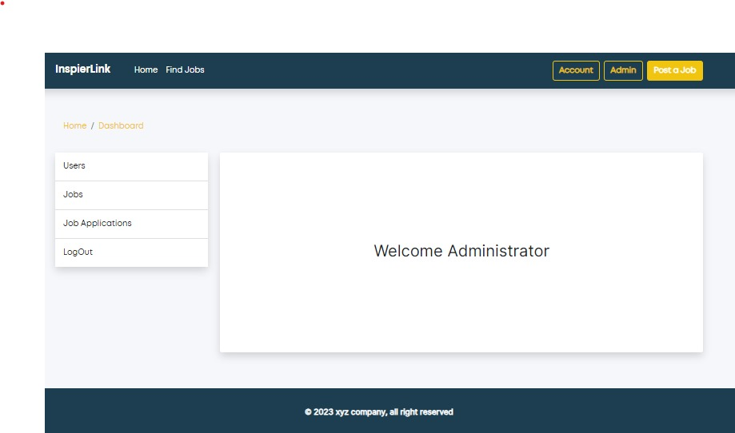
Dashboard Admin

Slide 8
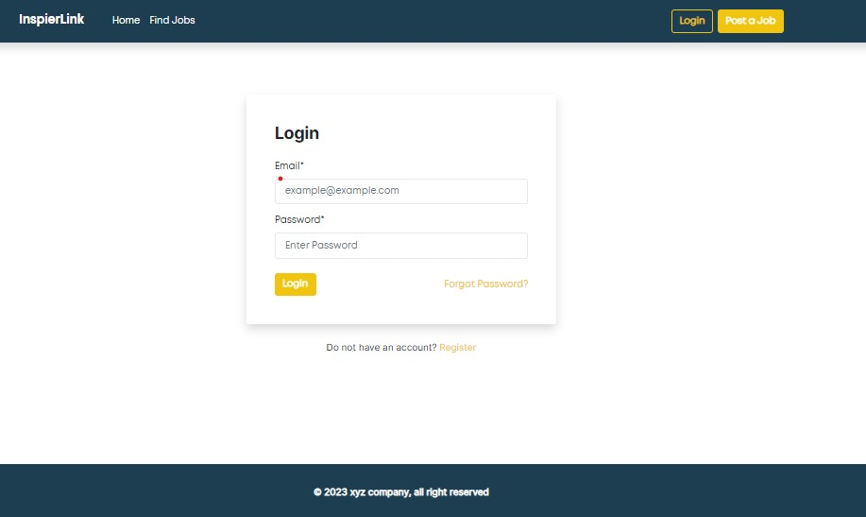
Login Page

Slide 9
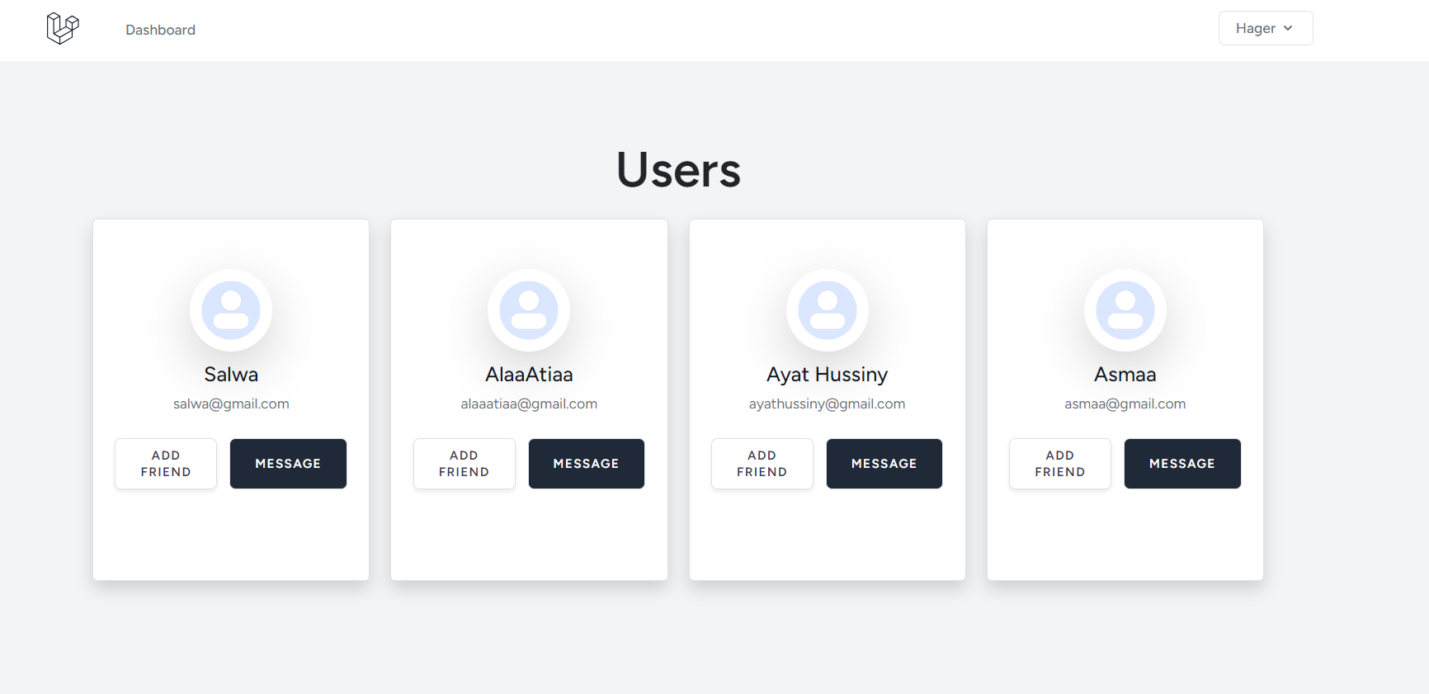
Hager And A’laa Users Page

Slide 10
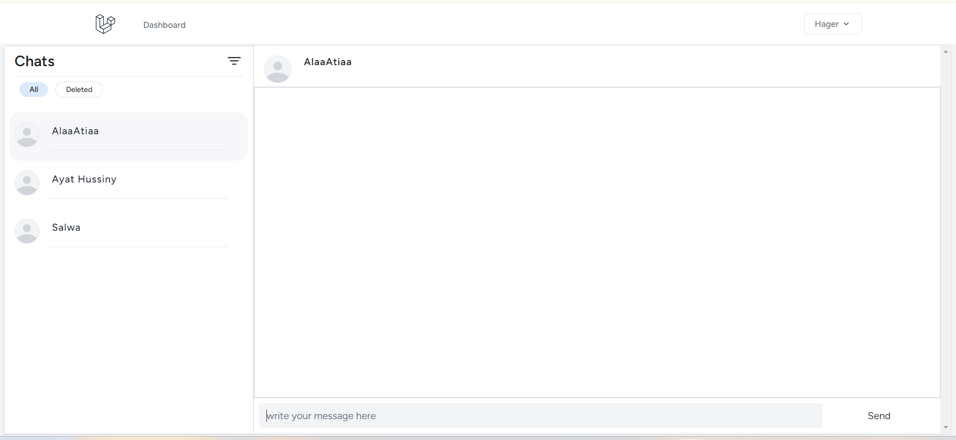
Chat Parts

Slide 11
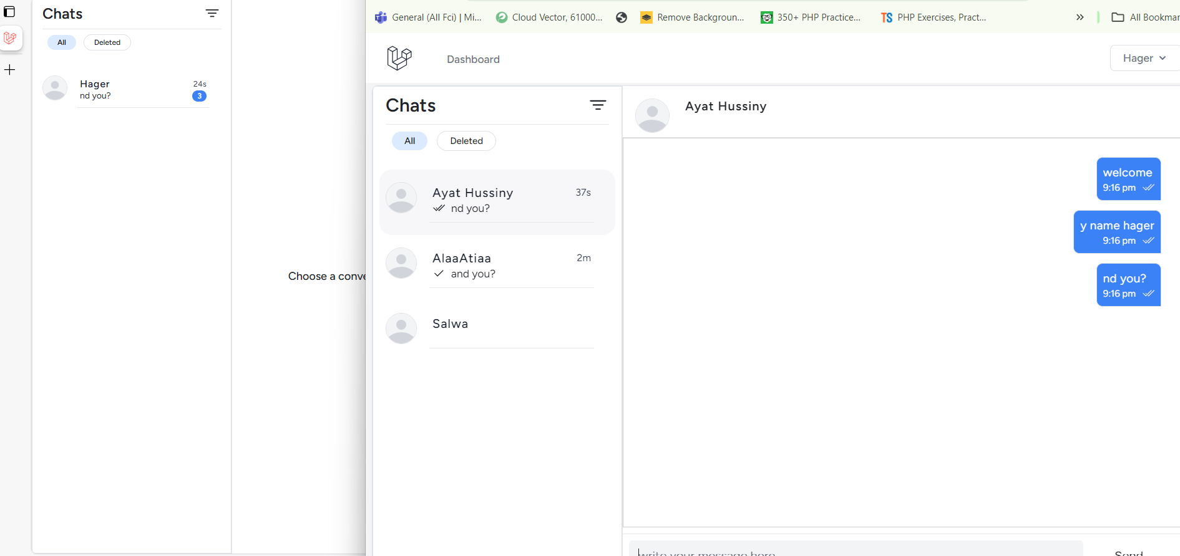
Chats Parts

Slide 12
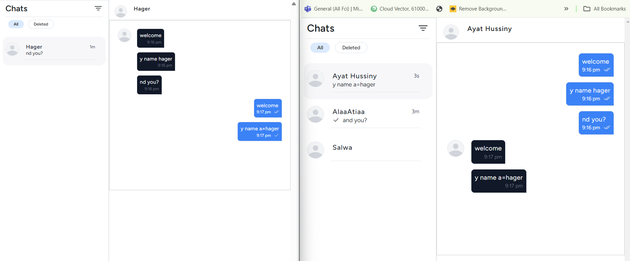
Chat Parts

Slide 13
Future plans
Enabling people with disabilities to post their work for their friends to see, comment on, and offer encouragement and enthusiasm.
We can make the site more secure by sending correspondence requests first and the recipient of the message can approve the correspondence or not.
We can improve the front-end of the site to suit people with visual impairments.
We can improve the performance of the site to suit people with visual impairments using artificial intelligence

Slide 14
Thanks

