Slide 1

Industrial Training Presentation
Wafer 8” Production – Preventive and Maintenance
Presenter Name : LIM YU WEN
University : TUNKU ABDUL RAHMAN UNIVERSITY OF MANAGEMENT AND TECHNOLOGY (TARUMT)
Training Period : 27 OCTOBER 2025 – 16 JANUARY 2026 ( 12 WEEKS )
Department : CVD AND DIFFUSION
Superior : MR MUHAMAD AMIRUL NAZRIN
Lecturer : MR TAN YONG LI
1

Slide 2
Table of Contents
1. Introduction of FEM
2. Job Scope
3. Training Content
4. Project
5. Q&A
2

Slide 3
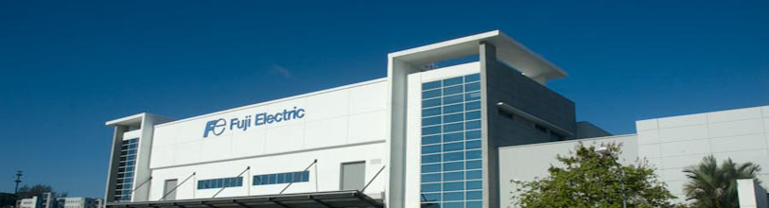
Fuji Electric Malaysia (FEM)
Incorporated : February 1996
Initial Operations : Magnetic Disk Production
March 2008 : Establishment of Fuji Electric Semiconductor (Malaysia) Sdn. Bhd. for IGBT module manufacturing
April 2015 : Magnetic disk and semiconductor businesses merged into single entity
July 2021 : Magnetic Media Business Division ceased operation
3

Slide 4
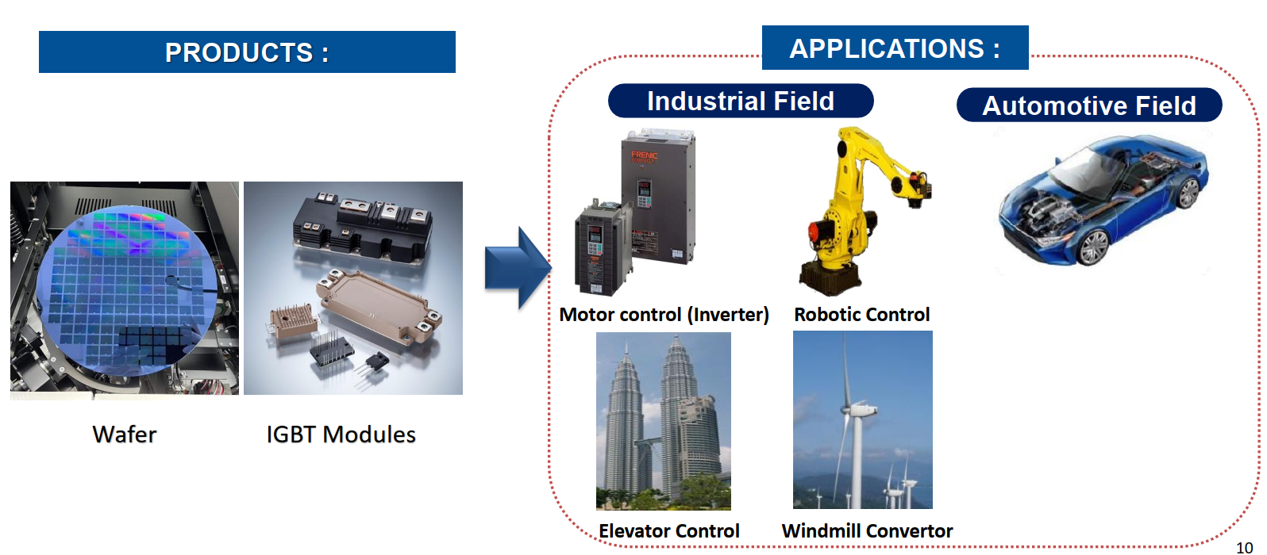
4

Slide 5
5

