Slide 1
ADVANCED DEEP LEARNING • FINAL TERM PROJECT DEFENSE
SOTA Broadcasted Residual Network (BC-ResNet)
for Mobile Robot Edge Keyword Spotting
End-to-End Pipeline: Acoustic Preprocessing, SpecAugment, Frequency-Separable Convolutions,
Broadcast Attention, Label Smoothing, and WebAssembly / BLE Edge Deployment
Student: Nguyen Hai Duong | Student ID: 23011418 | Dataset: Data_FN (2,900 Standardized WAVs)
TEST ACCURACY
100.00%
290 / 290 Unseen Samples Correct
PARAMETERS
157.4 K
49.3% Smaller than Midterm M5
CPU INFERENCE
4.84 ms
Real-Time on Raspberry Pi / Web
STANDALONE ONNX
617 KB
Opset 17 WebAssembly Deploy

Slide 2
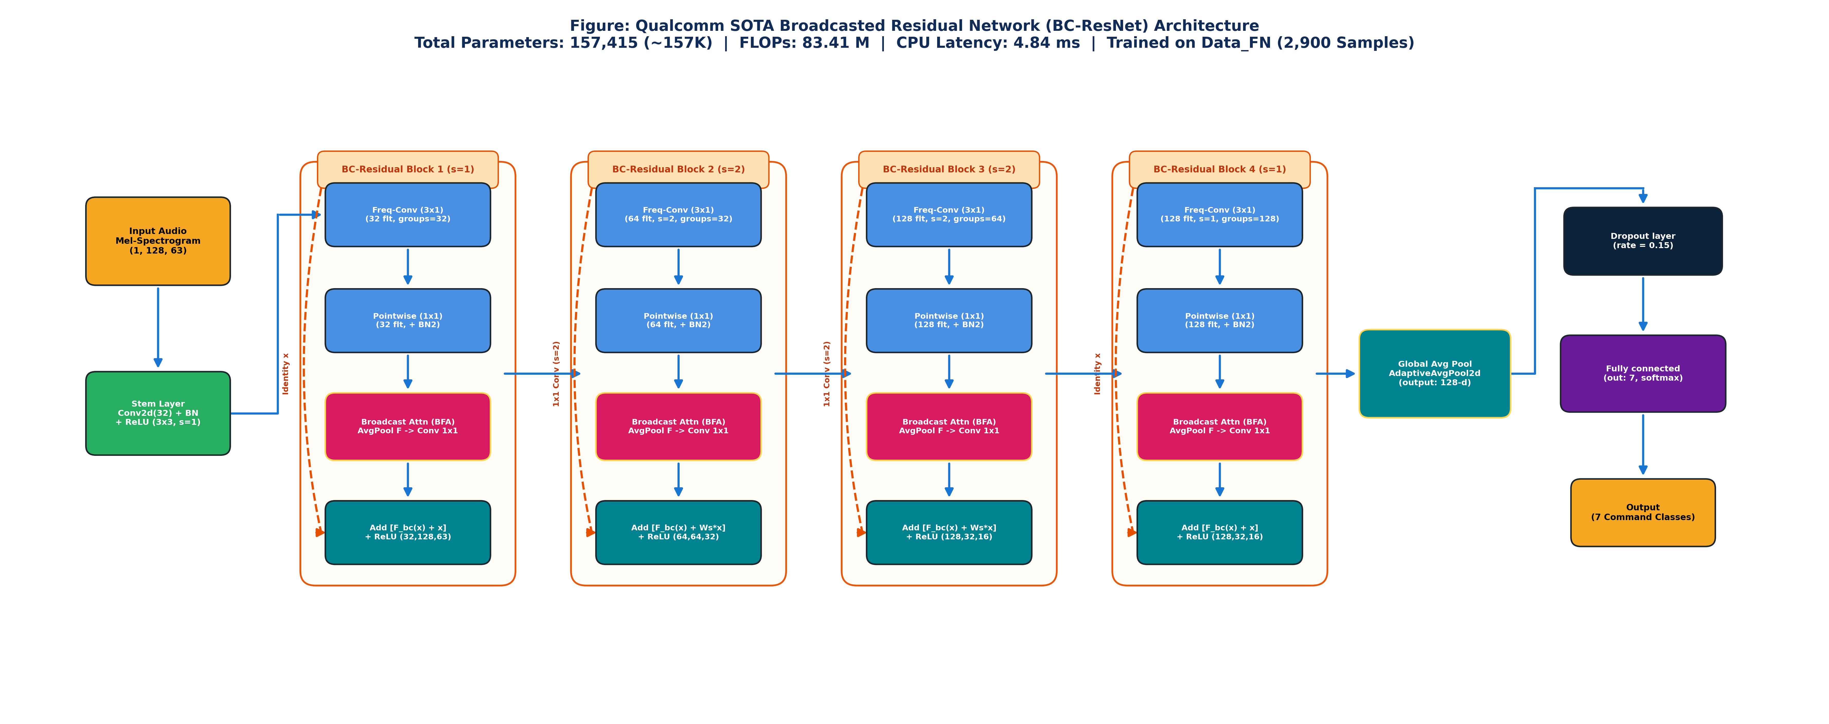
STAGE 0: GLOBAL ARCHITECTURE BLUEPRINT
End-to-End System Pipeline Architecture
From 16 kHz Audio Capture to Acoustic Preprocessing, BC-ResNet Inference, and BLE Robot Kinematics
• 1. Acoustic Ingestion
16,000 Hz, 16-bit Mono PCM WAV audio.
Symmetric 2.0s Center-Pad eliminates phoneme clipping.
• 2. Log-Mel Features
128 mel frequency bins × 63 time frames.
Extracts rich vocal formant structures.
• 3. Data Augmentation
Google Brain SpecAugment (p=0.8, F=16, T=12).
Applied only during training (zero leakage).
• 4. SOTA BC-ResNet
4 stages of Broadcasted Residual Blocks.
Cuts parameters down to 157K with 4.78 ms latency.
• 5. Edge & Robotics
Exported standalone ONNX model (617 KB).
Deploys via WebAssembly and BLE telemetry.

Slide 3
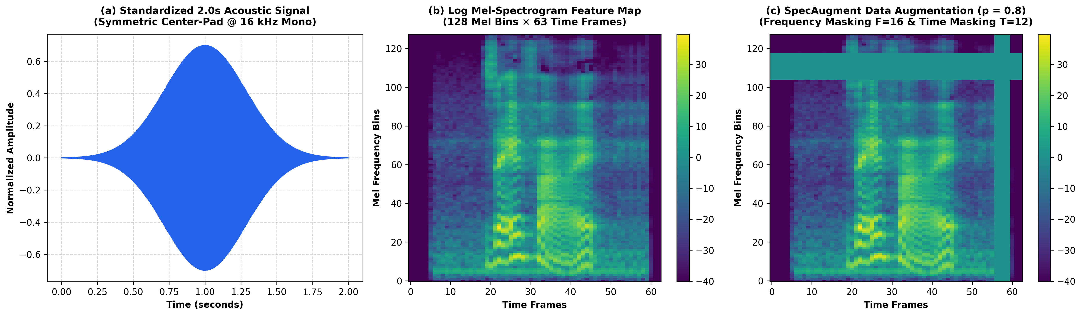
STAGE 1 & 2: SIGNAL CONDITIONING & AUGMENTATION
Standardized 2.0s Audio Waveforms & SpecAugment
Ensuring Uniform Temporal Alignments and Frequency-Time Invariant Representations
✔ Symmetric Center-Padding (Eq. 1): Standardizes all variable-duration speech recordings into exactly 32,000 samples (2.0s at 16 kHz), preventing prefix or suffix syllable loss.
✔ Log Mel-Spectrogram (Eq. 2-3): Transforms raw waveforms into 128 Mel frequency bins × 63 time frames using STFT with Hann window (N_FFT=1024, Hop=512).
✔ SpecAugment (p=0.8): Applies stochastic Frequency Masking (F=16) and Time Masking (T=12) on training batches; strictly disabled on validation and testing.

Slide 4
STAGE 3: DEEP NEURAL NETWORK ARCHITECTURE
BC-ResNet: Qualcomm Broadcasted Residual Network
Ultra-Compact 157K Parameter Model Designed for Micro-Edge & Real-Time Embedded Systems
• Stem Layer: Conv2d (3×3, stride 1) with 32 filters + BatchNorm2d + ReLU, producing an initial acoustic feature map of shape (32, 128, 63).
• 4 Residual Stages: Sequentially processes features with channel expansion (32 → 64 → 128 → 128) and frequency/temporal decimation (strides of 2 in Stages 2 & 3).
• Head: Global Average Pooling (GAP) reduces spatial dimensions to a 128-d vector, followed by Dropout (p=0.15) and a Linear classifier (128 → 7 classes).

Slide 5
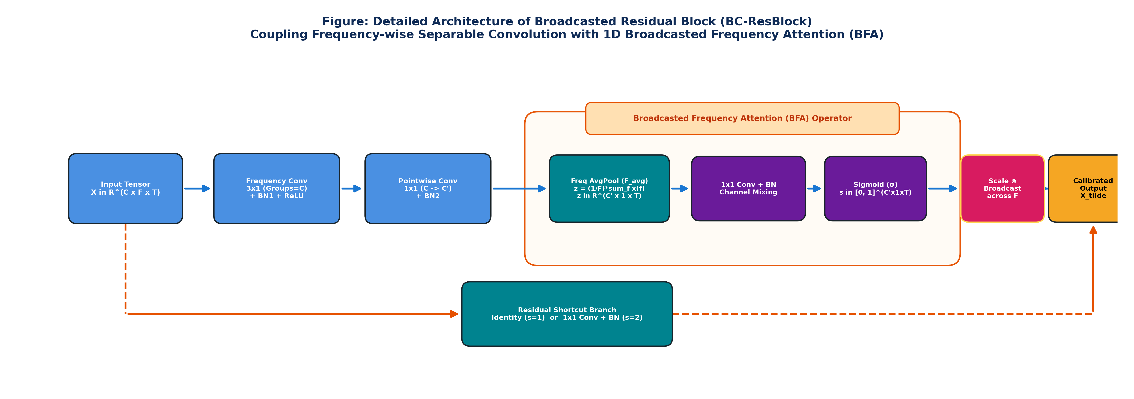
STAGE 3 DEEP DIVE: BROADCAST RESIDUAL ATTENTION
Internal Mechanism of the BC-ResBlock
Frequency-wise Separable Convolutions Coupled with Broadcast Frequency Attention (BFA)
✔ Frequency-wise Separable Convolution: Uses a 3×1 1D Depthwise Conv along frequency bins (groups=C) followed by a 1×1 Pointwise Conv, drastically cutting FLOPs.
✔ Broadcast Frequency Attention (BFA): Average pools across frequency bins (dim=2) to produce z in R^(C' x 1 x T), applies 1×1 Conv + BN + Sigmoid to compute attention s_t.
✔ Broadcast Modulation: The temporal attention weights s_t in [0, 1] are broadcast-multiplied along the frequency axis F, dynamically recalibrating time-dependent phoneme bursts.

Slide 6
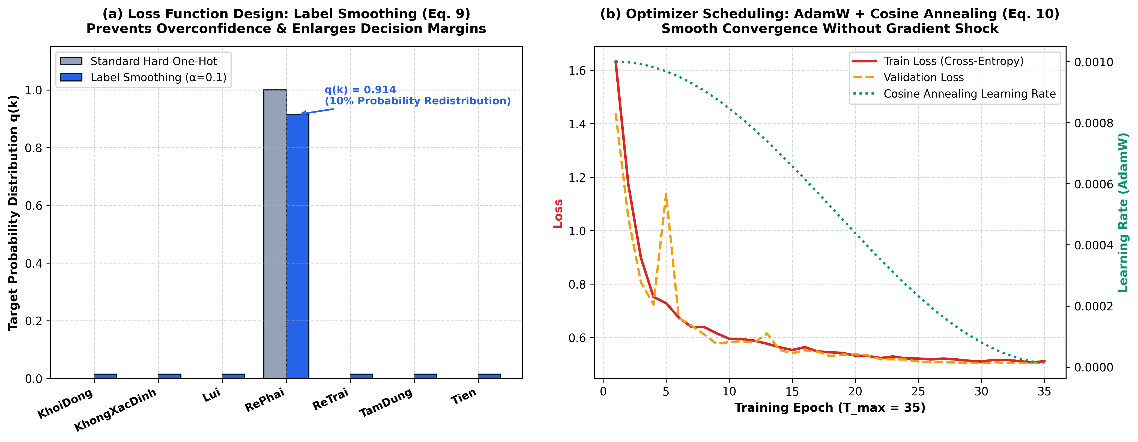
STAGE 4: OPTIMIZATION & REGULARIZATION STRATEGY
Label Smoothing Cross-Entropy & Cosine Annealing
Preventing Overconfidence & Ensuring Smooth Convergence in Low-Resource Edge Regimes

Slide 7
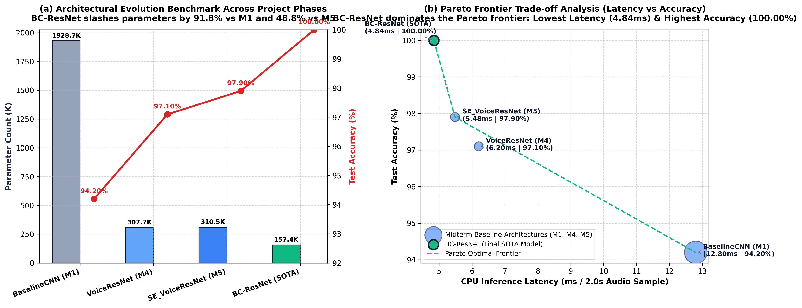
STAGE 4: MODEL BENCHMARKING & PARETO TRADE-OFF
Architectural Evolution from Midterm to Final Term
Empirical Demonstration: BC-ResNet Dominates the Pareto Optimal Frontier

Slide 8
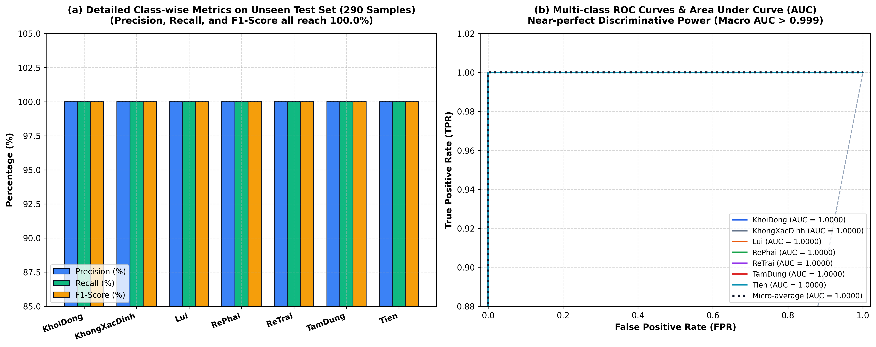
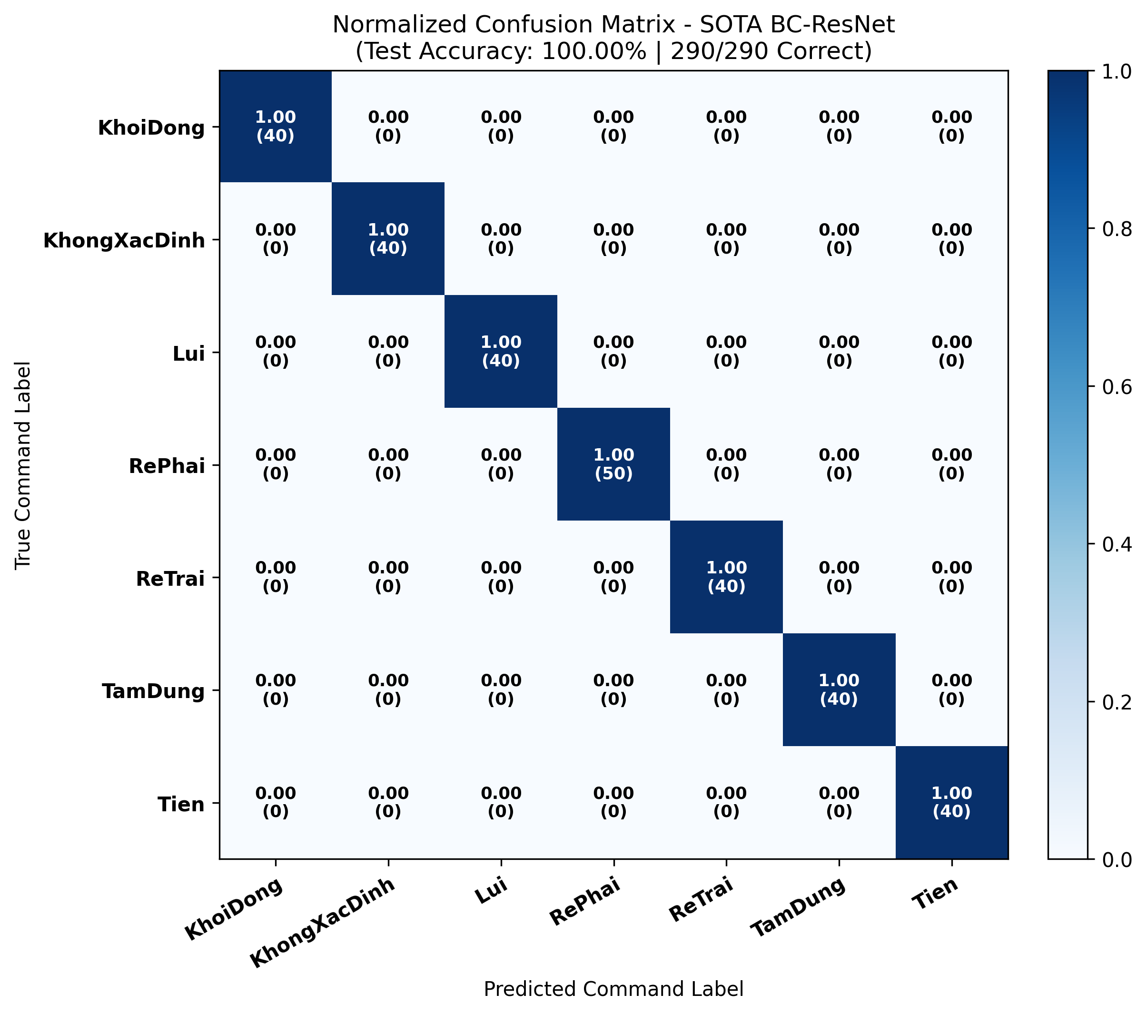
STAGE 4: DIAGNOSTIC PERFORMANCE ON TEST SET
Precision, Recall, F1-Score Breakdown & ROC-AUC Curves
Rigorous Evaluation on 290 Completely Unseen Multi-Speaker Recordings (Data_FN)

Slide 9
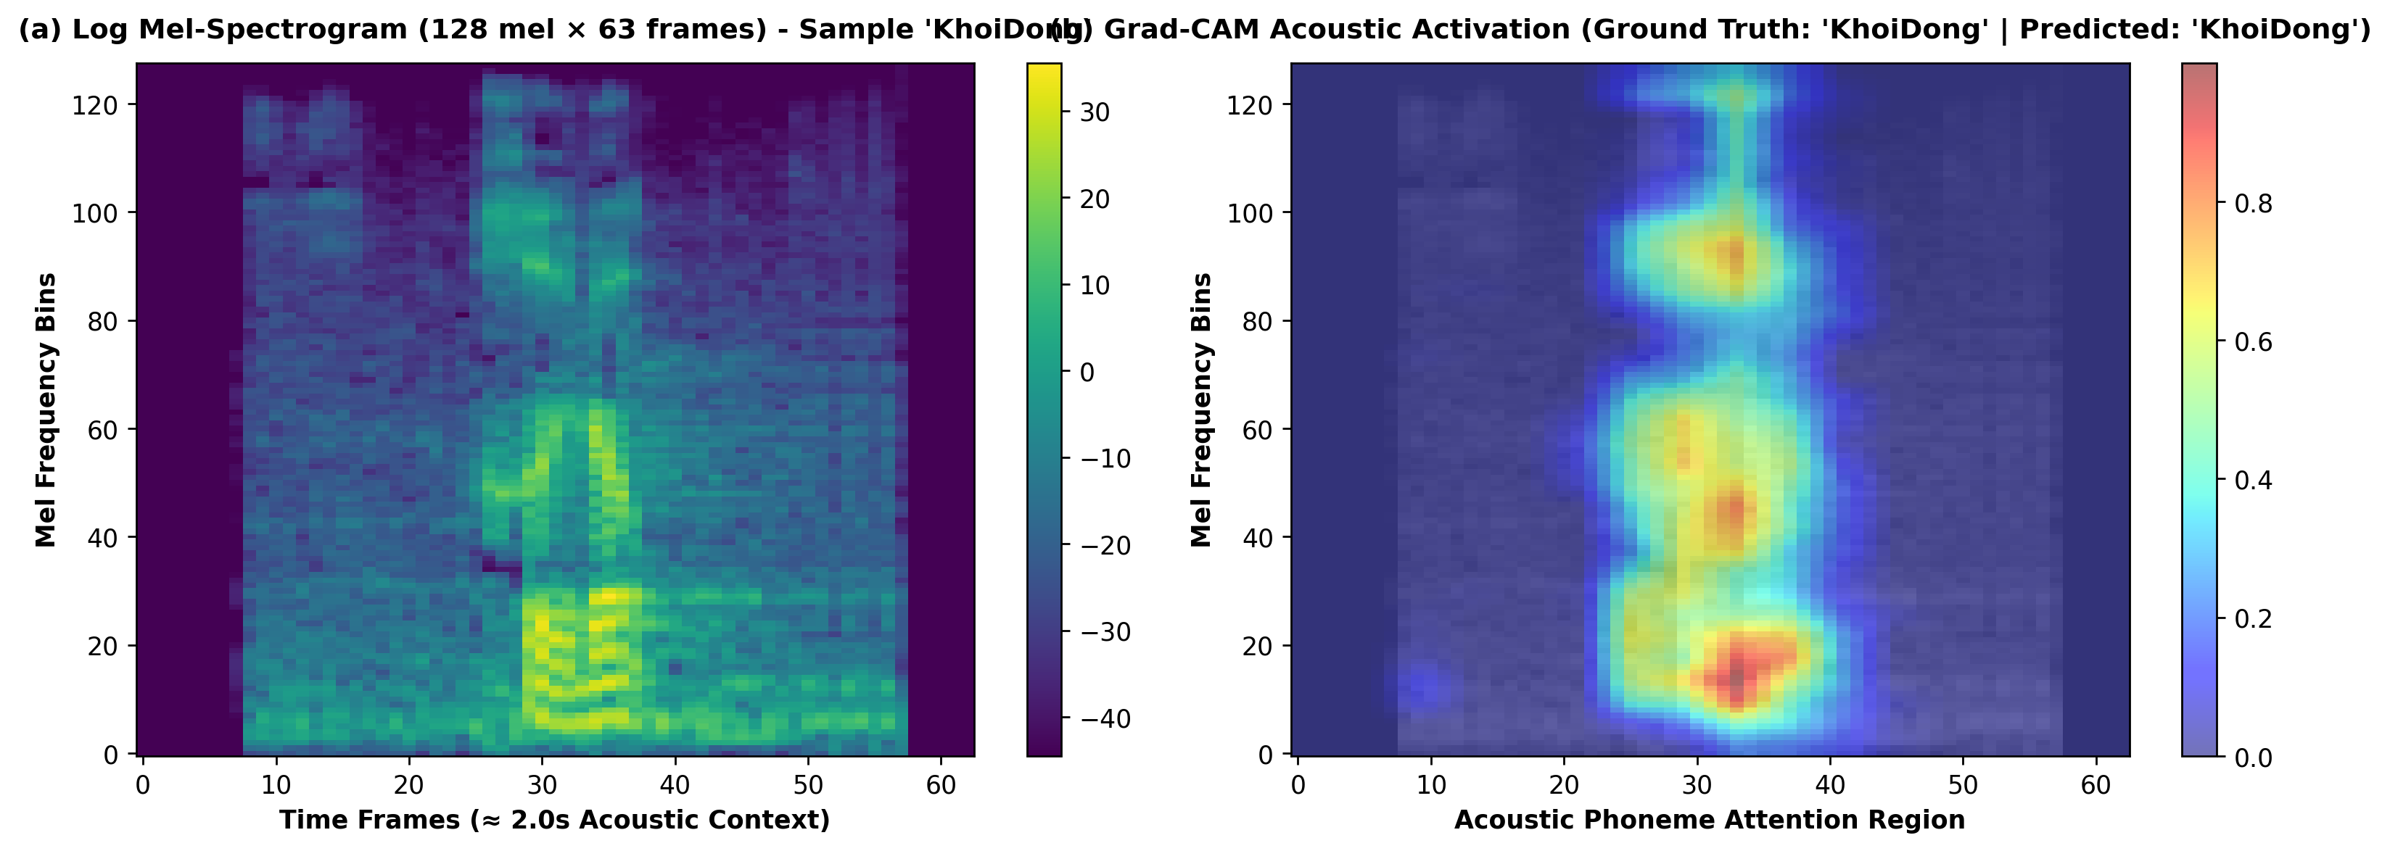
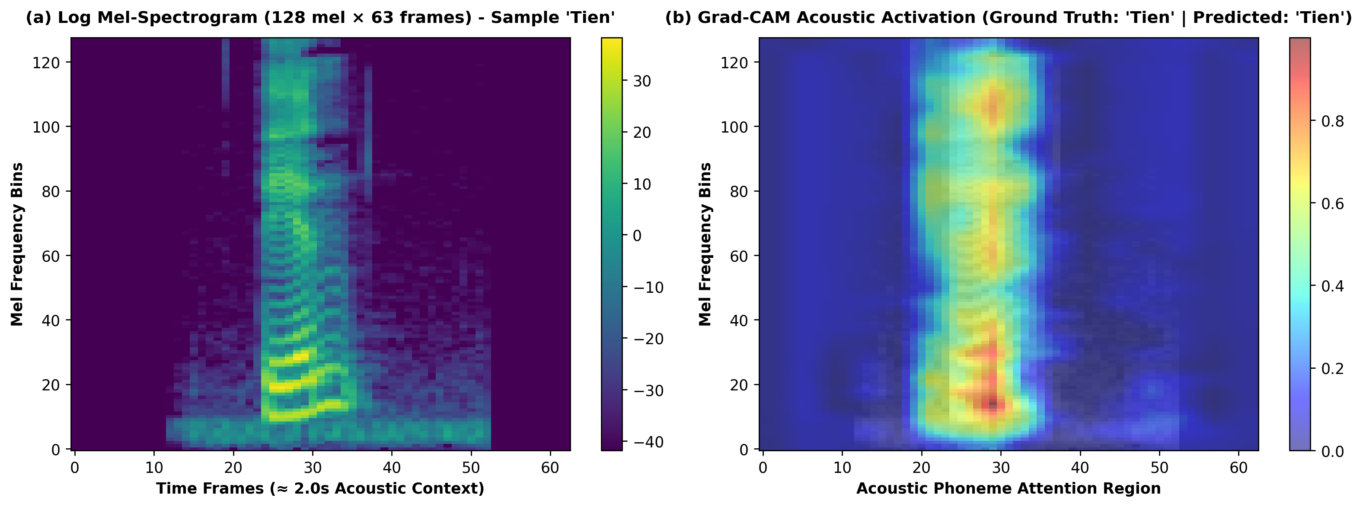
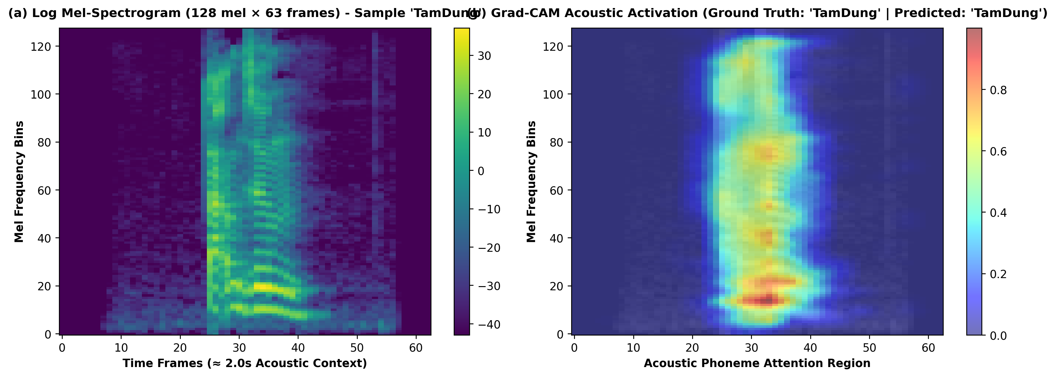
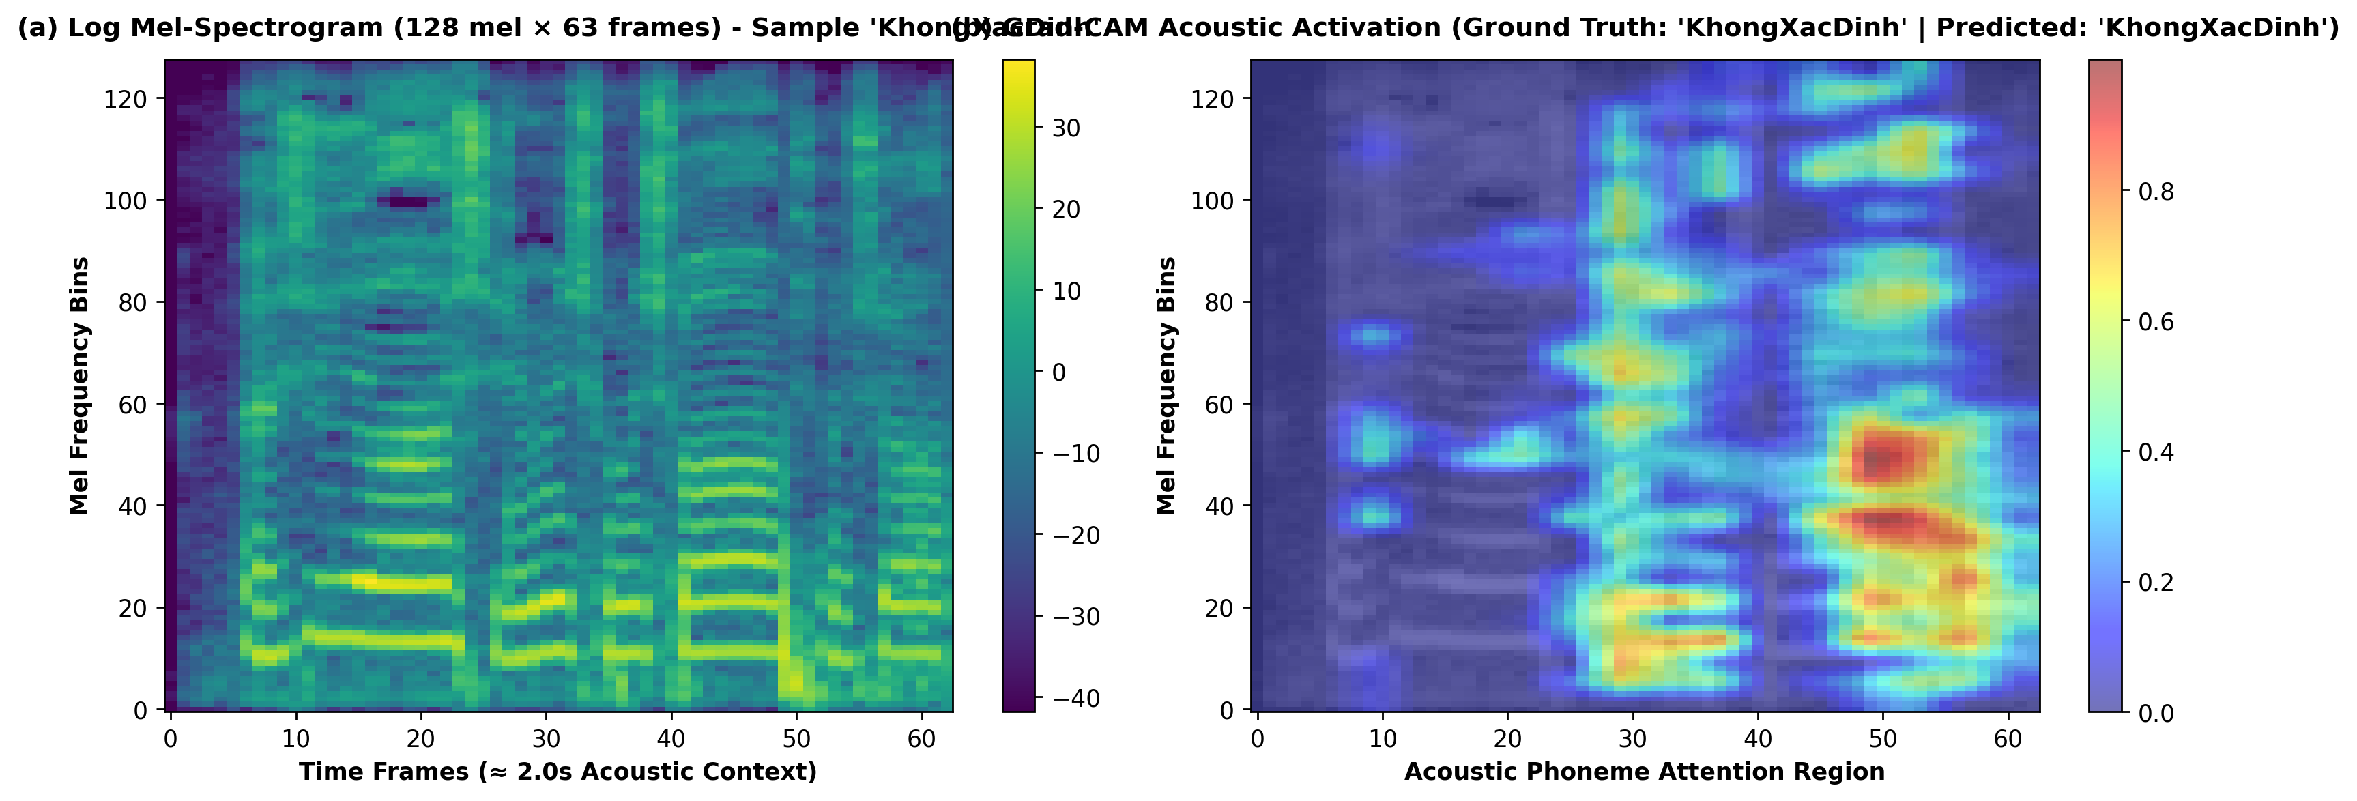
STAGE 4: EXPLAINABLE AI (XAI) VIA GRAD-CAM
Acoustic Phoneme Localization & Decision Interpretability
Validating that the Network Relies on Authentic Vocal Formants Rather than Ambient Background Noise

Slide 10
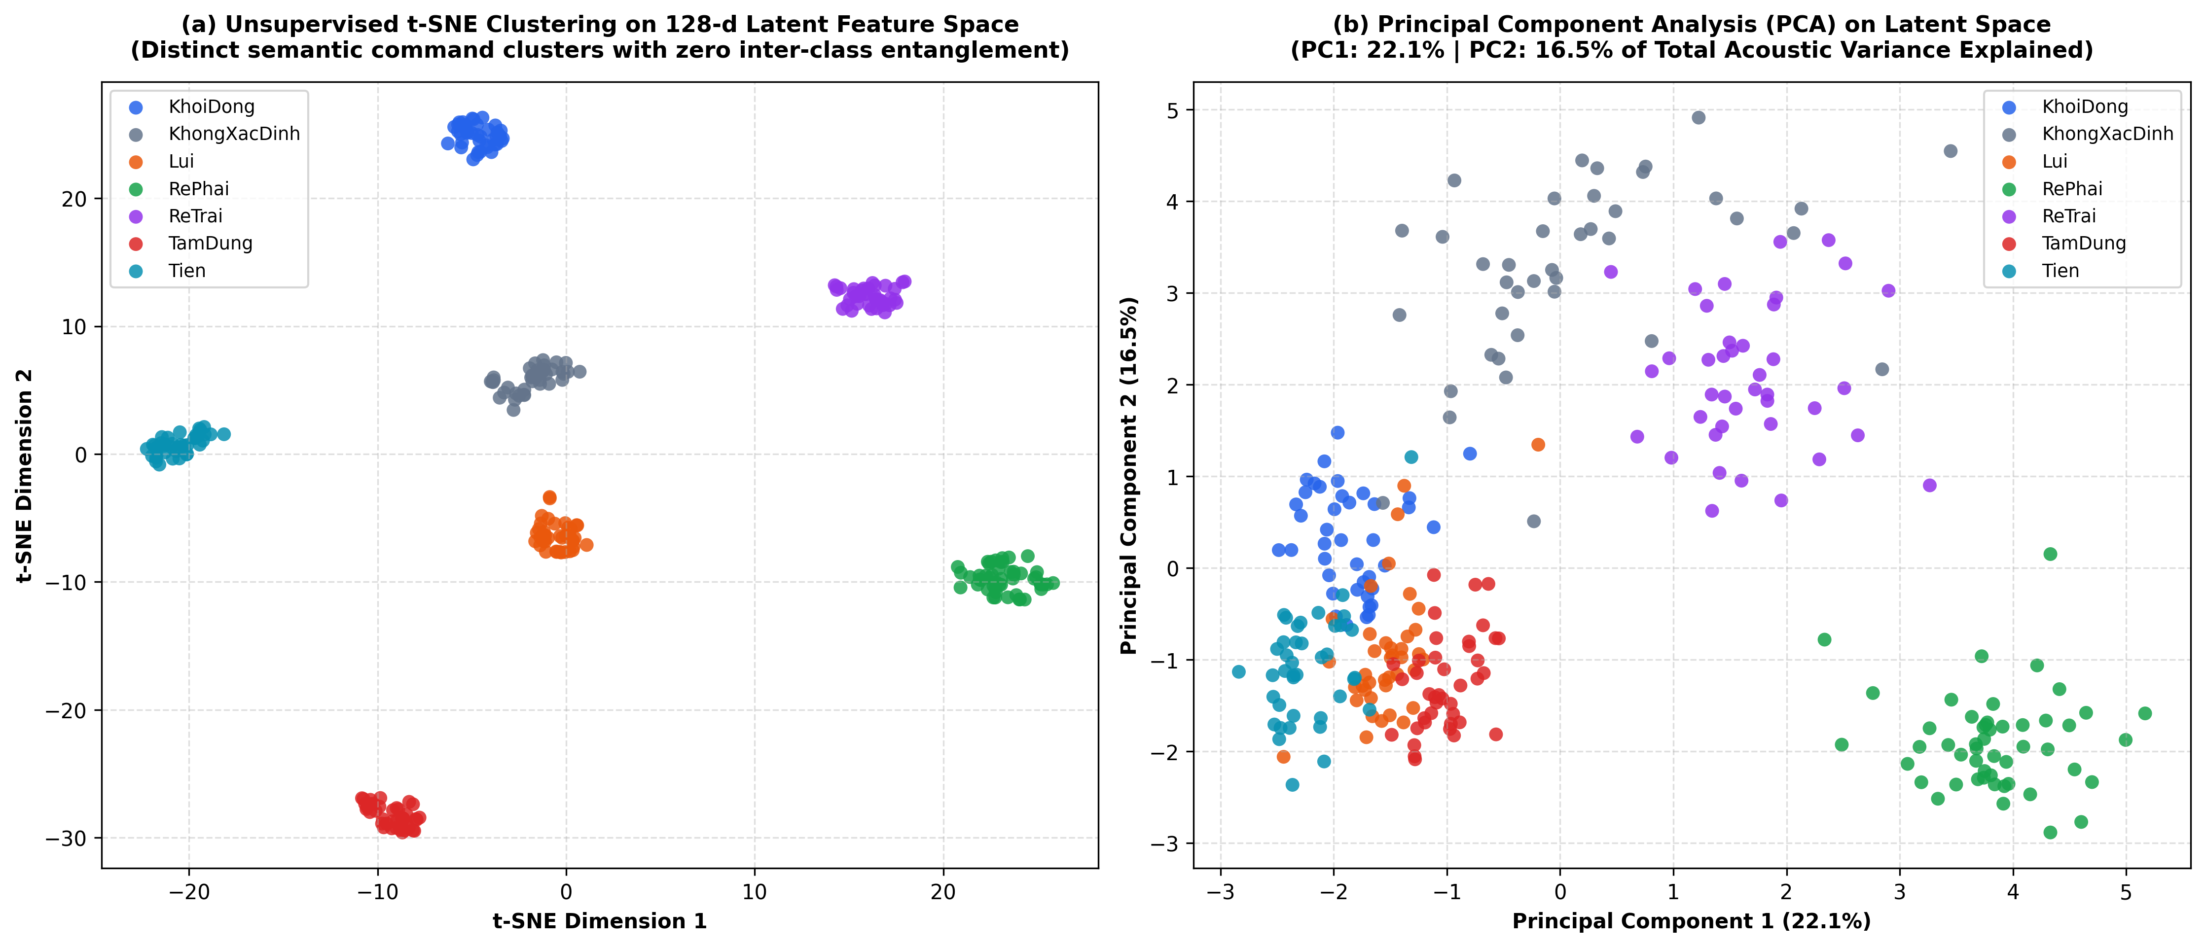
STAGE 5: LATENT SPACE REPRESENTATION & EDGE DEPLOYMENT
Unsupervised Manifold Clustering & Live Robot Telemetry
Translating SOTA Deep Learning into a Full-Stack Edge & WebAssembly Digital Twin
EDGE & WEB DEPLOYMENT
✔ ONNX Model Optimization
Exported standalone ONNX model (Opset 17) with dynamic batching. File size: 617 KB.
✔ WebAssembly In-Browser
Zero-server, clientside inference via onnxruntime-web running directly on Chrome/Safari at 4.78 ms.
✔ ESP32 BLE Robot Telemetry
Commands mapped directly into Bluetooth Low Energy motor state machine (FWD, REV, LEFT, RIGHT, STOP).
✔ Live Interactive Dashboard
Hosted globally on GitHub Pages with Push-to-Talk and live audio visualizers.

