Slide 1
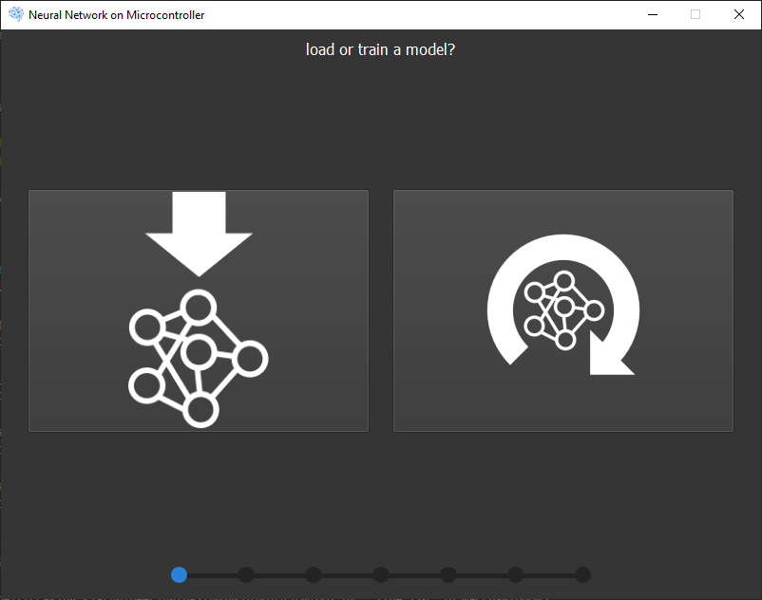
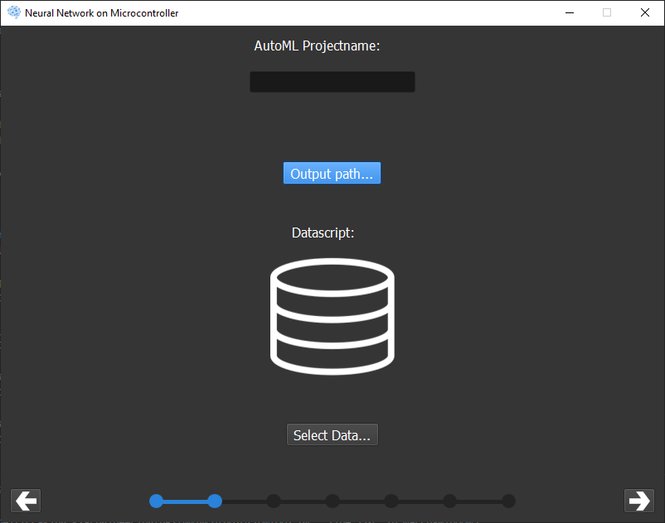
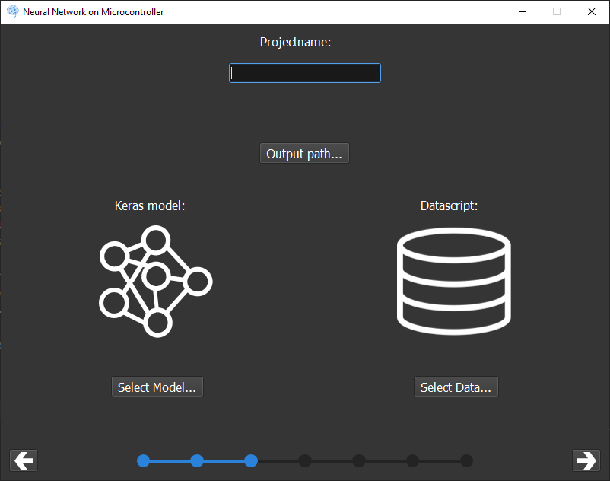
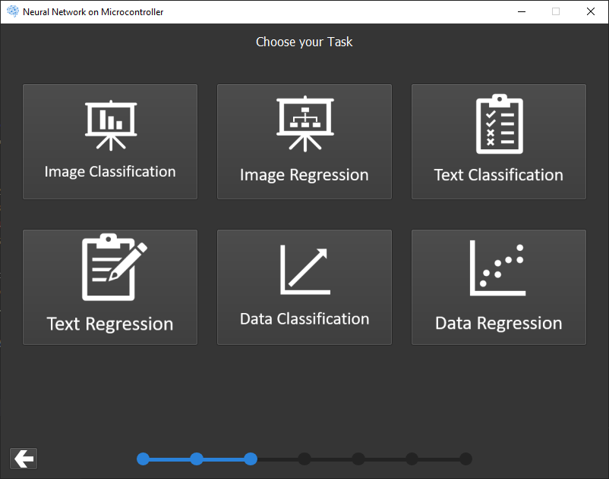
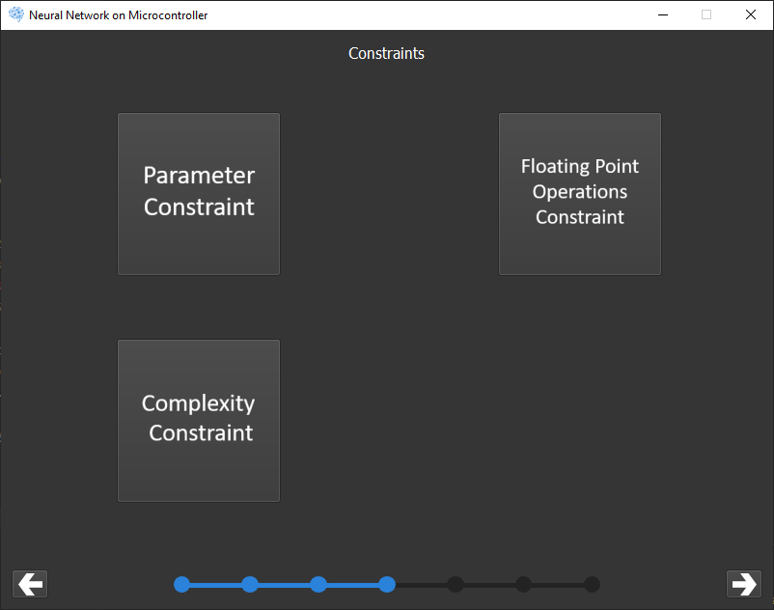
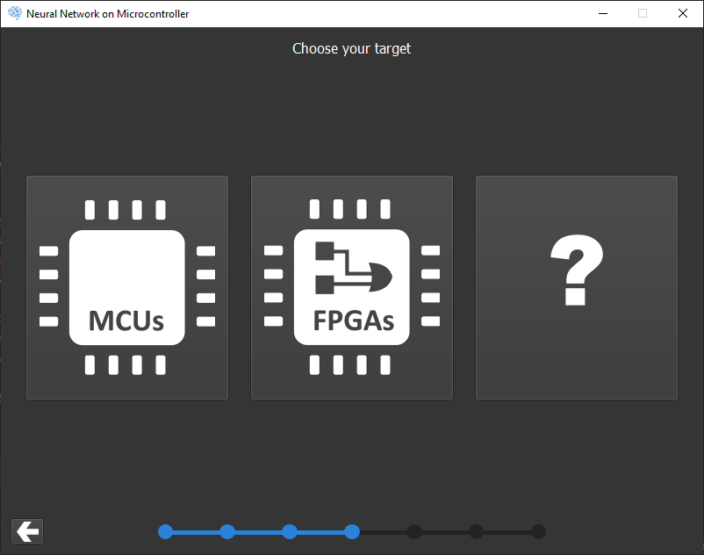
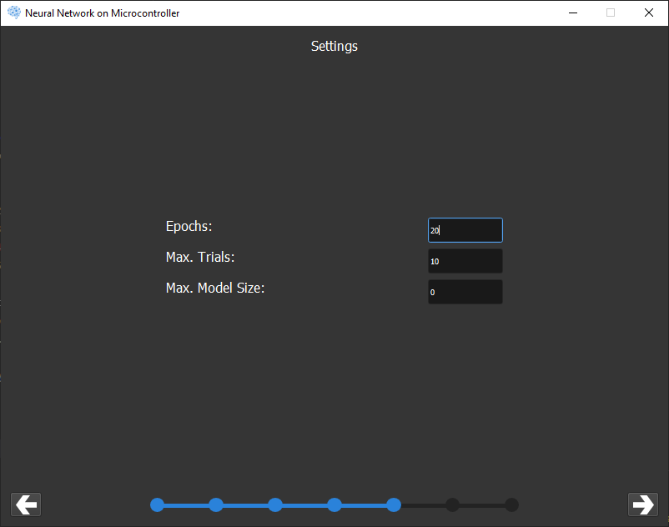
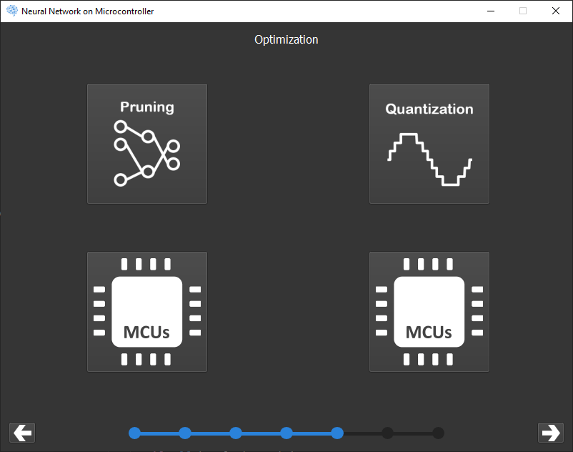
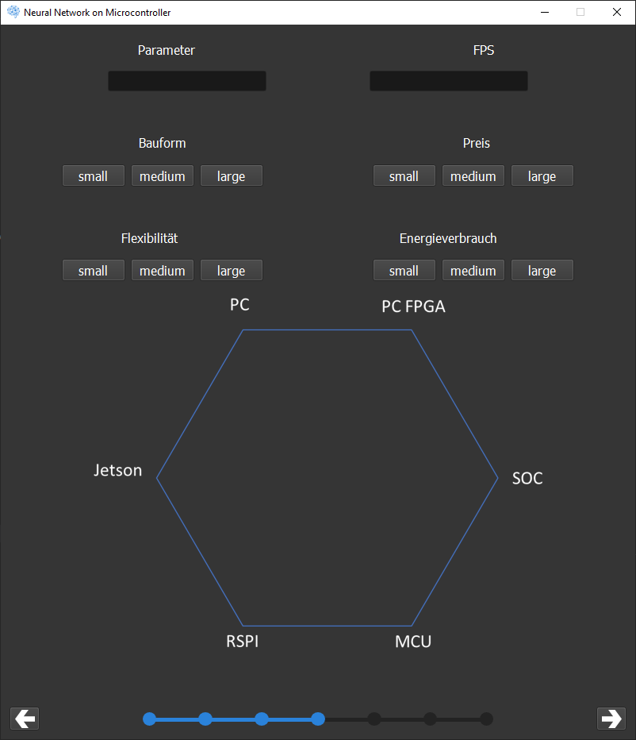
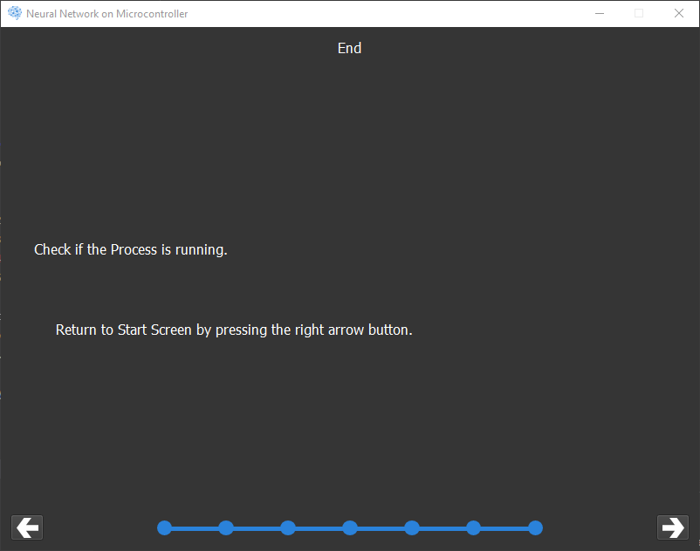
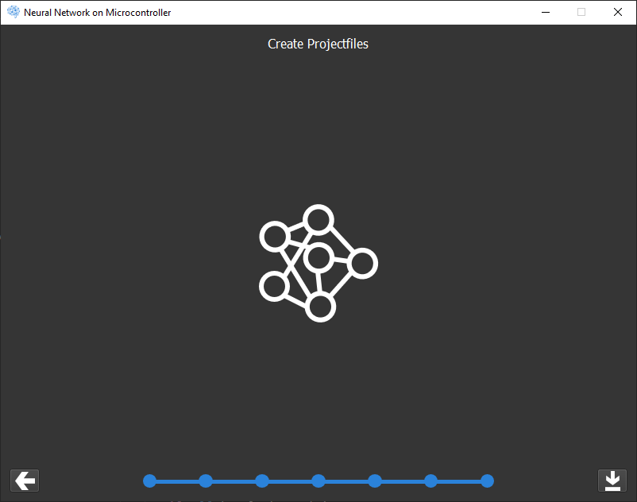
Start
AutoMLData
DeployData
AutoMLUseCase
AutoMLConstraints
DeployTarget
AutoMLSettings
DeployCompress
DeployTargetHelper
AutoMLRun
DeployRun

Slide 2
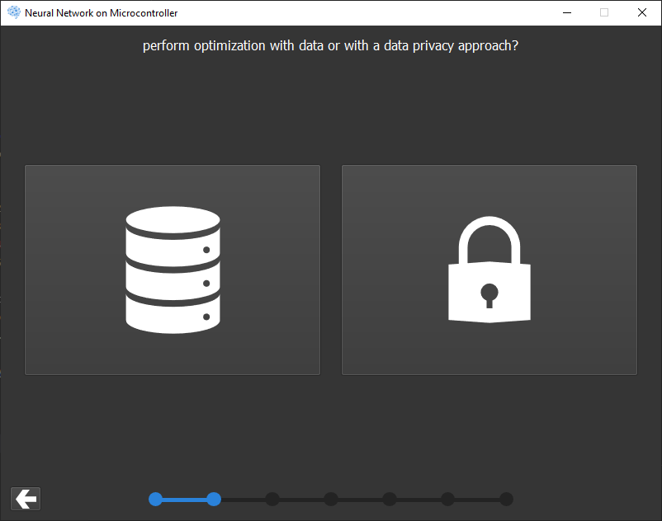
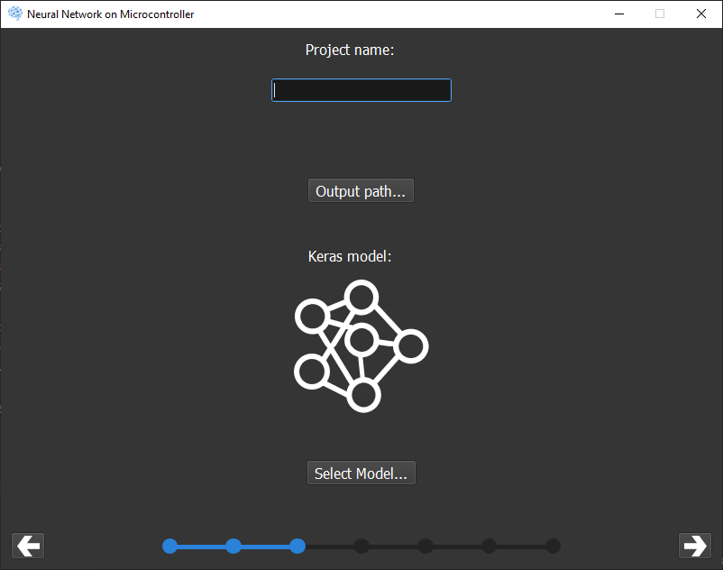
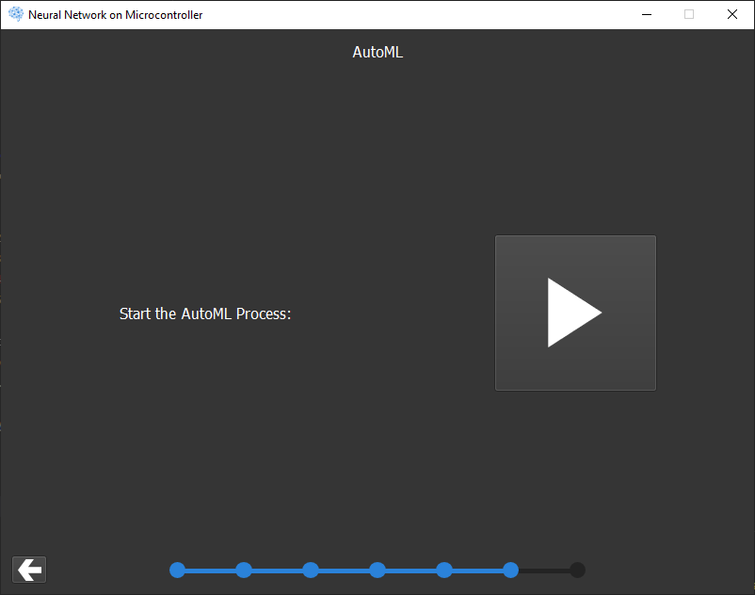
UIMarcusWindow1
UIMarcusWindow4
UIMarcusWindow2
UITaskWindow
UIStart
Window
UIMarcusWindow3
UIConstraintsWindow
UITargetWindow
UISettingsWindow
UIOptiWindow
UIHelperWindow
UIAutoMLWindow
UILoadWindow
UIReturnWindow

