Slide 1
Trivia Game
Matthew Hahn, Alan Chanthaboune, Donnie Davis, Donovan Turner, Jac Marois, Bennie Billings
A Trivia game that will be used for the purpose of entertainment or potentially even learning where you compete with another player by answering questions in a series of rounds to

Slide 2

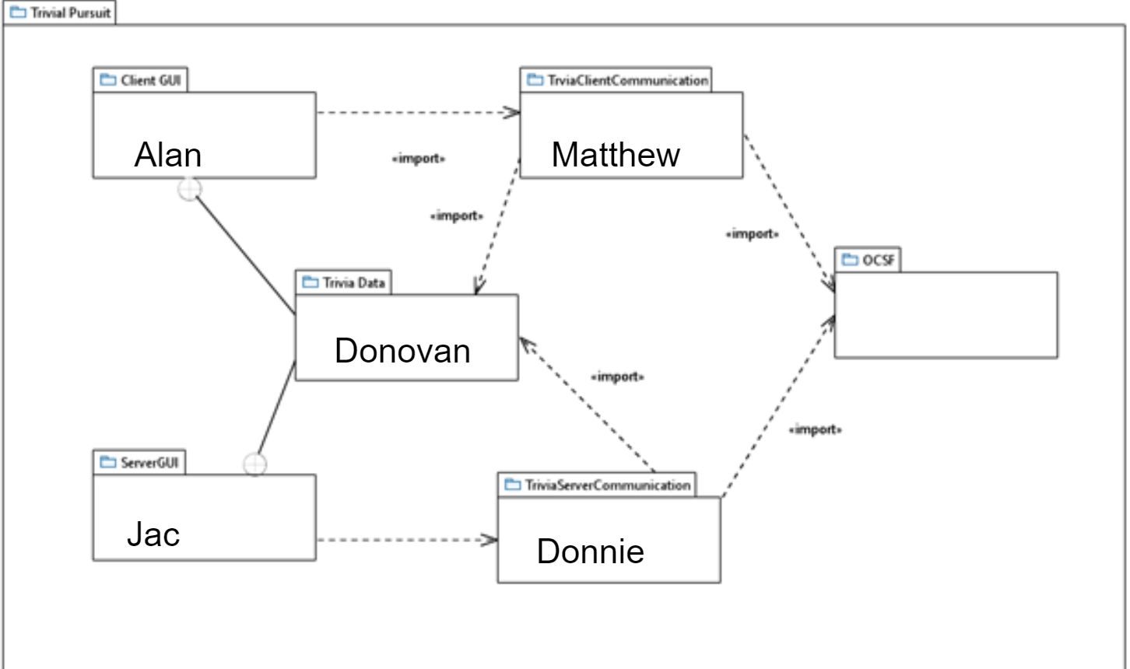
Package Diagram

Slide 3
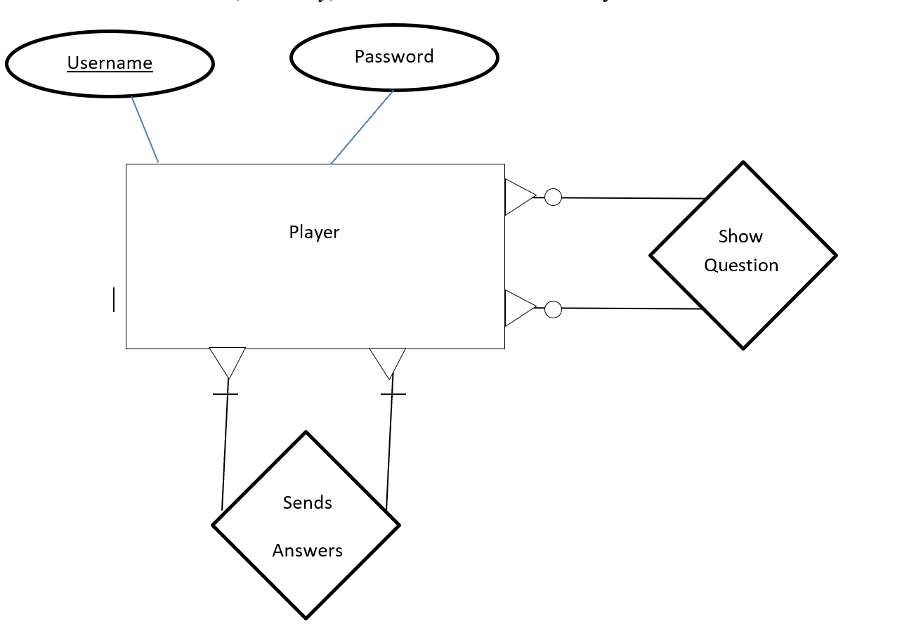
Database Design Diagram

Slide 4
Functional requirements
When all Players are connects, the game starts.
The Player can choose an answer to a question . The system checks if the Player have entered an answer. There will be 10 questions that will be presented to the player in a series of rounds
Players can win points by choosing the correct answer. Players with the most points win the game.

Slide 5
Use Case description
Use Case: Question Screen
Players are presented with a Q/A UI
Entry Condition
All players have been connected
Exit Condition
All players have chosen an answer and clicked “submit answer”
Use Case: Select Answer/Confirm Answer
Players are presented with a random question.
Each player can choose one of the presented answers and confirm said answer.
Player are shown if they got the question correct.
System tallies the player scores accordingly.
Entry Condition
All players are in the Question Screen
Exit condition
All questions has been played
Use Case: End-Game Screen
Players are shown the final results, and a winner is declared
Each players are given a option for another game session.
Entry Condition
All questions have been played
Exit Condition
All players have quit or opted in for another game session

