Slide 2
Database Project Presentation

Slide 3

Online Shop Management System

Slide 4
Team Members
Nguyễn Trường Giang 20194751
Nguyễn Kim Tuyến 20205196
Nguyễn Bá Hải 20194753
Lê Viết Hoàng 20194767

Slide 5
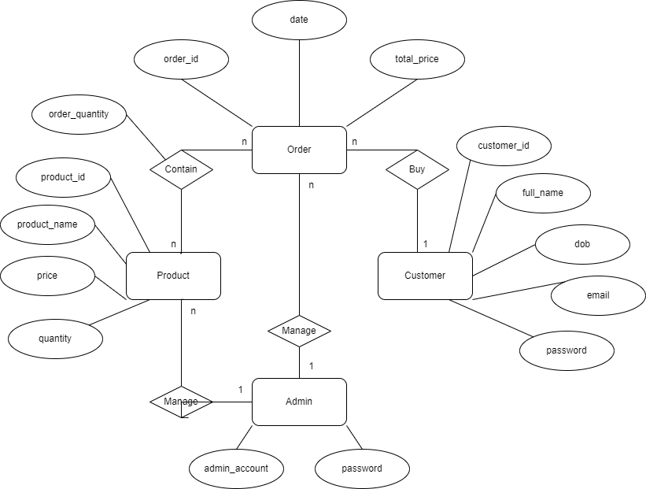
ER Diagram

Slide 6
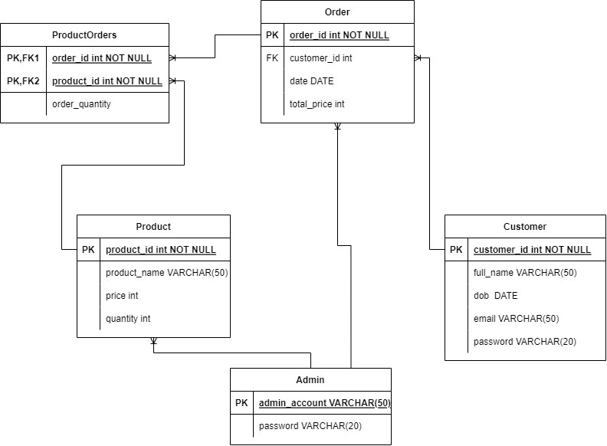
Relation Diagram

Slide 7
Functions
Admin: can update information of Products or delete.
Customer: can view and make order of Products.
Caculate the total price of customer’s order.
Place order

Slide 8
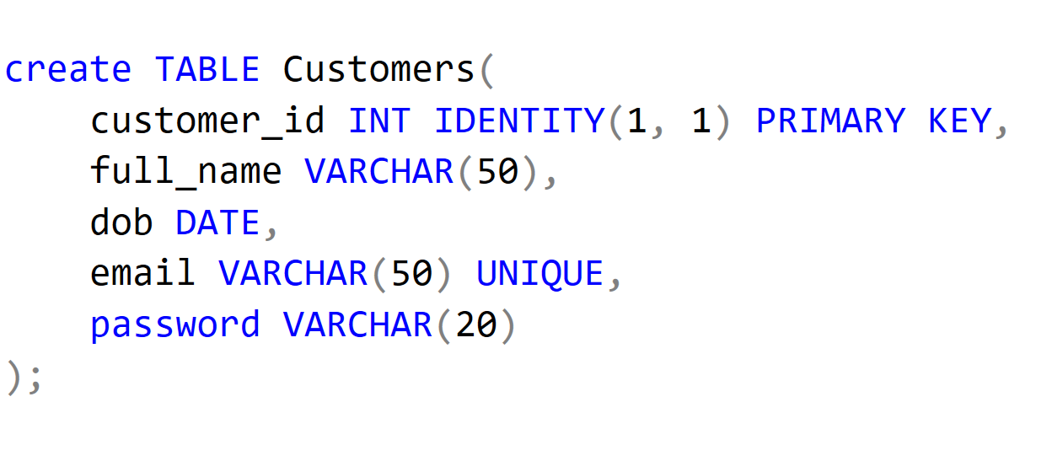
Create Customers table

Slide 9
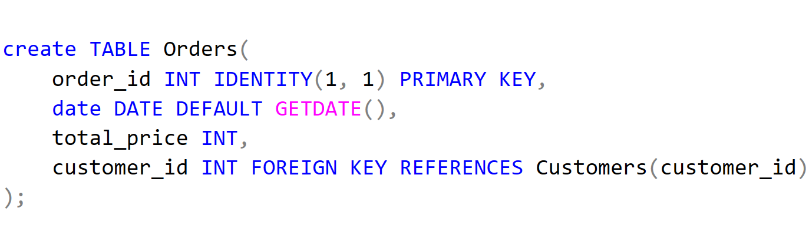
Create Orders table

Slide 10
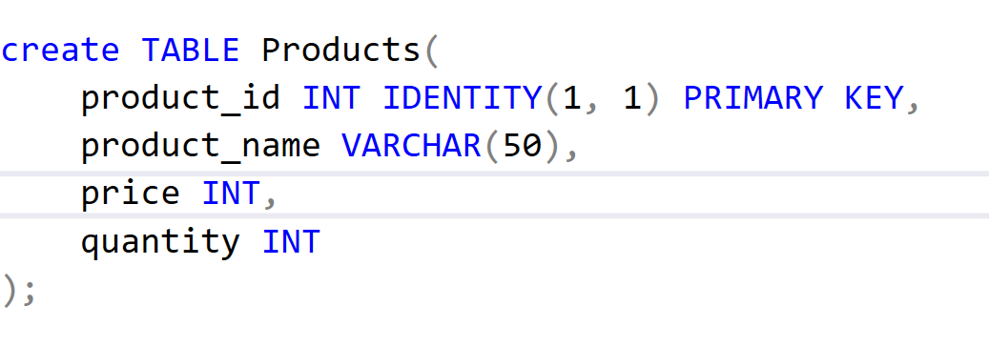
Create Products table

Slide 11
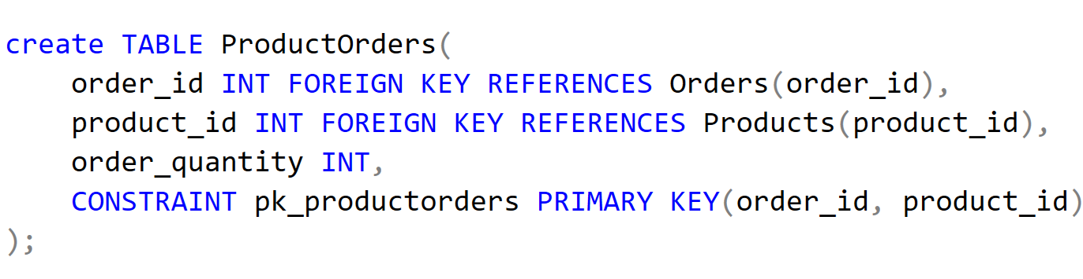
Create ProductOrders table

Slide 12
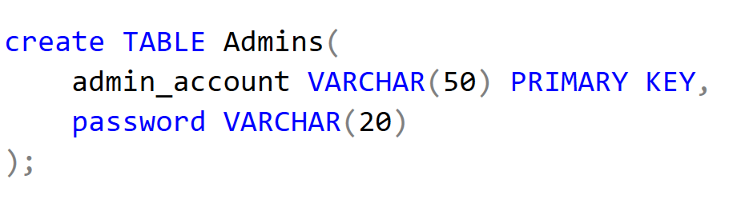
Create Admins table

Slide 13
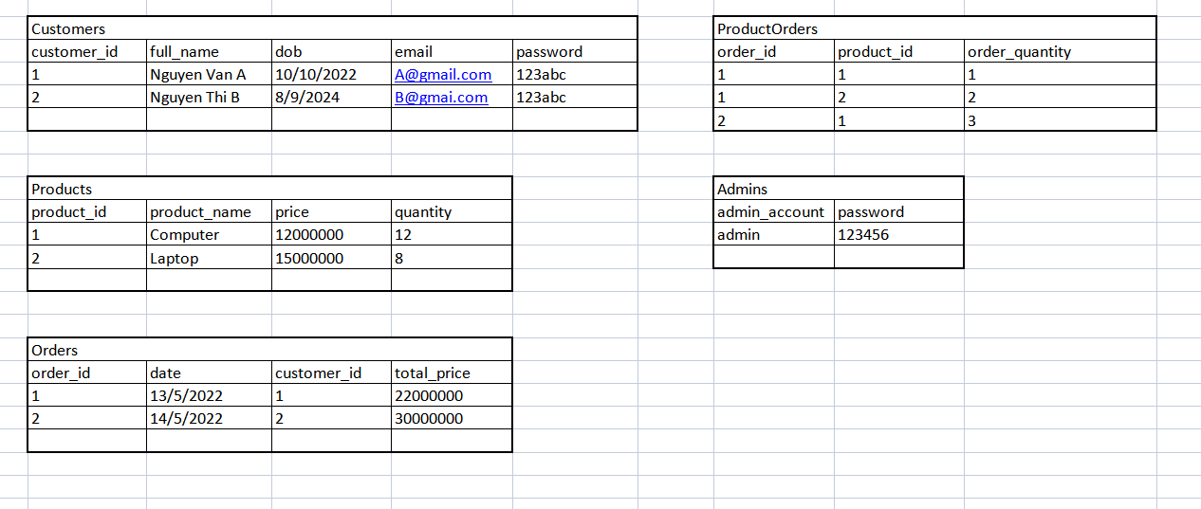
Example:

Slide 14
THANK YOU !

