Slide 2
Project Presentation

Slide 3

Online Shop Management System

Slide 4
Team Members 5
Nguyễn Trường Giang 20194751
Nguyễn Kim Tuyến 20205196
Nguyễn Bá Hải 20194753
Lê Viết Hoàng 20194767

Slide 5
Project Work Division
Nguyễn Bá Hải(Leader): Design DB, write BE, connect FE and BE
Nguyễn Trường Giang: Design DB, write BE, write report
Nguyễn Kim Tuyến: Design and write DB, write FE static

Slide 6
Overviews

Slide 7
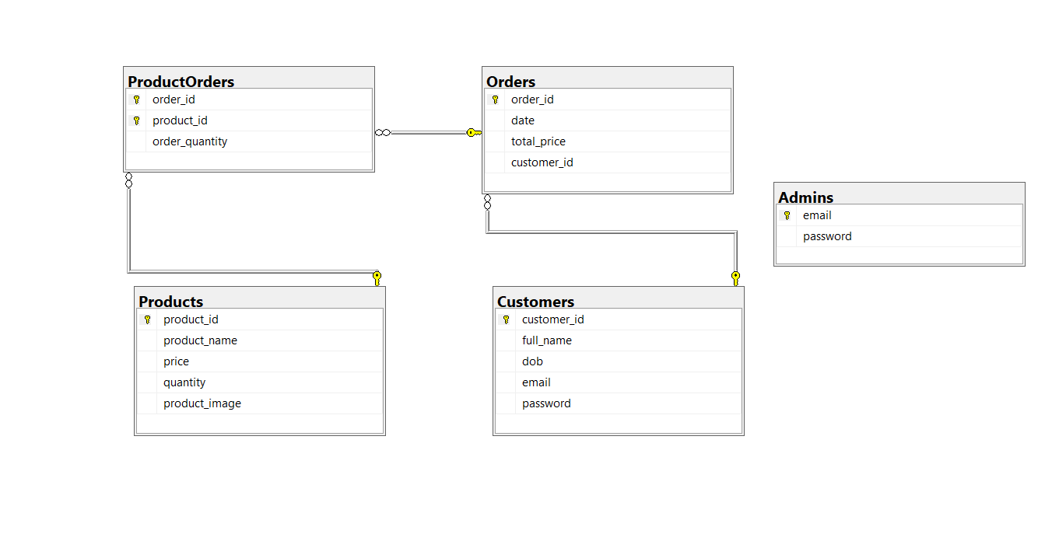
Relation Diagram

Slide 8
Functions
Admin: can update information of Products or delete.
Customer: can view and make order of Products.
Caculate the total price of customer’s order.
Place order

Slide 9
Details

Slide 10
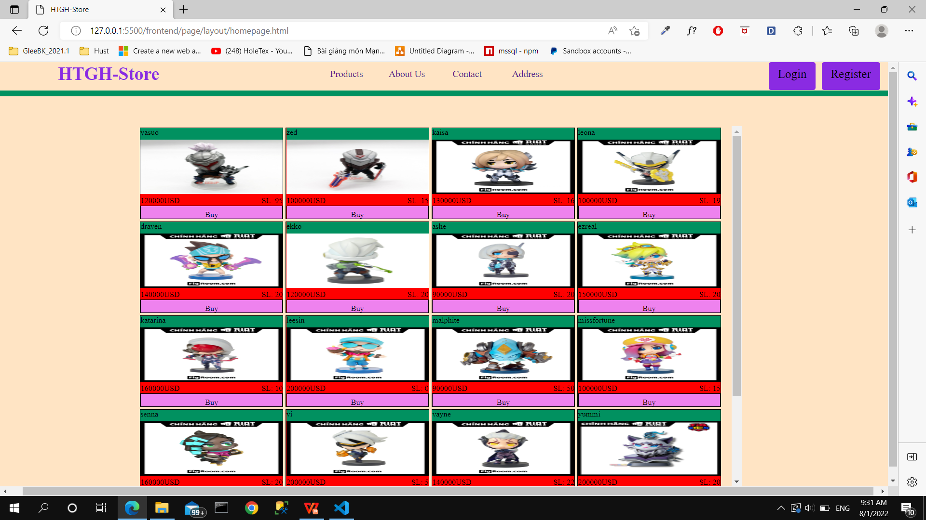
HomePage View

Slide 11
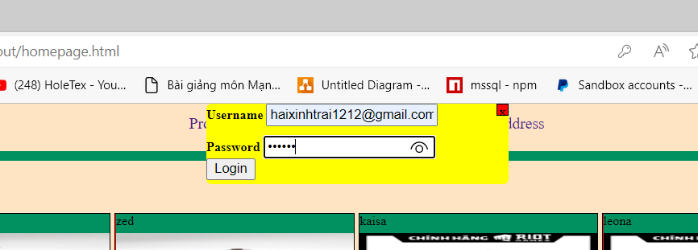
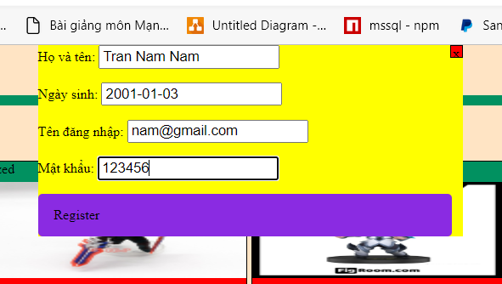
Login And Register
Login Box
Register Box

Slide 12
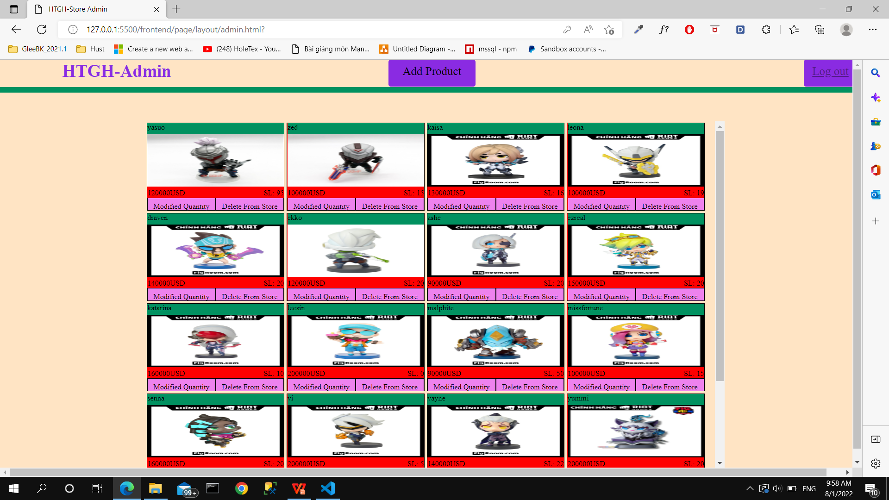
AdminPage View

Slide 13
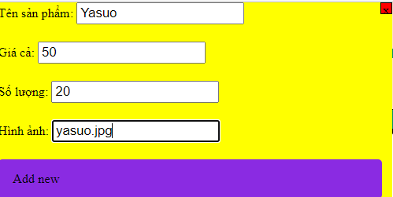
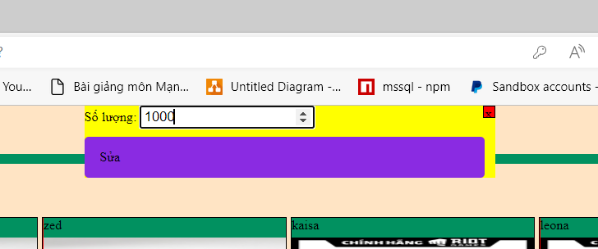
Admin Function
Add/Delete Product
Modify quantity of Product
Log out

Slide 14
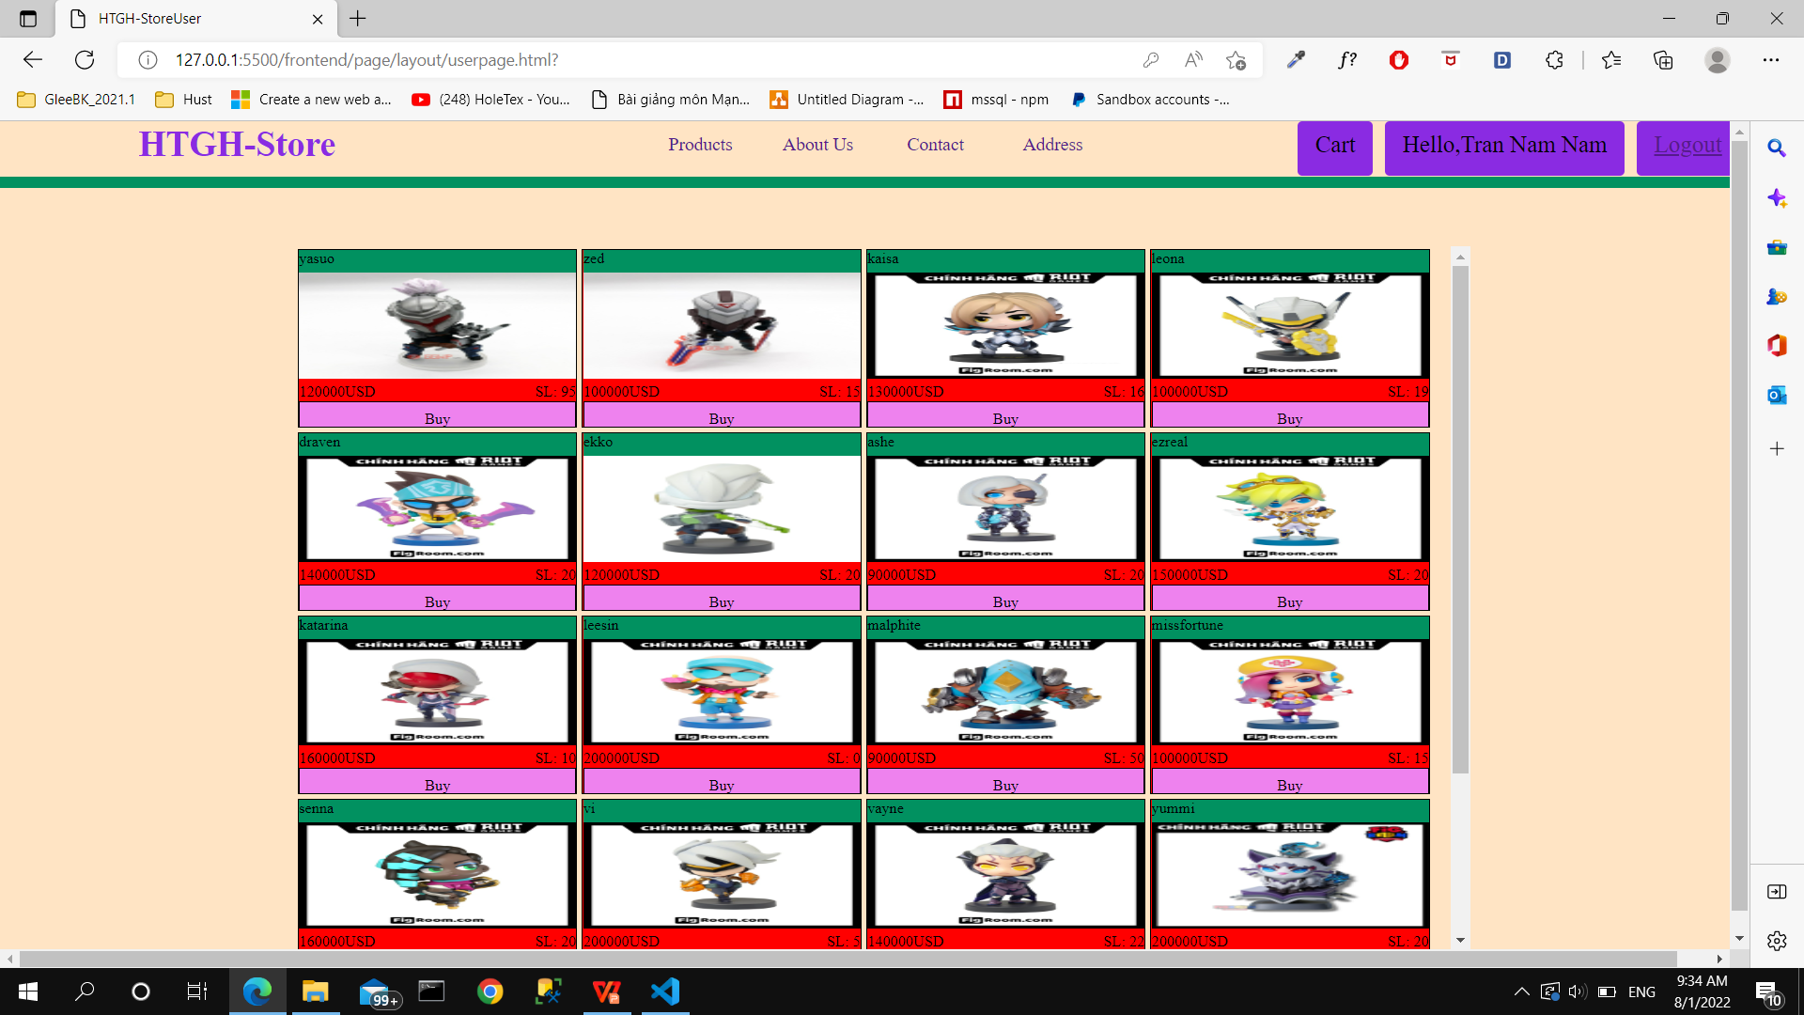
UserPage View

Slide 15
User Function
View store
View detail customer infomation
Buy product, view cart
Log out
Purchase via PayPal

Slide 16
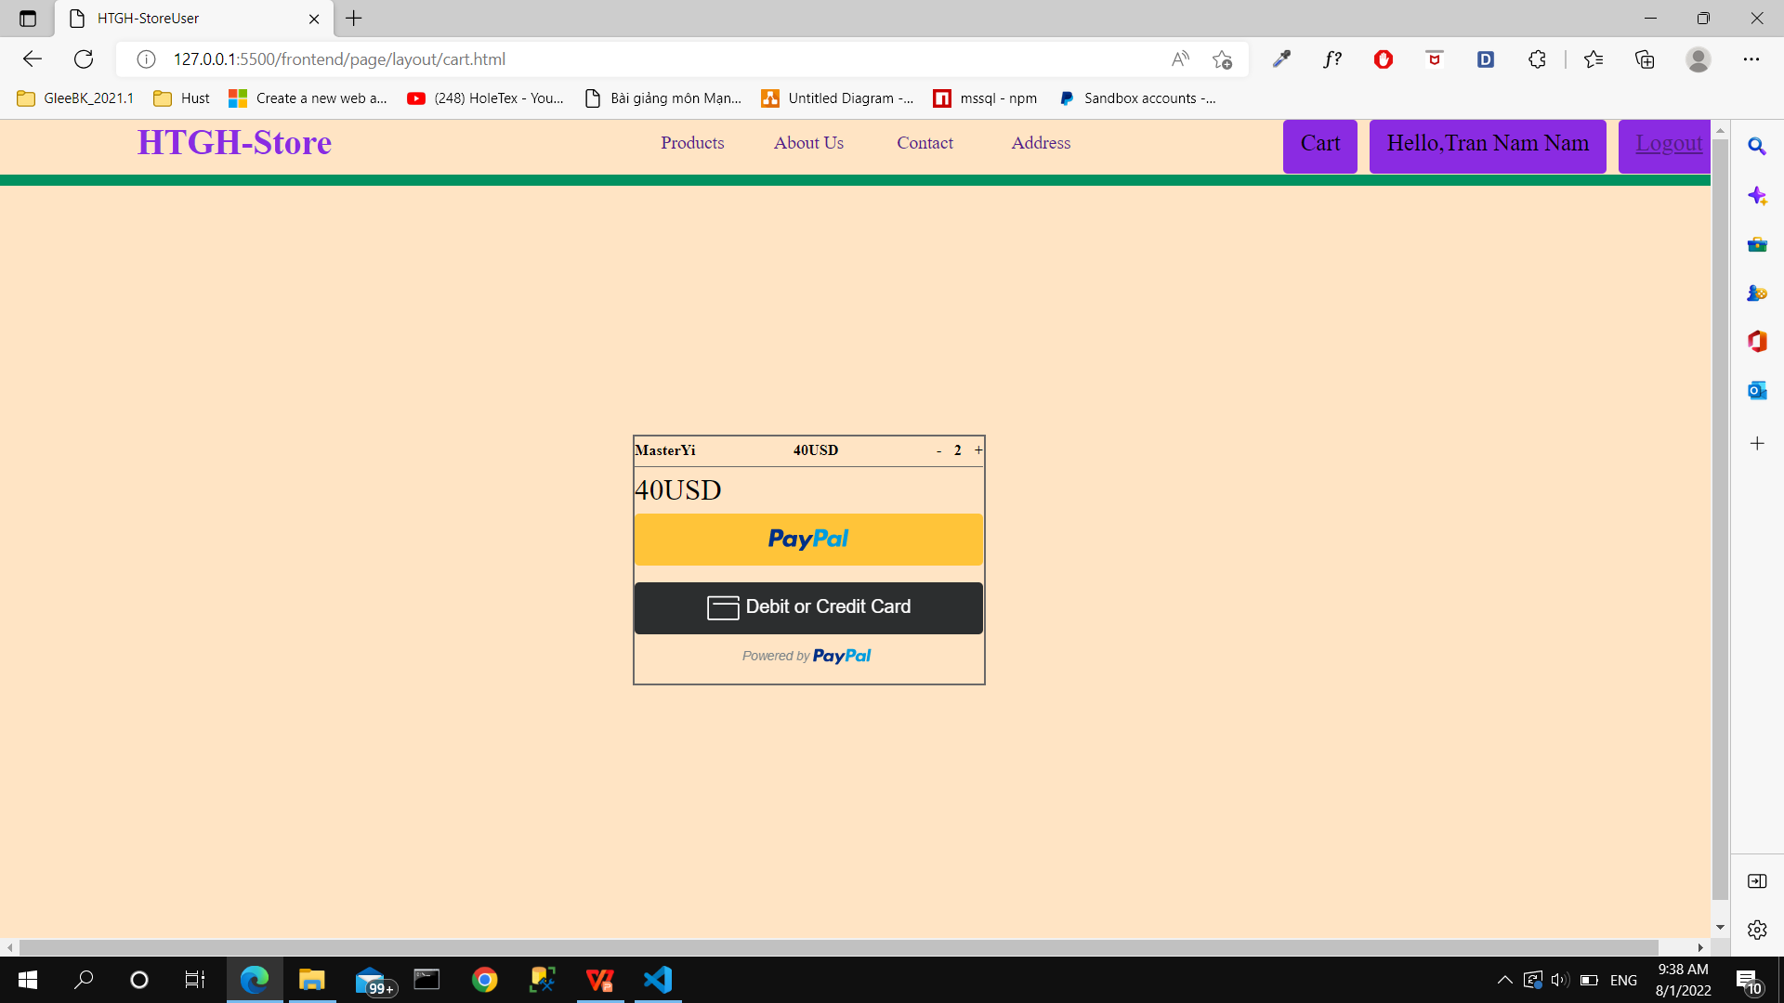
View cart

Slide 17
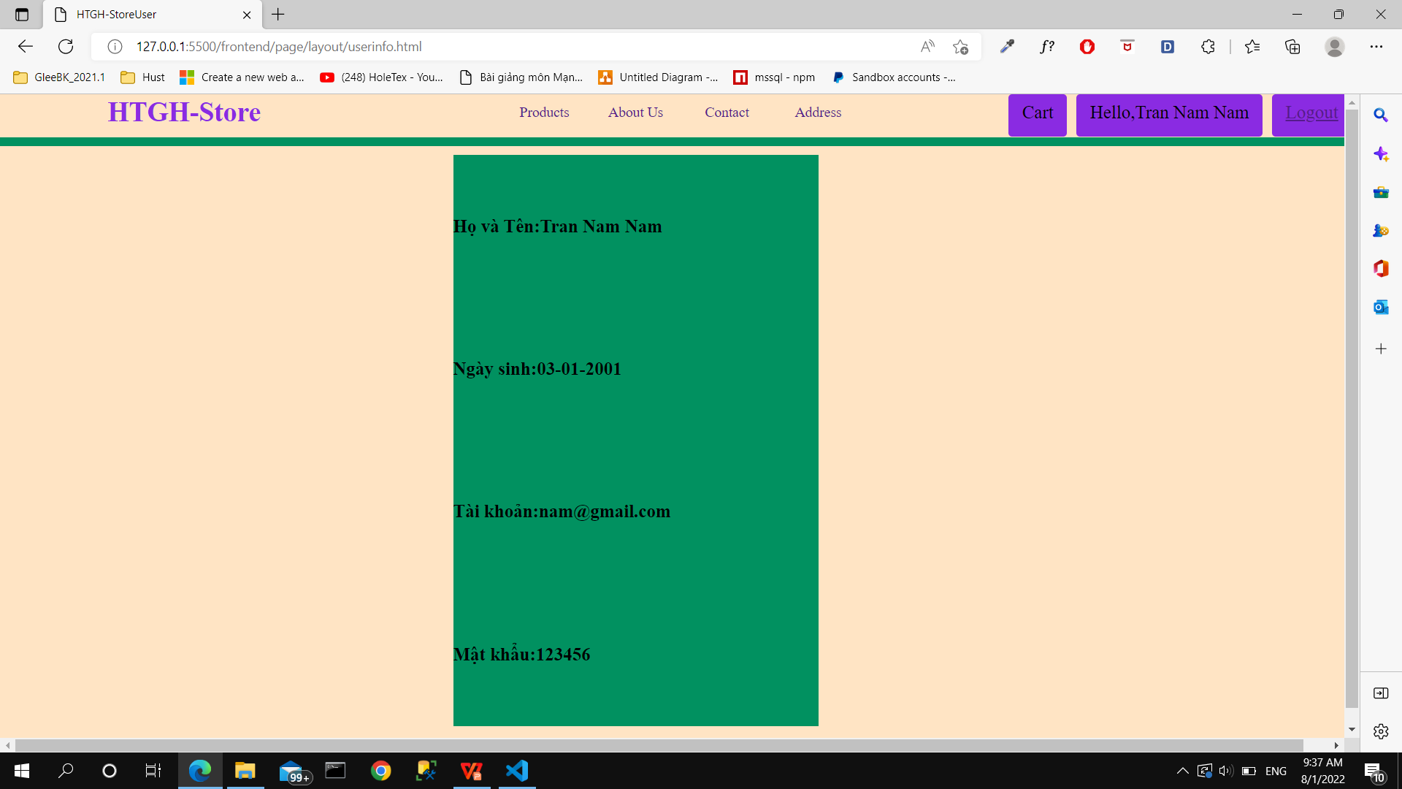
View Customer Detail

Slide 18
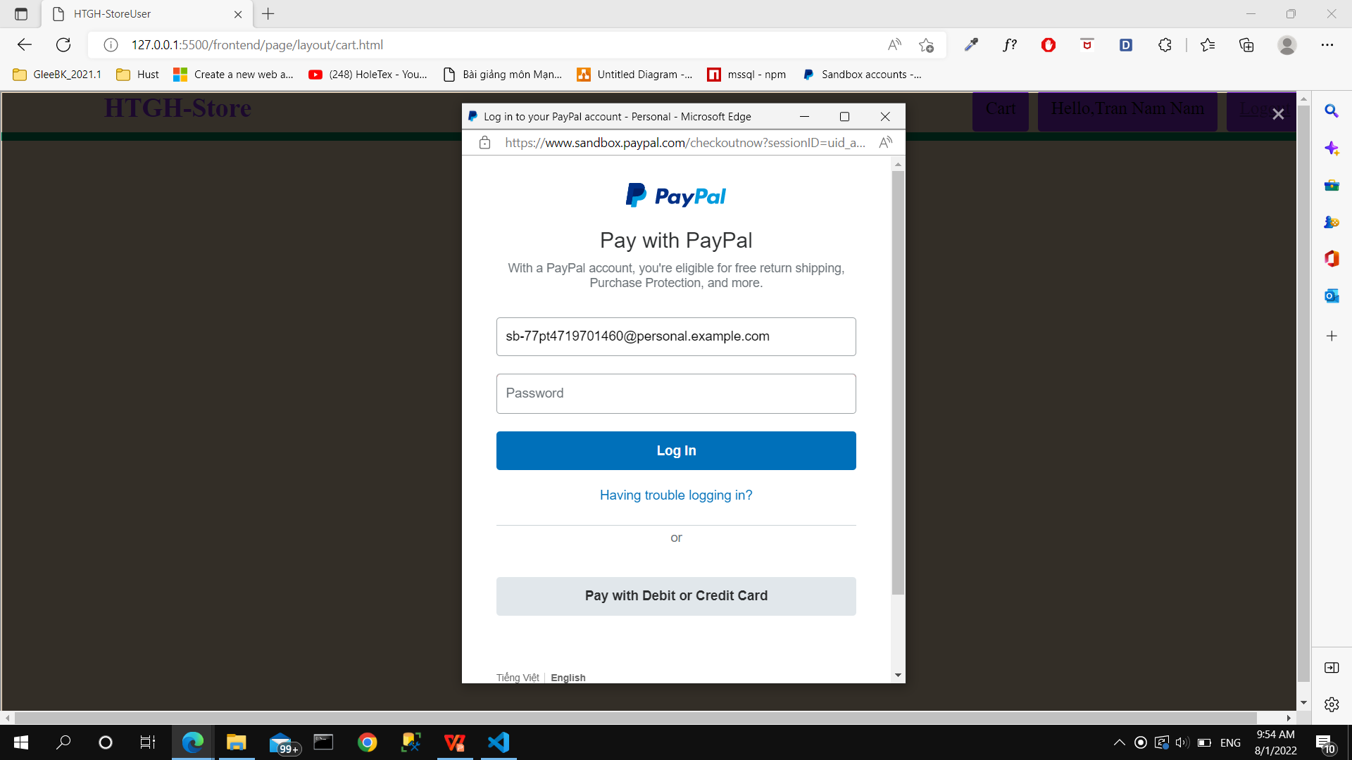
PayPal Payment

Slide 19
Demo

Slide 20
Thanks For Listening

