Slide 1
Source Control
Presenter Name
Presentation Date
Notes:
This template can be used as a starter file for presenting training materials in a group setting.
Sections
Right-click on a slide to add sections. Sections can help to organize your slides or facilitate collaboration between multiple authors.
Notes
Use the Notes section for delivery notes or to provide additional details for the audience. View these notes in Presentation View during your presentation.
Keep in mind the font size (important for accessibility, visibility, videotaping, and online production)
Coordinated colors
Pay particular attention to the graphs, charts, and text boxes.
Consider that attendees will print in black and white or grayscale. Run a test print to make sure your colors work when printed in pure black and white and grayscale.
Graphics, tables, and graphs
Keep it simple: If possible, use consistent, non-distracting styles and colors.
Label all graphs and tables.

Slide 2
Source Control
What is/Why source control
Improvement of GIT
Subversion
Git
Notes:
Give a brief overview of the presentation. Describe the major focus of the presentation and why it is important.
Introduce each of the major topics.
To provide a road map for the audience, you can repeat this Overview slide throughout the presentation, highlighting the particular topic you will discuss next.

Slide 3


What is/Why source control
I do whatever I want
Notes:
Give a brief overview of the presentation. Describe the major focus of the presentation and why it is important.
Introduce each of the major topics.
To provide a road map for the audience, you can repeat this Overview slide throughout the presentation, highlighting the particular topic you will discuss next.

Slide 4





What is/Why source control
I want update it
Please wait,
I’m updating It
Where is my changes?
I’ve just saved it
Hey! Ensure you guys get my recent changes
Oh, Really, me too
How to get changes from ALL of us?
Stop! We have to deliver it soon
Notes:
Give a brief overview of the presentation. Describe the major focus of the presentation and why it is important.
Introduce each of the major topics.
To provide a road map for the audience, you can repeat this Overview slide throughout the presentation, highlighting the particular topic you will discuss next.

Slide 5






What is/Why source control
Source Control Clients
Source Control Server
features
Notes:
Give a brief overview of the presentation. Describe the major focus of the presentation and why it is important.
Introduce each of the major topics.
To provide a road map for the audience, you can repeat this Overview slide throughout the presentation, highlighting the particular topic you will discuss next.

Slide 6
Source control features
People work on there own copy (working folder)
Synchronize Documents: Update, Commit, Merge, Detect Conflict
History of documents:
Time of changes
what were changed.
who did changes.
Get documents at specific time/tag
Versions of documents
Developing: trunk, for user-cases, for bug fixes …
Current production
Next Releases
Future Releases
Multiple deploys/customers
Permission

Slide 7


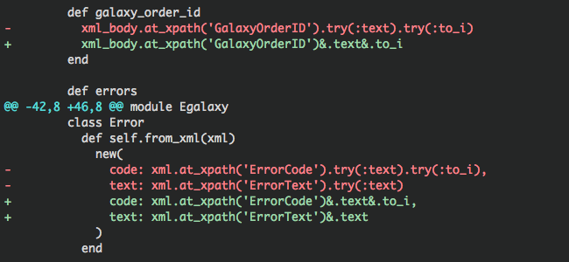
Synchronize Documents
Source control client
Working folder
Head/base copy
differences
Update
Commit
Merge
Detect Conflict
….

Slide 8
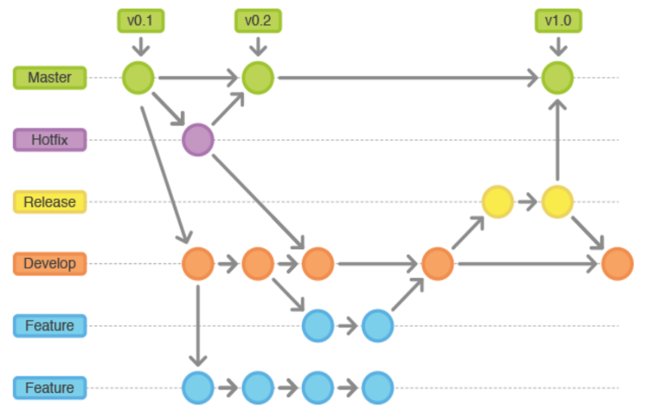
Versions of documents (Branching)

Slide 9
Issues of direct server source control
Clients directly make changes to server
Multiple small commits? Not enough, not mature, still need update
One Big commit? Risk, history of my current changes
Connection Lost.

Slide 10
Improvement of GIT
Clients
Local Repo
Remote repo
Batch
Notes:
Give a brief overview of the presentation. Describe the major focus of the presentation and why it is important.
Introduce each of the major topics.
To provide a road map for the audience, you can repeat this Overview slide throughout the presentation, highlighting the particular topic you will discuss next.

