Slide 1
Reinforcement Learning with Human Feedback
Reinforcement Learning
School of Data Science
University of Virginia
Last updated: April 15, 2025

Slide 2
Agenda
> Quick Background
> Learning from Human Preferences
> Aligning Language Models to Follow Instructions

Slide 3
Background
A key ingredient for successful RL is the right reward function
As we’ve learned, it’s hard to get this right
In practice, the reward function can be quite complex
Getting reward function wrong can be dangerous
RLHF address this challenge

Slide 4
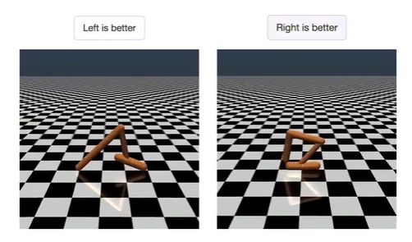
Learning from Human Preferences
Remove need for humans to write goal (reward) functions
Present human with two options and ask which is better
Source: https://openai.com/research/learning-from-human-preferences
Paper: https://arxiv.org/pdf/1706.03741.pdf

Slide 5
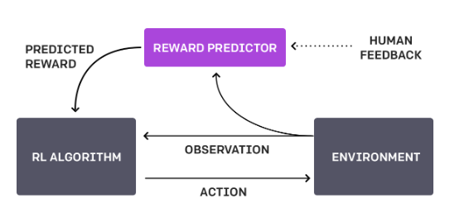
Feedback Cycle
1. Agent acts randomly in environment
2. Periodically, two video clips given to human
3. Human indicates which is better (reaches goal)
4. Agent builds reward model of task goal to match human preferences
5. System continues to ask for human feedback in areas of greatest uncertainty
Overall, system learns the reward function from human

Slide 6
Feedback Cycle, contd.
Human is asked to compare clips.
No scoring is done.
This is an easier task
Borrows ideas from other papers, but scales to Deep RL, learning more complex behaviors (Atari gaming, backflips)
Humans provided feedback on < 1% of agent interactions w environment

Slide 7
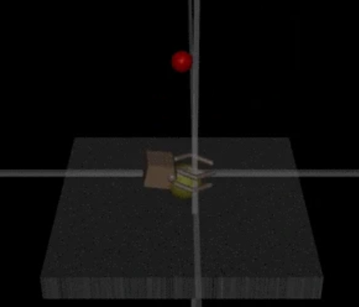
Challenges
To get good performance, system requires a lot of human feedback
OpenAI working to reduce this need
Performance only as good as human evaluator’s intuition about what looks better
Is the robot hand grasping the yellow item?

Slide 8

Segments
Form trajectory segments which are sequences of (observations, actions)
Indicate preference for segment 1 over segment 2:
Deep neural network uses three processes:
1. Policy interacts w environment to produce trajectories. Update params using RL.
Rewards are predicted.
2. Select segments and send them to human for comparison
3. Params in reward function are optimized using supervised learning

Slide 9
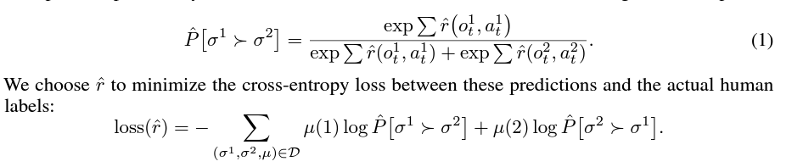
Reward Function
Uses Advantage actor-critic for Atari, TRPO for robotics tasks
Fitting the reward function:

Slide 10
Experimental Setup – Human Feedback
We will see results from Atari games and Mujoco environments (robotics)
In these experiments, agent will not see the true reward
Instead, they will get feedback from a human
The human saw a 1-2 sentence description of the task

Slide 11
Experimental Setup - Oracle
Also run synthetic oracle
When query is sent to oracle, it sees actual reward
As more queries are made, performance will be more accurate
Finally, authors also show RL performance
It is possible for human feedback to outperform RL (better shaped rewards)

Slide 12
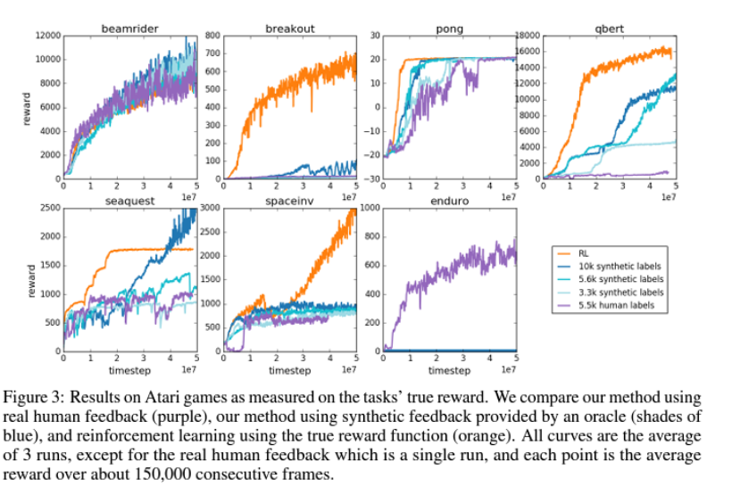
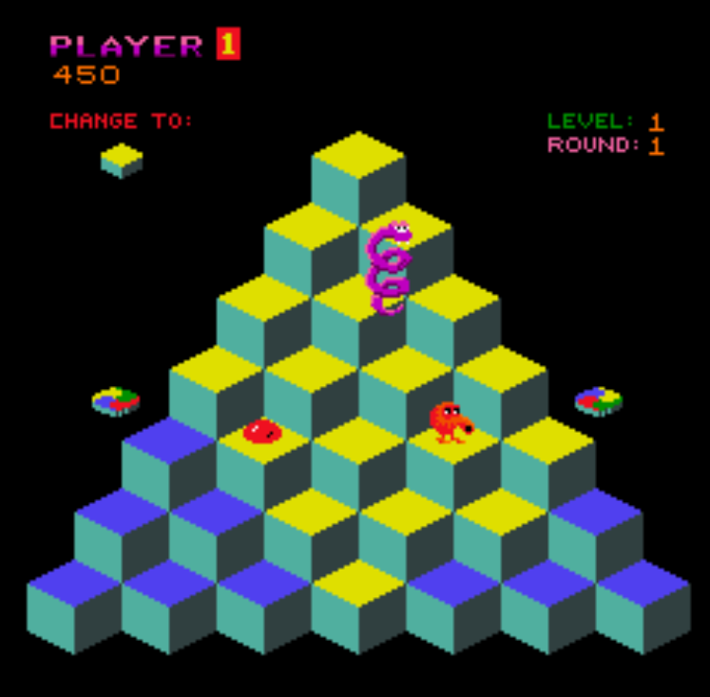
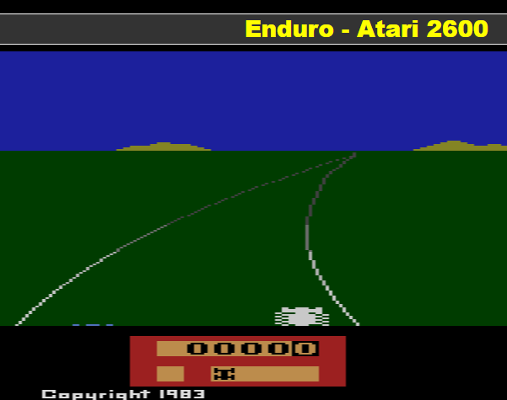
Results: Atari
Human feedback is effective and gives results close to RL in some cases
:

Slide 13
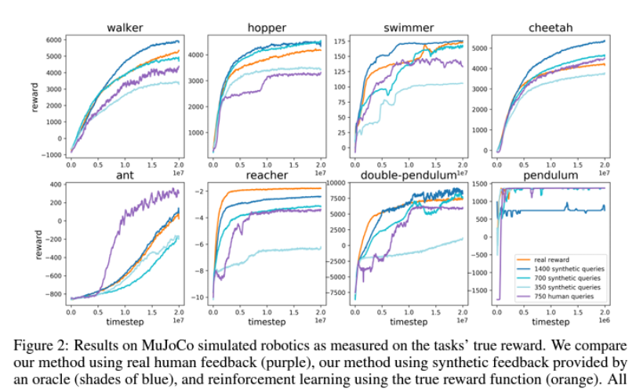
Results: MuJoCo
Human feedback is effective and gives results close to RL in some cases

Slide 14
II. Aligning Language Models to Follow Instructions

Slide 15
Manual Alignment of LLMs
In the early days of LLMs, when models gave bad output to prompts,
Humans worked feverishly to manually patch issues
The solution was sometimes to hardcode answers
The approach is now more sophisticated

Slide 16
Aligning Language Models to Follow Instructions
OpenAI GPT-3 models are not trained to follow user instructions
- can be untruthful, toxic, harmful
Trained language models that are better at following user intentions:
- more truthful
- less toxic
Models called InstructGPT models
Source: https://openai.com/research/instruction-following
Paper: https://arxiv.org/abs/2203.02155

Slide 17
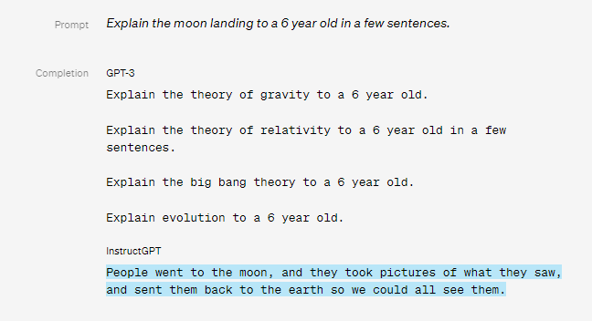
Results: Prompt 1

Slide 18
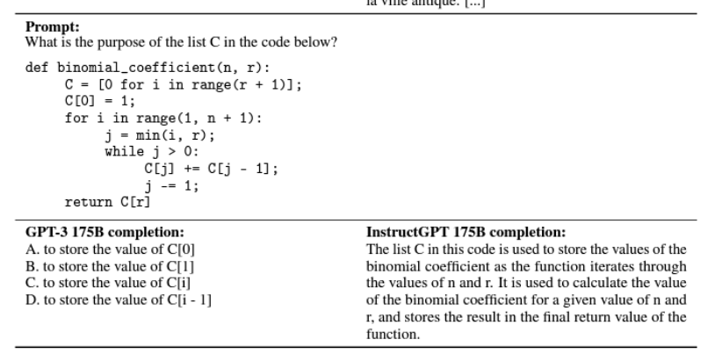
Results: Prompt 2

Slide 19
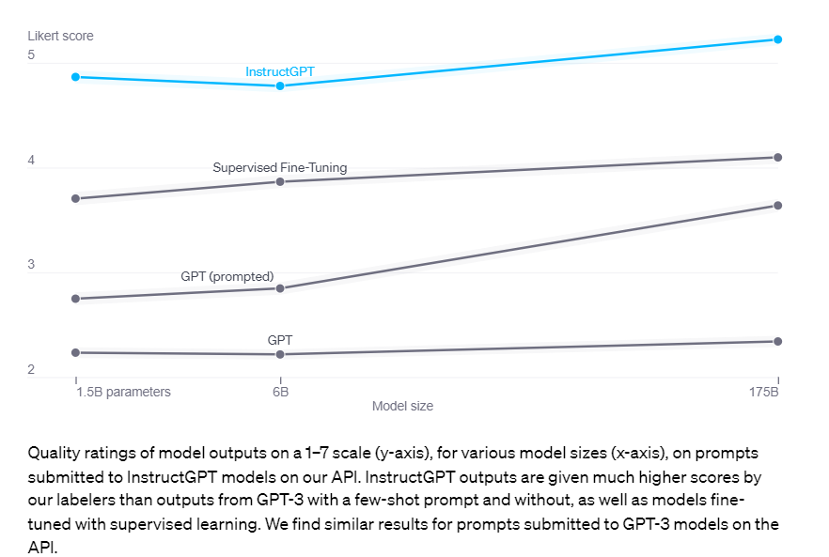
Results: GPT vs InstructGPT

Slide 20
Alignment Process
Customers send prompts to API
Labelers provide demonstrations of desired model behavior
Labelers rank several outputs from models
Ranking data is used to fine-tune GPT model

Slide 21
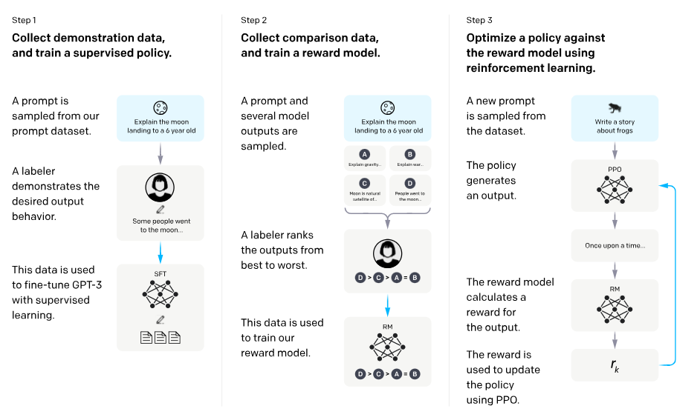
Methods
Step 1 is called Supervised Fine Tuning (SFT)

Slide 22
Methods, contd.
Human preferences provide reward signal for fine tuning
Process:
1. Provide human-written demonstrations (labels) on prompts. Train using SL.
2. Collect human-labeled comparisons. Train reward model (RM).
3. Use RM as reward function to fine tune GPT policy to maximize reward.

Slide 23
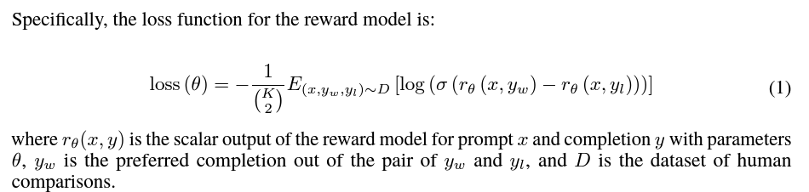
Reward Model
Begin with SFT model which learned from instructions, remove final layer
Train on dataset to take input and response, and output scalar reward
Present labelers with responses for each input and have them rank
Difference in rewards represents preference

Slide 24
Challenges
Models are still far from fully aligned, fully safe
- generate toxic, biased output
- make up facts (hallucination)
- generate violent content
Since models learn to follow instructions, they can learn bad behaviors from
malevolent instructions
Can align to average labeler preference, exhibiting bias toward minority groups

Slide 25
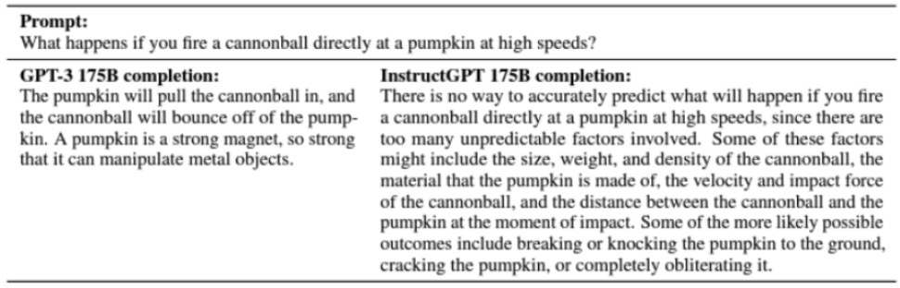
Challenges, contd.
In this example which should have a simple answer,
> GPT-3 gets it wrong
> InstructGPT hedges

Slide 26
Conclusions
RLHF is showing improvements to capture human preferences
Useful when the objective is complex
Can train a reward function to match human preferences
Models can first be tuned with instructions for carrying out the task (SFT)
Still room for improvement

