Slide 1

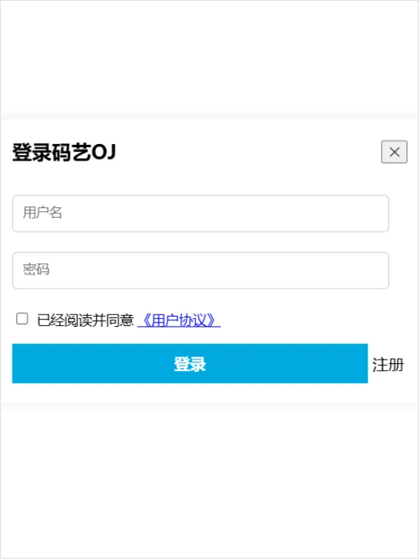
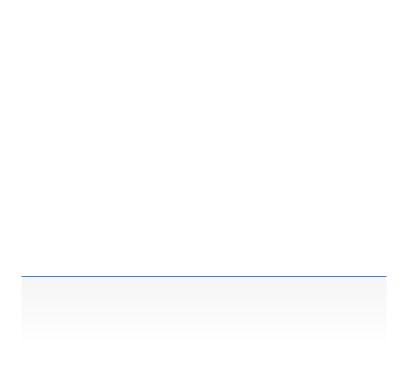
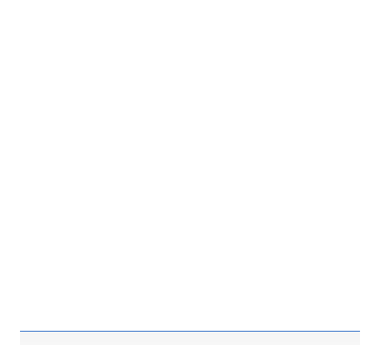



AntOJ登录界面
《div class="login">
《div class="login-header">
《span id="title">登录码艺OJ《/span>
《button id="logout-btn">&#10005;《/button>
《/div>
《div class="login-body">
《div>
《input type="text" id="username" placeholder="用户名">
《br>
《span class="error-message" id="username-error">《/span>
《/div>
《div>
《input type="password" id="password" placeholder="密码">
《br>
《span class="error-message" id="password-error">《/span>
《/div>
《/div>
《div class="login-footer">
《div class="agreement">
《input type="checkbox" id="agreement-checkbox">
《label for="agreement-checkbox">
已经阅读并同意
《a href="#">《用户协议》《/a>
《/label>
《span class="error-message" id="agreementbox-error">《/span>
《/div>
《div class="submit">
《button id="next-btn">登录《/button>
《span id="register-link">注册《/span>
《/div>
《/div>
《/div>

Slide 2

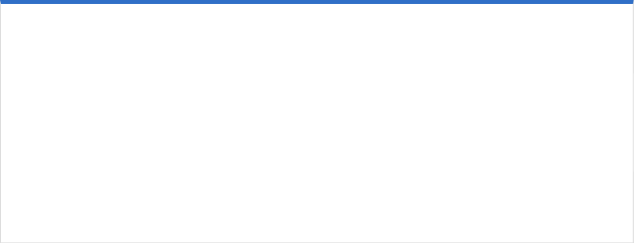


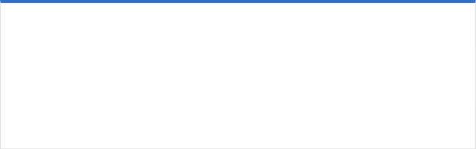
CSS
.login {
width: 400px;
padding: 20px;
border-radius: 10px;
background-color: #fff;
box-shadow: 0 0 10px rgba(0, 0, 0, 0.1);
animation: slide-up 1s ease-in-out forwards;
}
@keyframes slide-up {
0% {
opacity: 0;
position: absolute;
left: 50%;
top: 50%;
transform: translate(-50%, 0%);
}
100% {
opacity: 1;
position: absolute;
left: 50%;
top: 50%;
transform: translate(-50%, -50%);
}
}
.login-header {
display: flex;
justify-content: space-between;
align-items: center;
margin-bottom: 20px;
}
.login-header span {
font-size: 20px;
font-weight: bold;
}
.login-body {
margin-bottom: 10px;
}
.login-body input {
width: 90%;
padding: 10px;
margin: 10px auto;
border: 1px solid #ccc;
border-radius: 5px;
}
.login-footer label {
font-size: 14px;
}
.login #next-btn {
margin-top: 15px;
width: 90%;
height: 40px;
cursor: pointer;
font-size: 16px;
font-weight: bold;
background-color: rgba(0, 168, 223, 1);
border: none;
color: #fff;
}
.login #logout-btn {
cursor: pointer;
}
.login .error-message {
color: red;
font-size: 8px;
}
.login #register-link {
cursor: pointer;
}
.login #title {
cursor: default;
}

Slide 3



JS
usernameInput.addEventListener('blur', checkUsername);
passwordInput.addEventListener('blur', checkPassword);
loginBtn.addEventListener('click', validateForm);
registerLink.addEventListener('click', toRegister);
function checkUsername() {
const username = usernameInput.value.trim();
const errorMessage = document.querySelector('.login #username-error')
const regex = /^[a-zA-Z0-9_]{1,15}$/;
if (regex.test(username)) {
errorMessage.textContent = "";
return true;
} else {
errorMessage.textContent = "请输入符合规范的用户名";
return false;
}
}
function checkPassword() {
const password = passwordInput.value.trim();
const errorMessage = document.querySelector('.login #password-error')
const regex = /^[\w.]{6,15}$/;
if (regex.test(password)) {
errorMessage.textContent = "";
return true;
} else {
errorMessage.textContent = "请输入符合规范的密码";
return false;
}
}
function checkAgreement() {
const agreementError = document.querySelector('.login #agreementbox-error');
if (agreementCheckbox.checked) {
agreementError.textContent = "";
return true;
} else {
agreementError.textContent = "请勾选用户协议";
return false;
}
}
function validateForm() {
if (checkUsername() && checkPassword() && checkAgreement()) {
alert("登录成功");
}
}
function toRegister() {
alert("去到了注册界面");
}
const logoutButton = document.querySelector(".login #logout-btn");
const login = document.querySelector('.login');
logoutButton.addEventListener('click', function () {
login.style.display = 'none';
})
const registerBtn = document.querySelector('.registerBtn');

