Slide 1

Reinforcement learning
A quick introduction of the concept, terminology and different methods

Slide 2
Agenda
The concept of RL
Applications of RL
Terminology
Markov Decision Processes (MDP)
Overview of methods
Model Free RL
Neural networks in RL
Value based
Policy based
Actor Critic
Difficulties with RL

Slide 3
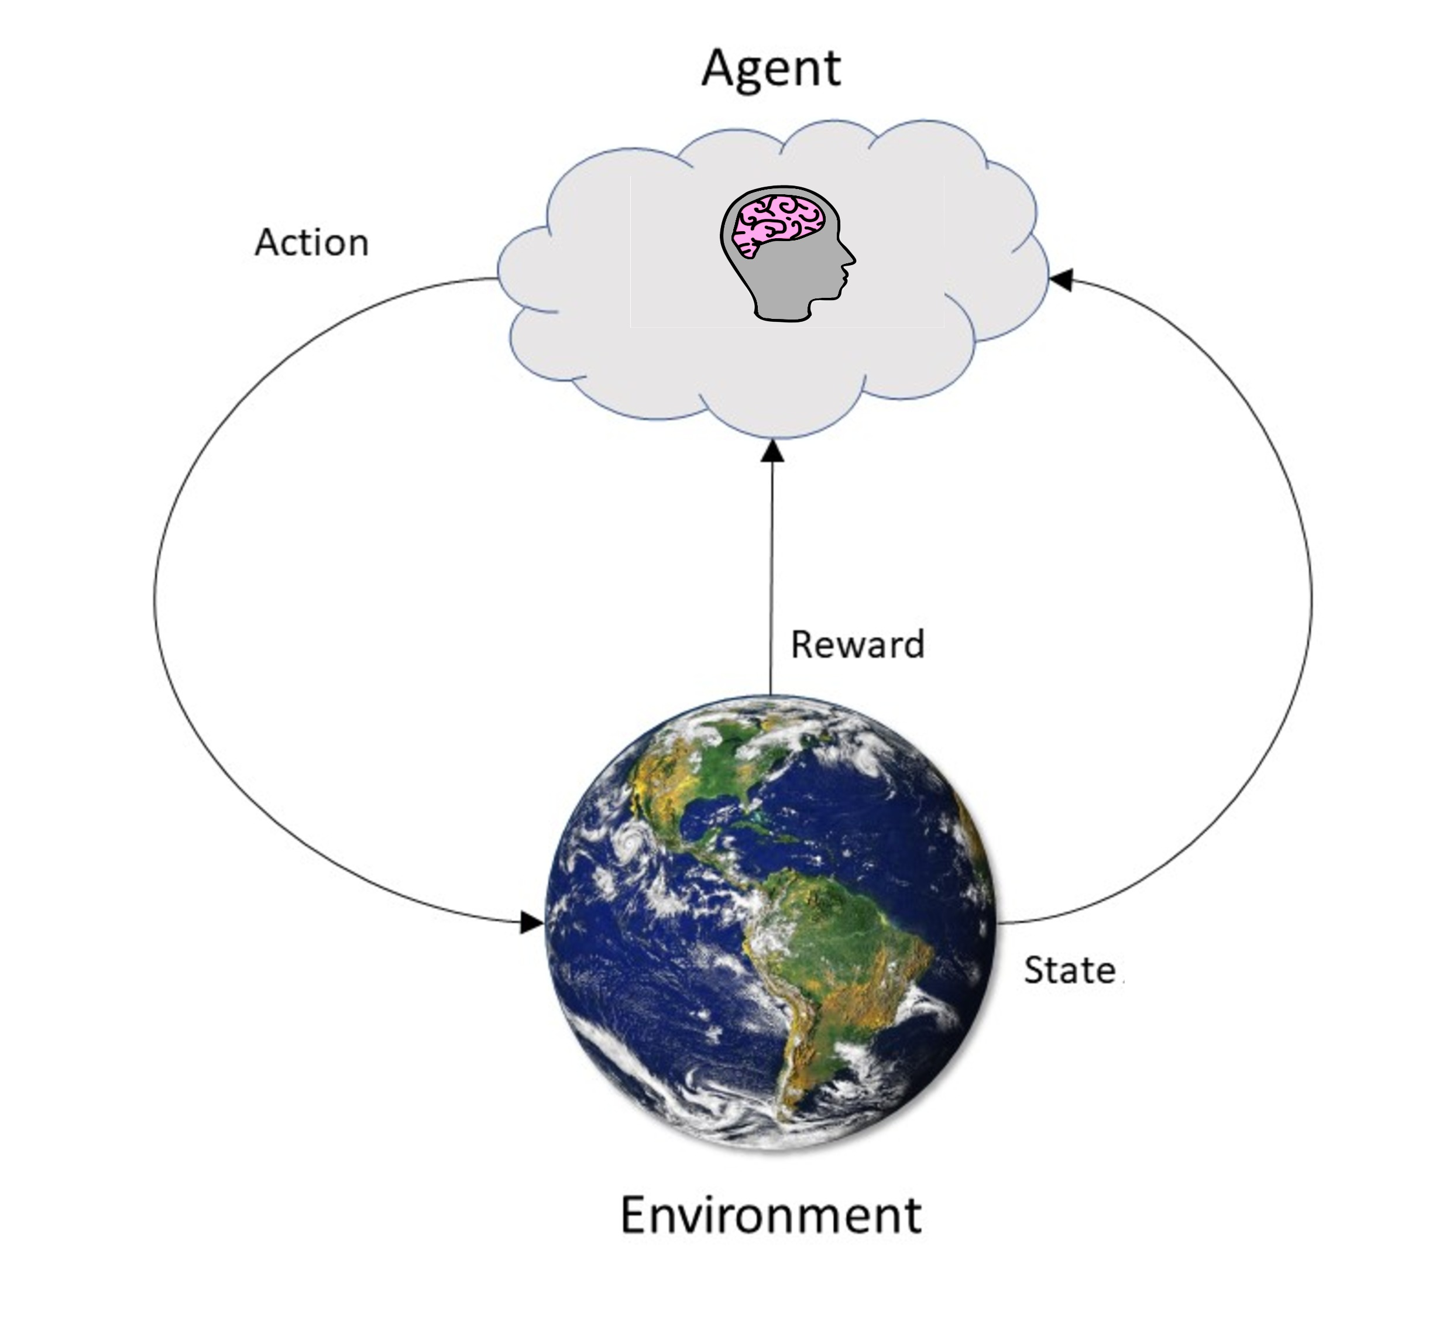
The concept
Concept – Application – Terminology – MDP – Overview of methods - Model free – Value based – Policy based – Actor critic - Difficulties
Supervised learning
Unsupervised learning
Reinforcement learning

Slide 4
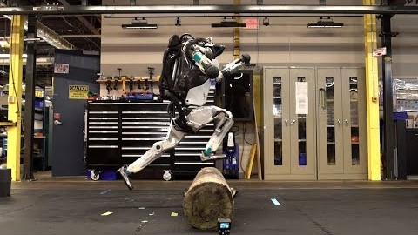
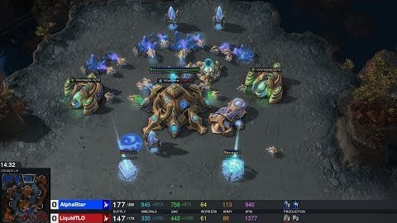
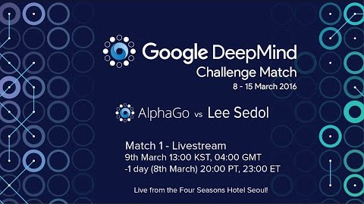
Applications
Concept – Application – Terminology – MDP – Overview of methods - Model free – Value based – Policy based – Actor critic - Difficulties
Mainly in video games and robotics control
Atlas from Boston Dynamics (2018)
AlphaStar from Google DeepMind playing StarCraft 2 (2019)
AlphaGo from google DeepMind
Vs Lee Sedol (2016)

Slide 5
Terminology in RL compared to control
Concept – Application – Terminology – MDP – Overview of methods - Model free – Value based – Policy based – Actor critic - Difficulties
Context of RL
Context of control
Agent
Environment
State (s) or Observation
Action (a)
Reward/cost (R, G, J)*
Hyper parameters and parameters (ϴ, w)*
State value (v) and state-action value (q)
Policy (π)
Controller
Controlled system
State (x)
Input (u)
Cost (J)
Parameters (ϴ)
* G: The cumulative rewards
* J: Continuous cost functions
* w: Parameters In neural networks

Slide 6
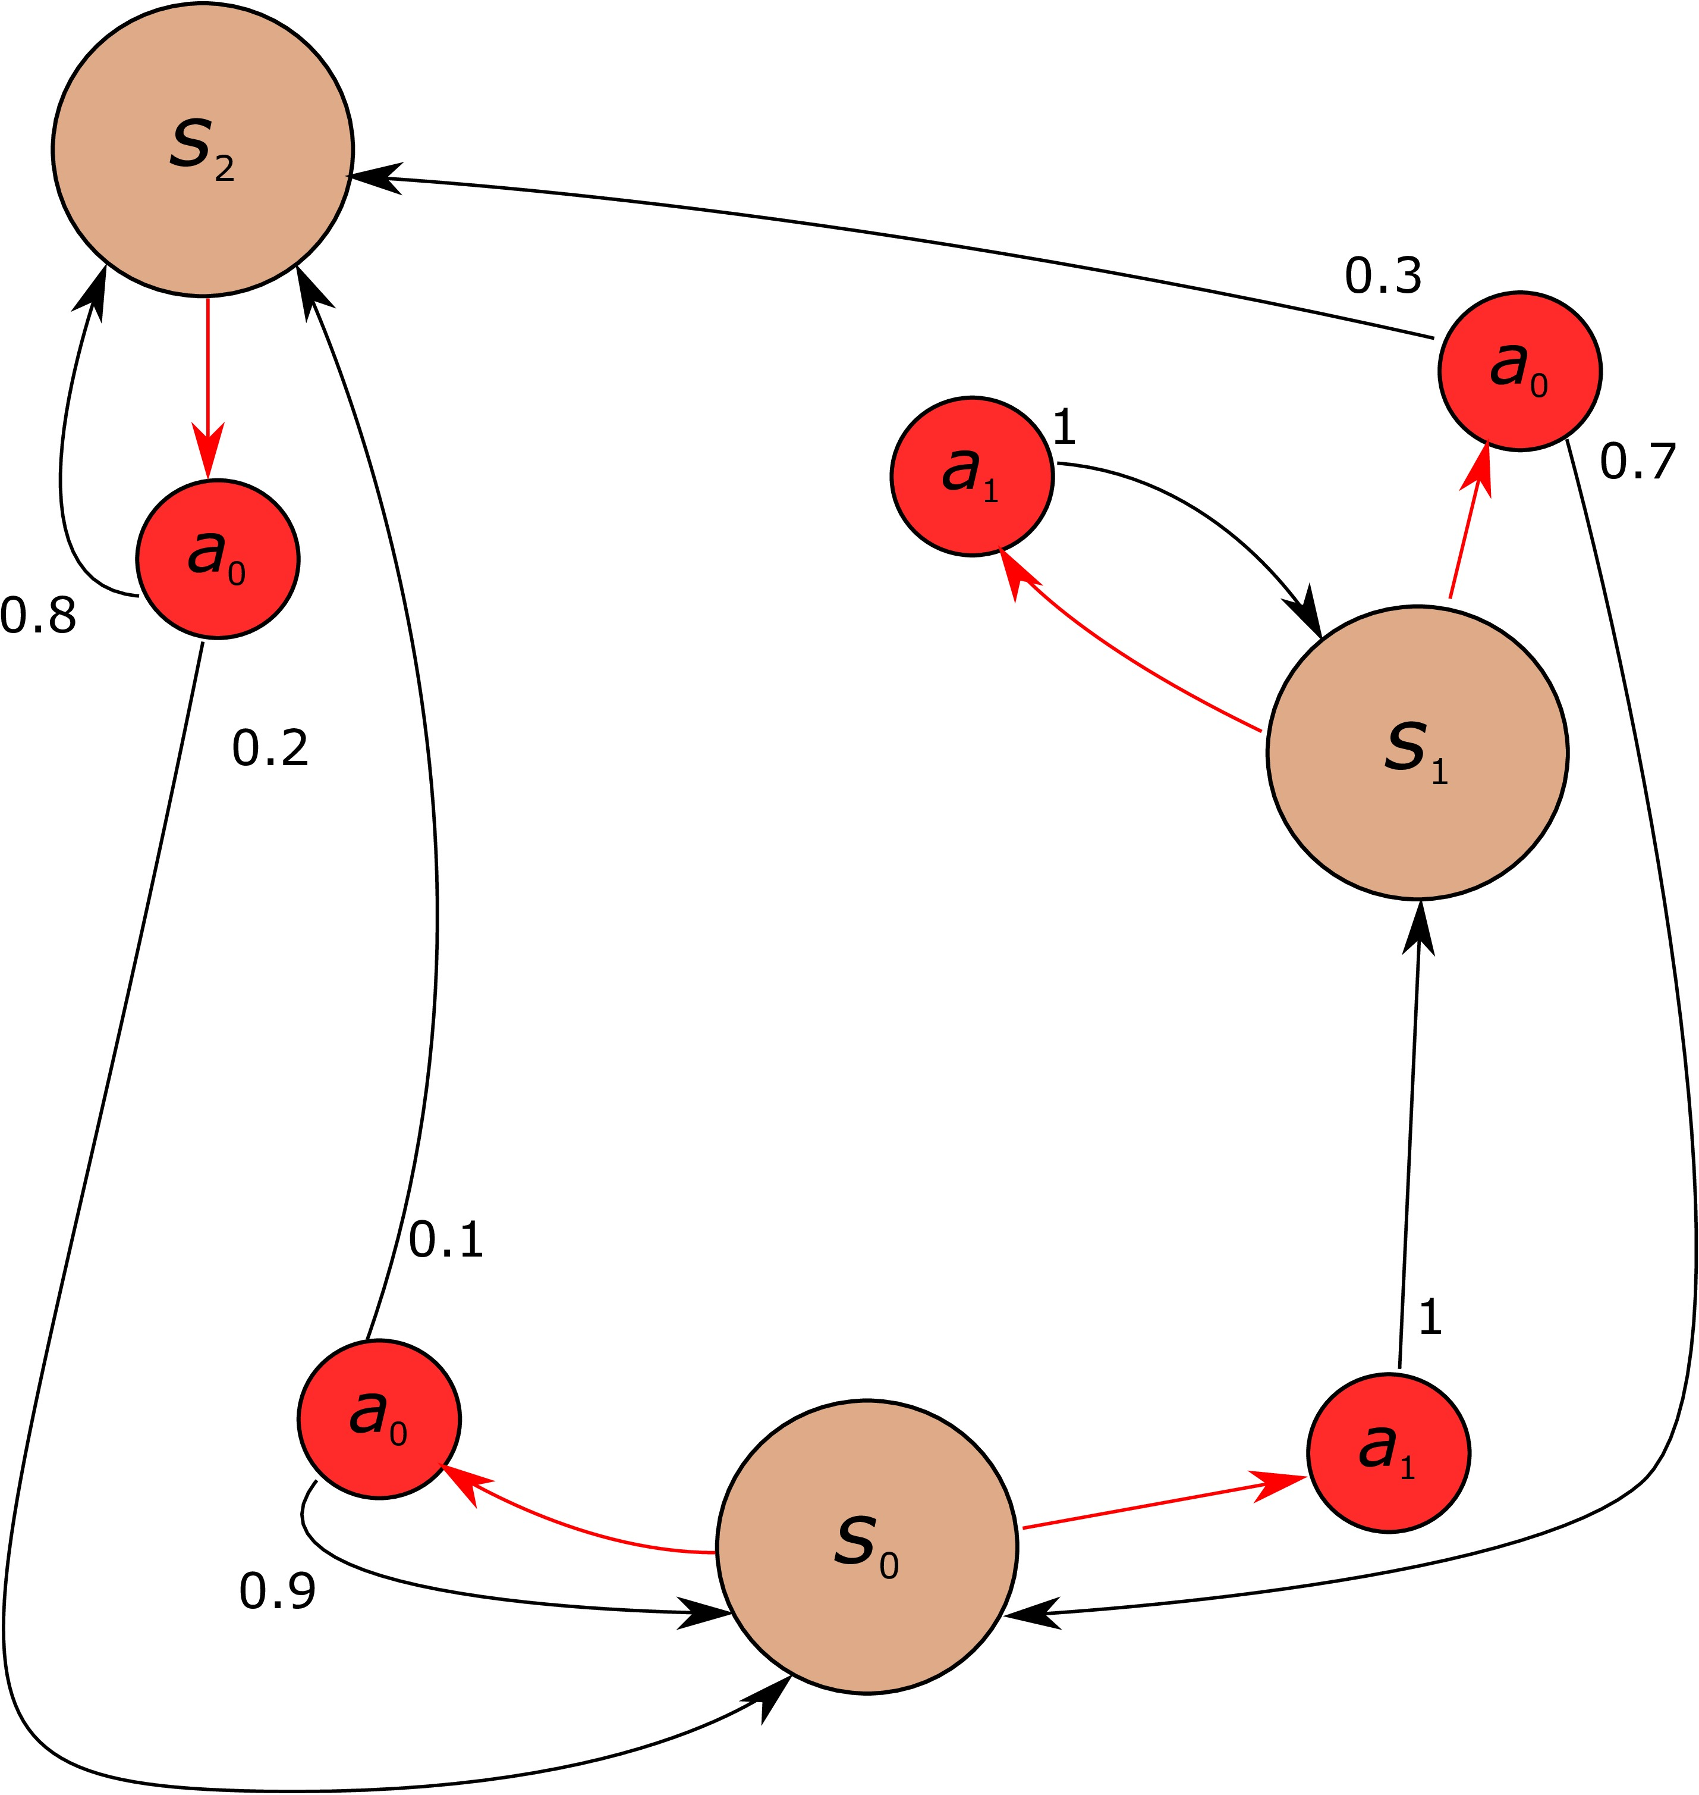
Markov Decision Process
Concept – Application – Terminology – MDP – Overview of methods - Model free – Value based – Policy based – Actor critic - Difficulties
A discrete time stochastic control process
The problem RL tries to solve
Builds on Markov chain
State-transition is affected by an action (a)
Markov property:
The “future” is only dependent on the given state

Slide 7
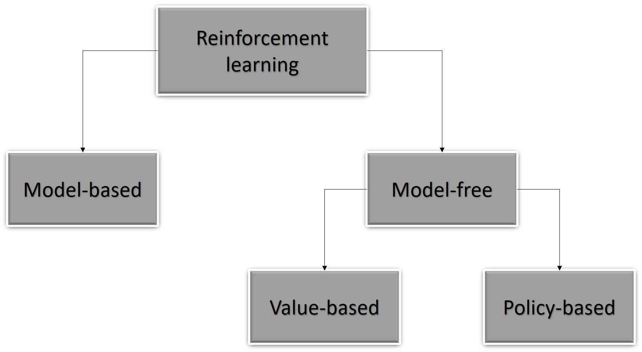
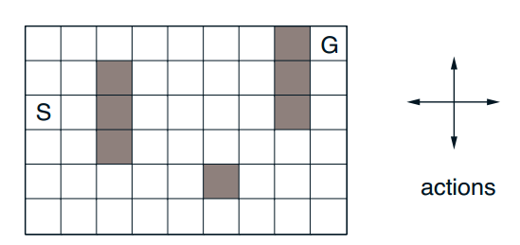
Overview of RL-methods
Concept – Application – Terminology – MDP – Overview of methods - Model free – Value based – Policy based – Actor critic - Difficulties
Model-Based uses a modelled MDP
Find the optimal path from S G
Tabular Methods used in model-based RL
Dynamic programming (DP)
Temporal Differences (TD)
Monte Carlo methods
N-step bootstrapping
Edibility traces with TD (λ)
Solved by updating values in a table, hence Tabular methods

Slide 8
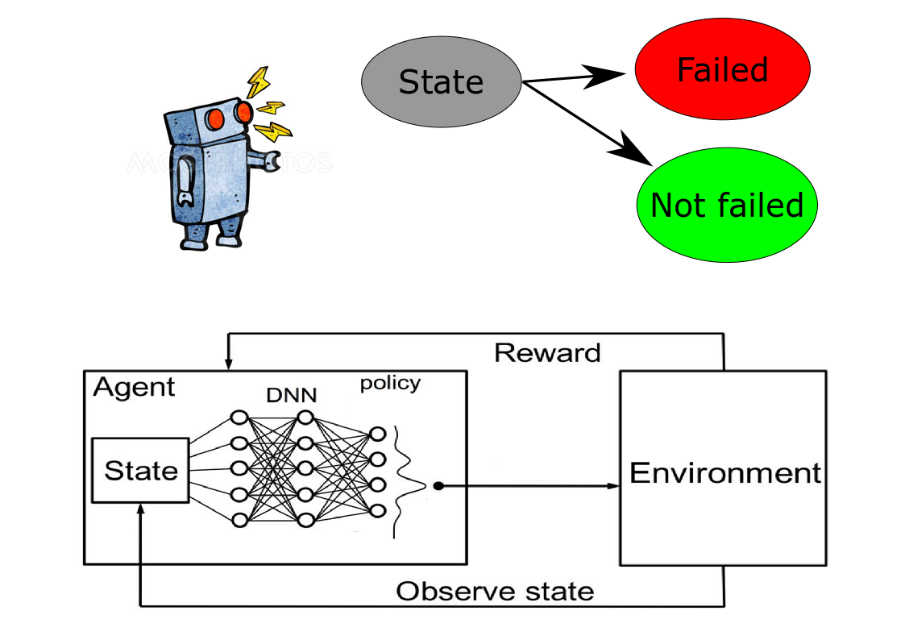
Model Free methods
Concept – Application – Terminology – MDP – Overview of methods - Model free – Value based – Policy based – Actor critic - Difficulties
Where the neural networks kicks in
When a MDP model is not feasible
Approximate the state value function v and/or the state-action value function q
Linear and non-linear function approximators
How does it learn?
Updating the weights by unconstrained optimization
The three main methods:
Value-based, policy based and actor critic

Slide 9
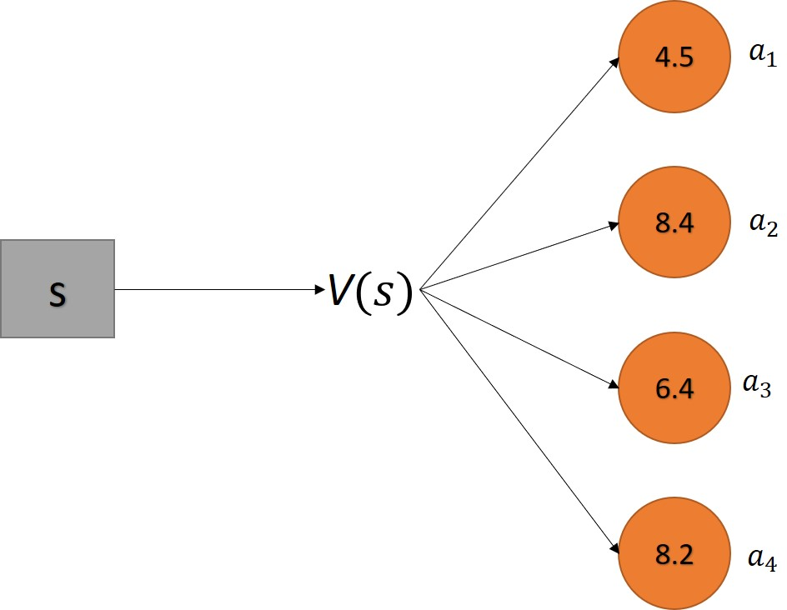
Value based methods
Concept – Application – Terminology – MDP – Overview of methods - Model free – Value based – Policy based – Actor critic - Difficulties
The policy is decided through the value estimate
The action space → discretized
Problems: High variance, needs discretized action space
Algorithms:
Q-learning or DQN
SARSA
S
v
π

Slide 10

Policy based methods
Concept – Application – Terminology – MDP – Overview of methods - Model free – Value based – Policy based – Actor critic - Difficulties
S
v
π
Lets skip the value estimation part
Good actions → Positive rewards → shift the weights → collect more positive rewards
Logarithmic probability of the value estimate
Allows for continuous action space
Problems: local minimums, slow
Algorithms:
REINFORCE, REINFORCE Monte Carlo, REINFORCE with baseline
$θ_{t+1}=θ_{t}+α∇J(θ_{t})$

Slide 11
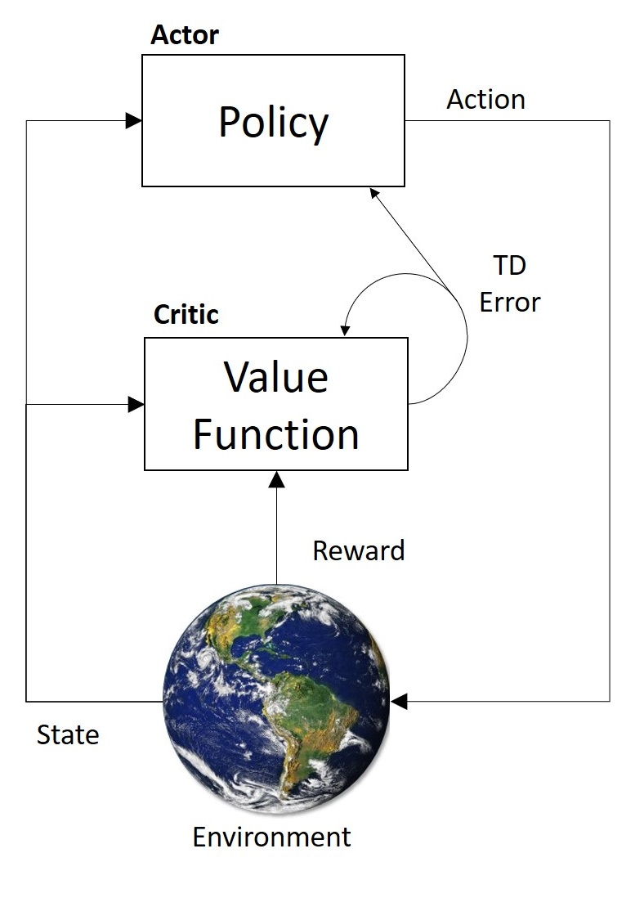
Actor critic
Concept – Application – Terminology – MDP – Overview of methods - Model free – Value based – Policy based – Actor critic - Difficulties
The best of both worlds
The actor → policy based
The critic → value based
Allows for bootstrapping which decreases training time
Problems: Difficult to implement, and debug
Algorithms:
A2C, A3C, PPO, DDPG, TRPO

Slide 12
Difficulties with RL
Concept – Application – Terminology – MDP – Overview of methods - Model free – Value based – Policy based – Actor critic - Difficulties
Know your environment, implementation goal, statistics and computer science
Problems
On the bright side
Why does it do that? God knows
Exploration vs exploitation
Hyper parameter sensitive
Design of reward function
Real world samples
Sample efficiency
Many frameworks for neural networks:
Tensorflow
Pytorch
Lots of information online
Growing field, with new RL frameworks

Slide 13

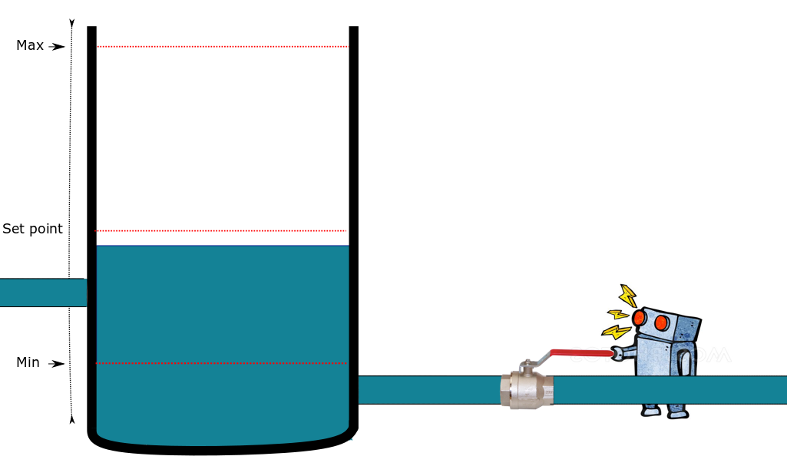
Questions?
My thesis RL implementations will be open sourced
If you are going for one reference:
https://github.com/emedd33/Reinforcement-Learning-in-Process-Control
Richard S Sutton and Andrew G Barto. Reinforcement learning: An introduction. MIT press, 2018.
David Silver has some great lectures about RL on youtube
RL Course by David Silver - Lecture 1: Introduction to Reinforcement Learning

