Slide 1
Version Control with Git
Notes:
Training note: Powershell font size = 18

Slide 2
Why do I provide this free training?
Because I want to learn more about Git.
Best way to learn: research > apply > share > repeat
I’m not an expert so if I cannot answer your questions, the web is your friend.

Slide 3
Goals
What is Git?
Why Git?
Install & configure Git
How to get help
Git basic concepts
Put Git to work
Notes:
Mention that since we don’t have enough time to cover everything.
No git process/service is running in the background

Slide 4
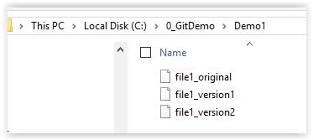
Demo I: Why Git?
Keep track of multiple version of a file or folder the ancient way.
Notes:
Mention that I too do this all the time, but lately want to getting away from this bad practice. Tell everyone that in some case this approach is useful.
Example: having undo database scripts when deploy to production system.
Want to have the unto scripts ready, just incase something go wrong.
Show demo with notepad and file explorer.
Mention that a file don’t need an extension. Tell class that the file can be any type of file such as word, powerpoint, excel, python, sql, c#, html, java script.

Slide 5
Git Overview
Git is a distribute version control system
Allow to work offline
Each person has a copy of the repository.
Git is fast
A copy of the repository is on your machine.
Use SHA1 hash to store and compare file.
Don’t take my word for this. Please try it.
Notes:
Mention that there will be a demo about the sha1 hash help git compare content of object quickly.

Slide 6
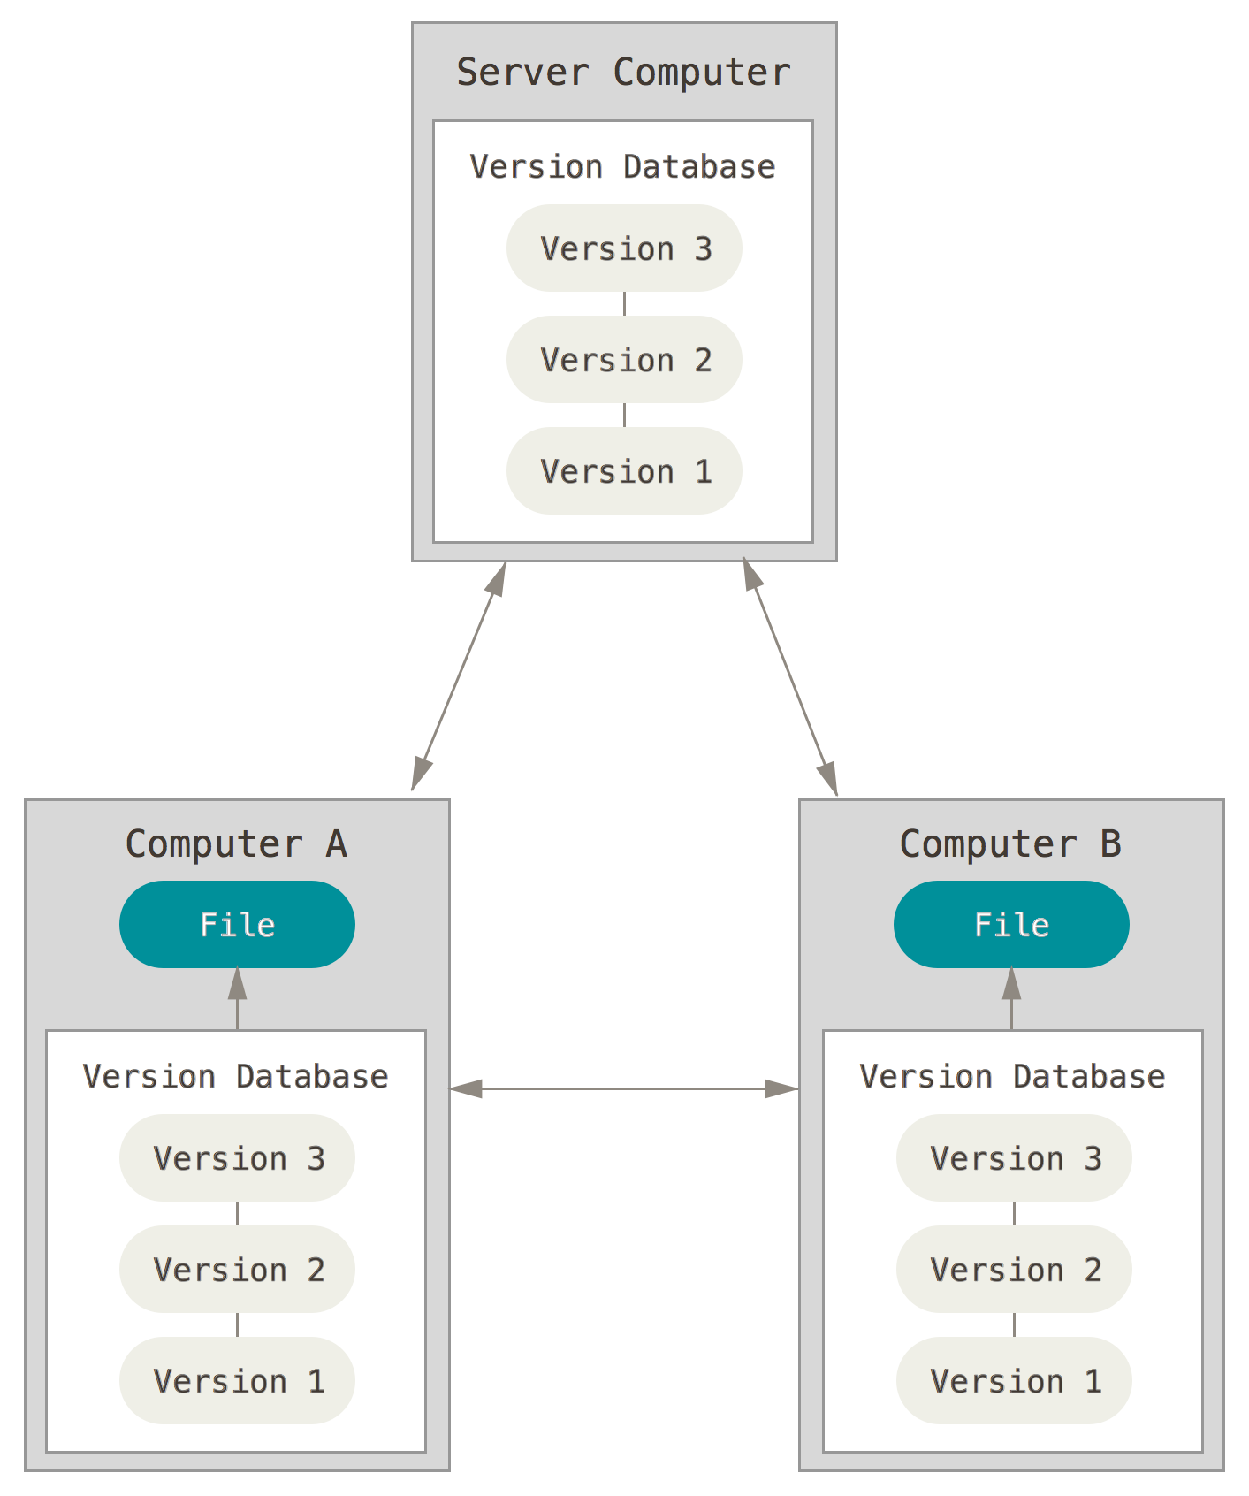
https://git-scm.com/book/en/v2/Getting-Started-About-Version-Control

Slide 7
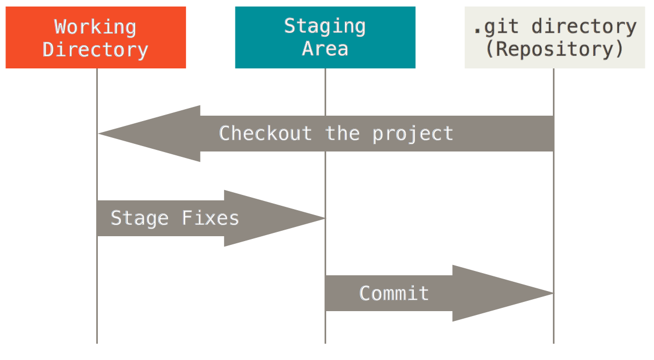
Git Workflow
https://git-scm.com/book/en/v2/Getting-Started-Git-Basics
Notes:
The basic Git workflow goes something like this:
1. modify files in your working directory.
2. stage the files, adding snapshots of them to your staging area.
3. do a commit, which takes the files as they are in the staging area and stores that snapshot permanently to your Git directory.
Using garage workshop analogy.
building a chair with 2 person.
On the working table contain all the objects: wood, glue, nail
When a chair leg is done you put on the staging table.
When done, move to commit table for final assembly.

Slide 8
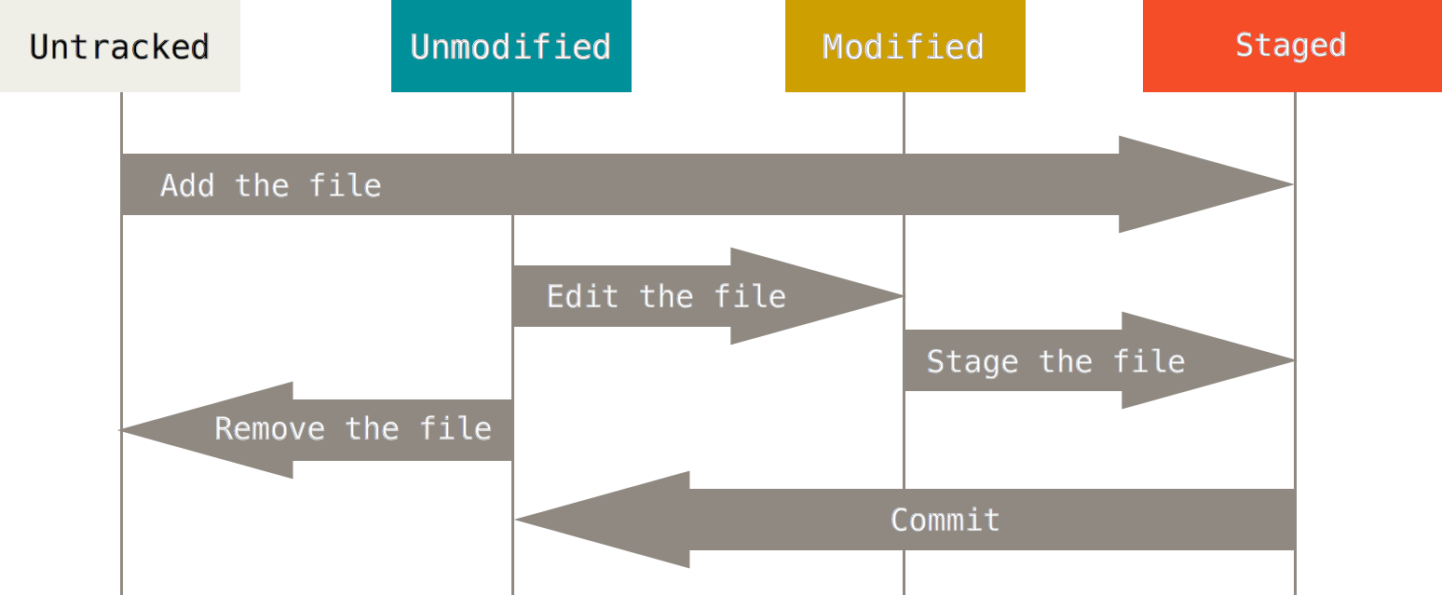
The lifecycle of the status of your files.
https://git-scm.com/book/en/v2/Git-Basics-Recording-Changes-to-the-Repository

Slide 9
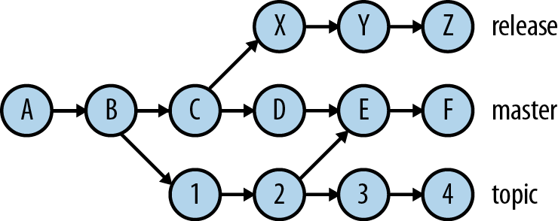
Branch
http://orm-chimera-prod.s3.amazonaws.com/1230000000561/images/gtpg_0101.png
Notes:
Master branch is the default branch

Slide 10
Demo: Version control with Git
Notes:
Use powershell and vim for demo.
Create repo under C:\0_GitDemo\Demo2
Show demo with powershell and vim.
PS command:
New-Item –path .\Demo2 –ItemType directory
Mkdir .\Demo2

Slide 11
Git Terminology
Git help glossary
http://stackoverflow.com/questions/7076164/terminology-used-by-git
Notes:
Go over main terminology: repo, repository, working directory, index(stage) area, commit, sha1 hash, tree, blob

Slide 12
Install Git
Download Git core installation:
https://git-scm.com/downloads
GUI Clients
https://git-scm.com/downloads/guis
Recommend Git Extension For Visual Studio
https://github.com/gitextensions/gitextensions/releases/tag/v2.48.05
Git installation also has a gui tool
Notes:
Ask everyone install only Git on his/her machine. Make sure to check all features during installation.
Running the installation as part of the demo but don’t proceed on the last step since Git is already install and configure on the laptop.
Mention that gui tools may only implement a subset of Git command.

Slide 13
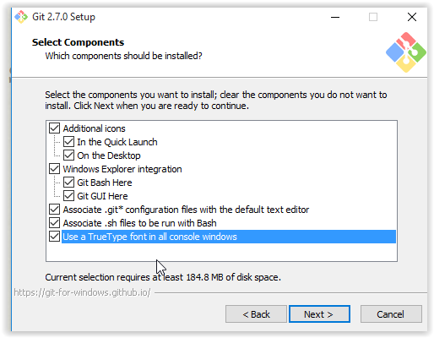
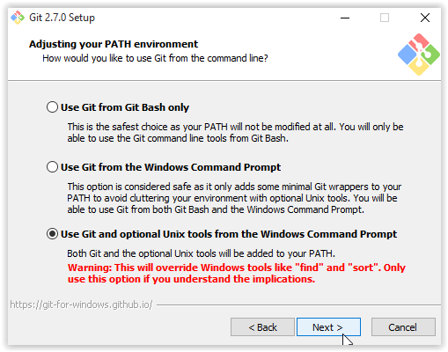

Slide 14
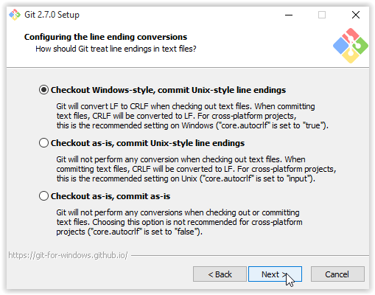
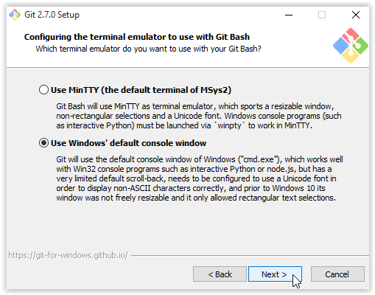

Slide 15
Exercise: Install Git

Slide 16
Exercise: Install Kdiff tool for compare/merge differences between file.
Download and install Kdiff:
http://sourceforge.net/projects/kdiff3/files/

Slide 17
Configure Git
Git config - -list
Show all your settings
Identity
Git config - -global user.name “Your Name”
Git config - -global user.email “your emai address”
Text editor
Git config - -global core.editor vim
git config --global core.editor "'C:/Program Files/Notepad++/notepad++.exe' -multiInst -nosession“
git config --global core.editor "'C:/Program Files (x86)/Notepad++/notepad++.exe' -multiInst -nosession“
Push changes option
Git config - -global push.default simple
Merge tool
Git config - -global merge.tool kdiff3
Git config - -global mergetool.kdiff3 ‘C:/Program Files/KDiff3/kdiff3.exe’
https://git-scm.com/book/en/v2/Getting-Started-First-Time-Git-Setup
Notes:
.gitconfig file in home dir
Unix/linux style name with “.” which mainly use to store configuration.
Ask class to follow along.

Slide 18
.gitconfig file location
Located in your home folder
On windows:
Is $home

Slide 19
Sample .gitconfig file
[user]
name = Hai
email = tnk7200@gmail.com
[core]
editor = vim
[diff]
tool = kdiff3
[mergetool "kdiff3"]
path = C:/Program Files/KDiff3/kdiff3.exe
keepBackup = false
trustExitCode = false

Slide 20
.gitIgnore File
Specify type of files/folders you don’t want git to track.
Place this file in your working directory and commit to your repo
Example:
.*log
.*swp
.*un~
/test
Sample Python and Visual Studio .GitIgnore file:
https://github.com/github/gitignore/blob/master/Python.gitignore
https://github.com/github/gitignore/blob/master/VisualStudio.gitignore
Notes:
Show demo of adding .gitignore file.
Show git status before and after adding .gitignore file to the working directory.
Content of .gitignore file
.*log
.*swp
.*un~
/test
*~

Slide 21
Demo: .gitignore

Slide 22
Exercise 2: Configure your git
Set your name and email address
Set default text editor
Add mergetool

Slide 23
Getting Help
Git help
Git help –a
All available commands
Git help –g
Git guides
Git help <command>
Show help for a command
Git help git-tag
Git help <concept>
Show guide for a particular concept. Example: git help glossary
https://git-scm.com/book/en/v2/Getting-Started-Getting-Help

Slide 24
Demo Get help

Slide 25
Exercise: display the help page for Git Status using Git command line

Slide 26
Create a local Repository
Git init
Git clone https://github.com/HaiTon/GitTutorial
https://git-scm.com/book/en/v2/Git-Basics-Getting-a-Git-Repository

Slide 27
Demo cloning a github repo

Slide 28
Exercise: cloning a github repo
Create a new folder on your computer home directory or anywhere you like.
Open git bash shell
Run command:
Git clone https://github.com/HaiTon/GitTutorial

Slide 29
Git status
Show the status of working tree
Notes:
Note by default git doesn’t track empty folder but does track empty file

Slide 30
Adding changes to Stage(Index)
Move files and folders in working directory to index(stage area)
Git add .
add all files and folder in working directory to index(stage area)
Git add .\file1 .\file2 .\folder1\file3
add muitiple files

Slide 31
Display Repository History
Git log
Git log --all
Git log - -oneLine
Git log - -oneLine - -decorate - -graph
More advanced git log commands:
http://stackoverflow.com/questions/1057564/pretty-git-branch-graphs
Notes:
Mention that Git command is case sensitive. Git lod - -Oneline result an error
Or git Log.
Use git log - -all to display all commit.

Slide 32
Committing changes
Git Commit
Move file from the staging (index) area to the repository.
Git commit –m “Adding new logo to home page.”

Slide 33
Exercise: Create a repository
Create a new folder
Create a git repository
Git init
Create add 2 files and add some text to each file to your working directory (the folder on step 1)
Run add the file the index (stage area)
Git status
Git add File1 File2
Commit the changes
Git commit –m “commit message”
Git log
Edit your file and repeat step 4 to 5.
Notes:
Pair with a partner

Slide 34
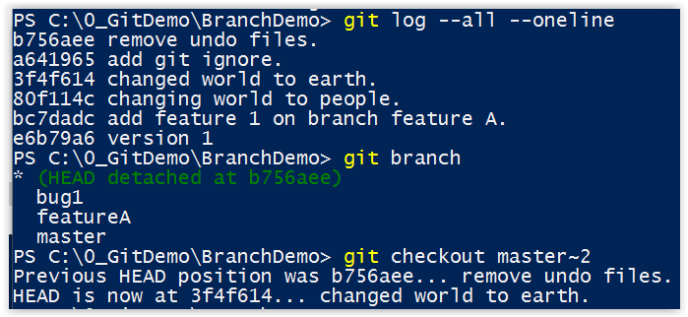
Check out a commit
Notes:
Notice the content of the working directory revert to the stage of the checked out commit.
Note HEAD head point when checkout a commit or switch branch
If you run git log, it only show the commit early before the checkout commit.
Use git log - -all to show all commit.

Slide 35
Checkout a file
Git checkout hash-id filename
Example:
Git checkout c10a4r ./file1 ./file2
Git checkout 38ce3fp /folder1/file1
Git chechout master~1 ./file1
Git checkout
Update files in working tree to match version in the index or the specified tree.
If not paths are given, git will update HEAD pointer to set the specified branch as current branch
https://git-scm.com/docs/git-checkout
Notes:
Note the HEAD pointer doesn’t change when only chechout a particular files

Slide 36
Demo: Reverse change of a file to last version

Slide 37
Demo: Recover a delete file
Notes:
Create a repo > Create 3 files > commit > edit file3 > commit > deleted file1, file2 > commit
Git checkoult hashid file1
git checkout 2083211 .\file1 .\file2
View content of file3 which is unchanged: cat .\file3

Slide 38
Exercise: Recover a delete file
Go to your working directory.
Delete one file
Stage the change
Commit the change
Checkout the deleted file with changes of the first commit.

Slide 39
Branch
http://orm-chimera-prod.s3.amazonaws.com/1230000000561/images/gtpg_0101.png
Notes:
This is an example of a commit gragh

Slide 40
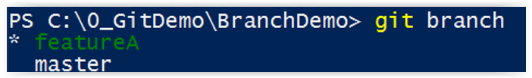
where am I?
Git branch

Slide 41
Branch
Create a new branch
Git branch <BranchName>
Swich/Jump to a branch
git checkout <branchName>
Creating a new branch and jump to it
git checkout –b <branchName>
Display all braches
git brach
https://git-scm.com/docs/git-checkout
Notes:
Actually there’s no jumping involved, git just move the head pointer.
git branch <branch> [<start point>]
git checkout -b|-B <new_branch> [<start point>]
<start-point> is the name of a commit

Slide 42
See which changes between branches
See is any different between current branch and bug1 branch.
git diff bug1

Slide 43
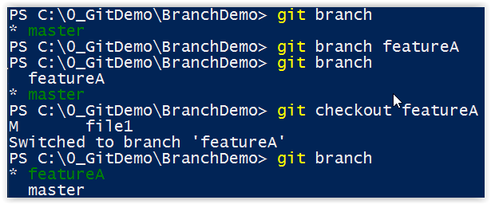
Demo: Branching/Merge
Notes:
The asterisk indicate which branch HEAD pointer is pointing to.
Draw the commit graph on the white board for easy visualization.

Slide 44
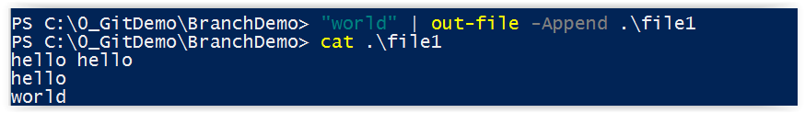
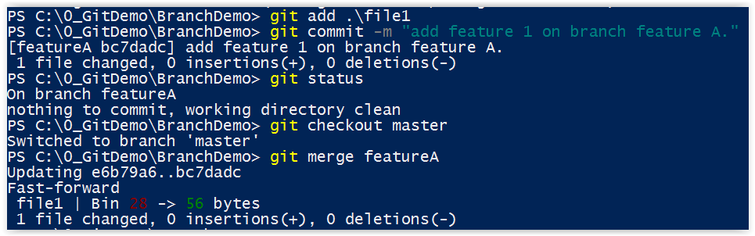
Merging: Fast-forward
Notes:
Merge FeatureA branch to Master branch. Notice that this is a fast forward merge.
Because FeatureA branch is upstream which has one more commit after branching from Master.
And there were no additional commit on Master branch.

Slide 45
Merge: fast forward example
Notes:
Explain: if merge 2 to E this is a fast forward merge because E is one commit ahead of 2
Where merge E to 2 is not

Slide 46
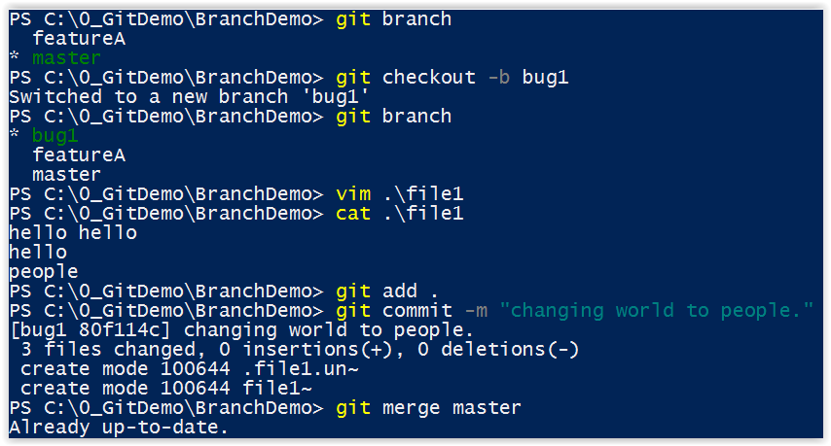
Merging: non fast-forward
http://stackoverflow.com/questions/634546/git-merge-reports-already-up-to-date-though-there-is-a-difference
Notes:
Notice that there nothing to merge from Master branch to bug1 branch because bug1 is upstream of master since no commit has made to master since we create bug1 branch from master.
Show commit graph on white board.

Slide 47
Exercise: create a new branch for your repo

Slide 48
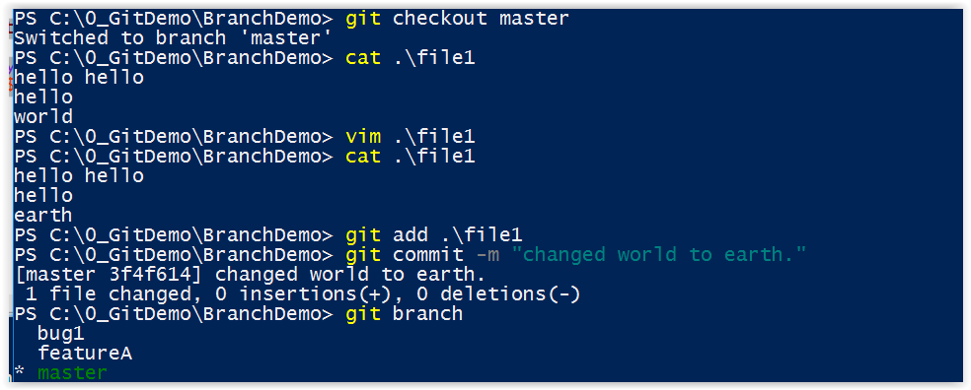
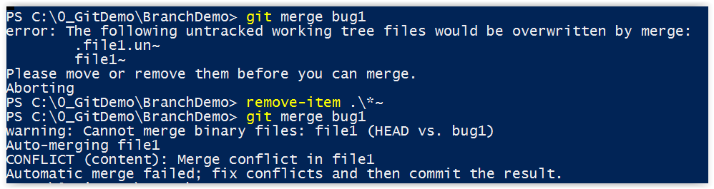
Merging: Resolve Conflict
Notes:
Now we have a conflict on file1 on line 3 between master and bug1 branch.
Master branch file1 line 3: has word “earth”
Bug 1 branch file1 line 3 has word “people”
Note git wiil complain if any undo file exist in the working directory. These undo file created by vim. In vim use command :set noundofile
Git will auto merge as much as possible. For conflict you will need to resolve them.

Slide 49
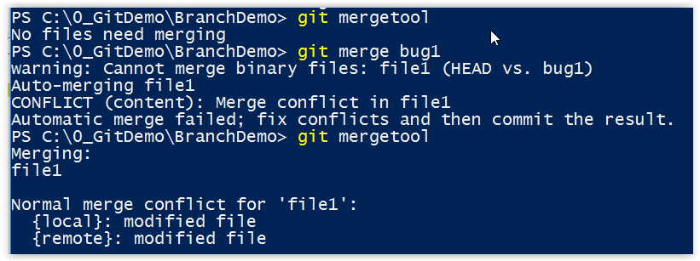
Resolve Conflicts with Kdiff tool
Notes:
Notice when we didn’t specify which branch to merge with master branch, git doesn’t detect which file to merge.
So run git merge branch
Then git mergetool

Slide 50
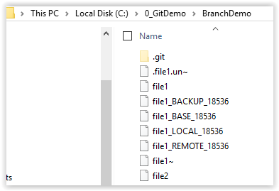
Resolve Conflicts with Kdiff tool
Notice kdiff tool create 4 additional files in your working directory.
Base file is the file on the branch you are merging to in this case is the master branch.
Remote file is the file on the branch your pulling changes from in this case is the bug1 branch.
Local file is the file currently on the working directory.
Backup file is the backup of local file .
These 4 files will be removed after the merge is complete.
Notes:
bace

Slide 51
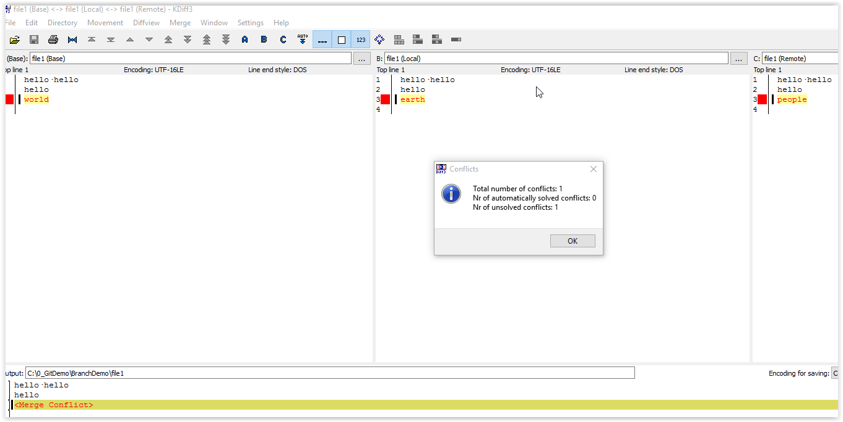
Resolve Conflicts with Kdiff tool
Notes:
This is a way merge.
Base file is the file on the branch you are merging to in this case is the master branch.
Remote file is the file on the branch your pulling changes from in this case is the bug1 branch.
Local file is the file current store on the working directory.
The bottom file is the merge result.

Slide 52
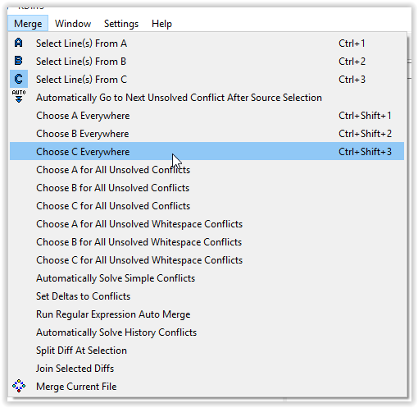
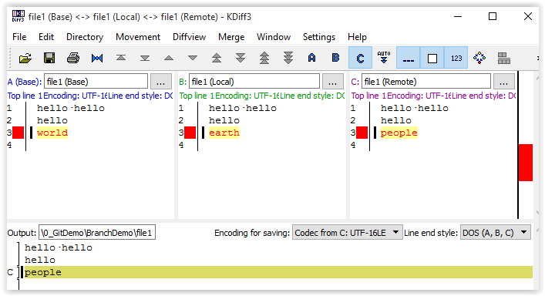
Resolve Conflicts with Kdiff tool
Make sure to save the merged result, and commit file1 after merge.
Notes:
Make sure to save the merged result, and commit file1 after merge.

Slide 53
Working with remote repo
Clone a remote repo
git clone https://github.com/HaiTon/GitTutorial.git
Getting changes from remote repo
git fetch
Merge changes in remote repo and local repo
git merge origin/master
Getting & merge change from remote repo to local repo
git pull
Push changes from local repo to remote
git push https://github.com/HaiTon/GitTutorial
http://stackoverflow.com/questions/21756614/difference-between-git-merge-origin-master-and-git-pull
Notes:
Mention that need to fetch first before merge, else you won’t see changes made on remote repo.
Notice when push changes don’t include the .git in url. If no branch is specified wiil push to origin/master.
Also when push changes, make sure to fetch/merge or just pull first.

Slide 54
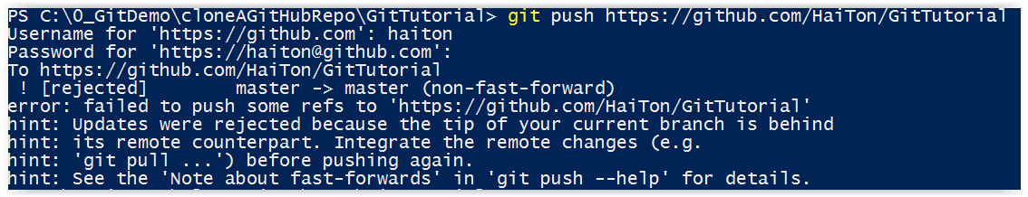
Pushing changes to remote repo
When push changes to remote repo, make sure to fetch/merge or just pull first.
This to ensure to get changes made on remote repo since last pull.
Notes:
Notice when push changes don’t include the .git in url. If no branch is specified wiil push to origin/master.
Also when push changes, make sure to fetch/merge or just pull first.

Slide 55
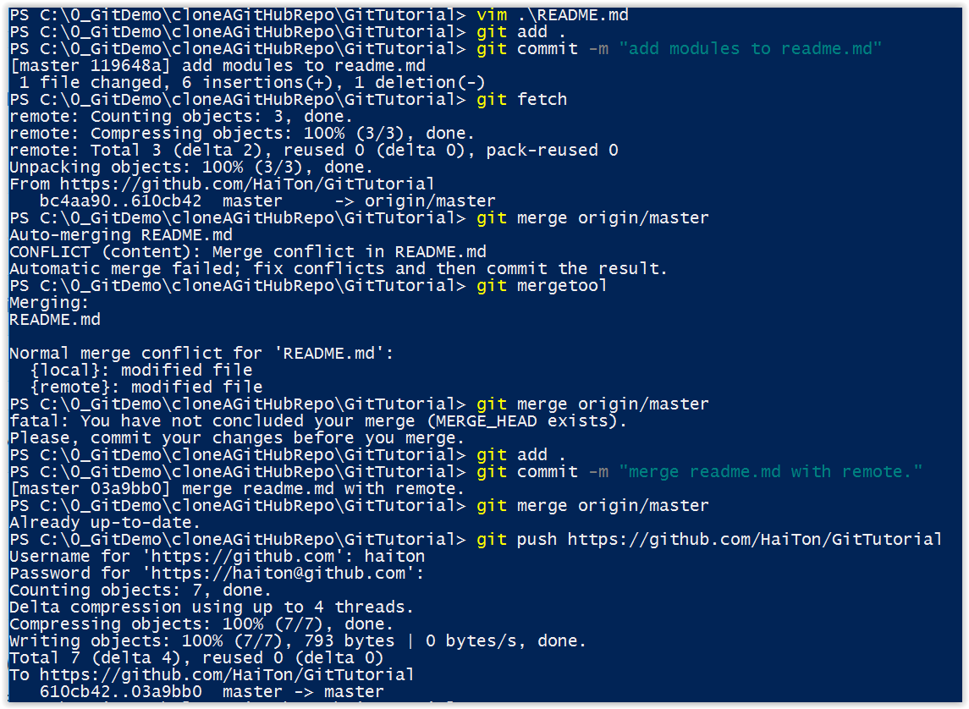
Pushing changes to remote repo

Slide 56
Resources
ReadTheManual by using git help command
Search Engine
Stack Exchange
http://www.gitguys.com/
http://gitref.org/basic/
https://git-scm.com/doc
https://www.youtube.com/watch?v=ig5E8CcdM9g

Slide 57
Useful PowerShell commands
Get-help <command>
example: get-help *alias*
get-help New-Alias -online
Invoke-item path
example: ii .
will open windows explore of current directory
Tree .git
displays the folder structure
Tree /?
for help on tree command
Cls
clear out the screen
Ls –recurse –hidden
show all files and folder even hidden
cat filepath
show content of a file. This is an alias of get-content cmdlet
“hello world” | out-file .\file1.cs
create file1.cs with “hello world” string and save to a file
Help New-Item –ShowWindow
Help New-Item –Online
Ctrl + c to quit a running command

