Slide 1
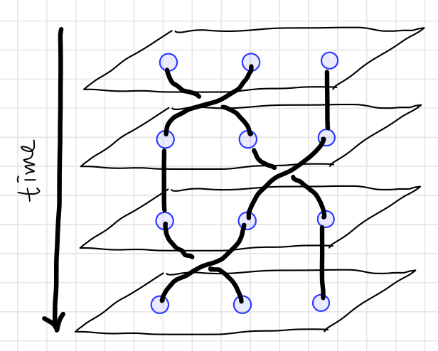
Counter-clockwise
Counter-clockwise
Counter-clockwise

Slide 2
c
a
b
c
a
b
c
b
e
e
a
d
d
e
b
c
d
a
d
e

Slide 3
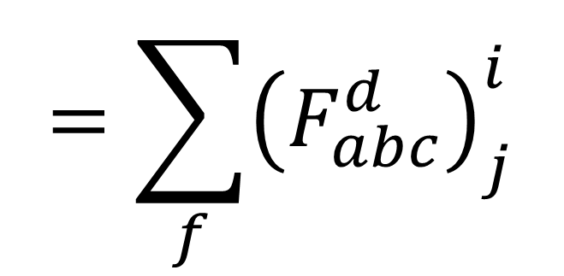
a
b
c
a
b
c
i
$$=\sum_{f}{{\left(F_{abc}^{d}\right)}_{j}^{i}}$$
j
d
d

Slide 4

a
b
a
b
$$=R_{ab}^{c}$$
c
c

Slide 5





1 2 3 4
a
c
1 2 3 4
1 2 3 4
5
$$F_{a34}^{5}$$
$$F_{12c}^{5}$$
a
c
b
d
5
$${F_{12c}^{5}}^{−1}$$
$${F_{234}^{d}}^{−1}$$
5
1 2 3 4
1 2 3 4
e
e
b
$${F_{1e4}^{5}}^{−1}$$
d
5
5

Slide 6










$s_{1}$ $s_{2}$ $l_{1}$ $l_{2}$
Same ingredient
$s_{1}$ $l_{1}$ $s_{1}$ $l_{2}$
$s_{1}$ $l_{1}$ $s_{1}$ $l_{2}$
$$S$$
$$L$$
Different intermediate results
$$j_{1}$$
$$j_{2}$$
?
$$J$$
Same result
$$J$$
$$J$$

Slide 7








$s_{1}$ $s_{2}$ $s_{3}$
Same ingredient
$s_{1}$ $s_{2}$ $s_{3}$
$s_{1}$ $s_{2}$ $s_{3}$
Different
coupling
order
$$S_{23}$$
?
$$S_{12}$$
Same result
$$S$$
$$S$$
$$S$$

Slide 8
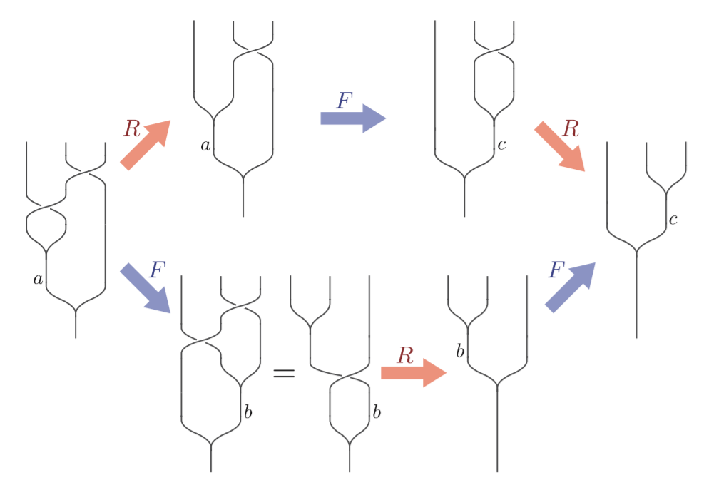

Slide 9
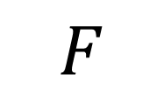
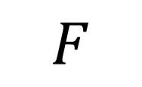
$$F$$
$$F$$

Slide 13


