Slide 1
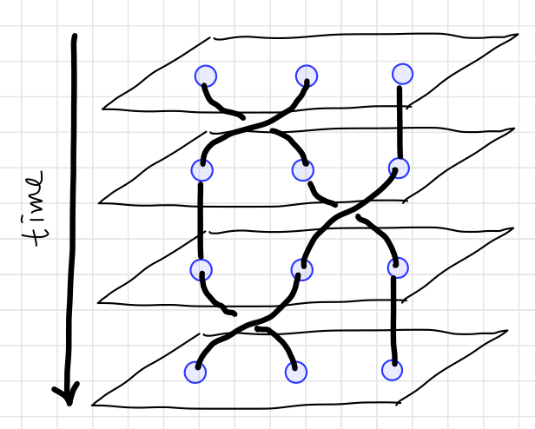
Counter-clockwise
Counter-clockwise
Counter-clockwise

Slide 2
c
a
b
c
a
b
c
b
e
e
a
d
d
e
b
c
d
a
d
e

Slide 3
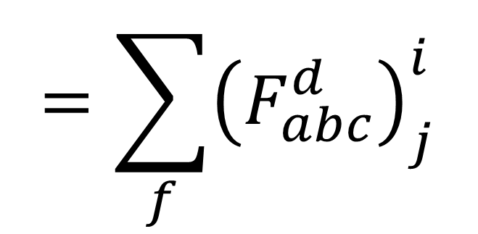
a
b
c
a
b
c
i
$$=\sum_{f}{{\left(F_{abc}^{d}\right)}_{j}^{i}}$$
j
d
d

Slide 4

a
b
a
b
$$=R_{ab}^{c}$$
c
c

Slide 5
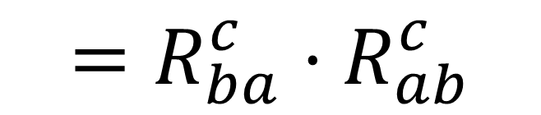
a
b
a
b
$$=R_{ba}^{c}⋅R_{ab}^{c}$$
c
c

Slide 6





1 2 3 4
a
c
1 2 3 4
1 2 3 4
5
$$F_{a34}^{5}$$
$$F_{12c}^{5}$$
a
c
b
d
5
$${F_{123}^{b}}^{−1}$$
$${F_{234}^{d}}^{−1}$$
5
1 2 3 4
1 2 3 4
e
e
b
$${F_{1e4}^{5}}^{−1}$$
d
5
5

Slide 7










$s_{1}$ $s_{2}$ $l_{1}$ $l_{2}$
Same ingredient
$s_{1}$ $l_{1}$ $s_{1}$ $l_{2}$
$s_{1}$ $l_{1}$ $s_{1}$ $l_{2}$
$$S$$
$$L$$
Different intermediate results
$$j_{1}$$
$$j_{2}$$
?
$$J$$
Same result
$$J$$
$$J$$

Slide 8








$s_{1}$ $s_{2}$ $s_{3}$
Same ingredient
$s_{1}$ $s_{2}$ $s_{3}$
$s_{1}$ $s_{2}$ $s_{3}$
Different
coupling
order
$$S_{23}$$
?
$$S_{12}$$
Same result
$$S$$
$$S$$
$$S$$

Slide 9
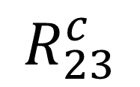

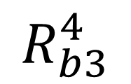
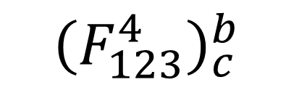



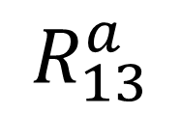
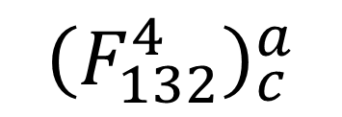
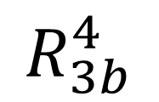






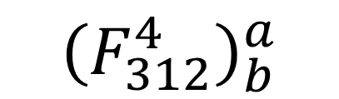




$${\left(F_{132}^{4}\right)}_{c}^{a}$$
$$1 3 2$$
$$1 3 2$$
$$R_{13}^{a}$$
c
$$R_{23}^{c}$$
a
$$4$$
$$4$$
$$1 2 3$$
$$3 1 2$$
c
a
$$4$$
$$4$$
$$1 2 3$$
$${\left(F_{312}^{4}\right)}_{b}^{a}$$
$${\left(F_{123}^{4}\right)}_{c}^{b}$$
$$3 1 2$$
b
b
$$R_{3b}^{4}$$
$$4$$
$$4$$
$$1 2 3$$
$$R_{b3}^{4}$$
b
$$4$$

Slide 10
$${\left(F_{132}^{4}\right)}_{c}^{a}$$
$$1 3 2$$
$$1 3 2$$
$$R_{13}^{a}$$
c
$$R_{23}^{c}$$
a
$$4$$
$$4$$
$$1 2 3$$
$$3 1 2$$
c
a
$$4$$
$$4$$
$$1 2 3$$
$${\left(F_{312}^{4}\right)}_{b}^{a}$$
$${\left(F_{123}^{4}\right)}_{c}^{b}$$
$$3 1 2$$
b
b
$$R_{3b}^{4}$$
$$4$$
$$4$$
$$1 2 3$$
$$R_{b3}^{4}$$
b
$$4$$

Slide 11
$${\left(F_{132}^{4}\right)}_{c}^{a}$$
$$1 3 2$$
$$1 3 2$$
$$R_{13}^{a}$$
c
$$R_{23}^{c}$$
a
$$4$$
$$4$$
$$1 2 3$$
$$3 1 2$$
c
a
$$4$$
$$4$$
$$1 2 3$$
$${\left(F_{312}^{4}\right)}_{b}^{a}$$
$${\left(F_{123}^{4}\right)}_{c}^{b}$$
$$3 1 2$$
b
b
$$R_{3b}^{4}$$
$$4$$
$$4$$
$$1 2 3$$
$$R_{b3}^{4}$$
b
$$4$$

Slide 12




$$1 2 3$$
$$1 2 3$$
$$4$$
$$4$$

