Slide 1

knowledge sharing

Slide 2
HISTORY
Linux kernel
Git (2005 – today)
Git created in a couple of weeks in April 2005 (wikipedia)
Support a distributed BitKeeper-like workflow
Very strong safeguards against corruption, either accidental or malicious
Very high performance

Slide 3
Prepare for Git
1) Setup the Git setting:
git config --global user.name "Trong Le"
git config --global user.email trong.v.le@dektech.com.au
2) Clone source code
git clone <url>
3) Git submodule
git submodule add <url> (one times)
git submodule init
git submodule update
Notes:
Git submodule :
It often happens that while working on one project, you need to use another project from within it. Perhaps it’s a library that a third party developed or that you’re developing separately and using in multiple parent projects.

Slide 4
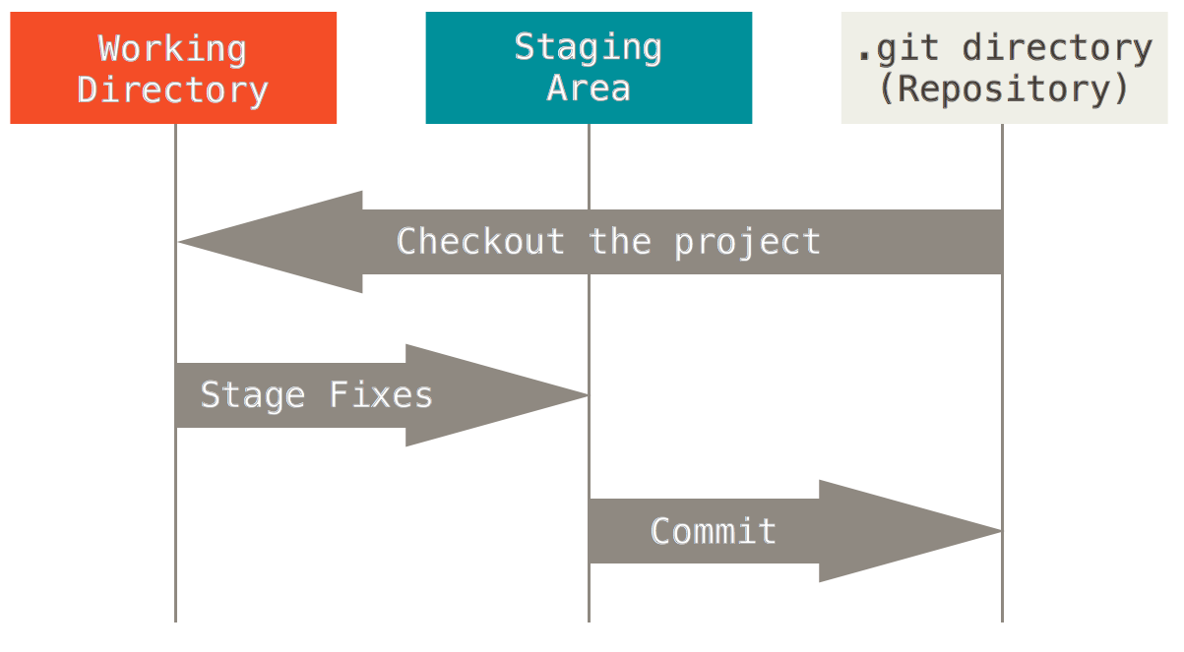
The Three States

Slide 5
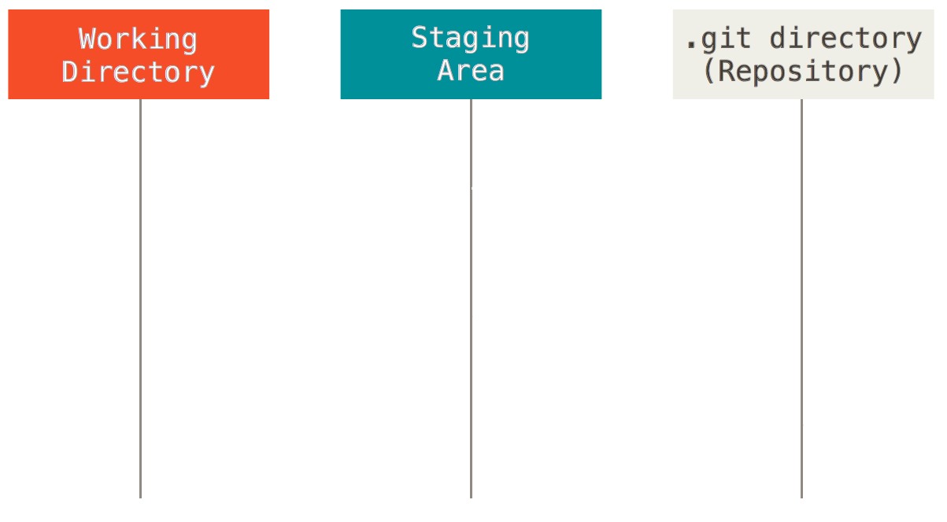
The Three States
$ git status
On branch master
Changes not staged for commit:
(use "git add <file>..." to update what will be committed)
(use "git checkout -- <file>..." to discard changes in working directory)
modified: file2
Untracked files:
(use "git add <file>..." to include in what will be committed)
file1
no changes added to commit (use "git add" and/or "git commit -a")
Create new file1
with 4 lines content
Modify existing file2
adding 1 line
$ git diff
diff --git a/file2 b/file2
index d1c36fb..98bc6aa 100644
--- a/file2
+++ b/file2
@@ -2,3 +2,4 @@ A A A
B B B
C C C
D D D
+E E E
$ git diff --cached

Slide 6
The Three States
Create new file1
with 4 lines content
short
$ git status -s
M file2
?? file1
Modify existing file2
adding 1 line
visualize changes
$ git diff --stat
file2 | 1 +
1 file changed, 1 insertion(+)
$ git diff --stat --cached
What’s in staging area?

Slide 7
The Three States
$git add file1
$ git status -s
A file1
M file2
$ git diff --stat
file2 | 1 +
1 file changed, 1 insertion(+)
$ git diff --stat --cached
file1 | 4 ++++
1 file changed, 4 insertions(+)

Slide 8
The Three States
$git add file1
$ git status -s
A file1
M file2
$ git diff --stat
$ git diff --stat --cached
file1 | 4 ++++
file2 | 1 +
2 files changed, 5 insertions(+)
$git add file2

Slide 9
The Three States
$git add file1
$ git reset file2
Unstaged changes after reset:
M file2
$ git status -s
A file1
M file2
$ git diff --stat
file2 | 1 +
1 file changed, 1 insertion(+)
$ git diff --stat --cached
file1 | 4 ++++
1 file changed, 4 insertions(+)
$git reset file2

Slide 10
The Three States
$git add file1
$git checkout file2
$ git checkout file2
$ git status -s
A file1
$ git diff --stat
$ git diff --stat --cached
file1 | 4 ++++
1 file changed, 4 insertions(+)

Slide 11
The Three States
Modify deleting 1 line
$ git status -s
AM file1
$ git diff --stat
file1 | 1 -
1 file changed, 1 deletion(-)
$ git diff --stat --cached
file1 | 4 ++++
1 file changed, 4 insertions(+)

Slide 12
The Three States
Modify deleting 1 line
$git commit -m ”My message”
$ git commit -m"My message"
[master 11e6b70] My message
1 file changed, 4 insertions(+)
create mode 100644 file1
$ git status -s
M file1
$ git diff --stat
file1 | 1 -
1 file changed, 1 deletion(-)
$ git diff --stat --cached

Slide 13

Branching - commit
$ git commit
What happens?
HEAD
master
C1
Snapshot 1

Slide 14
Branching - commit
$ git commit
HEAD
master
C1
C2
Snapshot 1
Snapshot 2

Slide 15
Branching - push
$ git push
HEAD
Nothing happens on local. But changes will be pushed to remote.
master
C1
C2
Snapshot 1
Snapshot 2

Slide 16
Branching - branch
$ git checkout –b MR1
What happens?
HEAD
master
C1
C2
Snapshot 1
Snapshot 2

Slide 17
Branching - branch
$ git checkout –b MR1
HEAD
master
MR1
Equivalent to:
$ git branch MR1
$ git checkout MR1
C1
C2
Snapshot 1
Snapshot 2

Slide 18
Branching
$ git commit
HEAD
What happens?
master
MR1
C1
C2
Snapshot 1
Snapshot 2

Slide 19
Branching
$ git commit
HEAD
master
MR1
C1
C2
C3
Snapshot 1
Snapshot 2
Snapshot 3

Slide 20
Branching
$ git commit
HEAD
master
MR1
C1
C2
C3
Snapshot 1
Snapshot 2
Snapshot 3
To simplify things, snapshots won’t be shown

Slide 21
Branching - pull
$ git pull origin master
What happens?
HEAD
master
MR1
C1
C2
C3

Slide 22
Branching - pull
$ git pull origin master
HEAD
master
MR1
C1
C2
C3
There are 2 ways to get new changes from ‘master’ branch to the current branch ‘MR1’: merge and rebase
C4
C5

Slide 23
Branching - merge
$ git merge master
What happens?
MR1
C1
C2
C3
C4
C5
master

Slide 24
Branching - merge
$ git merge master
HEAD
MR1
C1
C2
C3
C6
C4
C5
master

Slide 25
Branching - rebase
$ git rebase master
What happens?
HEAD
MR1
C1
C2
C3
C4
C5
master

Slide 26
Branching - rebase
$ git rebase master
HEAD
New C3 is actually different from old C3, different base.
MR1
HEAD
MR1
C1
C2
C3
C4
C5
C3’
master

Slide 27
Branching – merge vs rebase
Merge
MR1
C1
C2
C3
C6
C4
C5
master
Same!
Rebase
C1
C2
MR1
C4
C5
C3’
master

Slide 28
Moving around
HEAD
$ git checkout <commit/branch/tag>
$ git reset <commit/branch/tag>
$ git reset --hard <commit/branch/tag>
$ git reset --soft <commit/branch/tag>
HEAD
current branch

Slide 29
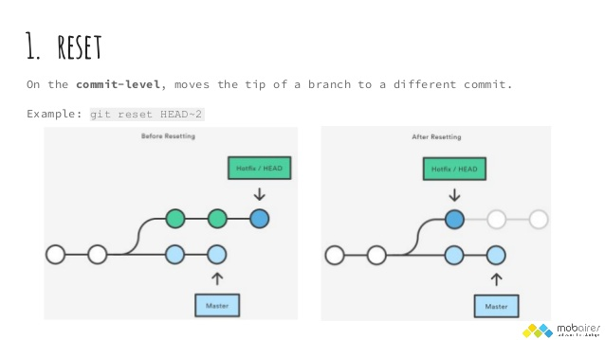
Moving around

Slide 30
Rewrite history
N.B. you can only rewrite history on local. You should not rewrite history of commits that you have pushed.
Using rebase interactive
$ git rebase -i
You can:
Squash commits into one
Amend a commit
Re-order commits
Edit a commit message
Drop a commit
Etc.

Slide 31
Rewrite history - example
$ git log --oneline
c0ec642 aaaa
4d320e5 ccc
a6fb541 bbb
11e6b70 My message
0ef9202 First commit
HEAD~4
$ git rebase -i 0ef9202 # or git rebase HEAD~4
pick 11e6b70 My message
pick a6fb541 bbb
pick 4d320e5 ccc
pick c0ec642 aaaa
# Rebase 0ef9202..c0ec642 onto 0ef9202
# …

Slide 32
Rewrite history - example
Suppose we want to re-order the commits, and also meld the commit ‘aaaa’ and commit ‘My message’ into one.
pick 11e6b70 My message
squash c0ec642 aaaa
pick a6fb541 bbb
pick 4d320e5 ccc
# Edit new message for the combined commit
[detached HEAD ae5869b] My message + aaaa
1 file changed, 6 insertions(+)
create mode 100644 file1
Successfully rebased and updated refs/heads/MR1.
$ git log --oneline
8abba8a ccc
cb566cd bbb
ae5869b My message + aaaa
0ef9202 First commit

Slide 33
Git TAG
Tag operation allows giving meaningful names to a specific version in the repository
Create tag the current HEAD by using the command :
git tag <tagname>
Or we can create tag with specific commit ID
git tag [-a] <tagname> <commit id> [-m <Message>]
List all tag at current branch
git tag -l
Push tag to server
git push origin <tag>
Delete the tag
git tag –d <tag>
Push to server (need permission for delete)
git push origin :<tagname>
HEAD
Tag_name2
B
Tag_name1
A
Notes:
-a : annotated tag : just like tag but with commit-like message

Slide 34
Git TAG
Show all commit which tag point
git log <tagname>
Get commit which tag point
git show-ref <tagname>
Create new branch from tag and checkout it.
git chekout -b <newbranch> <tagname>
Notes:
-a : annotated tag : just like tag but with commit-like message

Slide 35
Some handy git commands
git branch -a list all branches
git pull --ff-only pull but fast-forward merge only
git pull --rebase pull but instead of merging, rebase
git checkout list all modified files
git checkout . discard all modifications in current and sub-directories
git clean -xdf clean ALL untracked files
git fetch [--tags] fetch/update from remote to local
git checkout –b <commit/reference branch> create and checkout new branch
git add . Applied all change to stage area
git commit --amend papplied new change to the previous commit.
git pull = git fetch + git rebase
git log [branch] list all commit in branch
git show show all modifications between the current and previous commit

Slide 36
Some handy git commands
git apply some.patch apply a patch
git describe develop what’s the newest release
git checkout <commit> -- needed_file checkout file from a commit or branch, checked out will be put in staged area
git grep “needle” self-explaintory

Slide 37
Q&A

Slide 38
Thank you
Thank you for listening

