Slide 1
Benchmark of Local Matrix / Vector
libraries for ogs6
Haibing Shao
Presented internally in ENVINF
17.10. 2012

Slide 2
We have a problem to solve:
Which library to use in ogs6
for local matrix and vectors ?
Seite <number>

Slide 3
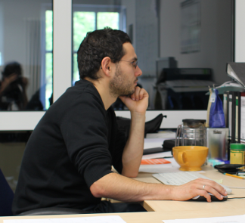
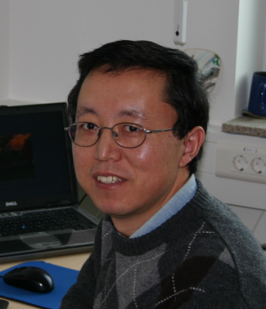
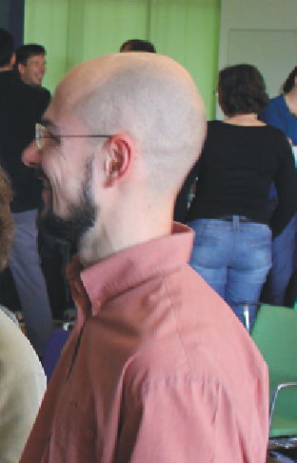
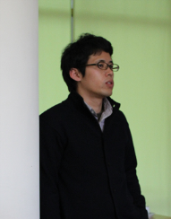

I support Tom, because our own code is easy to maintain!
Use my implementation MathLib::Matrix, because is it proven fast!
Currently available opinions
(and keep coming…)
I would like to use Eigen because its user friendlyness
There are other libraries like,
* Blas/Lapack
* Flense
etc.
And the speed is also quiet fast! Reza has tested already!

Slide 4
Must make sure it works on clusters, and our own source code is good for parallelization.
So my previous work is wasted? No way!
What they might be really thinking is…
(my personal guess)
I have already written everything in Eigen, why changing it???
Too bad that these guys can not work together. Let me propose something else.
If using Nori’s version, then my effort is minimum. So Eigen it is!
Seite <number>

Slide 5
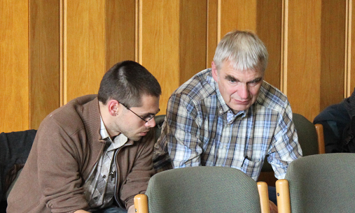
So for everybody else,
- Let’s just wait and see.
- Yeah, I agree with you.
Seite <number>

Slide 6
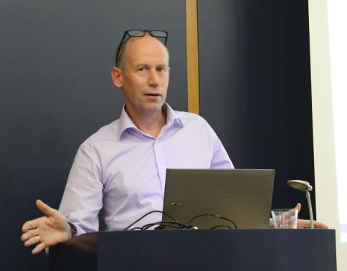
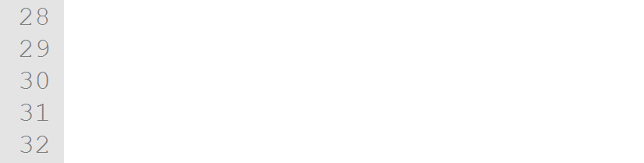
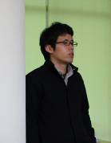

Good thing is, the boss has made a decision.
Olaf commented, ogs6 must
assert ( "High Performance"
&&
"Developer Friendliness" );
Eh~~, what if performance is in conflict with developer friendliness?
Eh~~ boss, is there any decision really made?
Seite <number>

Slide 7
Developer friendliness is objective.
What I can do is to compare performance.
Seite <number>

Slide 8
Critical operations
for local matrix/vector performance?
Matrix-matrix and matrix-vector multiplication (WW)
Shape function calculation (NW)
LU, QR and Cholesky Decomposition? <= not performance critical
Size of the local matrix/vector?
MeshLib: 2-by-2 and 3-by-3
Local advection/diffusion matrix: 3-by-3
Chemistry: 10-by-10 up to 100-by-100
Coupled processes: 10-by-10 up to 30-by-30 ?
We test 1-by-1 up to 100-by-100.
Seite <number>

Slide 9
Before talking of performance, we shall know:
Reza has done a benchmark before (08.2011).
Seite <number>

Slide 10
Before talking of performance, we shall know:
Tom has also made effort (08.2011).
Seite <number>

Slide 11
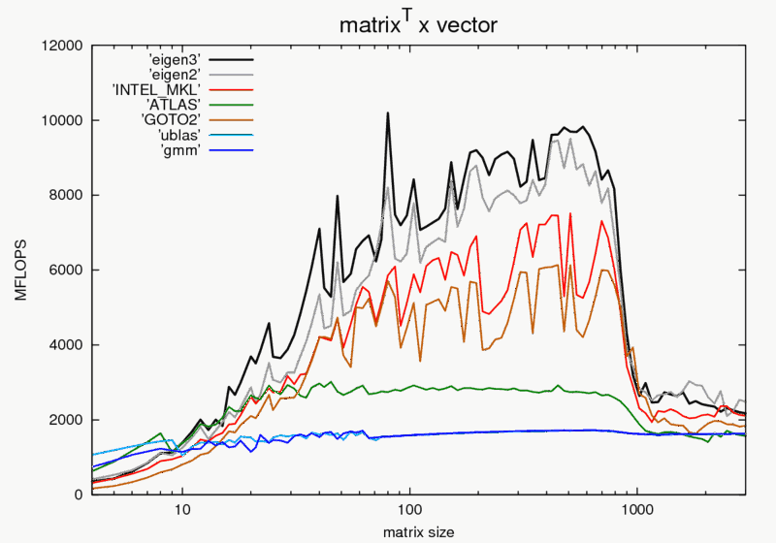
Before talking of performance, we shall know:
There is a benchmark on Eigen website.
So we test MFLOPS this time.
Source: http://eigen.tuxfamily.org/index.php?title=Benchmark
Seite <number>

Slide 12
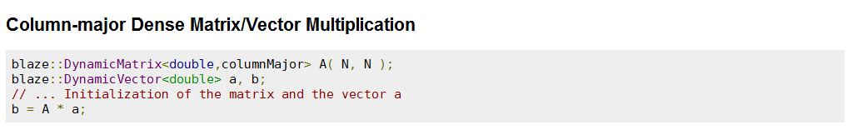
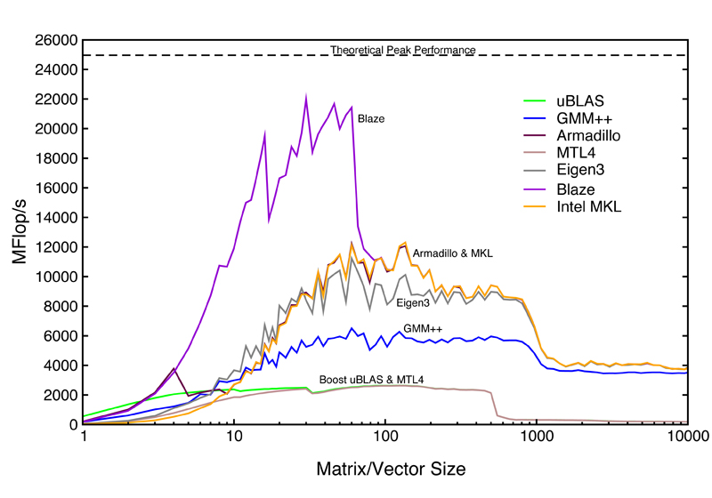
Before talking of performance, we shall know:
There is also a benchmark on Blaze website.
Source: http://code.google.com/p/blaze-lib/wiki/Benchmarks
Seite <number>

Slide 13
Take a closer look…
So I decide to test Blaze.
Seite <number>

Slide 14
Libraries laying one the bench:
MathLib::Matrix (serve as base line)
Eigen (3.1.12)
Blaze (1.0)
Intel MKL
Things I do not want to test:
GMM++
Boost::uBlas
MKL4
Seite <number>

Slide 15
Benchmark Result – Matrix Vector multiplication
Seite <number>

Slide 16
Benchmark Result – Shape function calculation
Seite <number>

Slide 17
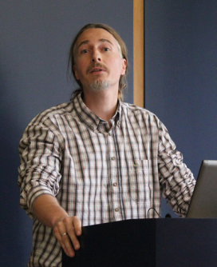
-Told you Nori, comments just keep coming, no matter what you do…
Oh, I wish to test the GPU / CUDA support!
SOMETHING
SOMETHING
-We keep quiet and listen this time…
Seite <number>

