Slide 1
BUDT 758B Final Project
Predicting Bank’s Customer Behavior
Group 6
Aka
Team Supernova

Slide 2
Project Overview
Context
This dataset contains 10000 customers’ demographic and financial data in which some of the customers are withdrawing their accounts from the bank
Example Variable Names: Credit Scores, Geography, Estimated Salary and Exited
Objective and Business Value
Provide Prediction over whether or not a customer will withdraw their account
Give inference over variables that influences the result
Help Bank make wiser decisions over advertising and customer relationship management

Slide 3
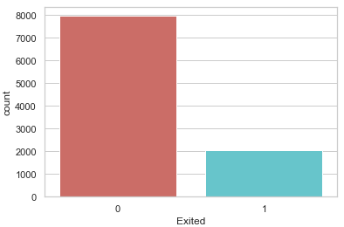
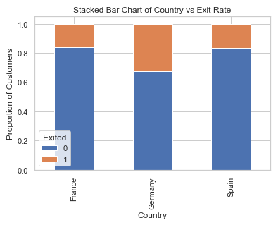
Data Processing
Data Cleaning
Drop Nulls
Drop Columns such as Row Number/ID
Data Exploration
Exploratory Analysis over Dependent Variable

Slide 4

Logistic Regression
Create Dummy Variables
Split categorical variables in dataset into dummy variables containing only 0 and 1
Drop original columns
Resample Using SMOTE
Resampling needed because of imbalance of data
SMOTE works by creating synthetic samples from the minor class (non-Exited) instead of creating copies. It randomly choose one of the k-nearest-neighbors and use it to create a similar, but randomly tweaked, new observation.

Slide 5
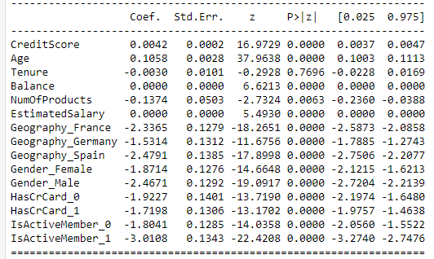
Logistic Regression
Train-Test Split
Randomly splitting data for testing accuracy
Model Fitting
Drop variables that has high p-values

Slide 6
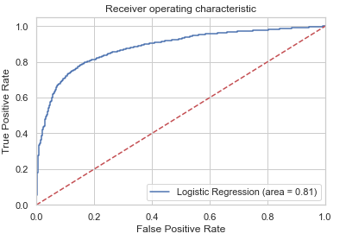
Logistic Regression
Measure Performance
Accuracy: 0.81
ROC-Curve
Confusion Matrix
TPR: 0.80
TNR: 0.82

Slide 7
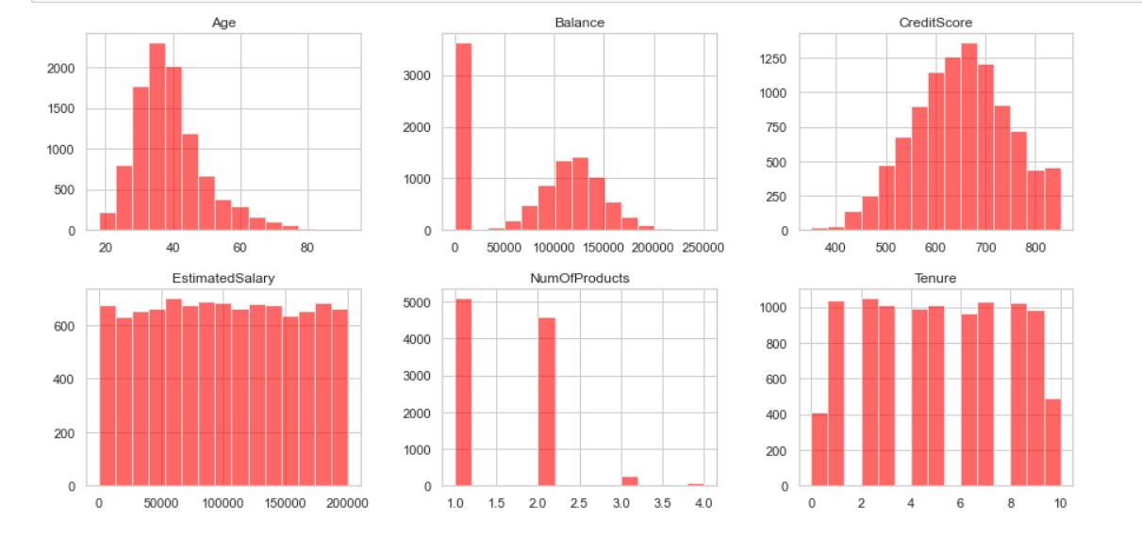
Numerical features

Slide 8
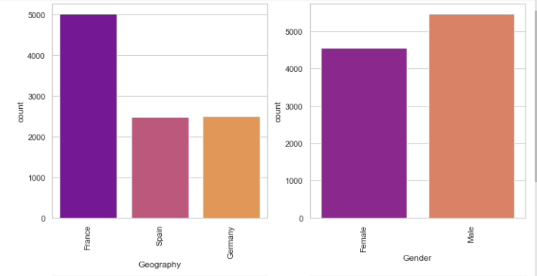
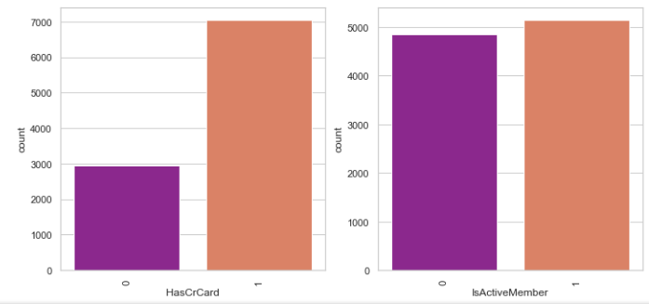
Categorical features

Slide 9
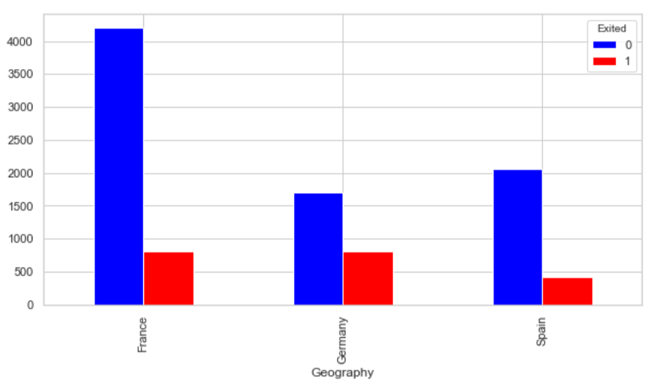
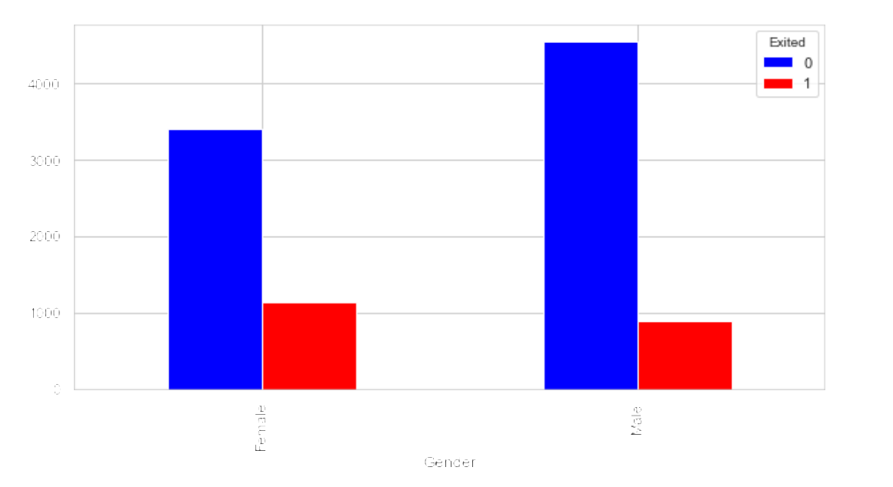
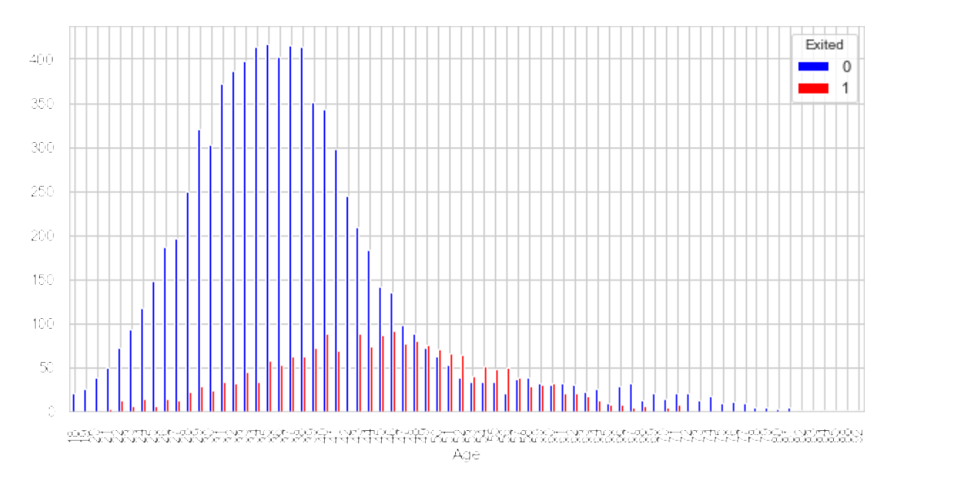
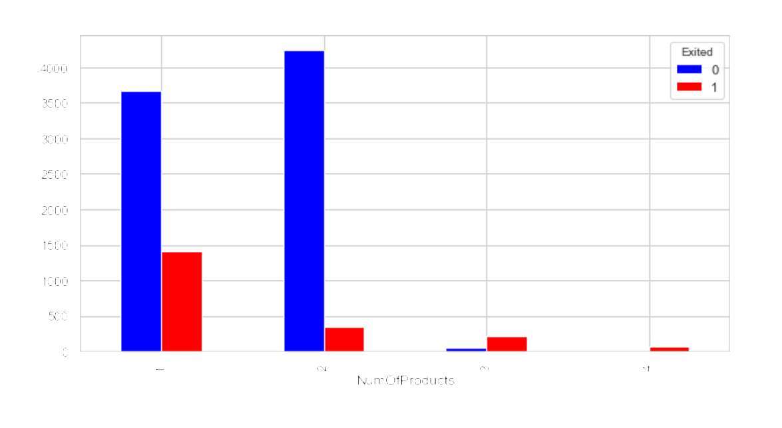
Relationships between features and target variable

Slide 10
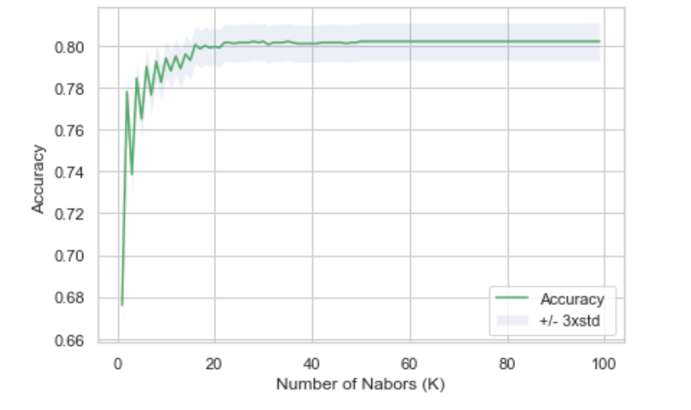
KNN
from sklearn.neighbors import KNeighborsClassifier, KNeighborsRegressor
Find the best K?
Try from 1:100
The best accuracy was with 0.802 with k= 28
Business Insights
highly summarized customer attributes analysis chart for management level review
How to segment customers into groups to provide the right service and monitor

Slide 11
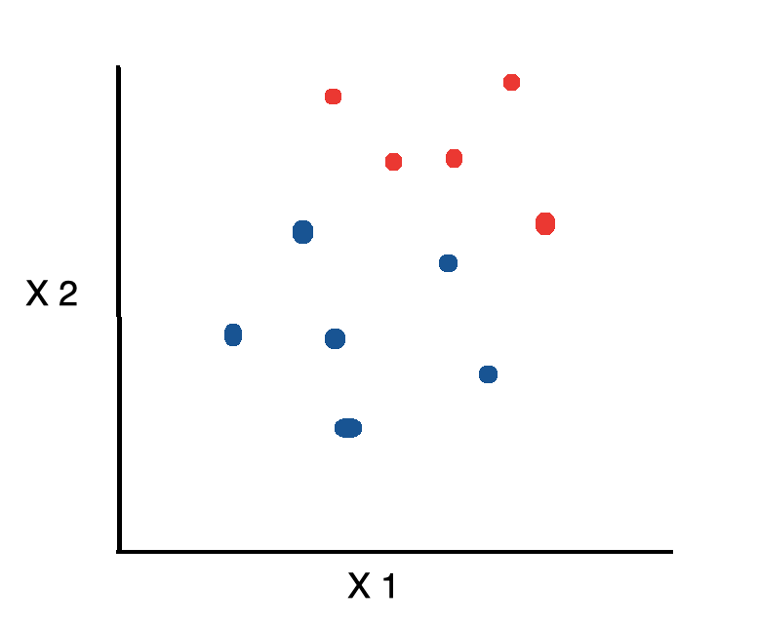
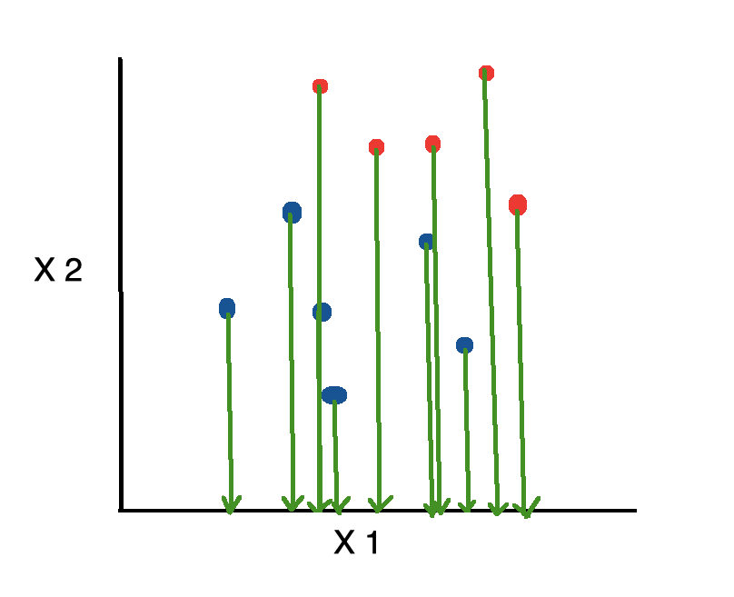
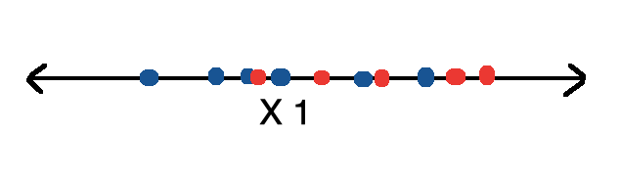
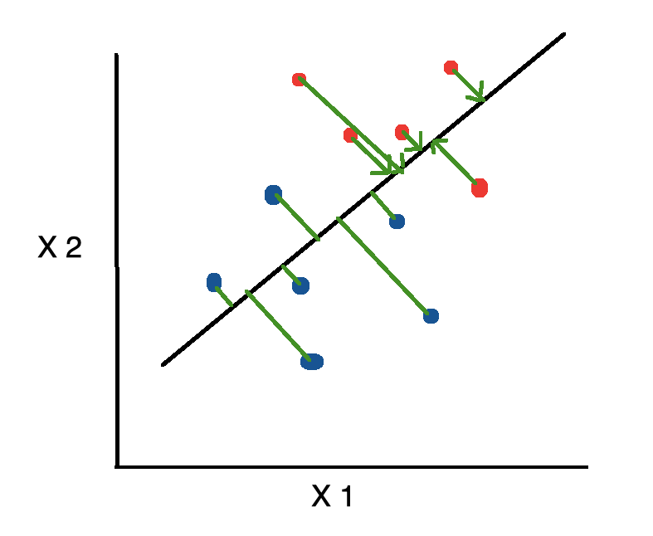
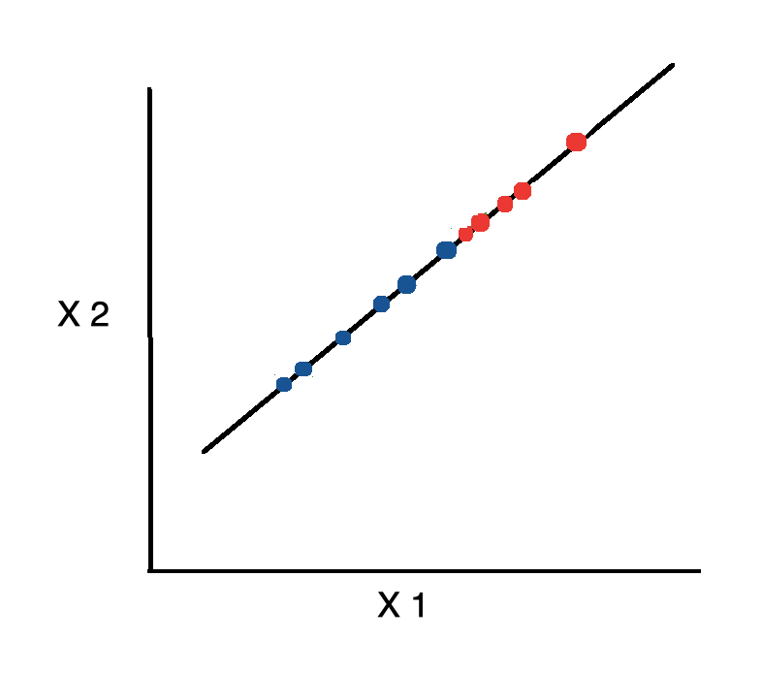
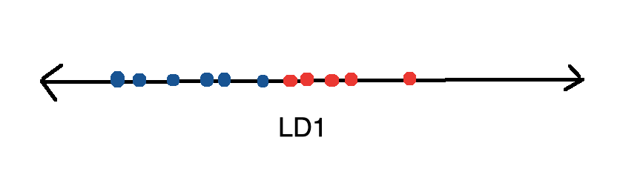
LinearDiscriminantAnalysis
LDA is a dimensionality reduction technique. It reduces the number of variables while trying to maximize the differences between classes.
Overlapping area
No overlapping area
Source:https://towardsdatascience.com/linear-discriminant-analysis-in-python-76b8b17817c2

Slide 12
LinearDiscriminantAnalysis(con't.)
Check and deal with the possible missing values.
Select features and get the labels
Encode Categorical Features
LabelEncoder converts each class under specified feature to a numerical value.
Train-Test Split
Model Fitting
Performance Meaturing

Slide 13
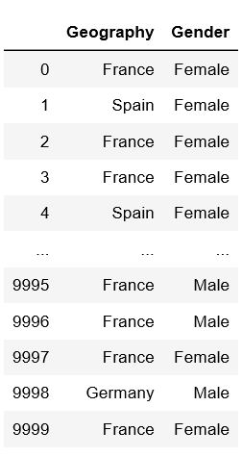
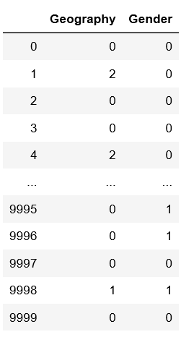
LinearDiscriminantAnalysis(con't.)
LabelEncoder

Slide 14
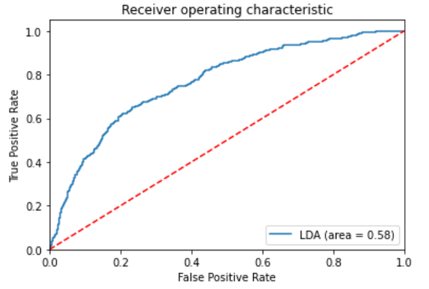
LinearDiscriminantAnalysis(con't.)
Measure Performance
Accuracy: 0.81
ROC-Curve
Confusion Matrix
TPR: 0.20
TNR: 0.96

Slide 15
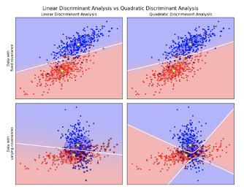
Quadratic Discriminant Analysis
Why QDA
Assume different groups have different Covariance Matrix
A quadratic decision surface
More flexible
No hyperparameters to tune
Source: https://scikit-learn.org/stable/modules/lda_qda.html

Slide 16
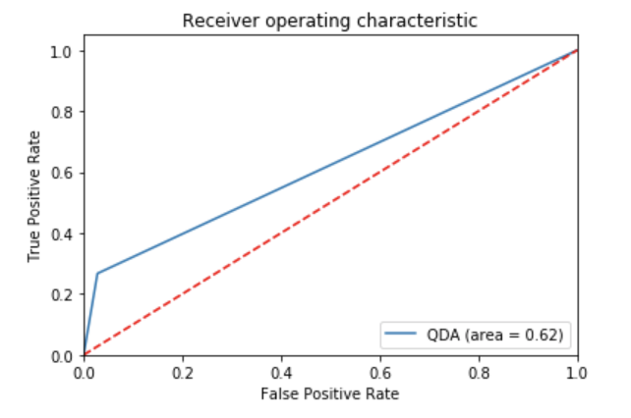
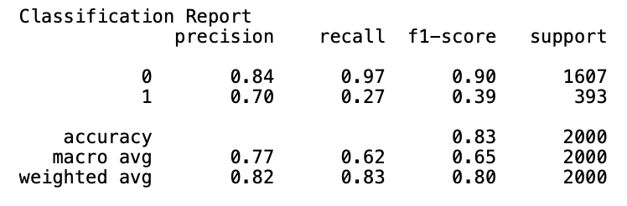
Quadratic Discriminant Analysis
QDA Model
Train-Test Split
Build QDA Model
Make prediction
Accuracy: 83.35%
ROC Curve
Classification Report

Slide 17
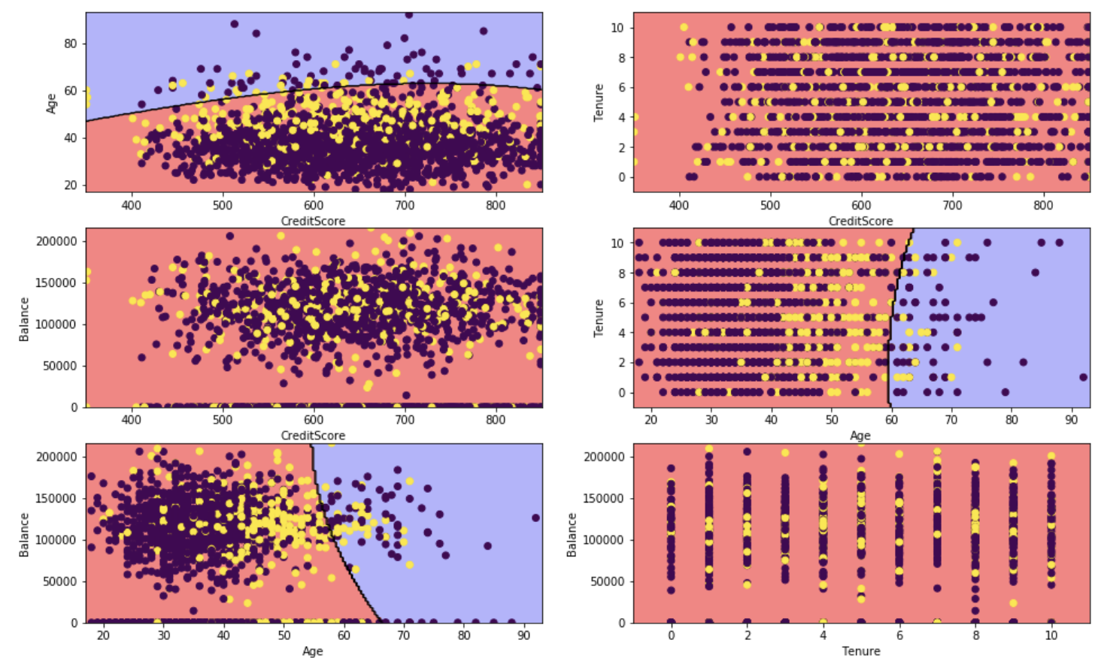
Quadratic Discriminant Analysis
A glance at how the QDA Classification works on the Test Dataset

Slide 18
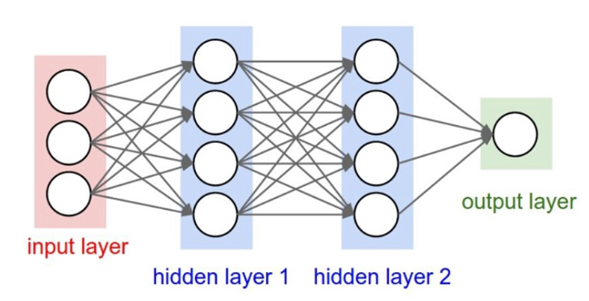
Sequential model

Slide 19
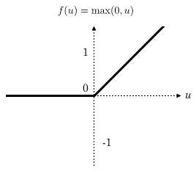
Hyperparameters
Activation: sets the element-wise activation function to be used in the dense layer
Units: output size of the layer
Initializer: define the way to set the initial random weights of Keras layers
y=max(0,x)
Rectified Linear Activation Function

Slide 20
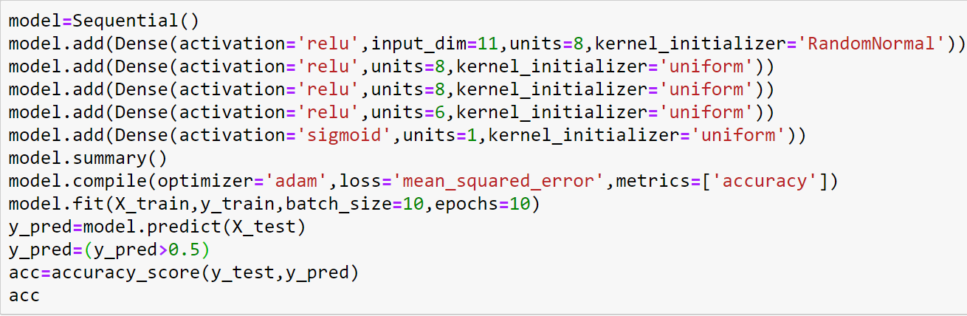
Model in Details
Accuracy around 84%

Slide 21
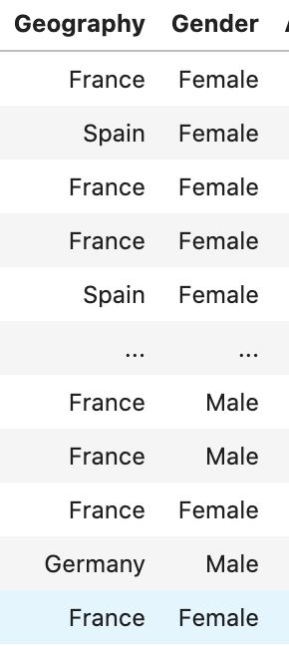
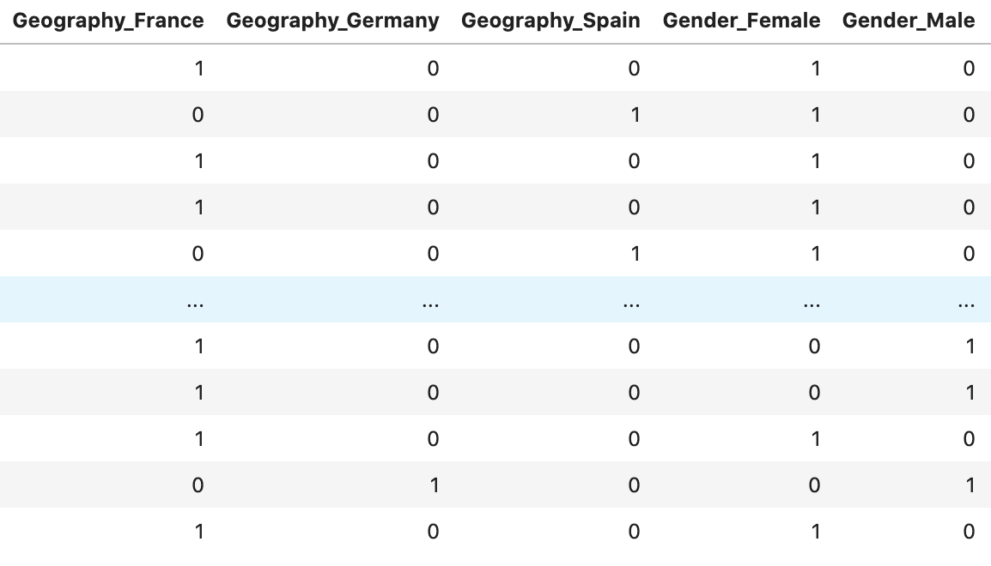
Random Forest

Slide 22
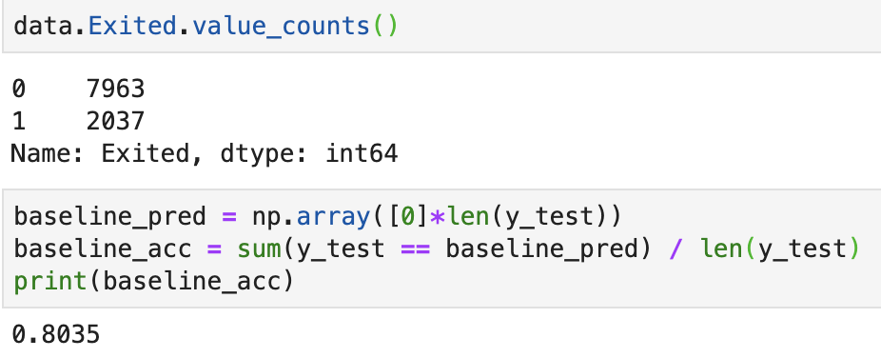
Baseline Accuracy: 80.35%

Slide 23
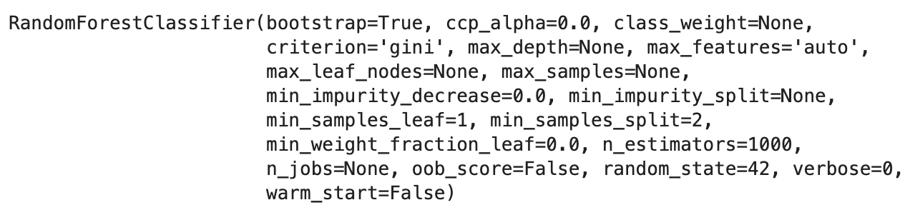
Random Forest Accuracy: 86.4%

Slide 24
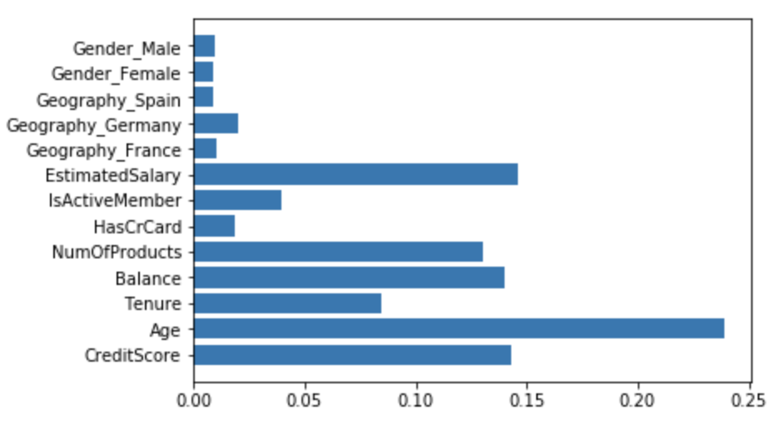
Feature Importances

Slide 25
Conclusion
Random Forest model has the highest accuracy
86%
By correcting the overfitting of Regression Tree models, Random Forest model performs better in our scenario
Inferences
Age was the key factor affecting customers’ decision over whether to withdraw; The older the customer is, the more likely he or she will withdraw
Credit scores, estimated salaries were also important in influencing the target variable
Among three nations in our dataset, Germany is the most possible location where customers withdraw their account, exhibiting likelihood of financial insecurity

