Slide 1


Personal Portfolio Web Application
SWE363 – Web Engineering | Assignment 4
Haidar AlDahan · ID: 202256620
https://haidar-aldahan.github.io/202256620-HaidarAlDahan-assignment4/

Slide 2
What Did I Build?
A fully deployed personal portfolio website — built from scratch with HTML, CSS, and Vanilla JavaScript. No frameworks. No shortcuts. Live on GitHub Pages.
About
Skills
Projects
Personal introduction and background
Technical competencies displayed visually
Filterable, searchable project showcase
GitHub
Contact
Live repos via REST API
Working email form via EmailJS

Slide 3
Key Features
Responsive Design
Dark / Light Theme
Fluid layouts for mobile, tablet, and desktop
Instant toggle with persistent preference
Project Filtering & Search
Live GitHub API
Filter, search, and sort projects dynamically
Real-time repository data via REST API
EmailJS Contact Form
Scroll Animations
Real email delivery — no backend required
Typing hero effect, scroll reveals, back-to-top button

Slide 4
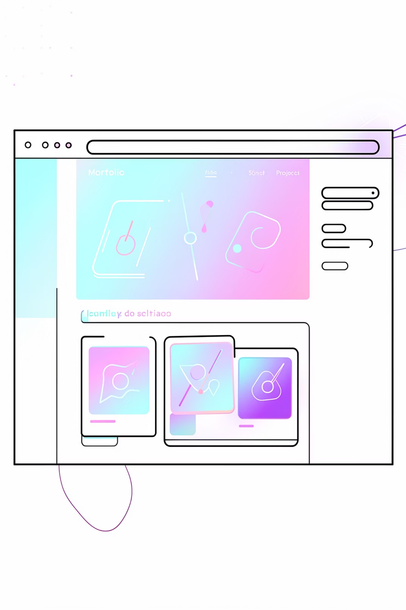

Live Demonstration
Switching to live site →
Explore the fully deployed portfolio live on GitHub Pages. Navigate all sections, toggle themes, filter projects, and test the contact form.
🔗 https://haidar-aldahan.github.io/202256620-HaidarAlDahan-assignment4/

Slide 5
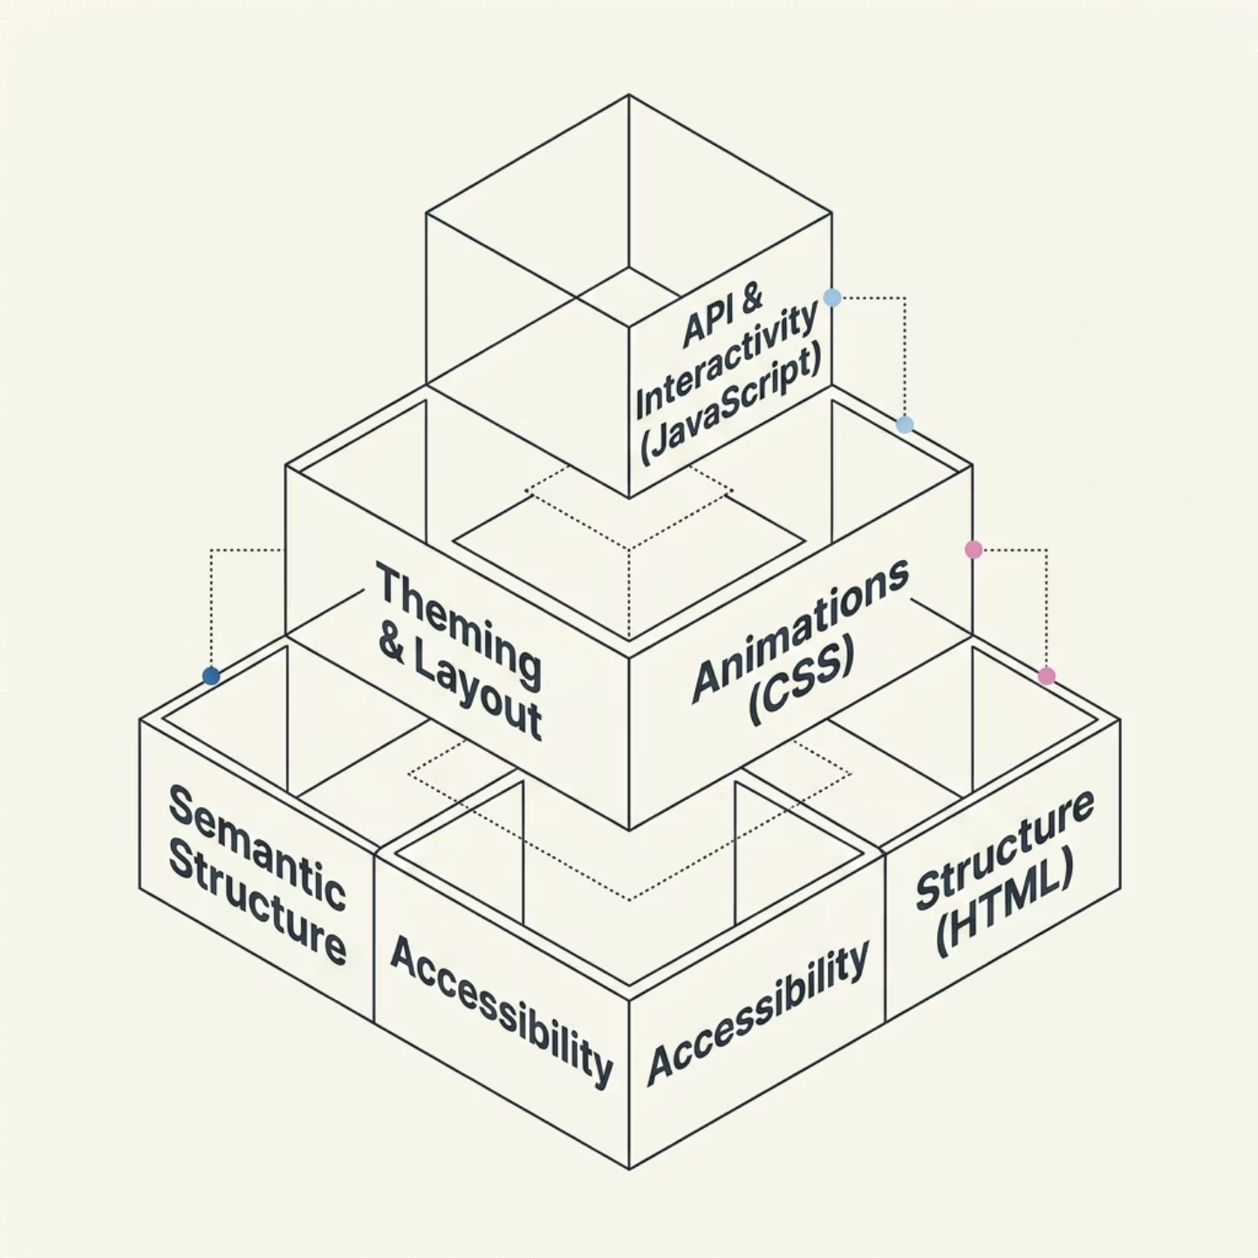


How It's Built
index.html
Semantic structure & accessibility
css/styles.css
Theming, layout, animations
js/script.js
Interactivity, API calls, EmailJS
No frameworks — pure HTML, CSS, JS + GitHub API + EmailJS

Slide 6

AI Tools Used
Claude (Anthropic)
ChatGPT
EmailJS service config, template variables & JS integration
Debugged silent email failures (mismatched variable names)
IntersectionObserver scroll animation logic
Typewriter effect with role cycling & timing
Resolved scroll animation conflicts with project cards
Back-to-top button scroll event & CSS transition
Code structure review & organization suggestions
README, AI report & technical documentation drafts
Cross-checked debouncing implementation
Validated GitHub API fetch & error handling
Suggested back-to-top scroll threshold
Alternative CSS animation approaches for comparison
All AI output was reviewed, tested, and manually modified — AI assisted, never replaced my understanding.

Slide 7
Technical Deep Dive
✅ Resolved
⚠️ Unresolved
🔮 Future Plans
EmailJS variable mismatch — fixed manually
Scroll animation conflicts — resolved with separate CSS classes
GitHub API errors — handled with graceful fallback messages
No auto-reply to contact form visitors
GitHub API rate limit (60 req/hr without auth)
Auto-reply via EmailJS configuration
GitHub OAuth token for higher rate limits
Blog / writing section

Slide 8
What I Achieved
Fully deployed on GitHub Pages
Live, accessible, and production-ready
Responsive design without frameworks
Mobile-first CSS built from scratch
Two real external APIs integrated
GitHub REST API + EmailJS
Working email system — no backend
Serverless contact form via EmailJS
Responsible AI-assisted development
AI as a learning tool, not a replacement
This portfolio is mine to keep, improve, and share proudly.

