Slide 1
RETRO TV
PROJECT
By Haidar Ali Alshowaikh | Class 8E

Slide 2
WHAT IT'S BUILT FROM
Materials Used
U
Replacement Pi 4
Arduino Uno
Volume knob
Speakers
Power button
Joystick Module
22-inch HDMI monitor
Enclosure frame
02

Slide 3
SECTION 01 · THE IDEA
The Monitor...
I reused an available monitor and built a new TV experience around it, with joystick controls and a retro-style cabinet.
05

Slide 4
SECTION 02 · THE PROBLEMS
Challenges That Took Work
INPUT
AUDIO
DISPLAY
Making joystick navigation reliable on the Raspberry Pi
Routing sound to the right output and linking the knob to system volume
Moving from the old laptop-panel setup to a 22-inch HDMI monitor
08

Slide 5
SECTION 03 · SOLUTIONS
How I Fixed Them
System Volume
Audio Output
Key Detection
The knob changes system volume with wpctl; the OSD shows speaker percentage and mute.
mpv uses PipeWire and follows the Pi’s selected audio output.
Matches the joystick’s hardware keycode so TV-app controls respond reliably.
12

Slide 6
SECTION 03 · SOLUTIONS
Current Status
The replacement Pi 4 boots to desktop. The merged update adds stream read ahead and smoother player cleanup; playback still needs testing on the Pi.
14

Slide 7
SECTION 04 · THE WIRING
How A Button Press Travels
U
→
→
1. ARDUINO
2. THE BRIDGE
3. THE APP
Reads the joystick, knob, and button; sends a command over serial
rpi_bridge.py turns that command into a real key or mouse event
tv.py receives it like normal keyboard input and reacts on screen
17

Slide 8
SECTION 04 · THE WIRING
Current Wiring Reference
 | PART | CONNECTION | PURPOSE
ARDUINO UNO | Joystick X/Y + click | Volume encoder A/B | USB serial to Pi
RASPBERRY PI | USB from Uno | HDMI to monitor | GPIO3 + GND to button
MONITOR | HDMI input | No LVDS connection | Monitor's own power
POWER BUTTON | Shutdown switch | GPIO3 + GND | Requests safe shutdown
POWER | USB-C to Pi | Monitor power cable | Uno powered over USB
21

Slide 9
SECTION 04 · THE WIRING
Build and Test Flow
→
→
→
STEP 1
STEP 2
STEP 3
STEP 4
Connect joystick and encoder to the Uno
Flash the Uno and test USB commands
Set up the TV app and USB bridge on Pi
Connect HDMI monitor and test GPIO3 button
22

Slide 10
SECTION 05 · GOALS
Goals
GOAL 1
GOAL 2
Build a retro TV prototype with joystick-led control
Build a customer-sized cabinet around the chosen monitor
24

Slide 11
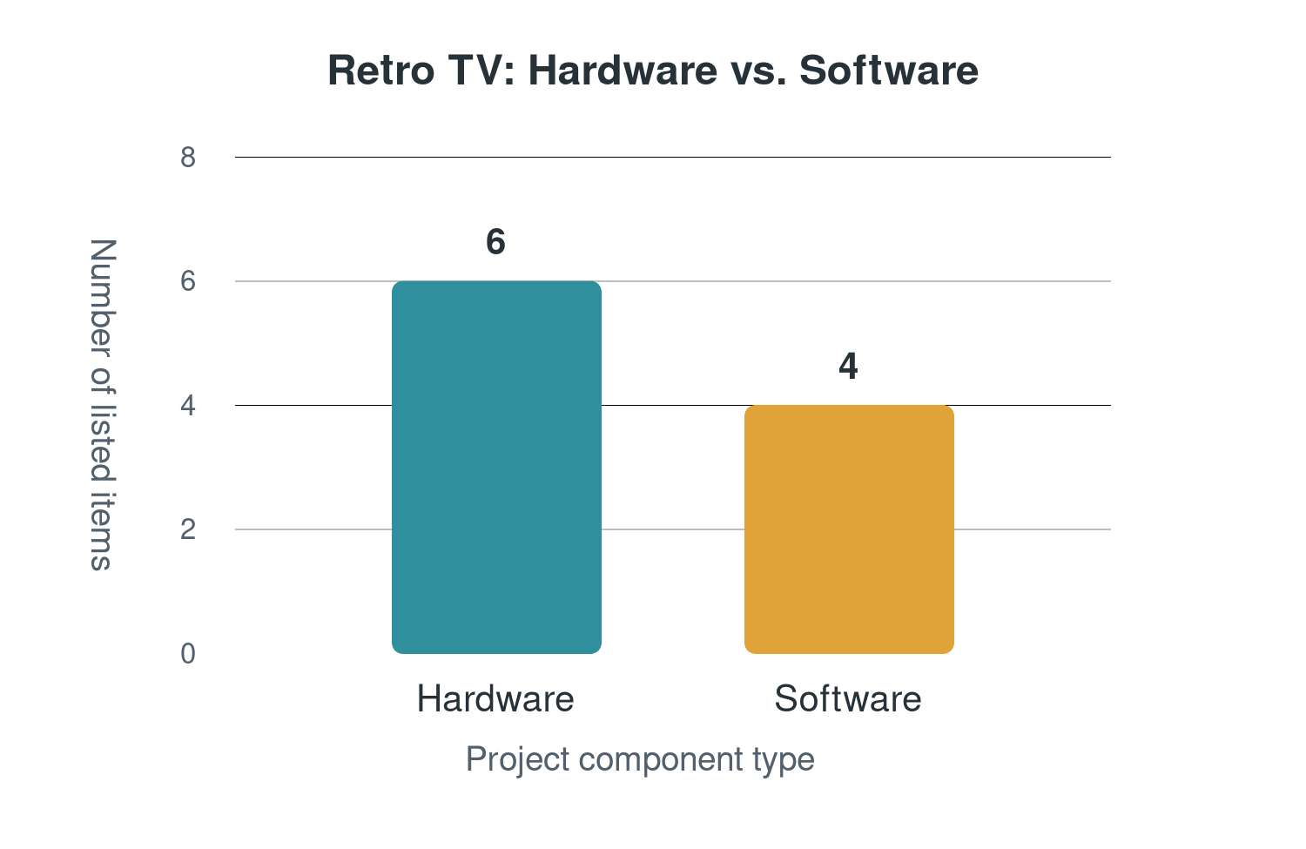
SECTION 06 · Programing
Hardware VS. Software
Hardware
Software
Rassperi Pi
Python
Arduino UNO
C++
V S
27

Slide 12
THANKS!
Haidar Ali Alshowaikh | Class 8E

