Slide 1
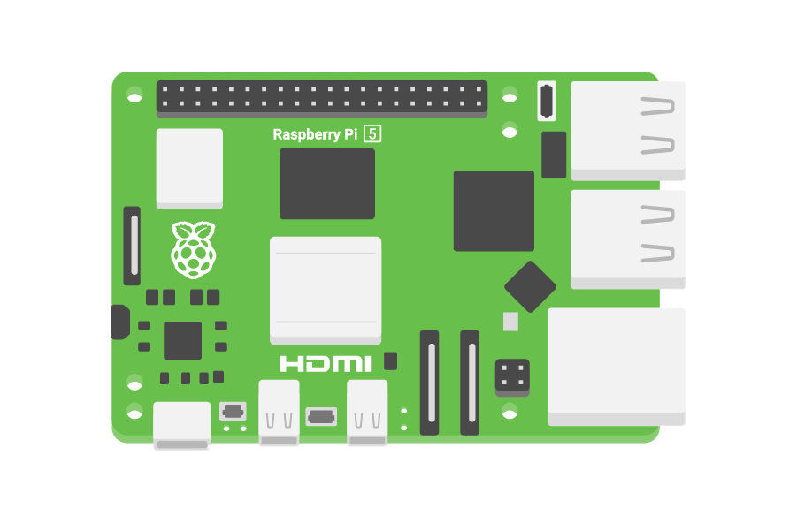
Retro Tv
Project
By: Haidar Ali Alshowaikh
Class: 8E

Slide 2
Matirials Used:
1- Rassperi Pi
2-Arduino Uno
3-Potentiometer 10K (A Knob)
4-Jumper Wires (Male to Female, and Female to Female)
5-Button
6-Joystick Module
7-A old Laptop screen
8- hdmi module

Slide 3
01
02
03
The Idea
The Problems
Solution of Problems
04
05
The Wirring
Goals
How I got the idea
How I solved these problems
The problems I faced during this project
How I wired the parts to the board
What are my project’s goals.

Slide 4
01
The Idea
How I got the idea

Slide 5
The Laptop…
I found a laptop that we don’t use any more, So I thought of recycling it and giving it a new prepouse

Slide 6
02
The Problems
The problems I faced during this project

Slide 7
PROBLEMS BY TYPE
CAUSES
SOFTWARE VS HARDWARE
TIME TO FIX
Under a day
Multiple days
60%
40%

Slide 8
BIGGEST TIME SINKS
35%
40%
25%
Tracking down the PipeWire bug that sent audio out the wrong HDMI port
Getting the joystick reliably read as arrow keys under the Wayland compositor
Repairing the LCD panel after its LVDS connector latch broke

Slide 9
COMPONENT ISSUES
WHAT WENT WRONG
COMPONENT | ISSUE
Audio output | Wider than screws
Volume knob | Size unconfirmed
LCD panel | Grabbed by OS
COMPONENT | ISSUE
Joystick hole | Wrong HDMI port
Speaker grille | Both at once
Volume keys | Latch broke

Slide 10
FOUR MAIN PROBLEMS
AUDIO ROUTING
VOLUME CONTROL
mpv was sending sound out the wrong HDMI port
The knob changed app and system volume together
SCREEN CONNECTOR
HOLE VS SCREWS
The connector latch snapped during repair
Joystick hole ended up wider than its screws

Slide 11
03
Solution of Problems
How I solved these problems

Slide 12
HOW I FIXED THEM
TOP FIX
VOLUME
AUDIO DEVICE
KEY INPUT
Volume knob now calls wpctl to change the speaker
mpv now points straight at the correct ALSA device
Checks the keysym and the raw hardware keycode both

Slide 13
DEBUGGING TOOLBOX
wpctl status to check audio routing
key_debug.py to print real keycodes
Flashlight test for backlight vs video
01
02
03
03
04
05
06
iptv-org database to verify channels
BFS check for keyboard reachability
Round-trip tests before sending installer

Slide 14
WHERE THIS STANDS NOW
Software problems are fixed. Screen repair is in progress.

Slide 15
04
The Wirring
How I wired the parts to the board

Slide 16
WIRING OVERVIEW
JOYSTICK
VOLUME KNOB
POWER BUTTON
ARDUINO -> PI
PI -> DRIVER BOARD
DRIVER BOARD -> SCREEN
Wired to Arduino digital pins for direction, plus one for the click button
A 10K potentiometer wired to an Arduino analog input
Its own Arduino digital pin, held for 2 seconds to shut down
Connected over USB, sending plain text commands over serial
HDMI out from the Pi into the universal LCD controller board
LVDS ribbon cable plus a separate backlight power connector

Slide 17
HOW A BUTTON PRESS TRAVELS
1. ARDUINO
2. THE BRIDGE
3. THE APP
Reads the joystick, knob, and button, and sends a plain text command over serial
rpi_bridge.py on the Pi turns that command into a real key or mouse event
tv.py receives it like any keyboard input and reacts on screen

Slide 18
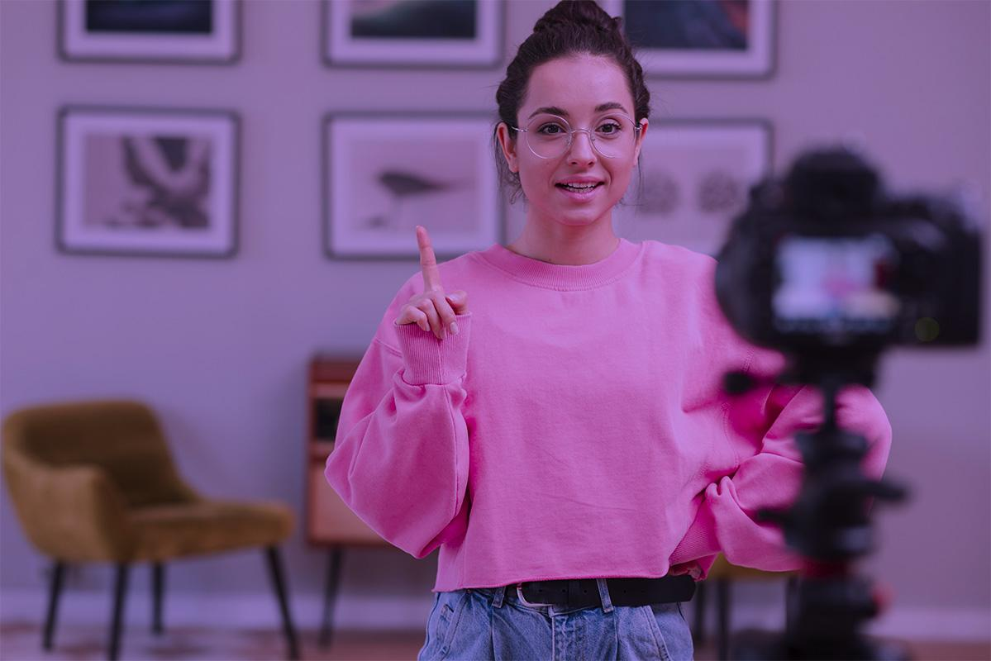
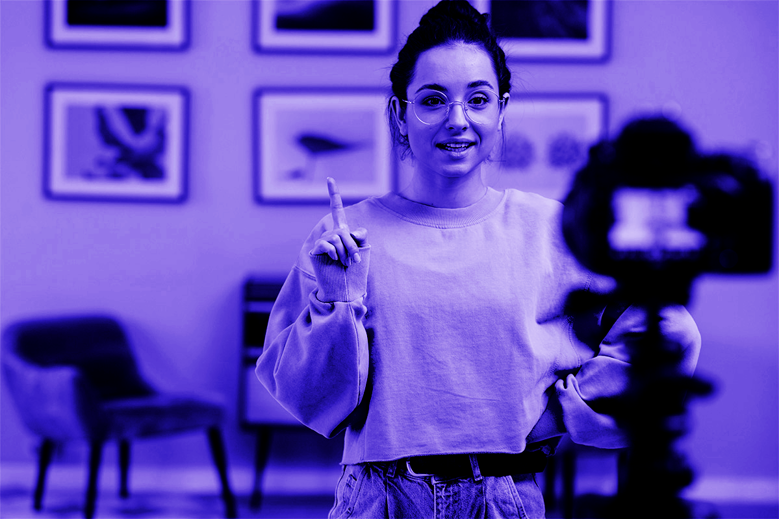
WIRING IN PROGRESS
Every input component runs back to the Arduino on its own pin, and the Arduino talks to the Pi over a single USB serial cable - no extra wiring needed between the controller and the software.

Slide 19


FINISHED BUILD

Slide 20
THREE MAIN CONNECTIONS
HDMI
GPIO
USB SERIAL
Raspberry Pi to the driver board, carrying video to the recycled laptop screen
The power button wired straight to the Pi for a direct, reliable shutdown
Arduino to Raspberry Pi, carrying every joystick, knob, and button command

Slide 21
WIRING REFERENCE TABLE
ARDUINO | Joystick X/Y/click | Knob wiper | Button pin
PI | USB from Arduino | HDMI to driver board | GPIO to power button
DRIVER BOARD | HDMI in | LVDS out to panel | Backlight power out
SCREEN | LVDS in | Backlight in | -
POWER | 5V to Pi | 12V to driver board | Shared ground

Slide 22
BUILD MILESTONES
Step 1
Step 2
Step 3
Step 4
Wire inputs to the Arduino
Flash sketch, test serial output
PHASE 1
PHASE 2
Bridge turns serial into key events
Wire board and screen into case

Slide 23
05
Goals
What are my project’s goals.

Slide 24
GOALS
GOAL 1
GOAL 2
Build a fully working retro TV controllable end-to-end with just the joystick
Fit everything into a custom laser-cut enclosure sized for the recycled screen

Slide 25
264
Channels curated for the custom IPTV channel list, each checked twice before being added

Slide 26
THANKS!
Do you have any questions?
youremail@freepik.com
+91 620 421 838
yourcompany.com
Please keep this slide for attribution

