Slide 1


RETRO TV
PROJECT
By Haidar Ali Alshowaikh | Class 8E

Slide 2
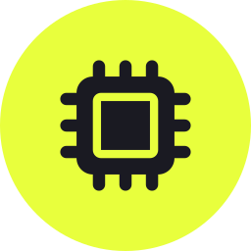
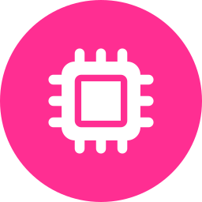
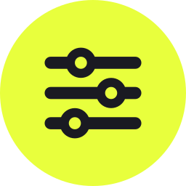





WHAT IT'S BUILT FROM
Materials Used
Raspberry Pi
Arduino Uno
Potentiometer 10K
Jumper Wires
Button
Joystick Module
Old Laptop Screen
HDMI Module
02

Slide 3





ROADMAP
What's Ahead
01
02
03
04
05
The Idea
The Problems
Solutions
The Wiring
Goals
How I got the idea
What went wrong along the way
How each problem got fixed
How every part connects
What the project set out to do
03

Slide 4
SECTION 01
THE IDEA
How I got the idea
04

Slide 5

SECTION 01 · THE IDEA
The Laptop...
I found a laptop that we don't use any more, so I thought of recycling it and giving it a new purpose.
05

Slide 6

SECTION 02
THE PROBLEMS
What went wrong along the way
06

Slide 7
SECTION 02 · THE PROBLEMS
Problems By Type
TIME TO FIX
Under a day
Multiple days
07

Slide 8



SECTION 02 · THE PROBLEMS
Biggest Time Sinks
35%
40%
25%
Tracking down the PipeWire bug that sent audio out the wrong HDMI port
Getting the joystick reliably read as arrow keys under the Wayland compositor
Repairing the LCD panel after its LVDS connector latch broke
08

Slide 9
SECTION 02 · THE PROBLEMS
Component Issues
COMPONENT | ISSUE
Audio output | Routed to the wrong HDMI port
Volume knob | Changed app AND system volume at once
LCD panel | Connector latch broke during repair
Joystick hole | Wider than the module's own screws
Speaker grille | Size was an unconfirmed placeholder
Volume keys | Real multimedia keys grabbed by the desktop
09

Slide 10

SECTION 02 · THE PROBLEMS
Four Main Problems
Audio Routing
Volume Control
mpv sent sound out the wrong HDMI port
The knob changed app and system volume together
Screen Connector
Hole vs Screws
The connector latch snapped during repair
Joystick hole ended up wider than its screws
10

Slide 11
SECTION 03
SOLUTIONS
How each problem got fixed
11

Slide 12


SECTION 03 · SOLUTIONS
How I Fixed Them
System Volume
Audio Device
Key Detection
Volume knob now calls wpctl to change the real speaker
mpv points straight at the correct ALSA HDMI device
Checks both the keysym and the raw hardware keycode
12

Slide 13

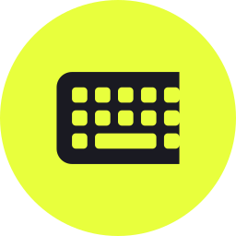




SECTION 03 · SOLUTIONS
Debugging Toolbox
wpctl status
key_debug.py
Flashlight test
Check where audio was actually routing
Print the real keycode for any key
Tell a dead backlight from dead video
iptv-org
BFS check
Round-trip test
Verify channels before adding them
Prove the keyboard is joystick-reachable
Verify the installer before sending it
13

Slide 14

SECTION 03 · SOLUTIONS
Where This Stands Now
Every major software problem has a working fix - audio, volume control, and key detection are all solid.
The screen connector repair is still in progress.
14

Slide 15
SECTION 04
THE WIRING
How every part connects
15

Slide 16


SECTION 04 · THE WIRING
Wiring Overview
Joystick
Volume Knob
Power Button
Arduino digital pins, plus one for the click button
A 10K potentiometer on an Arduino analog input
Its own pin, held 2 seconds to shut down
Arduino -> Pi
Pi -> Driver Board
Board -> Screen
USB, sending plain text commands over serial
HDMI into the universal LCD controller board
LVDS ribbon plus a separate backlight connector
16

Slide 17
SECTION 04 · THE WIRING
How A Button Press Travels
→
→
1. ARDUINO
2. THE BRIDGE
3. THE APP
Reads the joystick, knob, and button; sends a command over serial
rpi_bridge.py turns that command into a real key or mouse event
tv.py receives it like normal keyboard input and reacts on screen
17

Slide 18
SECTION 04 · THE WIRING
Wiring In Progress
Every input component runs back to the Arduino on its own pin, and the Arduino talks to the Pi over a single USB serial cable.
18

Slide 19
SECTION 04 · THE WIRING
The Finished Build
19

Slide 20
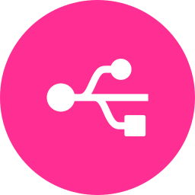
SECTION 04 · THE WIRING
Three Main Connections
USB Serial
GPIO
HDMI
Arduino to Pi, carrying every joystick, knob, and button command
The power button wired straight to the Pi for a direct shutdown
Pi to the driver board, carrying video to the recycled screen
20

Slide 21
SECTION 04 · THE WIRING
Wiring Reference Table
 | PORT A | PORT B | PORT C
ARDUINO | Joystick X/Y/click | Knob wiper | Button pin
PI | USB from Arduino | HDMI to driver board | GPIO to power button
DRIVER BOARD | HDMI in | LVDS out to panel | Backlight power out
SCREEN | LVDS in | Backlight in | -
POWER | 5V to Pi | 12V to driver board | Shared ground
21

Slide 22


SECTION 04 · THE WIRING
Build Milestones
→
→
→
STEP 1
STEP 2
STEP 3
STEP 4
Wire joystick, knob, and button to the Arduino
Flash the Arduino sketch, test raw serial output
Get rpi_bridge.py turning serial into key events
Wire the driver board, screen, and power button
22

Slide 23
SECTION 05
GOALS
What the project set out to do
23

Slide 24

SECTION 05 · GOALS
Goals
GOAL 1
GOAL 2
Build a fully working retro TV, controllable end-to-end with just the joystick
Fit everything into a custom laser-cut enclosure sized for the recycled screen
24

Slide 25

264
Channels curated for the custom IPTV channel list, each checked twice before being added
25

Slide 26

SECTION 06
PROJECT FAIR
How this project fits what judges look for
26

Slide 27


SECTION 06 · PROJECT FAIR
Why This Fits The Fair
Real Problem Solved
Engineering Process
Built a working alternative instead of buying a new TV
Idea, problems, solutions, wiring, and testing - all documented
Sustainability
Original Build
Gave a retired laptop screen a second life instead of e-waste
Custom Arduino + Pi software, not an off-the-shelf kit
27

Slide 28



SECTION 06 · PROJECT FAIR
Real-World Impact
Less E-Waste
Skills, Not Just Parts
Built To Show
One fewer laptop thrown out - the screen and body both got reused
Wiring, embedded software, and enclosure design in one build
Everything here actually works, live, not just on paper
28

Slide 29
THANKS!
Haidar Ali Alshowaikh | Class 8E
YouTube @brackstudy
YouTube @brackstudy_arabic
Instagram @brackstudy
Instagram @brackstudy_arabic

