Slide 1



Stack Overflow Developer Trends 2024
An Insight-Driven Analysis by Haidar Dagham
📧 DaghamHaidar@gmail.com
🔗 github.com/HaidarDagham

Slide 2

OUTLINE
Executive Summary
Introduction
Methodology
Tools & Technologies Used
Results
Visualization - Charts
Dashboards
Dashboard Insights Summary
Findings & Implications
Conclusion
Appendix

Slide 3

EXECUTIVE SUMMARY
The survey provides key insights into current and future tech usage among developers.
Top programming languages include JavaScript, HTML/CSS, and Python.
Databases like PostgreSQL and Microsoft SQL Server dominate current and future usage.
Cloud platforms like AWS and Azure are highly preferred now and in the future.
Demographic data reveals most respondents are aged 25–34 with bachelor's or master’s degrees.

Slide 4

INTRODUCTION
This project analyzes the Stack Overflow Developer Survey 2024.
It explores current usage and future preferences of programming tools.
Target audience includes tech managers, educators, and job seekers.
The value lies in guiding career and tech adoption decisions.

Slide 5

METHODOLOGY
Source: Stack Overflow Developer Survey 2024 dataset (18,845 responses).
Tool: IBM Cognos Analytics for dashboarding and visualization.
Techniques: Aggregation, filtering, and visualization.
Focus: Trends in languages, databases, platforms, and demographics.

Slide 6
🛠️ Tools & Technologies Used
🛠️
Python (`pandas`, `numpy`, `seaborn`, `matplotlib`, `plotly`, `sqlite3`).
Data Cleaning, Preparation & Visualization.
BI & Visualization Tools: IBM Cognos Analytics, PowerPoint.
Notebook Environments: Jupyter Notebook.
Version Control: Git & GitHub.

Slide 7
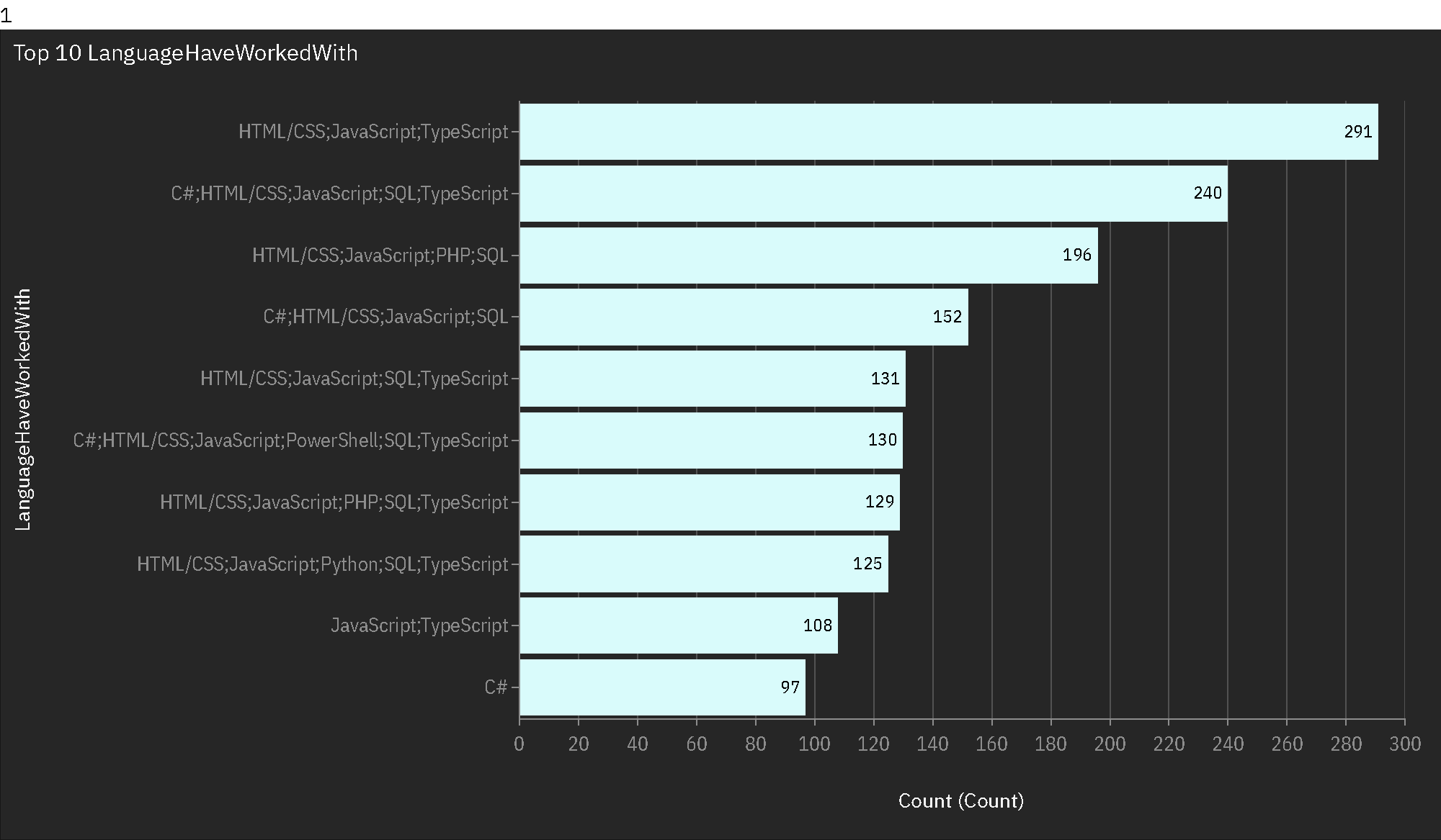
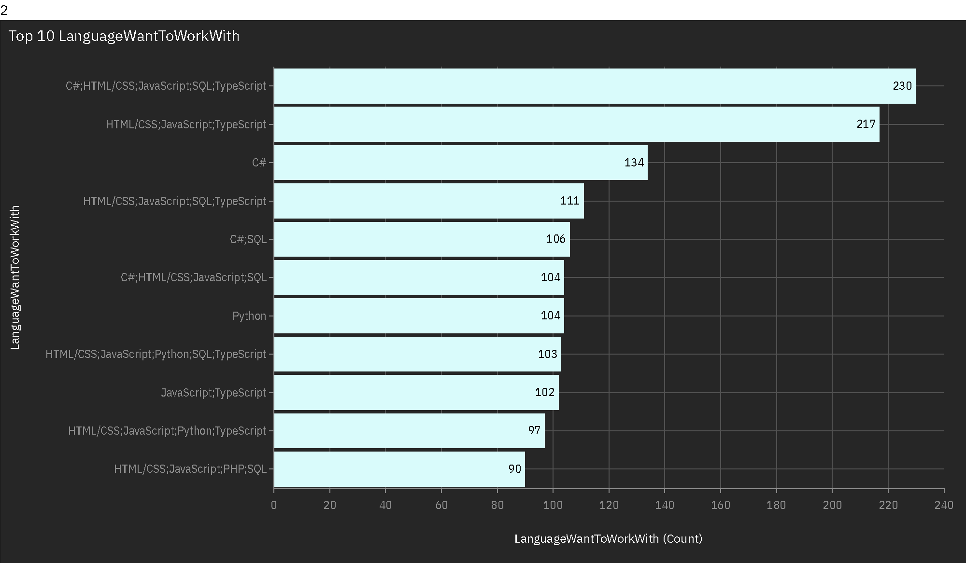
Programming Language Trends
Current Year
Next Year

Slide 8
Language Trends
Findings
Implications
JavaScript and HTML/CSS are the most commonly used languages among developers currently.
C# is not only widely used now but also appears prominently in future preferences, indicating sustained relevance.
Python, while not always in the top 3 currently, is gaining strong interest for future use, especially alongside JavaScript frameworks.
Developers and organizations should prioritize JavaScript and C# for immediate workforce needs and project development.
Rising interest in Python suggests a shift toward data science, automation, and AI-related programming.
Educators and training platforms should balance teaching legacy tech (C#, JavaScript) with future-oriented languages (Python, TypeScript).

Slide 9
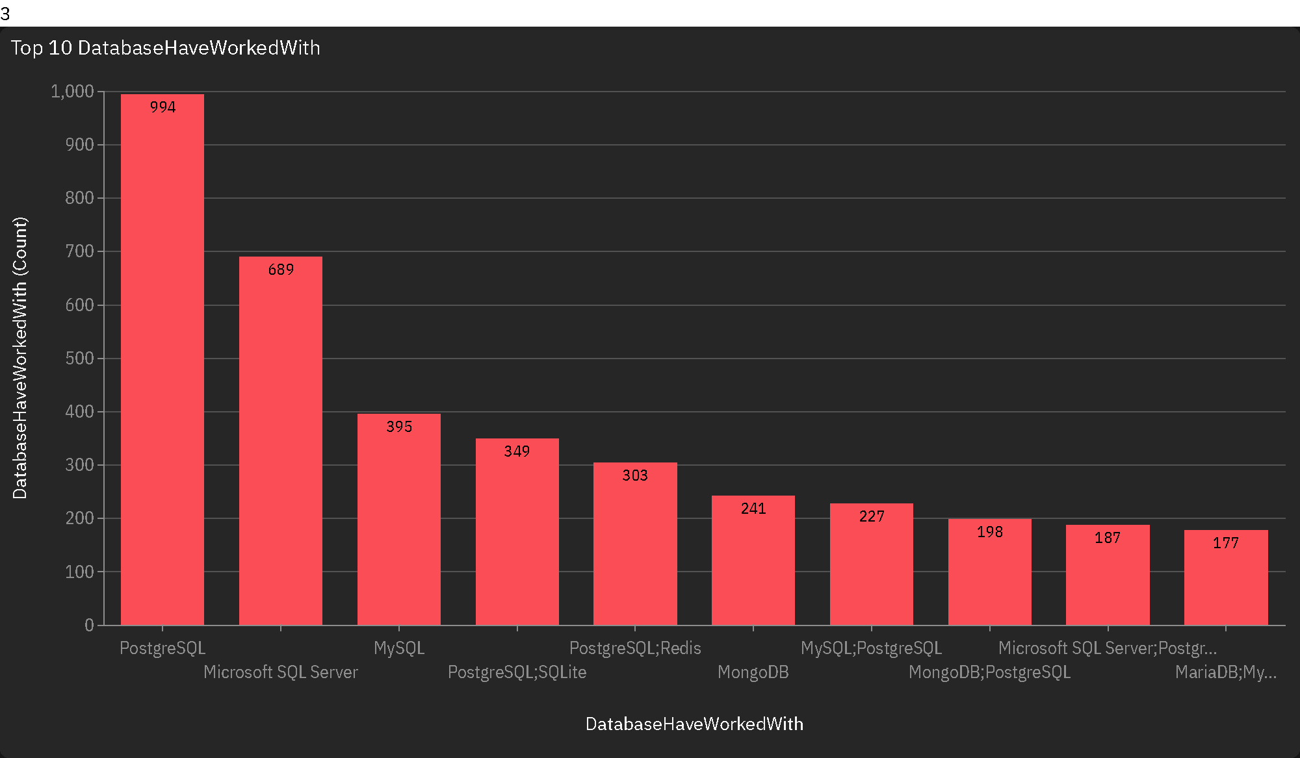
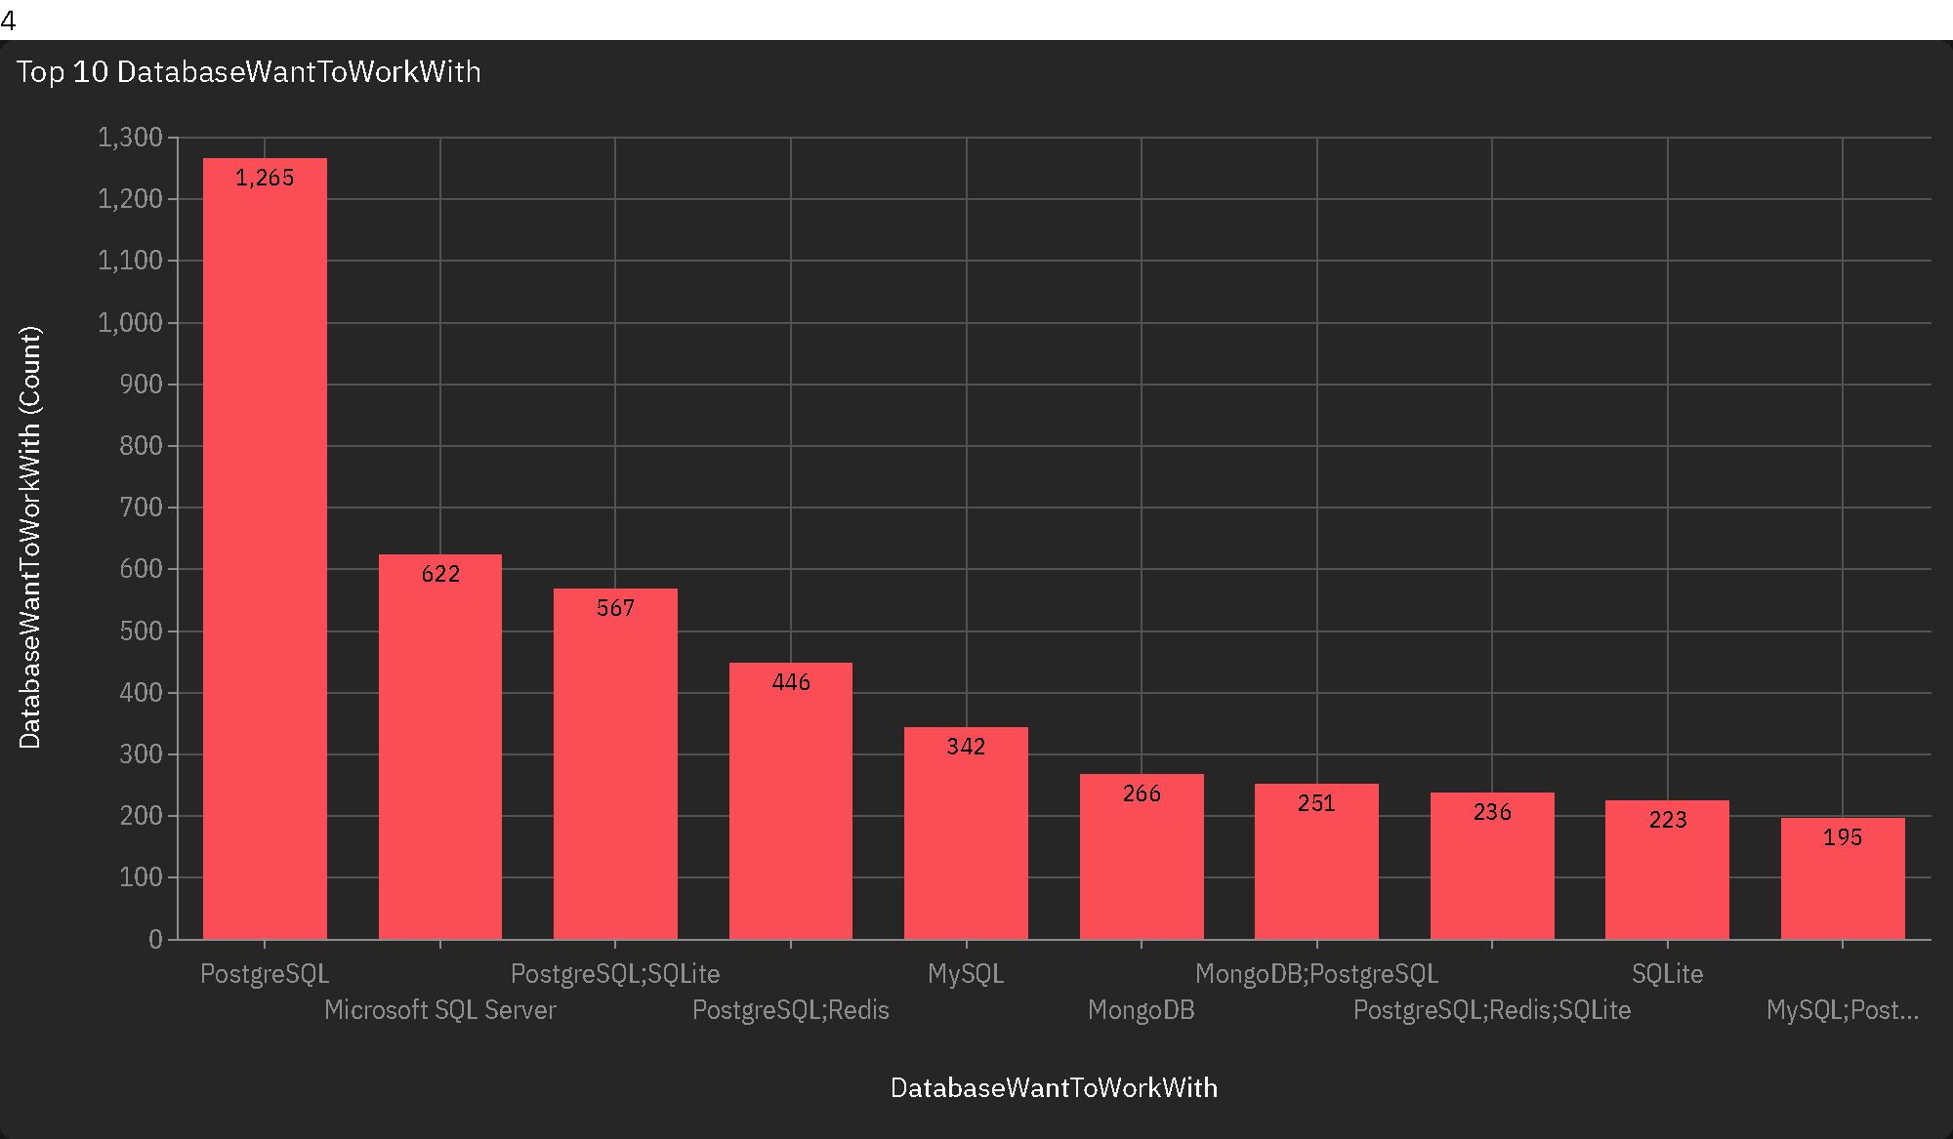
Database Technology Trends
Current Year
Next Year

Slide 10
Database Trends
Findings
Implications
PostgreSQL is the most widely used database currently and remains the top choice for future usage.
Microsoft SQL Server and MySQL are heavily used today and still have strong relevance in developers’ future preferences.
MongoDB and SQLite show rising popularity, especially in future trends, signaling increased adoption of NoSQL and lightweight databases.
PostgreSQL’s dominance suggests organizations and developers should invest in mastering it for both current and future roles.
The persistence of relational databases (SQL Server, MySQL) highlights their continued importance in enterprise and legacy systems.
The upward trend in MongoDB and SQLite indicates a shift toward flexible, scalable solutions, particularly in web and mobile applications.

Slide 11

DASHBOARD
The following three dashboards were created using IBM Cognos Analytics to visualize key insights from the Stack Overflow Developer Survey 2024.
Each tab focuses on a specific area: current technology usage, future technology trends, and developer demographics.

Slide 12
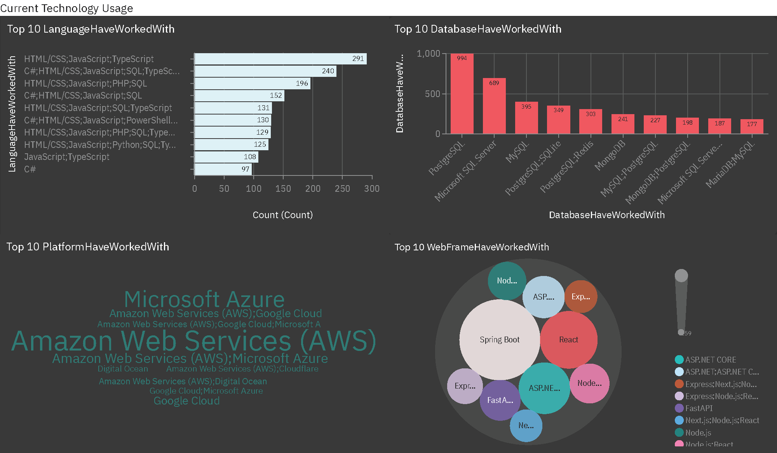
Dashboard Tab 1 – Current Technology Usage

Slide 13
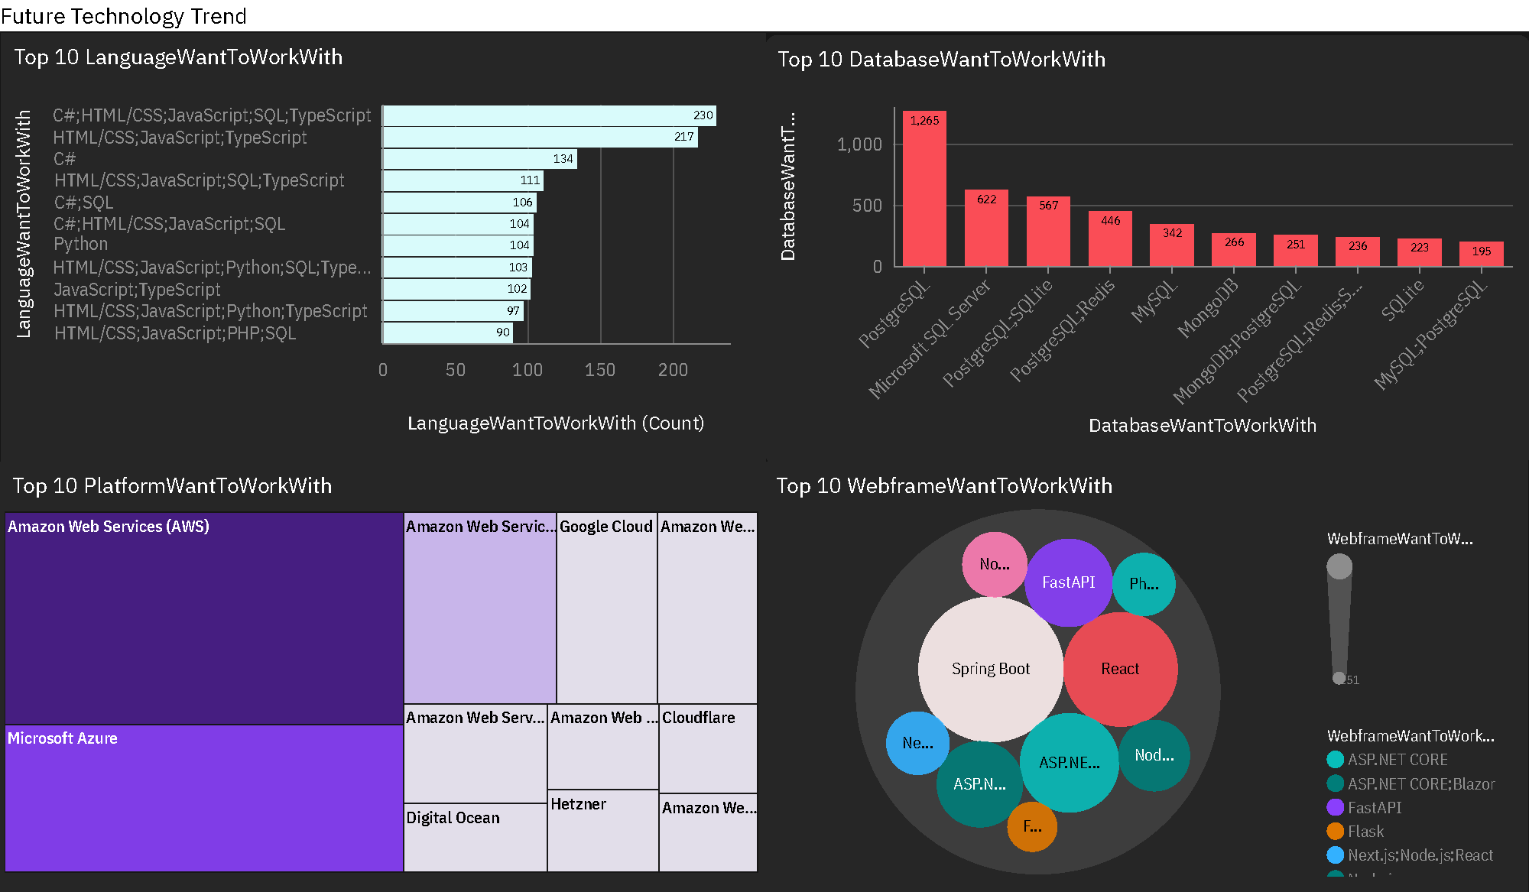
Dashboard Tab 2 – Future Technology Trends

Slide 14
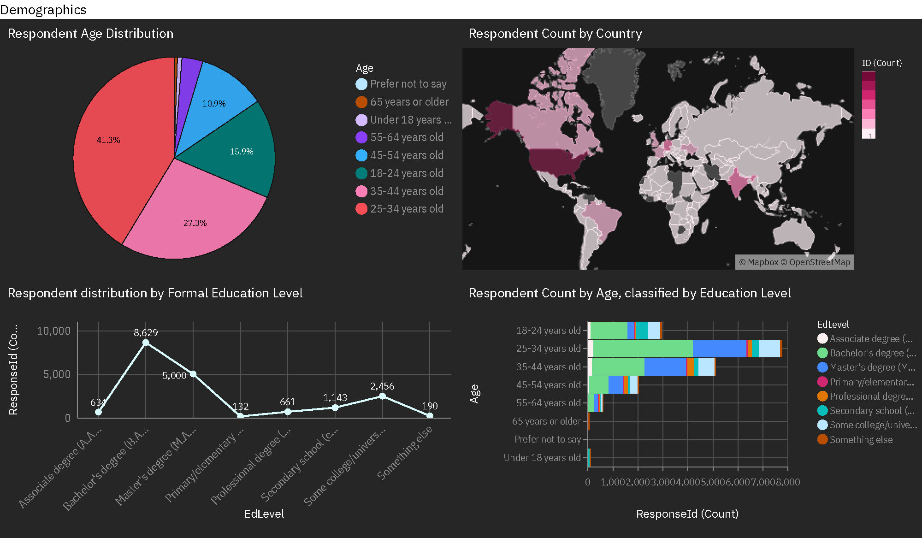
Dashboard Tab 3 – Demographics

Slide 15
Dashboard Insights Summary
JavaScript, HTML/CSS, and SQL are consistently popular across both current usage and future interest.
PostgreSQL leads as the most used and most desired database technology among developers.
Cloud platforms like AWS and Azure dominate both current and future technology preferences.
A significant portion of respondents are aged 25–34, and most hold Bachelor’s or Master’s degrees.
Modern frameworks such as FastAPI, Next.js, and ASP.NET Core are gaining traction in developer interest.

Slide 16
📊 Summary of Key Findings
Findings
Implications
PostgreSQL is the top database both in current usage and future preference, showing strong developer trust and versatility.
Relational databases such as Microsoft SQL Server and MySQL remain widely used and relevant in enterprise environments.
There is a growing interest in NoSQL and lightweight solutions like MongoDB and SQLite, especially among developers focused on flexibility and scalability.
PostgreSQL’s dominance suggests it should be a core skill for developers and a primary choice for new projects.
Organizations relying on SQL Server and MySQL must continue support and optimization of these systems, especially in enterprise applications.
The rise of NoSQL and embedded databases highlights a shift toward microservices, serverless computing, and mobile-first development strategies.

Slide 17

CONCLUSION
The Stack Overflow Developer Survey 2024 reveals clear patterns in current and future technology preferences among developers.
JavaScript, PostgreSQL, and AWS emerge as leaders across language, database, and platform categories.
Developers are highly interested in modern frameworks (e.g., FastAPI, Next.js) and cloud technologies.
The majority of respondents are young professionals (25–34) with strong academic backgrounds, guiding where education and recruitment efforts should focus.

Slide 18
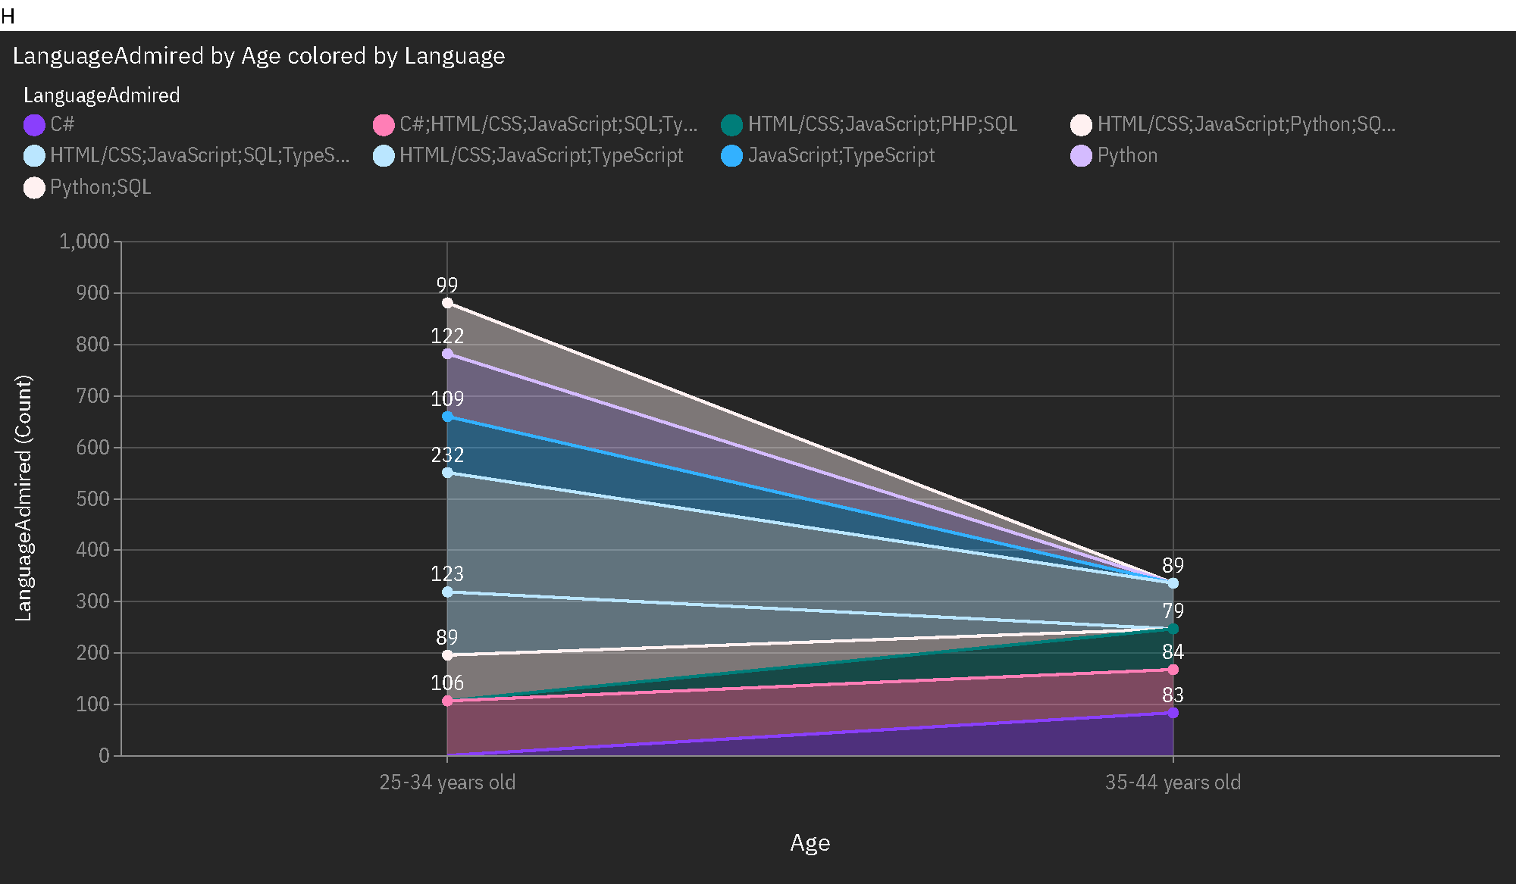
APPENDIX
Language Admired by Age colored by Language
This plot visualizes the most admired programming languages across different age groups.
The top preferences Python/SQL, Python, and JavaScript- are primarily driven by developers aged 25–34 and 35–44, indicating strong admiration from mid-career professionals.

Slide 19

Real-World Context
The strong interest in Python, SQL, and cloud platforms like AWS reflects industry-wide trends toward data-driven development and scalable cloud solutions.
These insights align with rising job market demands in fields such as data science, DevOps, and full-stack web development.
The
End

Slide 20
📬 Let’s Connect!
📧 DaghamHaidar@gmail.com
🔗 github.com/HaidarDagham
💼 Open to roles in Data Analysis, Python, or AI-related fields

