Slide 1

World Happiness Decoded by AI An AI-Driven Data Analysis Project by Haidar Dagham
📧 DaghamHaidar@gmail.com
🔗 github.com/HaidarDagham

Slide 2

OUTLINE
Executive Summary
Introduction
Methodology
Tools & Technologies Used
Visualizations Created
- Visualization
- Charts
Dashboard
Dashboard Insights Summary
Conclusion
Real-World Applications

Slide 3

EXECUTIVE SUMMARY
Analyzes 2016 World Happiness Report using Generative AI
Finds how economic and social factors influence happiness
Uses generative prompts for full code creation and visualization
Dashboard created for clear insight delivery

Slide 4

INTRODUCTION
Dataset Source: Kaggle – World Happiness Report (2016 subset)
Tool: Jupyter Notebook with AI-driven code generation
Focus: GDP, Health, Trust, Freedom, and Region-wise effects on happiness

Slide 5

METHODOLOGY
AI-generated Python code (Pandas, Seaborn, Plotly)
Data cleaning: Handled nulls and reformatted headers
EDA: Visual & statistical analysis via generative prompts
Dashboard created using Plotly for interactive insights

Slide 6
Tools & Technologies Used
Python Libraries: `pandas`, `numpy`, `seaborn`, `plotly`.
Notebook Environments: Jupyter Notebook, Google Colab.
Cloud Platforms: IBM Watsonx.ai
BI & Visualization Tools: IBM Cognos Analytics, PowerPoint.
AI Tools: ChatGPT, DeepSeek.
Version Control: Git & GitHub.
🛠️

Slide 7
Visualizations Created
Correlation Heatmap – Happiness & contributing factors
Scatter Plot – GDP vs Happiness across regions
Pie Chart – Happiness Score share by region
Choropleth Map – GDP with life expectancy as tooltip
Bar Chart - Top 10 countries: GDP vs Life Expectancy

Slide 8
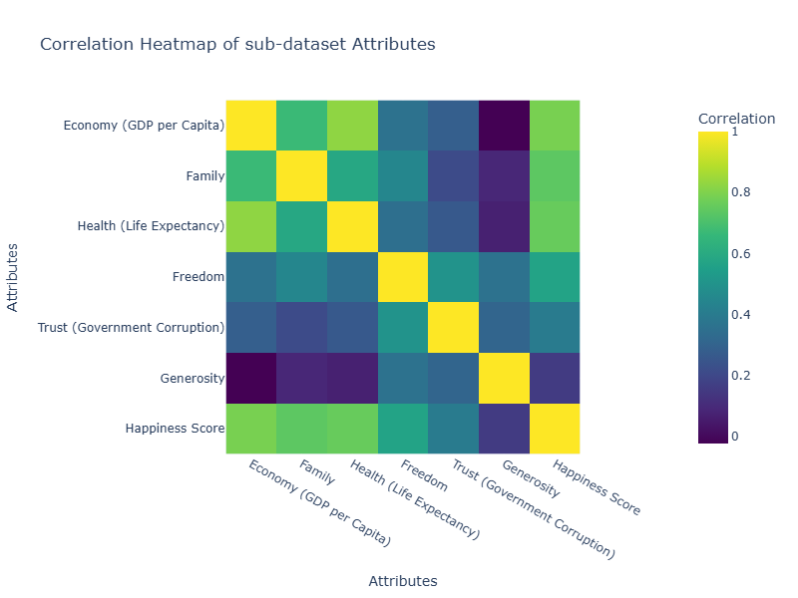
01 Correlation Heatmap of sub-dataset Attributes

Slide 9
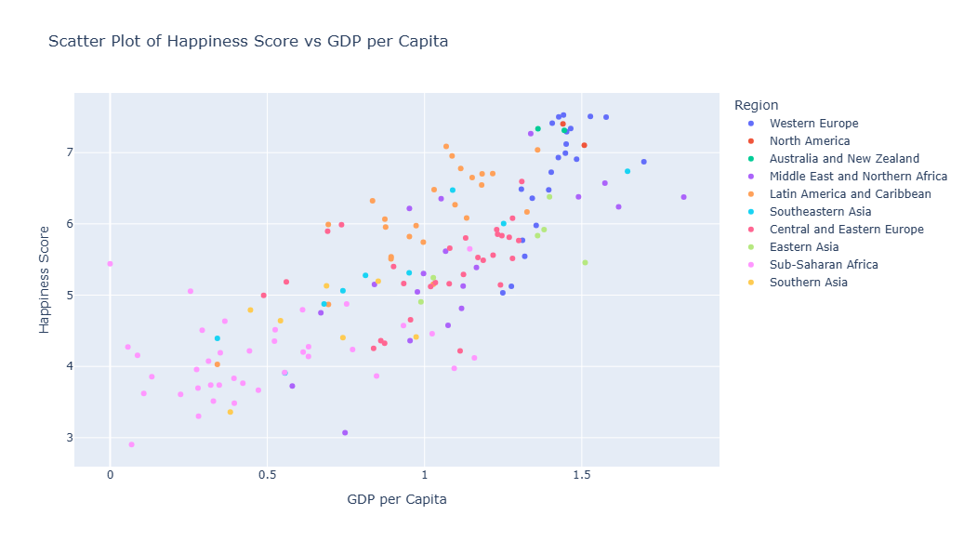
02 Scatter Plot of Happiness Score vs GDP per Capita

Slide 10
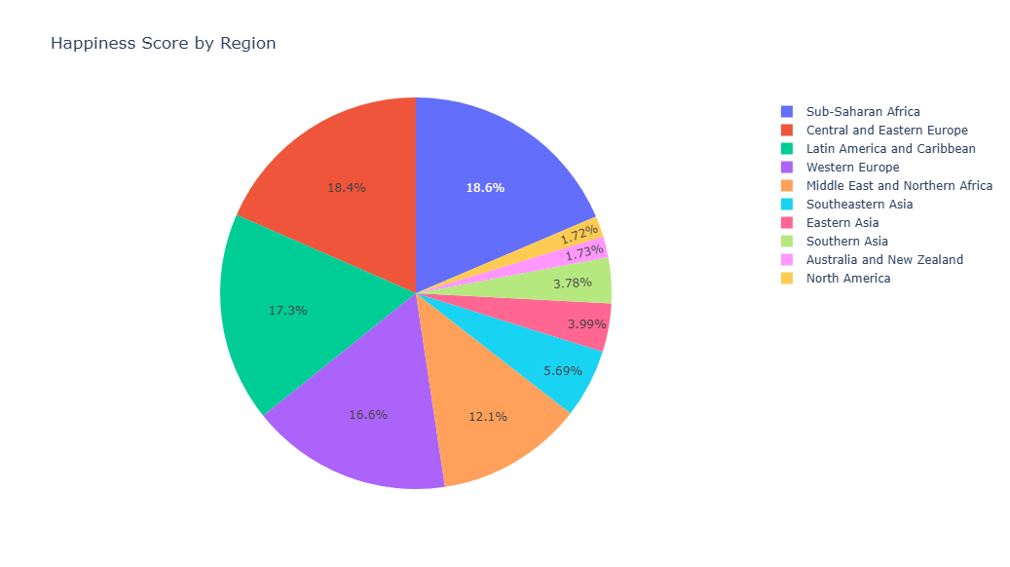
03 Happiness Score by Region

Slide 11
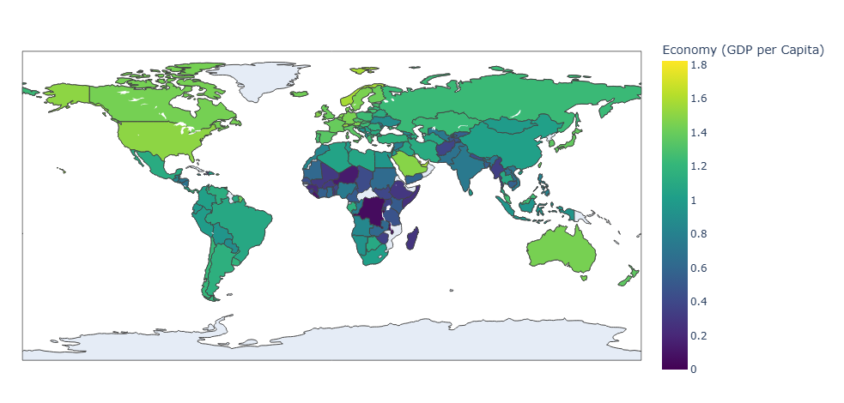
04 GDP per Capita and Healthy Life Expectancy by Country

Slide 12
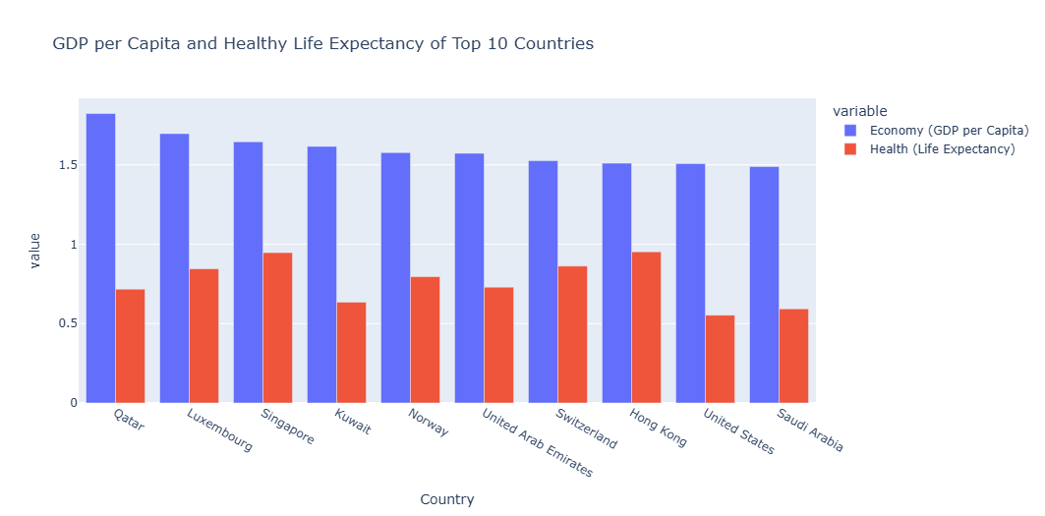
05 GDP per Capita and Healthy Life Expectancy of Top 10 Countries

Slide 13
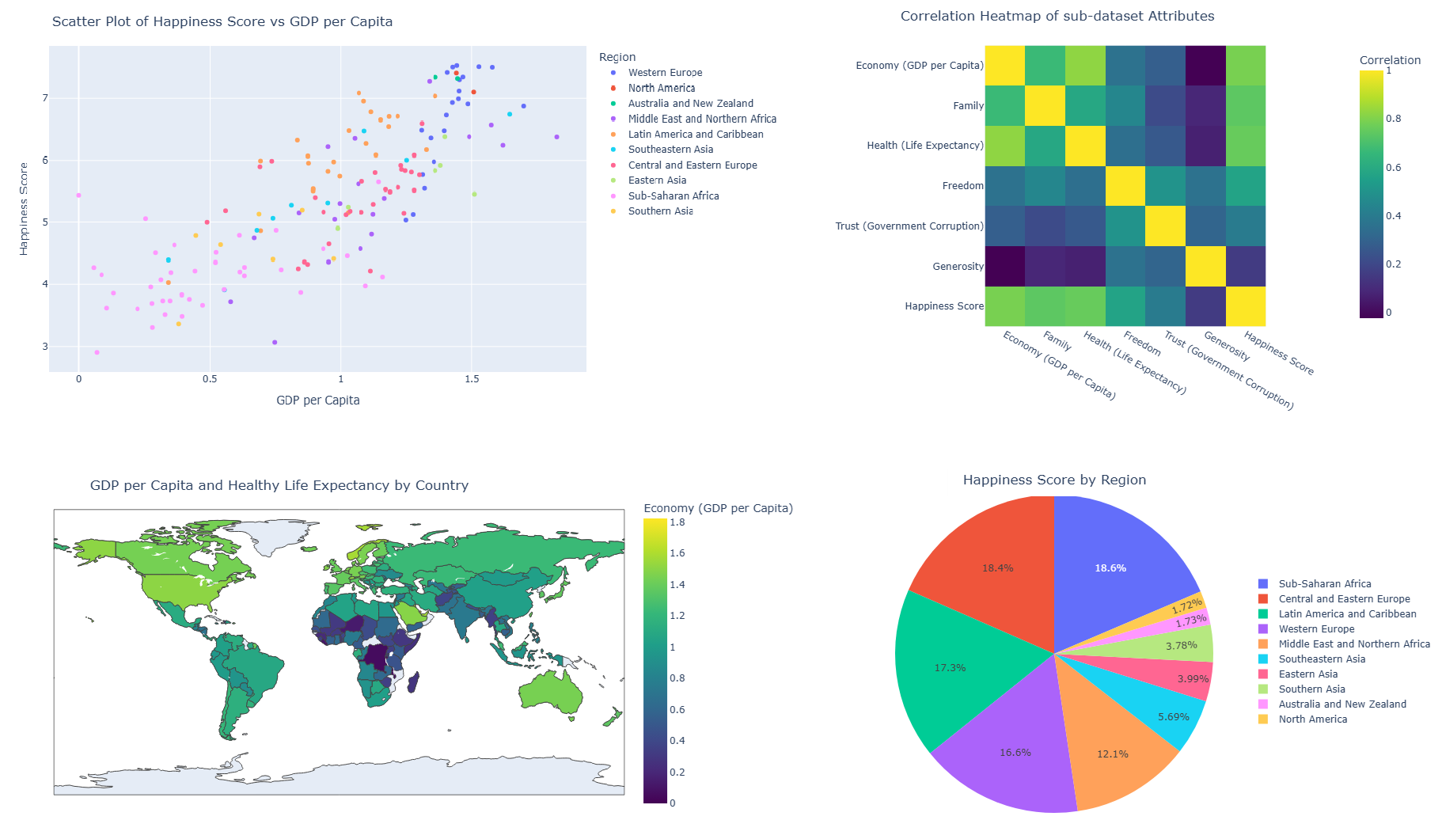
DASHBOARD

Slide 14

Dashboard Insights Summary
Multi-tab dashboard created using Plotly
Includes top contributors, trends, and geo visualizations
Interactive tooltips for deeper engagement
Helps policy-makers, educators, and global analysts

Slide 15

CONCLUSION
AI-driven tools can fully execute data analysis workflows
Happiness is clearly driven by economy, health, and social factors
Generative AI boosts productivity and insight discovery
This framework is scalable for future analytical studies

Slide 16
Real-World Applications
💼
Useful for public policy, education planning, and economic development.
Demonstrates the power of generative AI in real-world data analysis workflows.

Slide 17
📬 Let’s Connect!
📧 DaghamHaidar@gmail.com
🔗 github.com/HaidarDagham
💼 Open to roles in Data Analysis, Python, or AI-related fields

Slide 18
Thank You

