Slide 1

Lattice Wigner Model
Sergio Solorzano
Collaborations: Miller Mendoza Jimenez, Hans J. Herrmann, Sauro Succi
Notes:
/home/mmendozaj/ETH-design/presentation-openoffice/template_praesentation_oo.odp

Slide 2


Wigner Formulation
Wigner equation:
Equivalent to Schrödinger
Where:
Why is it useful?
Open quantum systems

Slide 3
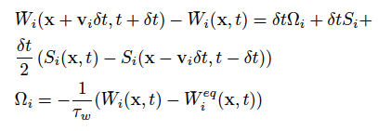
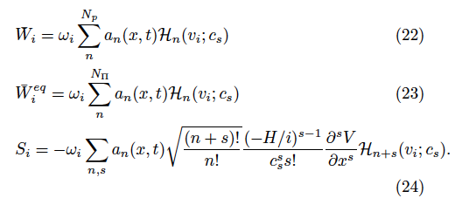
Lattice Wigner Model
Lattice Wigner equation:
Numerical diffusion

Slide 4
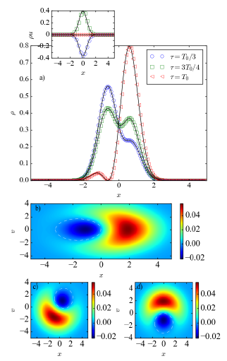


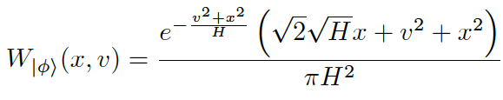
Lattice Wigner Model
Harmonic oscillator

Slide 5
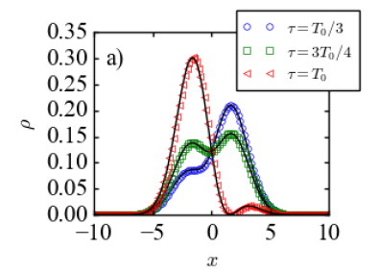
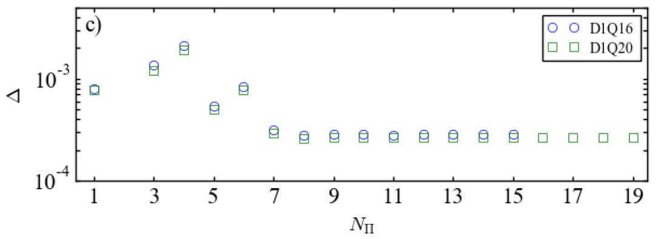
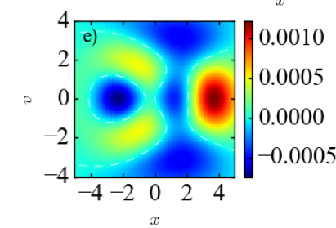

Lattice Wigner Model
Error due to numerical diffusivity:
Anharmonic oscillator

Slide 6
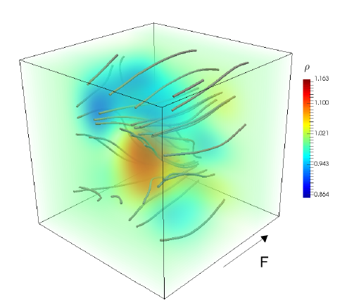
Lattice Wigner Model
3D simulation of randomly located Gaussian potential barriers:

